Slide 1
OMNIBAL · AUTOFIT ENGINE
From random numbers
to best-fit ladders
Drop in 25 – 125 random numbers. The engine automatically finds which of them line up as arithmetic (AP), geometric (GP), or harmonic (HP) ladders — then solves each with one midpoint-balance formula.
Kumaran Kanniappan · Machine-verified · Stardate 2026

Slide 2
THE USE CASE · ONE LINE
Random in → sorted ladders out
1 GENERATE
2 SCORE
3 ASSIGN
4 SOLVE
→
→
→
25–125 random
numbers
test each run:
add? × ? flip?
best-fit family
AP / GP / HP
midpoint formula,
exact
the number never has to fit you — the engine finds the family that fits the number
No labels, no setup. You hand it a messy bag of numbers; it hands back organized ladders plus a pile of honest “noise” it couldn’t fit.

Slide 3
HOW BEST-FIT IS DECIDED
Three simple tests, run on every run
＋ AP · ADD
constant DIFFERENCE
b − a stays the same
12, 19, 26, 33 … (+7)
× GP · MULTIPLY
constant RATIO
b ÷ a stays the same
3, 6, 12, 24 … (×2)
1/ HP · FLIP
constant reciprocal step
1/a, 1/b, 1/c is an AP
82, 123, 246 … (flips line up)
A run is kept only if at least three numbers pass one test cleanly. Whatever passes the most/longest wins; ties go to the rarer signal (GP, then HP, then AP).

Slide 4
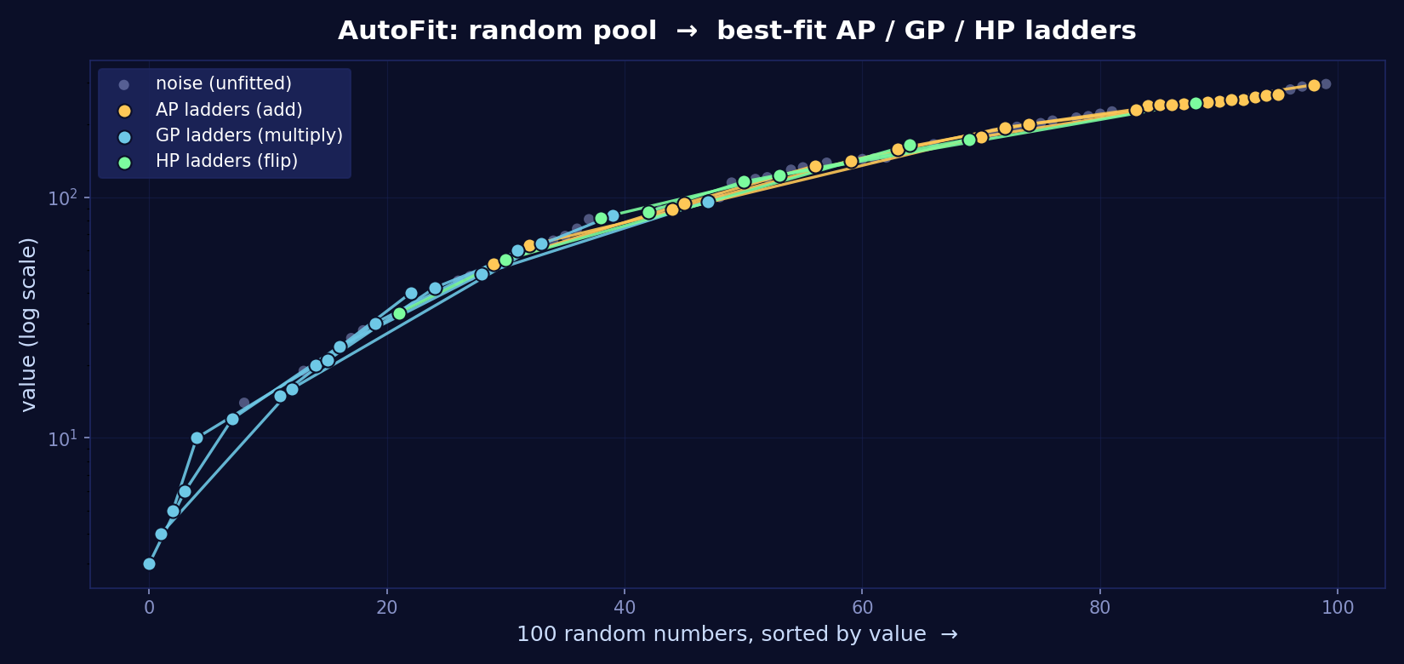
LIVE RUN · 100 RANDOM NUMBERS
Watch the ladders surface from the noise
Grey = numbers that fit nothing. Colored chains = ladders the engine pulled out automatically.

Slide 5
WHAT CAME BACK · 100 → SORTED
Auto-classified, nothing forced
6
5
3
33
AP ladders
GP ladders
HP ladders
noise (honest)
Family | A recovered ladder | Signal
AP | 240, 245, 250, 255, 260, 265 | +5 each
GP | 3, 6, 12, 24, 48, 96 | ×2 each
HP | 82, 123, 246 | flips → +1/246
67 of 100 numbers snapped into a ladder; the other 33 were left honestly unfitted. That balance is the point — the engine never fakes a pattern.

Slide 6
THEN THE FORMULA FINISHES THE JOB
Each recovered ladder, solved exactly
＋ AP 240…265 (6 terms)
Σk = 1,515 Σk² = 382,975 Σk³ = 96,922,125
M = 252.5 · step 5
× GP 3…96 (6 terms)
product = 23,887,872
(first×last)^(X/2) = 288³
1/ HP 82,123,246
Σ1/k = 1/41 ≈ 0.024390
flips 3,2,1 over 246
Every value above reproduced by exact fraction arithmetic AND by the midpoint-balancing formula — they agree to the last digit.

Slide 7
IT SCALES · 25 → 125 NUMBERS
More numbers, more ladders found
Pool size | AP | GP | HP | Fitted | Noise
25 | 1 | 2 | 0 | 17 | 8
50 | 1 | 5 | 1 | 30 | 20
75 | 8 | 4 | 0 | 47 | 28
100 | 4 | 4 | 1 | 50 | 50
125 | 10 | 6 | 2 | 87 | 38
Same engine, no re-tuning. Bigger bags simply contain more hidden ladders — the recovery grows with the pool, and the leftovers stay labelled as noise instead of being force-fitted.

Slide 8
Give it any numbers.
It finds the order inside.
Random → best-fit AP / GP / HP → exact midpoint solution. That is the collective use case.
OMNIBAL AutoFit · Kumaran Kanniappan · machine-verified · 2026

