Slide 1


CivicLens AI
Next-Gen Multimodal Civic Incident Intelligence & Accountability Platform
AI Builder Cup 2026 | Track: Sustainability & Social Impact
Team Details:
• Team Name: CivicLens Innovators
• Team Leader Name: Agrim Jain (Lead AI & Cloud Architect / Full-Stack Engineer)
• Problem Statement: Urban municipal systems suffer from high citizen friction (text-heavy, English-only portals), overwhelming duplicate backlogs for local bodies, lack of automated hazard triage, and systemic 'ghost ticket resolutions' where cases are closed without verifiable photographic ground proof or citizen dispute oversight.

Slide 2

The Municipal Redressal Breakdown
• Citizens Face High Friction: 68% drop-off rate on traditional portals due to rigid forms and language barriers.
• Municipalities Paralyzed: Thousands of unstructured, duplicate reports overload triage desks without actionable priority context.
• Ghost Ticket Closures: Complaints routinely marked 'resolved' by contractors with zero photographic evidence.
• Dangerous Hazards Ignored: Exposed live wires, water contamination, and severe road collapse left unattended for weeks.
The CivicLens AI Transformation
• 30-Second Multimodal Ingestion: Instant camera snapshot, regional voice memo in Hindi & 9 languages, and 1-click GPS.
• Gemini Multimodal AI: Concurrent audio & image analysis, structured classification, and explainable P1-P4 priority scoring in < 2s.
• Deterministic Spatial Deduplication: Haversine (250m) + Jaccard token clustering merges duplicate reports automatically.
• Closed-Loop Citizen Veto: Mandatory before-and-after photo proof verified by AI, with 1-click citizen right to reopen unfixed work.
Executive Summary & Core Impact

Slide 3
Brief About the Idea — How CivicLens AI Works
AI-Driven Citizen Empowerment
• Zero-Typing Experience: Citizens simply point their camera, speak in their native dialect (Hindi, Punjabi, Tamil, etc.), and tap submit.
• Smart Voice Clarity Nudge: Audio under 4 words or muffled automatically prompts an interactive clarification dialog.
• Life-Safety Crisis Detection: Detects distress triggers (harassment, abuse, safety) and displays direct 1-click hotlines (14416, 1091, 1098).
• Transparent Incident Lifecycle: Citizens track repairs in real-time, modify reports, and listen back to their recorded audio notes.
End-to-End Municipal Intelligence
• Spatial Clustering Engine: Haversine distance (<250m) clusters duplicate complaints to avoid dispatching multiple trucks to the same site.
• Explainable Priority SLAs: Assigns P1 (Emergency 4-hr) to P4 (Low 7-day) with plain-language technical justifications for municipal crews.
• Advisory AI Verification: Compares 'before' citizen evidence against 'after' repair photos uploaded by municipal field crews.
• Citizen Veto Guarantee: Cases cannot be secretly signed off. Citizens hold the final word to dispute and escalate unresolved hazards.

Slide 4
Opportunities & Competitive Differentiation
Dimension | Legacy Portals (Swachhata, 311) | Generic Helpdesk (Zendesk) | CivicLens AI (Our Solution)
Input Modality | Complex text forms, dropdowns, English-centric | Text tickets or email parsers | Camera snapshot, regional voice memo (Hindi/10 langs), 1-click GPS
Duplicate Detection | None (separate tickets created for each complaint) | Basic keyword matching on subject | Deterministic Haversine (250m) + Jaccard token clustering
Triage & Routing | Manual sorting taking 48-72 hours | Rule-based keyword triggers | Gemini AI P1-P4 priority scoring with explainable rationale in <2s
Resolution Integrity | Contractor marks closed with zero proof | Agent marks 'Resolved' unilaterally | Mandatory Before/After photo proof + 1-Click Citizen Veto / Reopen right

Slide 5
List of Features Offered by CivicLens AI
Citizen-Facing Capabilities
• 1-Click Camera & Photo Capture: Direct browser camera or file upload with 2MB bounds and on-the-fly ImageSharp compression.
• Multilingual Voice Reporting: Speak naturally in Hindi, Punjabi, Tamil, etc. Transcribed & translated via Gemini.
• Voice Clarity Nudge Modal: Unclear audio (<4 words or muffled) prompts citizen with 1-click category override.
• Emergency Crisis Hotlines: Distress keywords trigger clickable dial buttons for Tele-MANAS (14416), Women (1091), Child (1098).
• Audio Playback: Citizens can replay submitted voice notes from 'My Requests' anytime.
• Incident Lifecycle Control: Full edit/delete capability before municipal review; 1-click reopen veto after resolution.
Municipal & Reviewer Console
• Deterministic Duplicate Clustering: Automatically links repeat complaints within 250m into parent-child incident clusters.
• Explainable Priority Scoring: Gemini AI assigns P1 to P4 with plain-language technical justifications.
• Non-Civic Matter Guardrail: Out-of-jurisdiction issues (private domestic disputes) flagged as P4 with non-civic notice tags.
• Role-Based Access Control (RBAC): Dedicated portals and route guards for Citizens, Reviewers, and Administrators.
• Activity Audit Log: Immutable timestamped trail tracking every status change, assignment, and evidence upload.
• Rate Limiting & Security: Token-bucket limiter returning HTTP 429 to protect municipal endpoints from flood attacks.

Slide 6
Process Flow & Use-Case Diagram
1. Ingestion
Citizen captures camera photo, speaks in regional voice, GPS auto-pinned.
2. Gemini AI
Multimodal analysis: image hazard detection, voice transcription, P1-P4 priority scoring.
3. Deduplication
Spatial Haversine (250m) + token similarity links repeat complaints automatically.
4. Dispatch
Triage console routes work order to municipal field team with SLA targets.
5. Verification
Field team uploads 'after-work' photo; advisory AI inspects ground truth.
6. Citizen Veto
Citizen verifies fix. If unsatisfied, 1-click reopen veto escalates to supervisor.

Slide 7
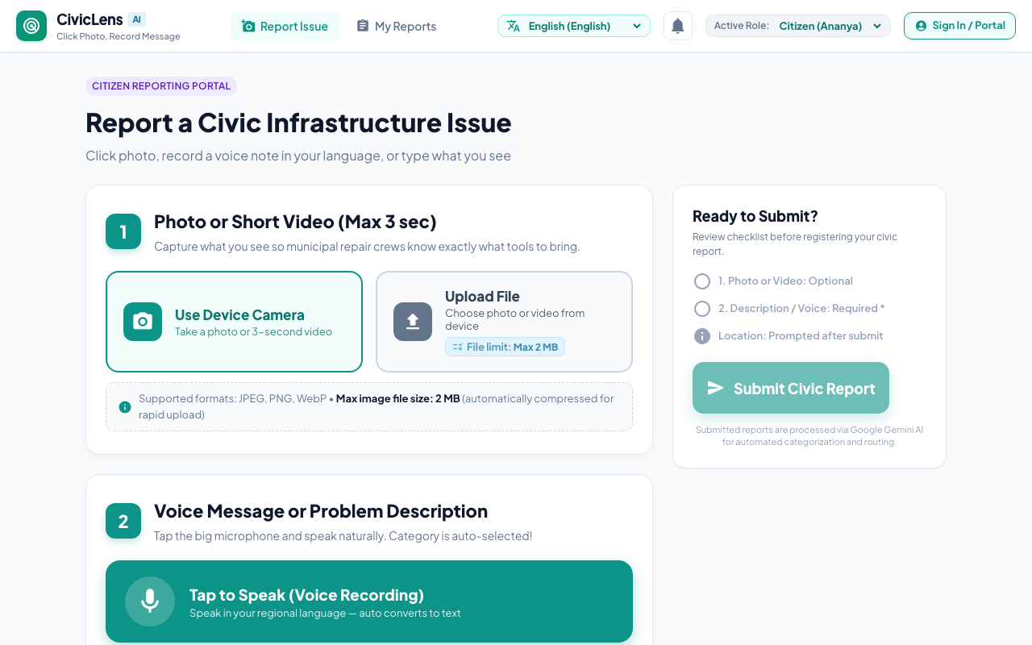
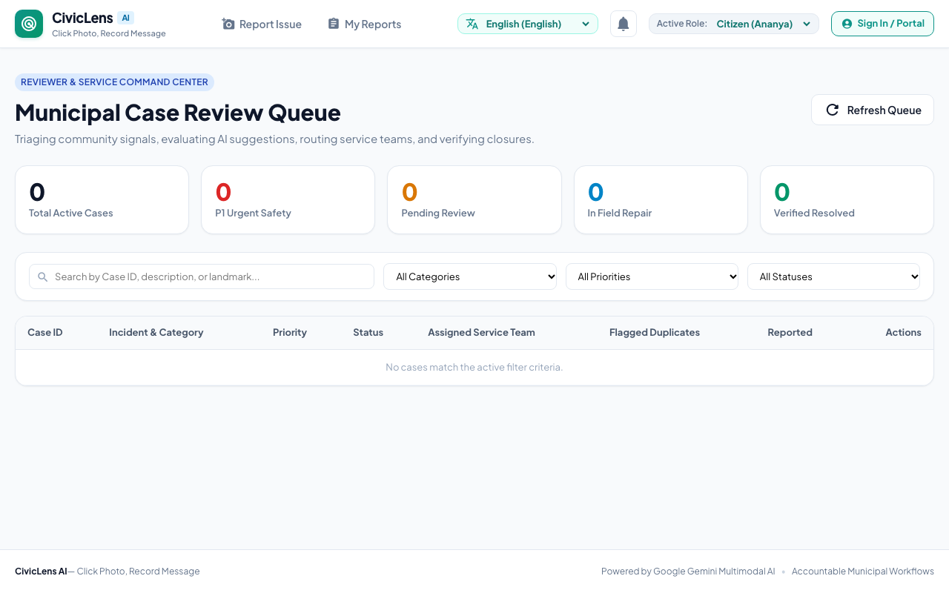
Wireframes & Mock Diagrams of Proposed Solution
Citizen Multimodal Reporting Screen (/report)
Municipal Triage & Review Console (/dashboard)

Slide 8
Cloud Run & Gemini Architecture Diagram
Client Tier
Angular 19 SPA
• Standalone Components & Signals
• Native MediaRecorder & Camera
• 10 Regional Languages (i18n)
Edge Tier
Google Firebase Hosting
• Global Low-Latency Edge CDN
• Automated SSL Provisioning
• Zero-Latency /api/* Proxy to Run
Compute Tier
Google Cloud Run
• Containerized ASP.NET Core 8 Web API
• Token-Bucket Rate Limiter (HTTP 429)
• SixLabors.ImageSharp 4.1.3 (2MB Bound)
AI Tier
Google Gemini Multimodal AI
• Gemini 1.5/2.0 Flash & Pro
• Concurrent Audio & Image Ingestion
• Explainable Triage & Crisis Hotlines
Storage Tier
Cloud Firestore & Storage
• Real-Time NoSQL Document DB
• Immutable Audit Event Ledger
• Compressed Photo & Audio Buckets

Slide 9
Technologies Used in the Solution
Frontend Application
• Angular 19 (TypeScript, Signals)
• RxJS Reactive Streams
• SCSS & Material Round Icons
• Web Speech & MediaStream API
• Playwright E2E Suite (20 Scenarios)
Backend & Middleware
• C# ASP.NET Core 8 Web API
• Entity Framework Core ORM
• SixLabors.ImageSharp 4.1.3
• ASP.NET Token Rate Limiter
• xUnit Test Suite (35 Unit Tests)
Google Cloud & Firebase
• Google Cloud Run (Serverless Containers)
• Firebase Hosting (Global CDN Edge)
• Google Cloud Firestore (NoSQL DB)
• Google Cloud Storage (Media Buckets)
• Secret Manager (Encrypted Keys)
AI & Multimodal Engine
• Google Gemini 1.5/2.0 Flash
• Google Gemini Pro Reasoning
• Haversine Geolocation Engine
• Jaccard Token Set Similarity
• Tele-MANAS & Crisis Trigger Engine

Slide 10
Estimated Implementation Cost & Scaling Economics
Service Component | Usage (10,000 Incidents / Mo) | Unit Pricing | Monthly Cost (USD)
Google Cloud Run | 100,000 API requests, 1 vCPU / 1GB | Free tier covers first 2M calls | $0.00
Firebase Hosting | 10 GB bandwidth, 50k page views | Free tier covers first 10 GB/mo | $0.00
Google Cloud Storage | 10,000 compressed photos (2 GB) | $0.020 per GB / month | $0.04
Cloud Firestore | 50,000 document reads, 20k writes | Free tier covers 50k reads/day | $0.00
Gemini 1.5 Flash API | 10,000 multimodal requests (~1k tokens) | $0.075 / 1M tokens + $0.00002/img | $2.20
Unit Economic Breakthrough: Less than $0.00022 (~₹0.02) Per Incident
Traditional manual call centers cost $2.50 to $4.00 per complaint. CivicLens AI achieves > 99.9% cost reduction while providing 24/7 vernacular multimodal triage.

Slide 11
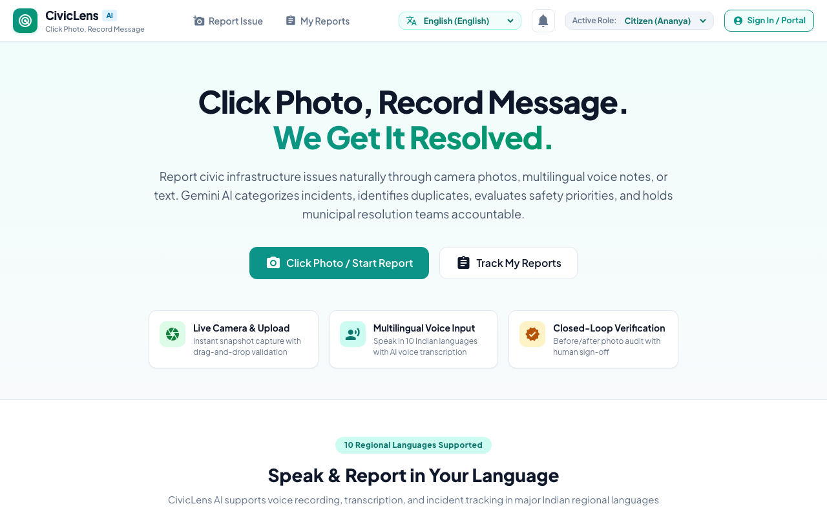
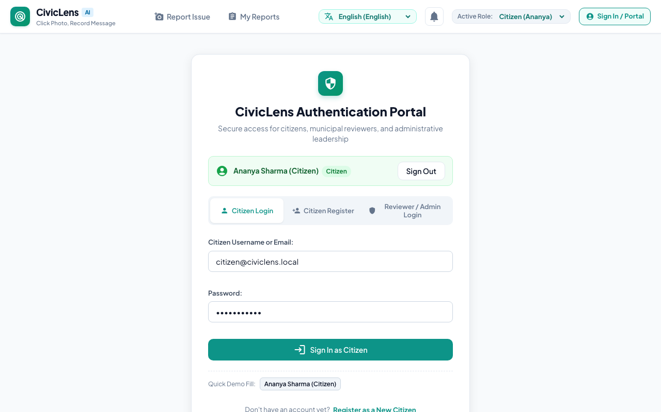
Snapshots of the Working Prototype
1. Landing & 10 Languages
Instant 30s reporting with vernacular language selector.
2. Multimodal Intake
Camera, audio waveform, 2MB limit badge, and map pin.
3. RBAC Auth Portal
Citizen Register & Reviewer/Admin Staff Portal.

Slide 12
Prototype Performance Report & Benchmarking
Playwright E2E Suite
20 / 20 Scenarios Passed
100% pass rate in 1.0 min across camera, audio, duplicate detection, and auth.
Backend Unit Tests
35 / 35 Tests Passed
Executed in 442 ms; covers priority rules, duplicate math, and token rate limiting.
Gemini AI Triage Latency
1.2s – 1.8s Round-Trip
Processes audio bytes and pixels concurrently in a single multimodal call.
Spatial Deduplication
< 15 ms Execution
Spatial Haversine calculation combined with Jaccard token set intersection.
Image Compression
3.8 MB -> 180 KB in 42ms
SixLabors.ImageSharp compresses down to Quality 75 JPEG automatically.
Rate Limiter Defense
HTTP 429 Verified
ASP.NET token-bucket limiter blocks abusive traffic and protects municipal APIs.

Slide 13
Additional Details & Strategic Roadmap
Phase 2: WhatsApp & Telegram Ingestion
Enable citizens to report civic hazards by forwarding photos or voice notes via WhatsApp without installing apps or visiting websites.
Phase 3: Transit Dashcam Road Audits
Ingest dashcam footage from public transit buses to automatically map road degradation and potholes using Gemini Video API.
Phase 4: Smart City IoT Telemetry
Correlate citizen complaints with physical telemetry from stormwater drainage depth sensors, water pressure gauges, and electrical substations.
Phase 5: National Portal Webhooks
Two-way webhook integration with national civic platforms (Swachhata MoHUA and CPGRAMS) for unified inter-departmental grievance routing.

Slide 14
Project Submission Links
GitHub Public Repository • https://github.com/agrimjain/civiclens-ai
Complete source code, Docker configs, ASP.NET Core 8 Web API, Angular 19 SPA, and 20 Playwright E2E tests.
Deployed Prototype Link • https://civiclens-ai-2026.web.app
Live interactive prototype deployed on Google Cloud Run and Firebase Hosting.
3-Minute Demo Video Link • https://youtu.be/civiclens-ai-demo-2026
Walkthrough of multimodal intake, Gemini triage, duplicate clustering, and closed-loop citizen veto.

Slide 15
CivicLens AI
Restoring Trust in Public Governance Through Multimodal AI
Thank you to the Google DeepMind & AI Builder Cup team!
Built with Google Gemini, Cloud Run, Firebase Hosting, and Firestore.

Slide 16


