Slide 1
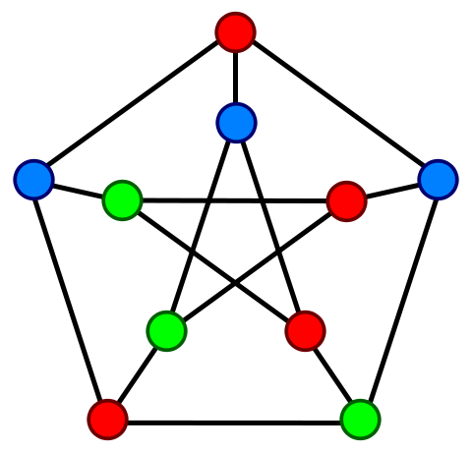
Chromatic Numbers

Slide 2
Algorithm
Find two vertices that are not adjacent
Combine them & Simplify the graph
Repeat
Runtime: O( V³ ), fairly poor

Slide 3
Implementation
Search
    Using a adjacency matrix
    Searches Row by Row
    Reasonable use of cache
Combine, two major steps
    Element-wise OR of two non-adjacent vertices
    Also Row major
Reflection to main correctness
    Column major

Slide 4
Search
Row by Row
    Row major, good use of Cache
    Important facet: row by row search implies a certain order of search
Vertices that are combined get ignored in following iterations
    Much faster than creating a new array in memory
    But still maintains recursive nature of the search

Slide 5
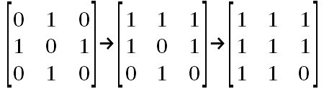
Combination
Simple Matrix Operations
    Low Computational intensity
Good for vectors and GPU's
Bad for threads

Slide 6
Improving Combination
Vectorization
  Using SSE achieved ~ 2.5x speed up over serial
  Less susceptible to cache misses
Threads
    Very poor performance
    High overhead of creating threads & managing them
GPU's
    In theory, much greater potential for performance increase
    In reality, the overhead of moving memory to and fro slowed down the operation

Slide 7
Improving the Search
Less straight-forward
    Entire process is dependent on the adjacent matrix
    Combination process must be carefully controlled
    Lots of possible problems
Process is not readily parallelized
    Dividing the work may inhibit simplifying the matrix
    Lots of communication required
GPU's may not be very useful here because there is a high amount of communication involved
Different search algorithm may be necessary

