Slide 1
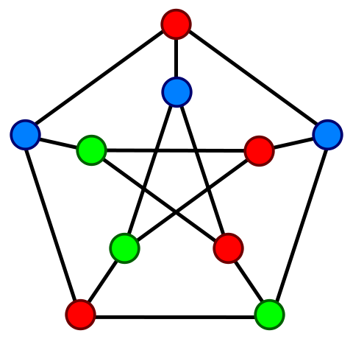
Chromatic Numbers

Slide 2
Algorithm
Find two vertices that are not adjacent
Combine them & Simplify the graph
Repeat
Runtime: O( V³ ), fairly poor

Slide 3
Implementation
Search
Using a adjacency matrix
Searches Row by Row
Reasonable use of cache
Combine, two major steps
Element-wise OR of two non-adjacent vertices
Also Row major
Reflection to main correctness
Column major

Slide 4
Search
Row by Row
Row major, good use of Cache
Important facet: row by row search implies a certain order of search
Vertices that are combined get ignored in following iterations
Much faster than creating a new array in memory
But still maintains recursive nature of the search

Slide 5
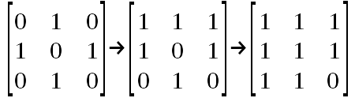
Combination
Simple Matrix Operations
Low Computational intensity
Good for vectors and GPU's
Bad for threads

Slide 6
Improving Combination
Vectorization
Using SSE achieved ~ 2.5x speed up over serial
Less susceptible to cache misses
Threads
Very poor performance
High overhead of creating threads & managing them
GPU's
In theory, much greater potential for performance increase
In reality, the overhead of moving memory to and fro slowed down the operation

Slide 7
Improving the Search
Less straight-forward
Entire process is dependent on the adjacent matrix
Combination process must be carefully controlled
Lots of possible problems
Process is not readily parallelized
Dividing the work may inhibit simplifying the matrix
Lots of communication required
GPU's may not be very useful here because there is a high amount of communication involved
Different search algorithm may be necessary

