Slide 1

Design of MODEM for Underwater Communication
V.S.S.Sai Charan
(13BT6EC080)
Vinit Jain
(13BT6EC083)
Ronil Jain
(13BT6EC089)
Internal Guide
Mr.Manjunath
Assistant Professor
Department of ECE
SET, Jain University

Slide 2
Introduction
Underwater wireless communication is the wireless communication in which acoustic signals(waves ) carry digital information through an underwater channel.
The signal that are used to carry digital information through an underwater channel are acoustic channel.
Wireless communication technology today has become part of our daily life, the idea of wireless undersea communications may still seem far-fetched.
Department of Electronics and Communication
Engineering

Slide 3
Introduction
Some of the wired underwater communication links would be prone to attacks by aquatic animals.
Also, these wired links have problems related to dispersion and low data rate due to extreme pressure underwater.
Hence the motivation and interest in wireless underwater communications.
Together with sensor technology and vehicular technology, wireless communications will enable new applications.
Department of Electronics and Communication
Engineering

Slide 4
Literature Survey
The science of underwater acoustics began in 1490.
In 1687 Isaac Newton wrote his Mathematical Principles of Natural Philosophy which included the first mathematical treatment of sound.
In recent years, underwater acoustic (UWA) communications have received much attention as their applications have begun to shift from military toward commercial.
Department of Electronics and Communication
Engineering

Slide 5
Literature Survey
Radio waves do not propagate well underwater due to the high energy absorption of water.
Therefore, underwater communication are based on acoustic links characterized by large propagation delays.
Acoustic propagation is characterized by three major
factors: attenuation that depends on the signal frequency, multipath propagation, and low speed of sound (1500 m/s).
Department of Electronics and Communication
Engineering

Slide 6
Limitations
Signal carrier
Electromagnetic wave
Optical wave
Acoustic wave
Propagation Medium
Instrumentation System Devices
Department of Electronics and Communication
Engineering

Slide 7
problem definition and objective
Definition: Design of Modulation and Demodulation of any message signal using orthogonal frequency division multiplexing (OFDM) technique for underwater communication.
Objective:
Reduce ISI
Optimize SNR
Reduce losses
Department of Electronics and Communication
Engineering

Slide 8
Methodology
Characterization of underwater channel with a well known mathematical model, to be borrowed from published literature.
To survey the various novel communication schemes in Digital Communication.
Attempt to implement the same schemes and variations of it for an underwater communication channel in the theoretical domain.
Department of Electronics and Communication
Engineering

Slide 9
Methodology
Optimize the schemes for better performance. Once, the various schemes for a underwater channel is performed.
Compare and contrast the new model with previously established schemes.
Department of Electronics and Communication
Engineering

Slide 10
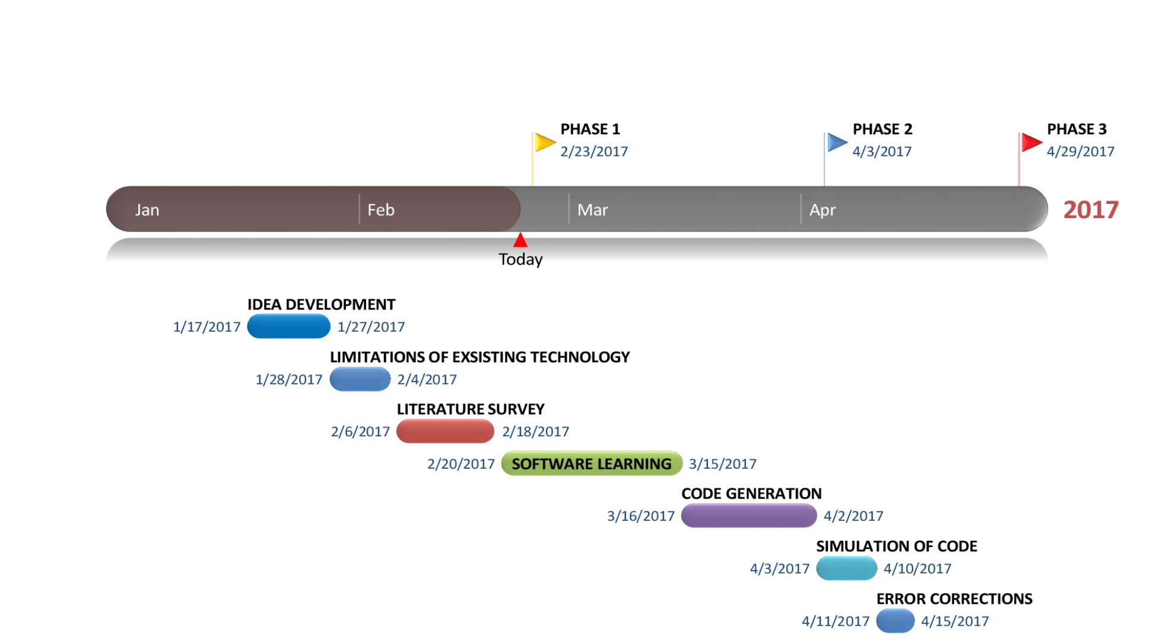
Plan Of Work
Department of Electronics and Communication
Engineering

Slide 11
References
[1] Milica Stojanovic, “Recent Advances in High-speed Underwater Acoustic Communications”, In IEEE Journal of Oceanic Engineering, Vol. 21, No. 2, April 1996.
[2] Milica Stojanovic, “Underwater acoustic communication: design considerations on the physical layer”, in MIT, cambridge, MA 02139.
[3] Sandeep Kaur, Gurpreet Bharti, “Orthogonal Frequency Division Multiplexing in Wireless Communication Systems: A Review”, International Journal of Advanced Research in Computer Engineering & Technology Volume 1, Issue 3, May 2012.
Department of Electronics and Communication
Engineering

Slide 12
THANK YOU
Department of Electronics and Communication
Engineering

