Slide 1
ANGULAr 2 components advanced: communication

Slide 2
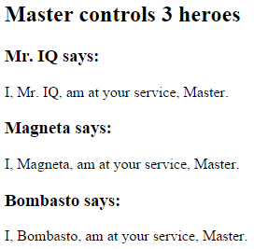
Pass data from parent to child with input binding
@Component({ selector: 'hero-child', template: `
<h3>{{hero.name}} says:</h3> <p>I, {{hero.name}}, am at
your service, {{masterName}}.</p>
` }) export class HeroChildComponent { @Input() hero: Hero; @Input('master') masterName: string; }
@Component({ selector: 'hero-parent', template: `
<hero-child *ngFor="let hero of heroes" [hero]="hero" [master]="master">
</hero-child>`
}) export class HeroParentComponent { heroes = HEROES; master: string = 'Master'; }
HeroParentComponent
HeroChildComponent
hero
master

Slide 3
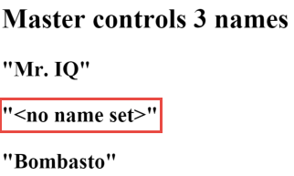
Intercept input property changes with a setter
@Component({ selector: 'name-child', template: '<h3>"{{name}}"</h3>' }) export class NameChildComponent { private _name = ''; @Input() set name(name: string) { this._name = (name && name.trim()) || '<no name set>'; } get name(): string { return this._name; } }

Slide 4
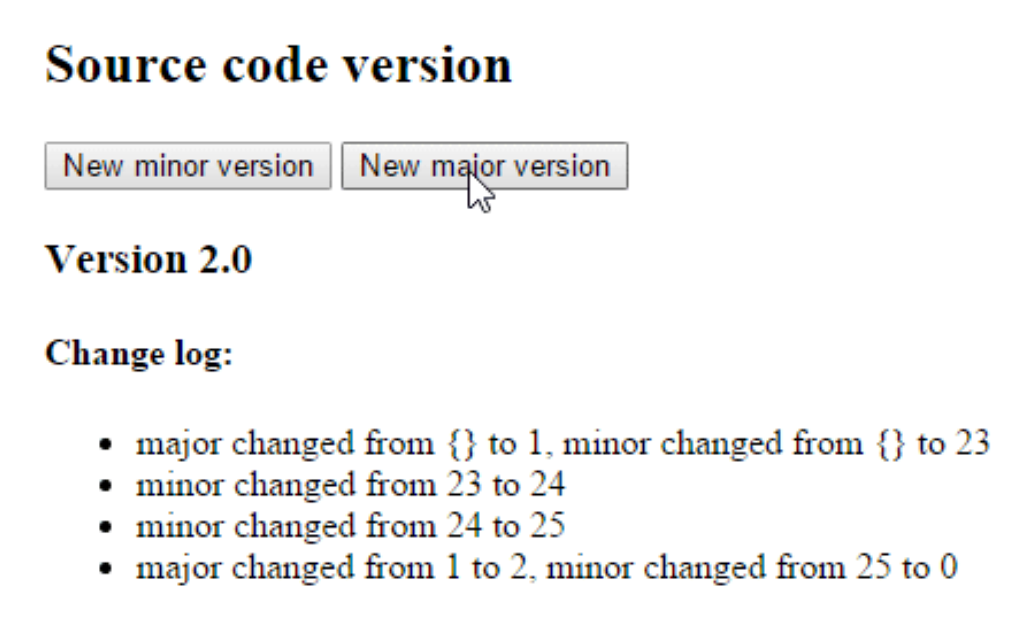
Intercept input property changes with ngOnChanges
@Component({ selector: 'version-parent', template: ` <h2>Source code version</h2> <button (click)="newMinor()"> New minor version </button> <button (click)="newMajor()"> New major version </button> <version-child [major]="major" [minor]="minor"> </version-child>` }) export class VersionParentComponent { major: number = 1; minor: number = 23; newMinor() { this.minor++; } newMajor() { this.major++; this.minor = 0; } }

Slide 5
Intercept input property changes with ngOnChanges
@Component({ selector: 'version-child', template: ` <h3>Version {{major}}.{{minor}}</h3> <h4>Change log:</h4> <ul><li *ngFor="let change of changeLog">{{change}}</li></ul>`}) export class VersionChildComponent implements OnChanges { @Input() major: number; @Input() minor: number; changeLog: string[] = []; ngOnChanges(changes: {[propKey: string]: SimpleChange}) { let log: string[] = []; for (let propName in changes) { let changedProp = changes[propName]; let from = JSON.stringify(changedProp.previousValue); let to = JSON.stringify(changedProp.currentValue); log.push( `${propName} changed from ${from} to ${to}`); } this.changeLog.push(log.join(', ')); } }

Slide 6
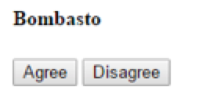
Parent listens for child event
@Component({ selector: 'my-voter', template: ` <h4>{{name}}</h4> <button (click)="vote(true)" [disabled]="voted">Agree</button> <button (click)="vote(false)" [disabled]="voted">Disagree</button> ` }) export class VoterComponent { @Input() name: string; @Output() onVoted = new EventEmitter<boolean>(); voted = false;
vote(agreed: boolean) { this.onVoted.emit(agreed); this.voted = true; } }

Slide 7
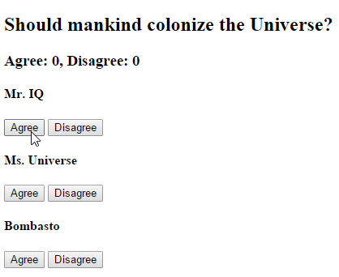
Parent listens for child event
@Component({ selector: 'vote-taker', template: ` <h2>Should mankind colonize the Universe?</h2> <h3>Agree: {{agreed}}, Disagree: {{disagreed}}</h3> <my-voter *ngFor="let voter of voters" [name]="voter" (onVoted)="onVoted($event)"> </my-voter> ` }) export class VoteTakerComponent { agreed = 0; disagreed = 0; voters = ['Mr. IQ', 'Ms. Universe', 'Bombasto']; onVoted(agreed: boolean) { agreed ? this.agreed++ : this.disagreed++; } }

Slide 8
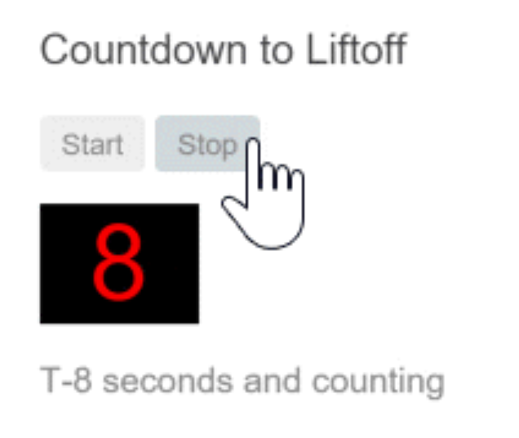
Parent interacts with child via local variable
@Component({ selector: 'countdown-parent-lv', template: ` <h3>Countdown to Liftoff (via local variable)</h3> <button (click)="timer.start()">Start</button> <button (click)="timer.stop()">Stop</button> <div class="seconds">{{timer.seconds}}</div> <countdown-timer #timer></countdown-timer> `, styleUrls: ['demo.css'] }) export class CountdownLocalVarParentComponent { }
We can place a local variable (#timer) on the tag (<countdown-timer>) representing the child component. That gives us a reference to the child component itself and the ability to access any of its properties or methods from within the parent template.
NOTE: The parent component itself has no access to the child.

Slide 9
Parent interacts with child via local variable
@Component({ selector: 'countdown-timer’, template: '<p>{{message}}</p>’}) export class CountdownTimerComponent implements OnInit, OnDestroy { intervalId = 0; message = ''; seconds = 11; clearTimer() { clearInterval(this.intervalId); } ngOnInit() { this.start(); } ngOnDestroy() { this.clearTimer(); } start() { this.countDown(); } stop() { this.clearTimer(); this.message = `Holding at T-${this.seconds} seconds`; } private countDown() { this.clearTimer(); this.intervalId = window.setInterval(() => { this.seconds -= 1; if (this.seconds === 0) { this.message = 'Blast off!'; } else { if (this.seconds < 0) { this.seconds = 10; } // reset this.message = `T-${this.seconds} seconds and counting`; } }, 1000);
} }

Slide 10
Parent calls a ViewChild
We can't use the local variable to access from parent component to child.
In this case we can use @ViewChild
@Component({ selector: 'countdown-parent-vc', template: ` <h3>Countdown to Liftoff (via ViewChild)</h3> <button (click)="start()">Start</button> <button (click)="stop()">Stop</button> <div class="seconds">{{ seconds() }}</div> <countdown-timer></countdown-timer>` }) export class CountdownViewChildParentComponent implements AfterViewInit { @ViewChild(CountdownTimerComponent) private timerComponent: CountdownTimerComponent; seconds() { return 0; } ngAfterViewInit() { setTimeout(() =>
this.seconds = () => this.timerComponent.seconds, 0); } start() { this.timerComponent.start(); } stop() { this.timerComponent.stop(); } }
Notes:
We import references to the ViewChild decorator and the AfterViewInit lifecycle hook.
We inject the child CountdownTimerComponent into the private timerComponent property via the @ViewChild property decoration.
The #timer local variable is gone from the component metadata. Instead we bind the buttons to the parent component's own start and stop methods and present the ticking seconds in an interpolation around the parent component's seconds method.
These methods access the injected timer component directly.
The ngAfterViewInit lifecycle hook is an important wrinkle. The timer component isn't available until after Angular displays the parent view. So we display 0 seconds initially.
Then Angular calls the ngAfterViewInit lifecycle hook at which time it is too late to update the parent view's display of the countdown seconds. Angular's unidirectional data flow rule prevents us from updating the parent view's in the same cycle. We have to wait one turn before we can display the seconds.
We use setTimeout to wait one tick and then revise the seconds method so that it takes future values from the timer component.

Slide 11
Parent and children communicate via a service
@Injectable() export class MissionService { // Observable string sources private missionAnnouncedSource = new Subject<string>(); private missionConfirmedSource = new Subject<string>(); // Observable string streams missionAnnounced$ = this.missionAnnouncedSource.asObservable(); missionConfirmed$ = this.missionConfirmedSource.asObservable(); // Service message commands announceMission(mission: string) { this.missionAnnouncedSource.next(mission); } confirmMission(astronaut: string) { this.missionConfirmedSource.next(astronaut); } }

Slide 12
Parent and children communicate via a service
A parent component and its children share a service whose interface enables bi-directional communication within the family.
@Injectable() export class MissionService { // Observable string sources private missionAnnouncedSource = new Subject<string>(); private missionConfirmedSource = new Subject<string>(); // Observable string streams missionAnnounced$ = this.missionAnnouncedSource.asObservable(); missionConfirmed$ = this.missionConfirmedSource.asObservable(); // Service message commands announceMission(mission: string) { this.missionAnnouncedSource.next(mission); } confirmMission(astronaut: string) { this.missionConfirmedSource.next(astronaut); } }

Slide 13
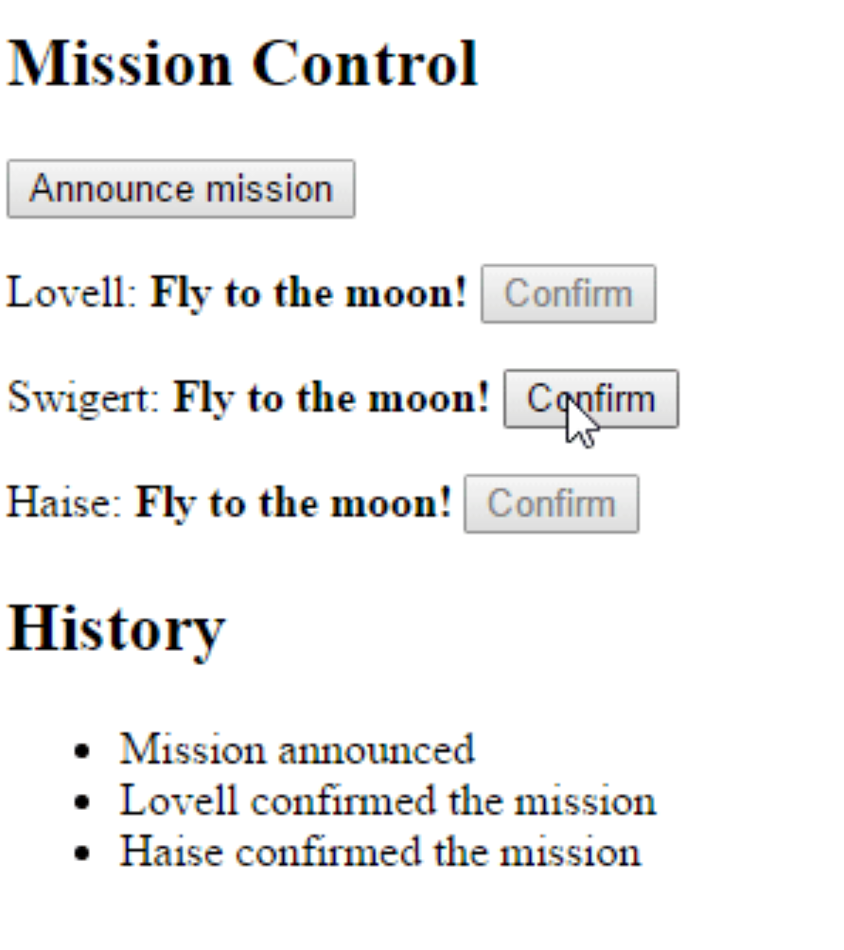
Parent and children communicate via a service
@Component({ selector: 'mission-control', template: `<h2>Mission Control</h2> <button (click)="announce()">Announce mission</button> <my-astronaut *ngFor="let astronaut of astronauts" [astronaut]="astronaut”></my-astronaut> <h3>History</h3> <ul><li *ngFor="let event of history">{{event}}</li></ul>`}) export class MissionControlComponent { astronauts = ['Lovell', 'Swigert', 'Haise']; history: string[] = []; missions = ['Fly to the moon!', 'Fly to mars!', 'Fly to Vegas!']; nextMission = 0; constructor(private missionService: MissionService) { missionService.missionConfirmed$.subscribe( astronaut => { this.history.push(`${astronaut} confirmed the mission`); });} announce() { let mission = this.missions[this.nextMission++]; this.missionService.announceMission(mission); this.history.push(`Mission "${mission}" announced`); if (this.nextMission >= this.missions.length) { this.nextMission = 0; } } }

Slide 14

Parent and children communicate via a service
@Component({ selector: 'my-astronaut', template: `<p> {{astronaut}}: <strong>{{mission}}</strong> <button (click)="confirm()" [disabled]="!announced || confirmed">Confirm</button></p>`}) export class AstronautComponent implements OnDestroy { @Input() astronaut: string; mission = '<no mission announced>'; confirmed = false; announced = false; subscription: Subscription; constructor(private missionService: MissionService) { this.subscription = missionService.missionAnnounced$.subscribe( mission => { this.mission = mission; this.announced = true; this.confirmed = false; }); } confirm() { this.confirmed = true; this.missionService.confirmMission(this.astronaut); } ngOnDestroy() { this.subscription.unsubscribe(); // prevent memory leak when component destroyed } }

