Slide 1




Development, Test and Application of a framework for cloud serverless services
z
December 2020 - Andrea Santu [251579]
Supervisor: Dr. Ing. Boyang Du
Company: Getapper

Slide 2
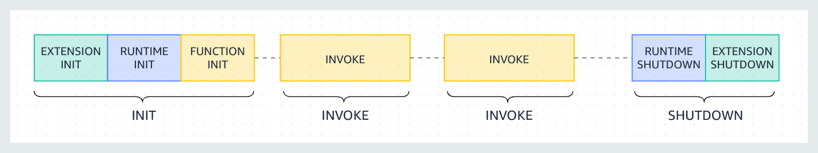
Function as a Service - Serverless
Advantages
Disadvantages
Simplified development/deploy
Auto scaling
Cost effective
Less infrastructure control
Complicated local testing
Cold Start overhead
function initialization

Slide 3
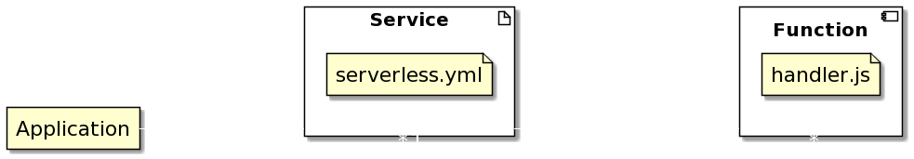
Serverless Framework
Advantages
Disadvantages
Provider agnostic (no vendor lock-in)
Simplified deployment
Extensible (external plugins)
Tedious Compilation of Configuration files
No standard project structure
Complex programmatic testing

Slide 4
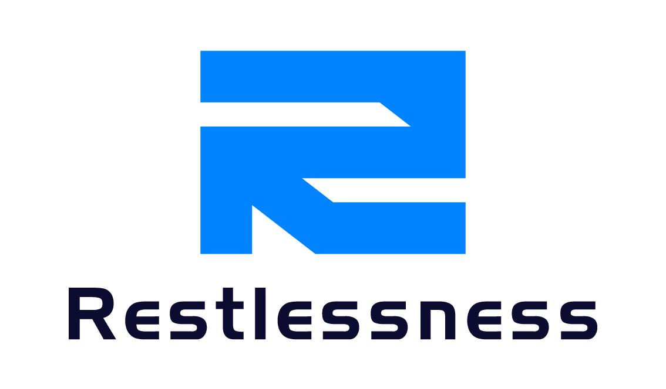
Restlessness
Objectives
Standard project structure
Provide a CLI and a local Web Interface
Standard structure for test and validation (generated code templates)
Extensibility

Slide 5

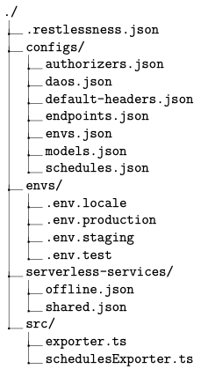
@restlessness/core
Functionalities
Project creation
Resources management
Endpoints
Schedules
Services
Models
Environments
Extensions utility (lifecycle hooks)
Handler functions

Slide 6
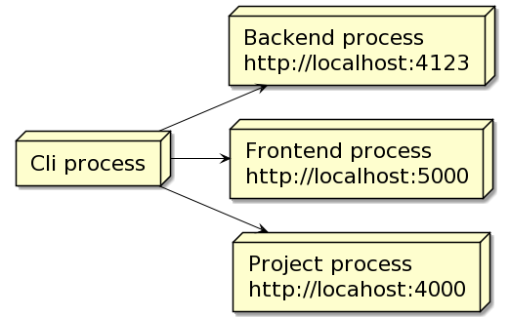
@restlessness/cli
Local development
processes
Command Line Interface
Project creation
Manage extension packages
Services deploy/remove
Environment file generation
Web Interface
Backend
A Restlessness project itself

Slide 7
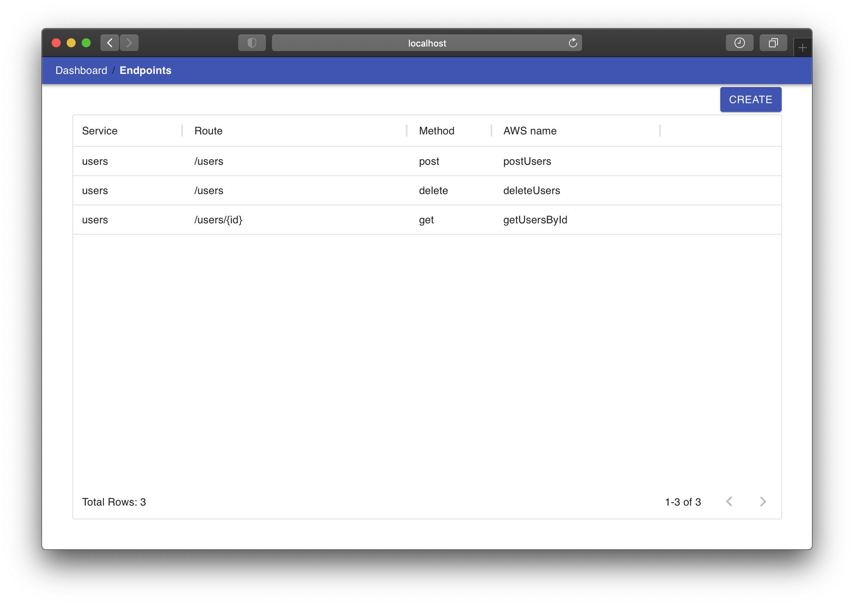
Site map
Create new Endpoint
User defined Endpoints

Slide 8
Extensions
Common patterns
Provided packages
Data Access Objects
Abstract interface for database
Authentication
@restlessness/dao-mongo
@restlessness/auth-jwt

Slide 9
Dev Ops
Github
Version control platform
CircleCi
Continuous Integration platform
Early integration of code changes
Npm
Node.js Package Manager

Slide 10
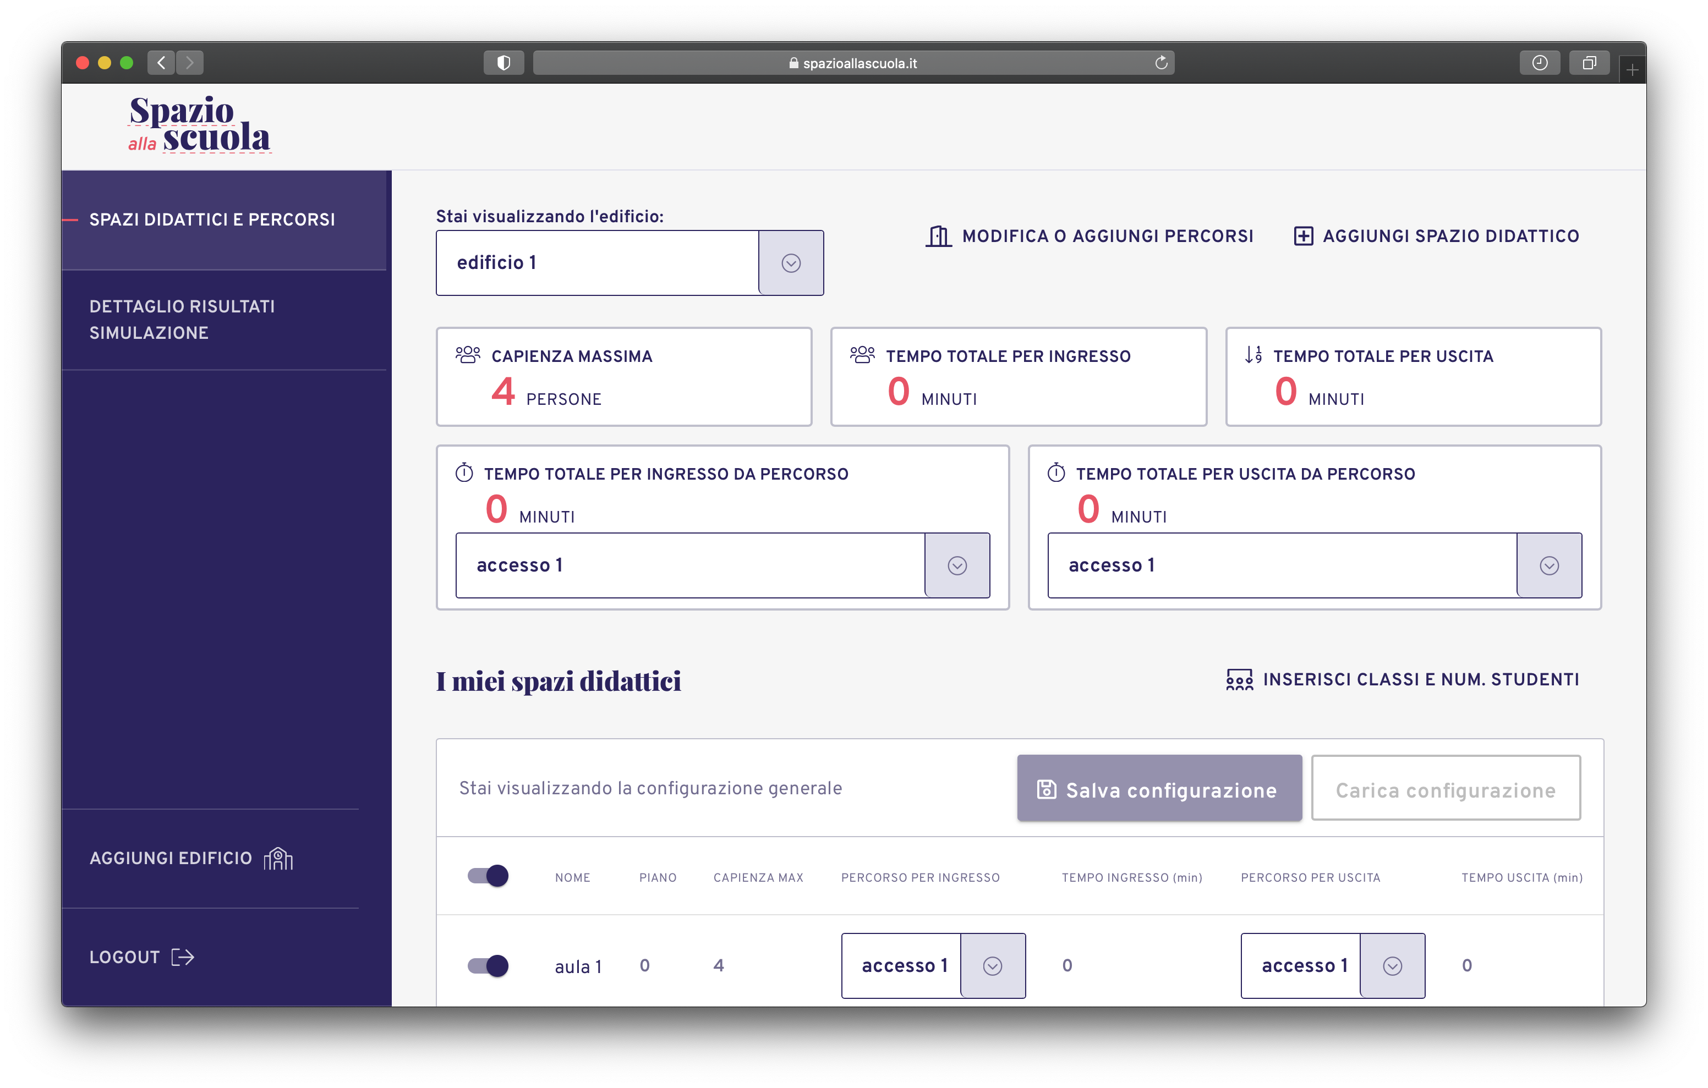

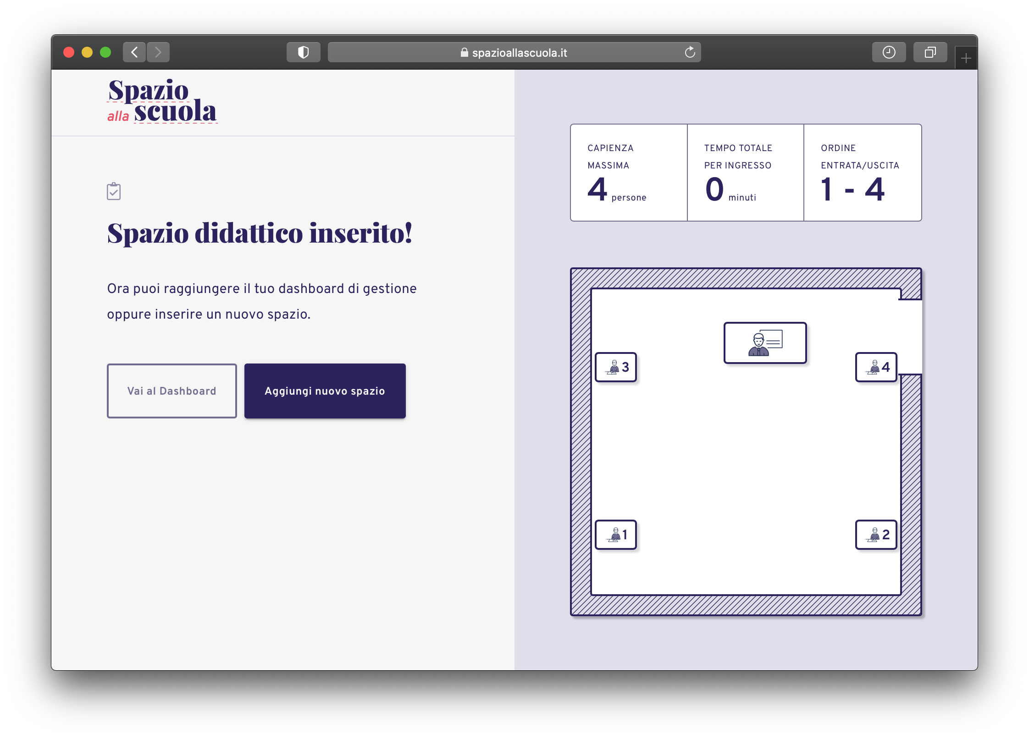
Showcase Application
Encountered problems
Cold start
Saturation of available database connections

Slide 11

z
Thank you
For your attention

