Slide 1




Development, Test and Application of a framework for cloud serverless services
z
December 2020 - Andrea Santu

Slide 2
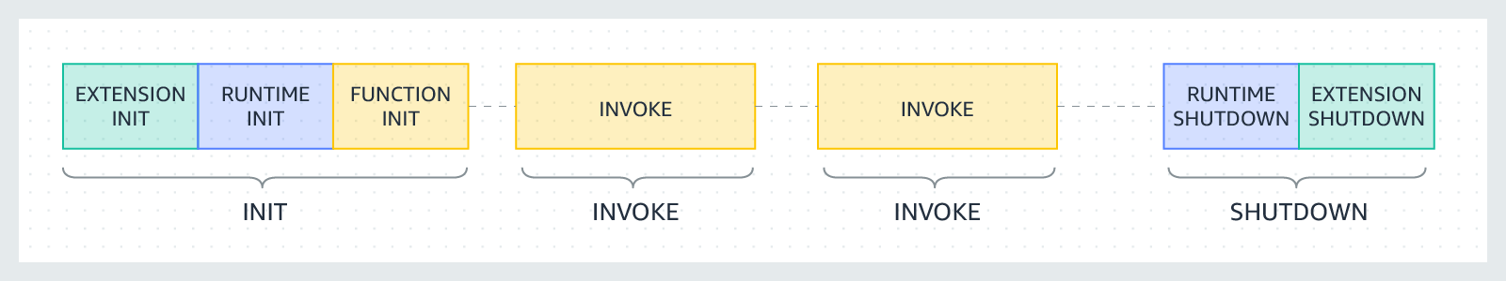
Function as a Service - Serverless
Advantages
Disadvantages
Simplified development/deploy
Auto scaling
Cost effective
Infrastructure control
Local testing

Slide 3
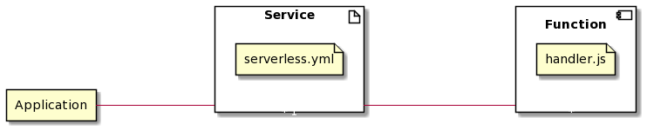
Serverless Framework
Configuration files
Flexibility
Testing
Resource threshold
Cold start
Advantages
Disadvantages
Provider agnostic
Simplified deployment
Extensible
Configuration files
Flexibility
Testing
Cold start

Slide 4
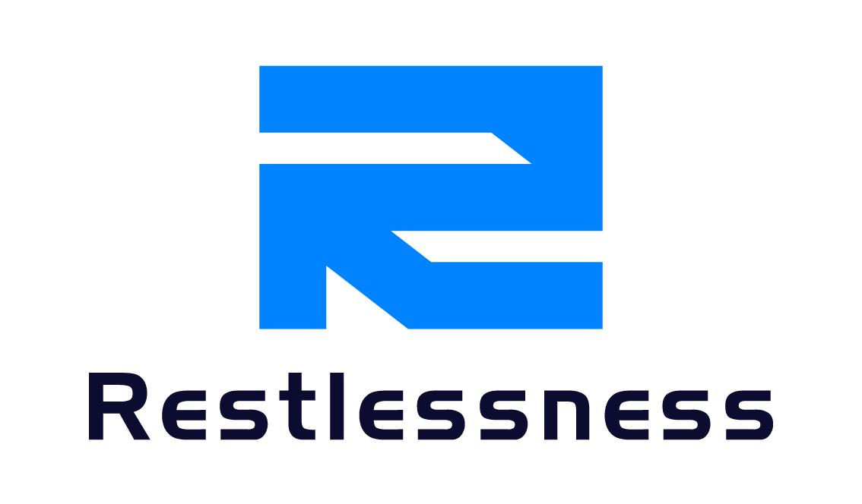
Restlessness
Configuration files
Flexibility
Testing
Resource threshold
Cold start
Objectives
Standard project structure
Provide a CLI and a local Web Interface
Standard structure for test and validation
Extensibility

Slide 5

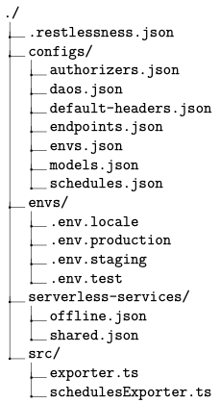
@restlessness/core
Configuration files
Flexibility
Testing
Resource threshold
Cold start
Resources
Functionalities
Endpoints
Schedules
Services
Models
Environments
Project creation
Resources management
Extensions utility
Handler functions

Slide 6
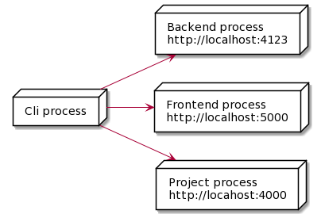
@restlessness/cli
Command Line Interface
Web Interface
Backend

Slide 7
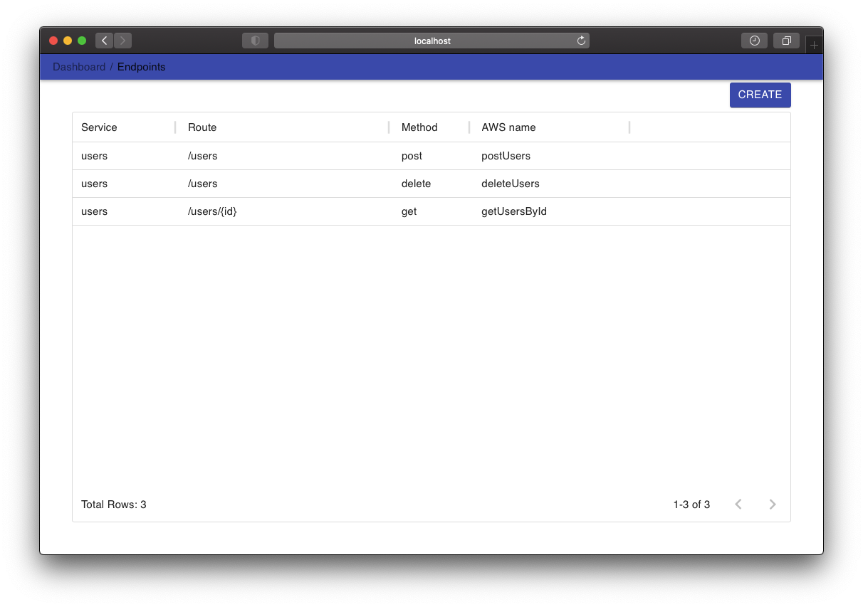

Slide 8
Extensions
Common patterns
Provided packages
Data Access Objects
Authentication
@restlessness/dao-mongo
@restlessness/auth-jwt

Slide 9
Dev Ops
Github
CircleCi
Npm

Slide 10

Application
Encountered problems
Cold start
Database connection
Resources threshold

