Slide 1

Andrés Cadenas Blanco (UO282276)

Slide 2
Contents
Requirements
General Aspects
Testing
Example

Slide 3

Requirements

Slide 4



Requirements
SOLID
Github Pages
Gamification

Slide 5




Technologies
TypeScript
React
Inrupt
Google Maps API

Slide 6
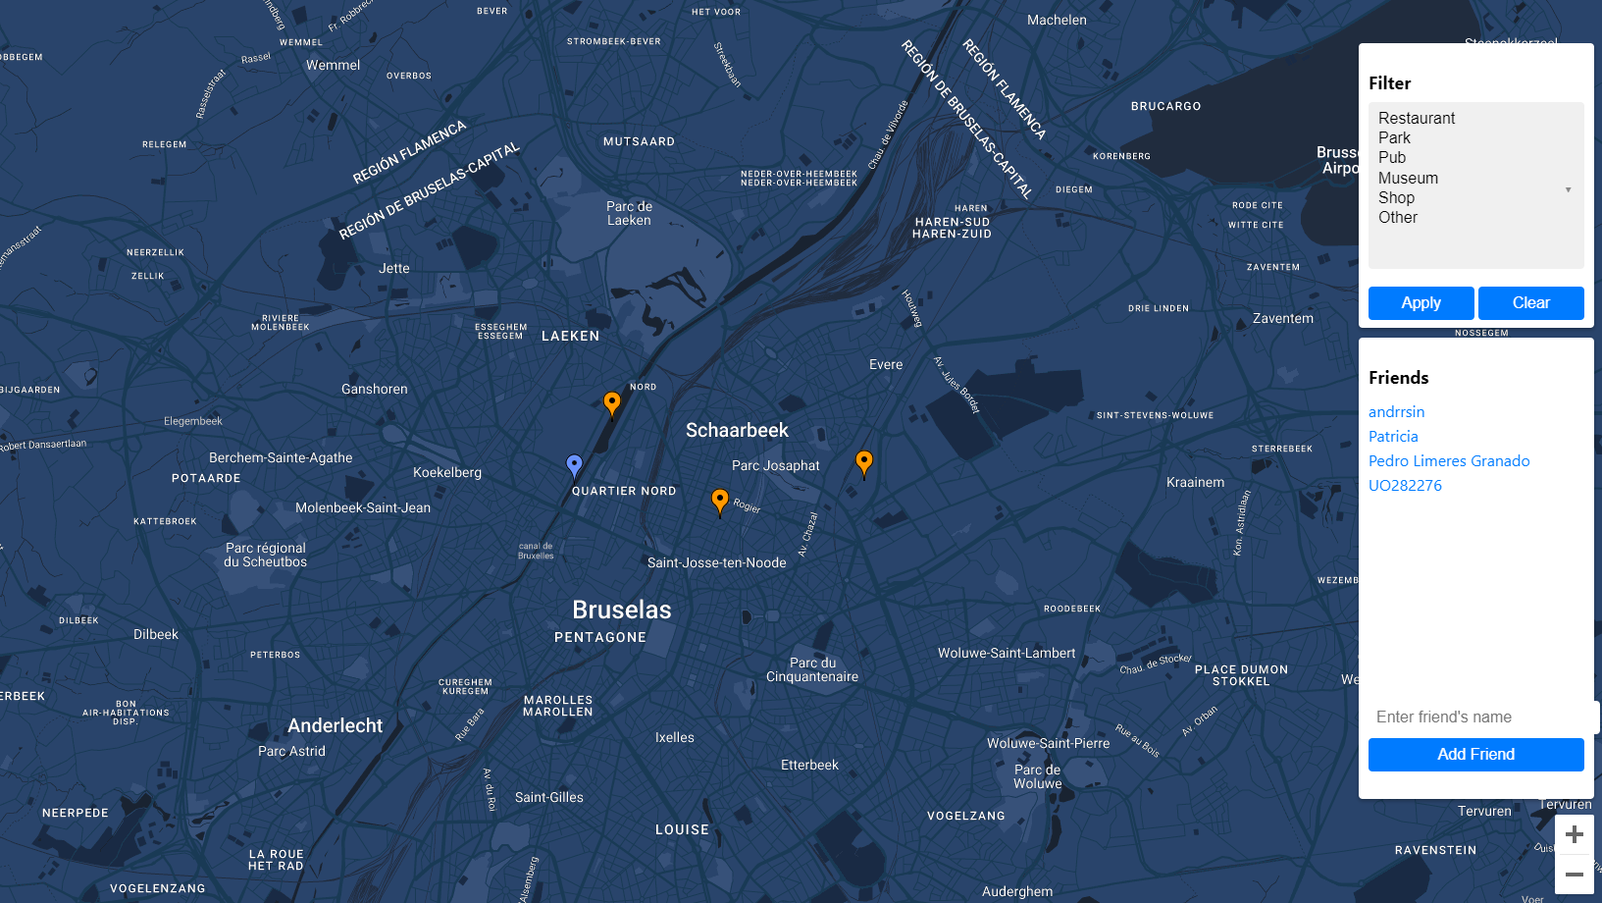
General Aspects

Slide 7
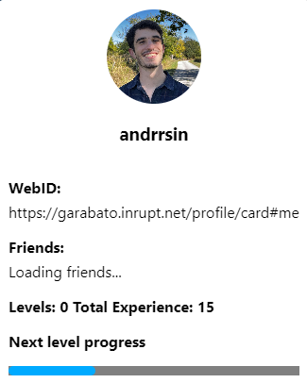
What is new in BITS
BITS is a gamification of lomap, where the user earns levels by creating markers. Encouraging the users to discover theplaces
How does the level system work?

Slide 8
Quality View
Availability
Github Pages
Security
SOLID Properties
Usability
Works in all browsers

Slide 9
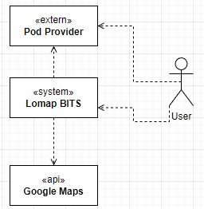
Internal Structure
Serverless approach (Availability,Usability, Security…)

Slide 10
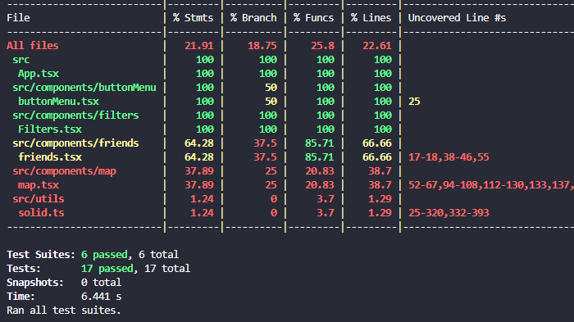
Testing

Slide 11
Coverage
Coverage objective was not achieved sadly. It reached 46%

Slide 12
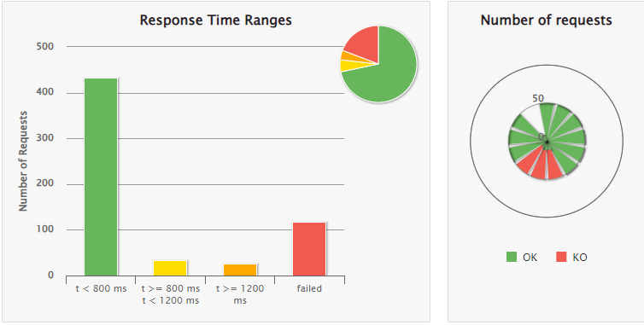
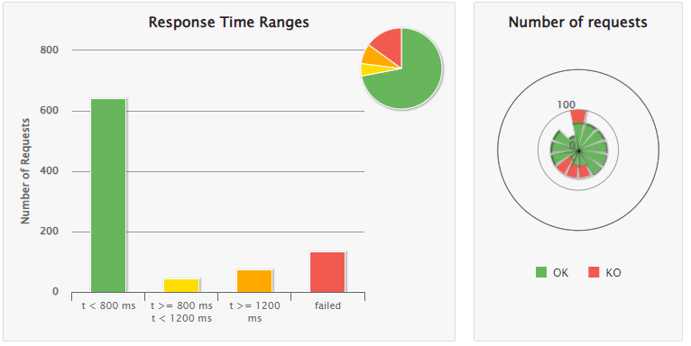
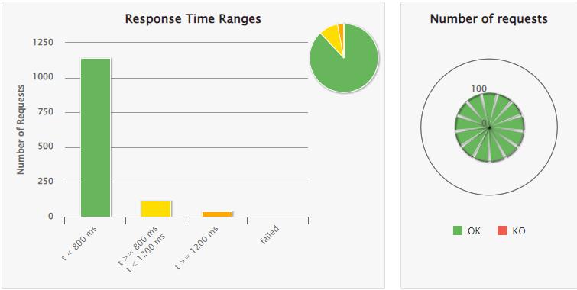
Gatlin
Surprising effect on simultaneous with failure.
Good results in more realistic simulation

Slide 13

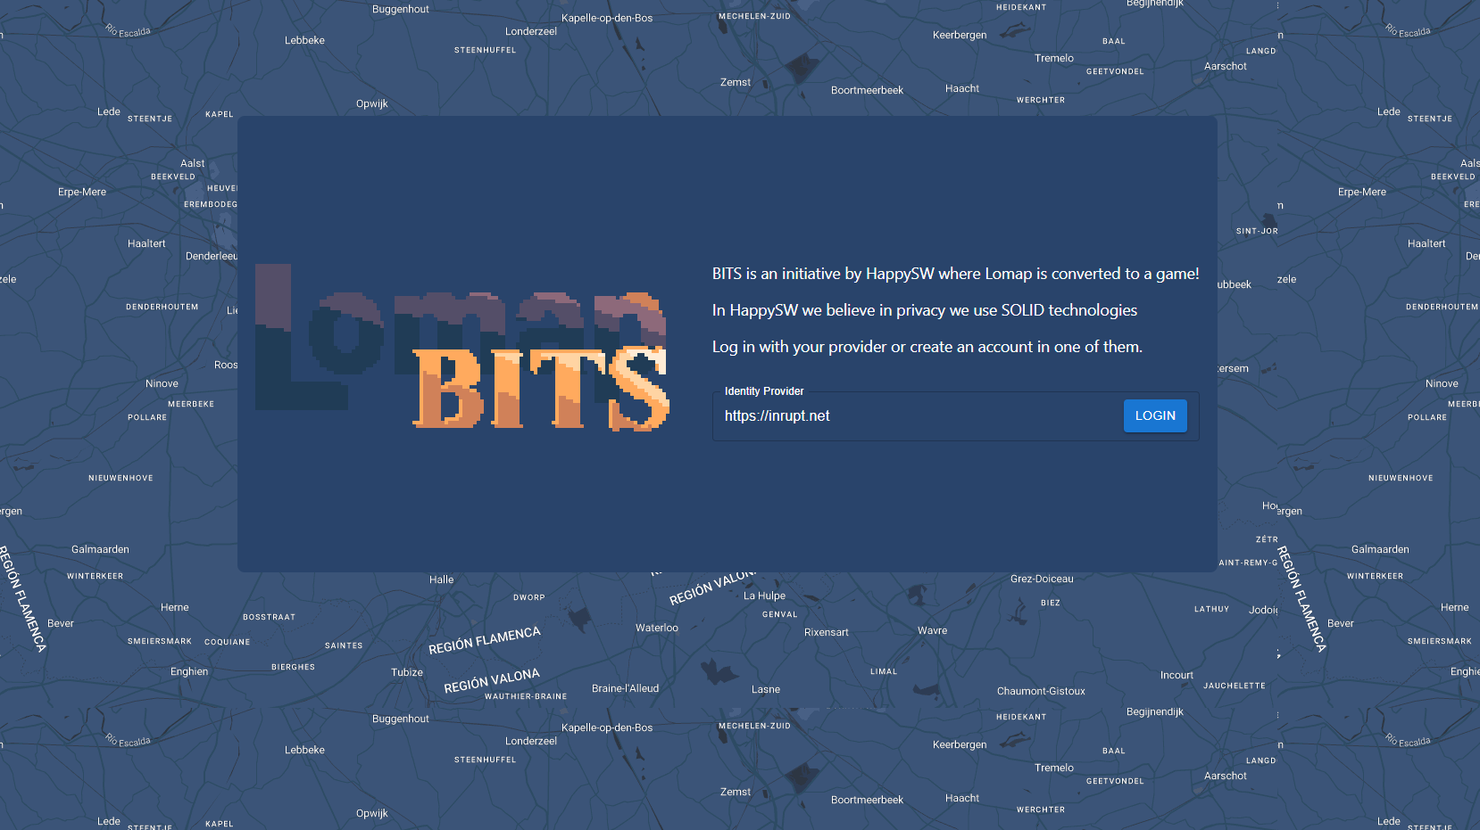
Demo
Documentation: andrrsin.github.io/lomap_2.0/documentation
Deployed Web: andrrsin.github.io/lomap_2.0/

Slide 14
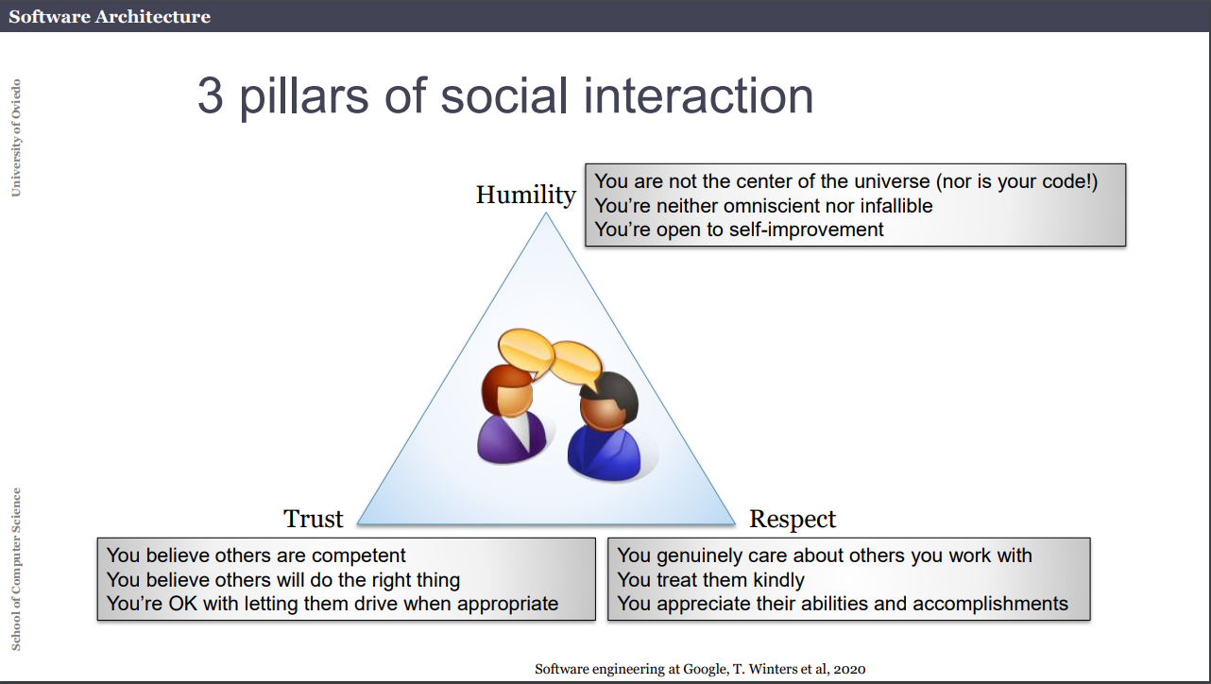
Thank You!

