Slide 1
OPC - Early computers
PROGRAM-CONTROLLED COMPUTERS – These computers (1938-1949) were programmed by setting switches and inserting patch cables.
Primitive architecture –CPU, ALU, registers, I/O devices, storage units?, etc.,….
Every configuration of switches and patch cables conformed an instruction. Each instruction was wired, then the program.
The electric storage units and I/O devices ranged from very primitive to something better, for a short time.

Slide 2
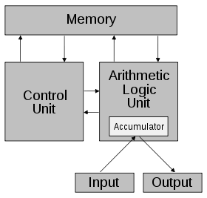
Context of a current Computer
Current architecture –CPU (control unit), ALU, registers, storage unit, I/O devices, etc.,….
VON NEUMANN’S –
The addition of a stored-program in a single separate memory structure that keeps both instructions and data.
The computers that follow the "von Neumann architecture" are also known as the "stored-program computer“.
Registers

Slide 3
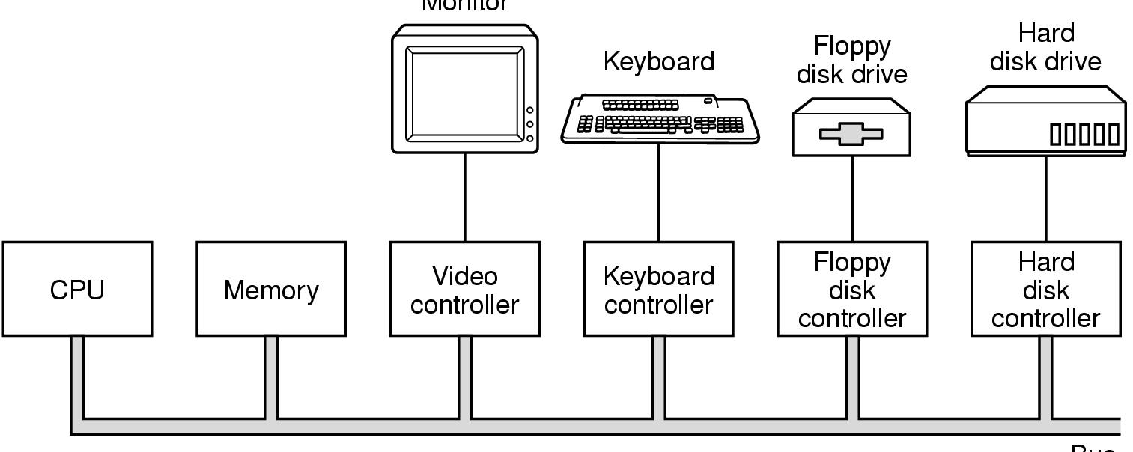
Hardware moderno con Bus
Monitor
controller
BUS
Componentes de una computadora básica
Exceptuando el CPU, cada uno de los componentes tiene un controlador
Cada controlador posee: registros y un buffer, para realizar las entradas y / o las salidas.
El bus tiene tres canales: datos, direcciones de memoria y señales de control.

Slide 4
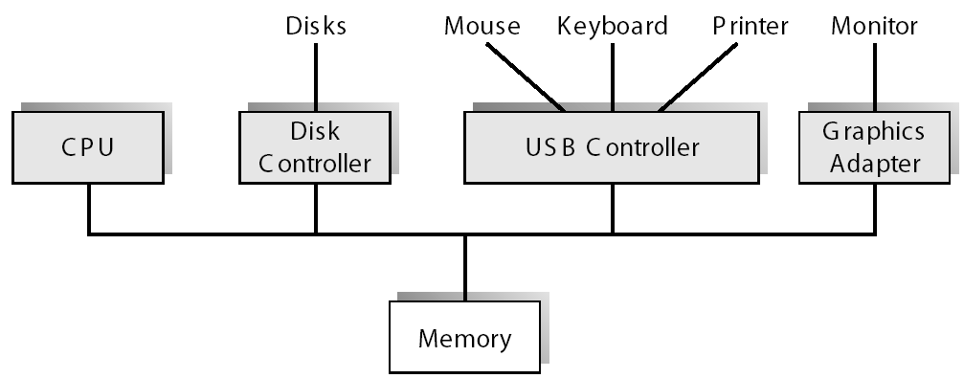
A Desktop Computer with USB
controller
BUS

Slide 5
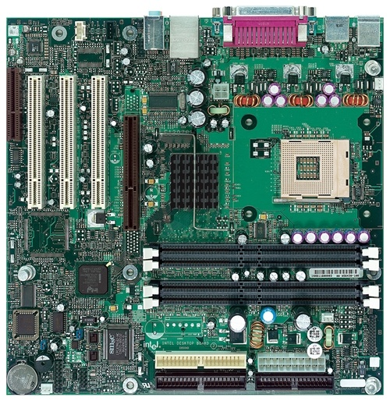
Intel D850MD Motherboard
mouse, keyboard, parallel, serial, and USB connectors
Video
Audio chip
PCI slots
memory controller hub
Pentium 4 socket
AGP slot
dynamic RAM
Firmware hub
I/O Controller
Speaker
Power connector
Battery
Diskette connector
IDE drive connectors

Slide 6
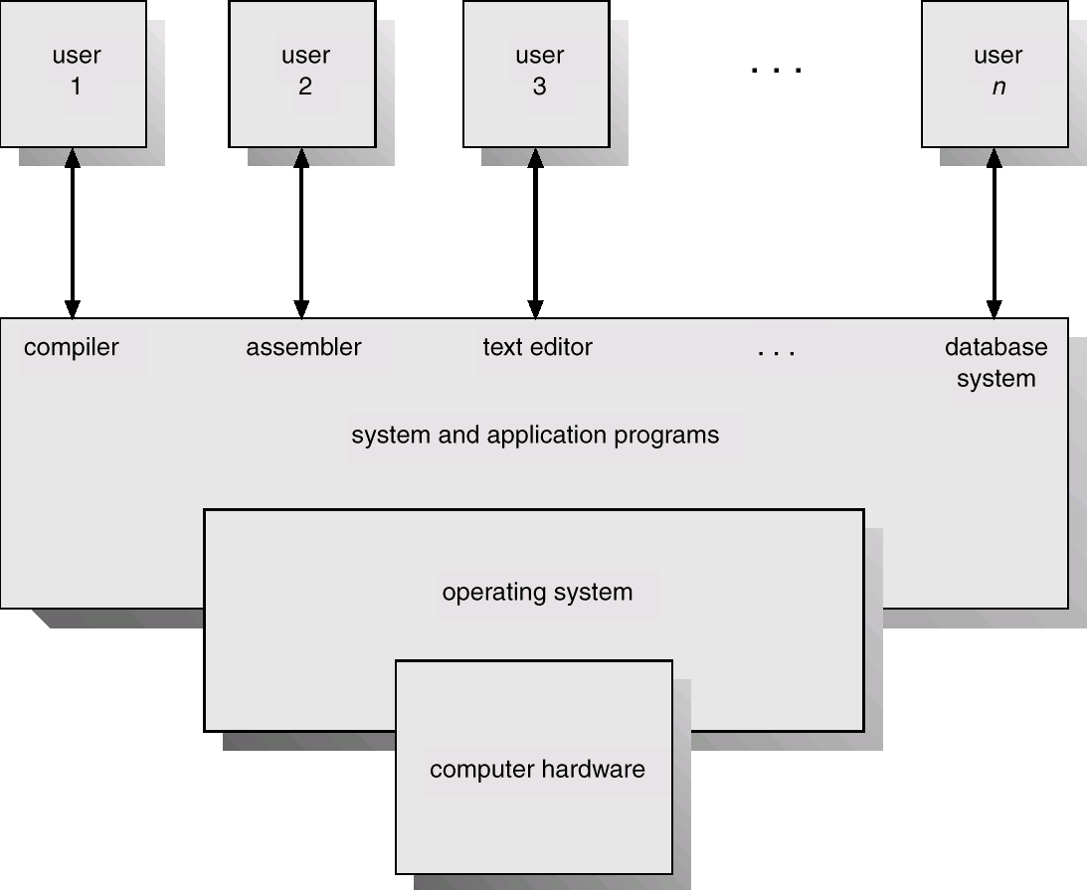
Computer System Components (layers)
Command Interpreter?
Kernel
Instructions?
Software
O.S.
Basic Routines

Slide 7
Computer System Components
Users (people, machines, other computers)
System and Applications programs : System programs – help the users to develop applications (compilers, assemblers, database systems, line text editors, etc.), Command Interpreter. Applications programs – help the users to solve their computing problems (spreadsheets, web explorers, video games, business programs, word processors, function libraries). -Software-.
Basic Routines – controls and coordinates the use of the hardware among the various application programs for the various users. For these tasks contains programs and subprograms (kernel) -Software-.
Hardware – provides basic computing resources (CPU, memory, I/O devices)

Slide 8
Computer Hardware
Which ones are the main functions / services of the Computer Hardware?
__________________
__________________
__________________

Slide 9
Referencias
Chapters: Tanenbaum, Operating Systems.
Notas de Ramón Ríos.
13-Ago-2018

