Slide 1
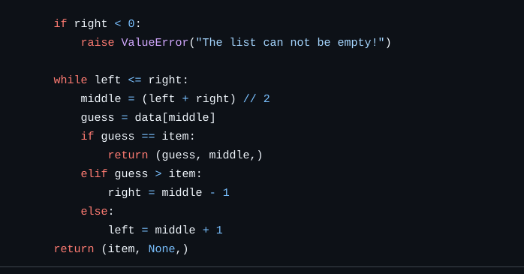
? 8
L [0]
R [len(A) - 1]
L - Left
R - Right
A =
1 | 5 | 8 | 10 | 15 | 16 | 20 | 100 | 152
M = round((L + R) /2) = 4
A[M] = 15
L
M
R
M == 20 – False
M < 20 – True
M > 20 - False
A =
1 | 5 | 8 | 10 | 15 | 16 | 20 | 100 | 152
L
M
R
A =
1 | 5 | 8 | 10 | 15 | 16 | 20 | 100 | 152

