Slide 1
ITSS Sign Language Interface Design
Andrew Puhalla

Slide 2
Proposed Interface Designs
Mobile Semi-Transparent
The sign language follows the user (via the Eye Tracker) giving the corresponding signs to the reading as the user reads along and is semi-transparent so that the user can read and see the sign language simultaneously.
Fixed Semi-Transparent
The sign language is in a fixed position on the reading side and is semi-transparent so that the reader can read behind it.
Fixed Open/Close
The sign language is in a fixed position, but only shows up when the user presses the button. The user could bring up or close the sign language window/box.

Slide 3
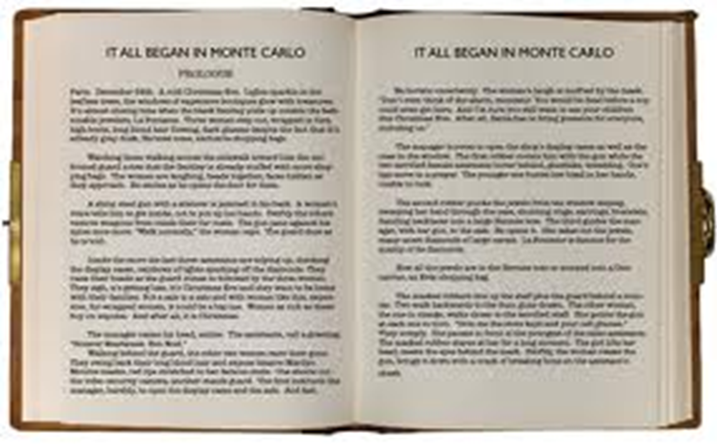
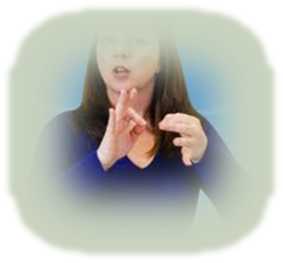
Semi-Transparent Mobile Design

Slide 4
Why Mobile Semi-Transparency
Spatial Contiguity – people learn more deeply when corresponding words and pictures are presented near one another rather than far from one another on a page or screen (Mayer).
Spotlight theory – Your eyesight only focuses on a single spotlight (189).
Zoom Lens theory – Your focus could zoom in or out (Wolfe, Kluender and Levi 189).

Slide 5
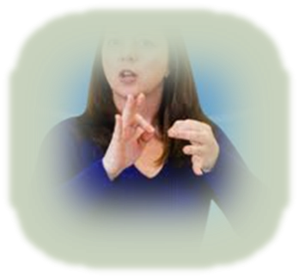
Semi-Transparent fixed

Slide 6
Hold on a Minute!
Visual Crowding – the deleterious effect of clutter on peripheral object recognition – you can’t recognize objects in your peripheral vision (Wolfe, Kluender and Levi 67).
Selective Attention – the ability to pick one (or few) stimuli out of many stimuli (Wolfe, Kluender and Levi 188).
Simultagnosia – the inability to perceive more than one object at a time (Wolfe, Kluender and Levi 206).
Inattentional Blindness – a failure to notice a stimulus that would be easily noticed if it were attended to (Wolfe, Kluender and Levi 216).

Slide 7
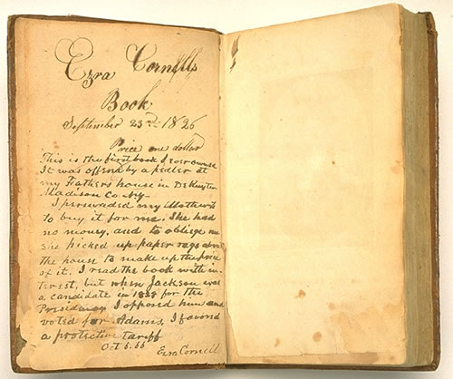

Fixed Open/Close
Open Sign Language
Close Sign Language

Slide 8
Works Cited
Mayer, Richard E. "An Eye Movement Analysis of the Spatial Contiguity Effect in Multimedia Learning." Journal of Experimental Psychology (2012): 178.
Wolfe, Jeremy M., Keith R. Kluender and Dennis M. Levi. Sensation and Perception. Sunderland: Sinauer Associates, Inc., 2012.

