Slide 1

Game Fitness
Shankar Chandrasekaran
Andrew Shults
Abdulmajeed Mesefir
IST303 Project - Part D - Fall 2019
Shankar Chandrasekaran - Andrew Shults - Abdulmajeed Mesefir

Slide 2

contents
User stories
Project demo
Issues
What we learned

Slide 3
Overview
Users can create a profile and login, giving them access to a list of sports
Users can pick a sports activity and Game Fitness will provide a list of suggested exercise
Game Fitness will tailor exercise difficulty based off the user’s BMI

Slide 4
MILESTONE 2 (RELEASE)
User Stories
As the application owner, I want to make sure that there are minimal bugs in the program so that the user experience is the best it can be
As a application designer, I need to be able to create a database design to store information related to exercises and user profiles
As a sports enthusiast, I would want to be able to create a profile in the Game Fitness application so I can manage my profile and history
As a user, I want to be able to choose a game and get a list of exercises so I remain injury free

Slide 5
User registration and sign in
Allow users to create an account and login
New users can create an account and begin using Game Fitness
Existing users can login and continue to use Game Fitness

Slide 6
Game and Exercises
Once users register or login, they can choose a game and get a list of exercises
Users will receive exercises tailored to the sport they choose

Slide 7
Minimize bugs in the system
Code was tested with sufficient coverage
Tested the models.py, views.py and forms.py files
91% test coverage

Slide 8
Store user and game data
Stored user registration information, games and exercises
Utilized SQLite database

Slide 9
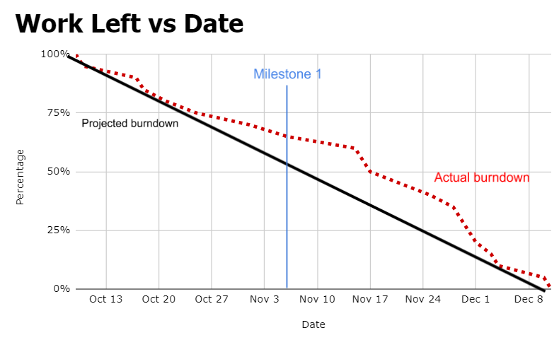
Burndown Chart

Slide 10

Demo

Slide 11
Testing

Slide 12
Walkthrough

Slide 13
ProJECT BACKLOG – Github
https://github.com/shankarchandru/GameFitness

Slide 14
Issues we faced
Django framework is awkward to use
Connecting the database via models.py was complicated and confusing
Extracting data from the database was difficult
Wiring bootstrap was not very straightforward
Couldn’t tailor exercise difficulty based off of BMI

Slide 15
What we learned
Things don't go as planned, with errors and setbacks arising at every step. Therefore, flexibility and a level demeanor are key to solving problems and moving ahead with the project
Iterative development is useful in helping maintain the continual progress of a software development project. Without set iterations and milestones, it is easy to fall behind
Each group member brings different strengths to the project, so initially it is advantageous for teams to have roles tailored to each group member. However, the team and its members need to be flexible and break from their roles when needed to ensure the project's completion

Slide 16

Thank YOU

