Slide 1

Game Fitness
Shankar Chandrasekaran
Andrew Shults
Abdulmajeed Mesefir
IST303 Project - Part C - Spring 2019
Shankar Chandrasekaran - Andrew Shults - Abdulmajeed Mesefir

Slide 2

contents
What is in Milestone 1.0
Present code and how it fulfils the user stories
Explaining Milestone 2.0
Demo of the project

Slide 3
MILESTONE 1 (RELEASE)
Collect exercises information
User Enrollment and Login Module
Admin login and exercises Module
Initial database connection and storage of user and exercise information

Slide 4
MILESTONE 1 (RELEASE)
User Stories
Support User enrollment(3)
Support admin user input(3)
User login and modify profile(5)
Decide which sports to include(1)
Identify common injuries and exercises by sport(1)
Python functions to support connection to SQLite database(1)

Slide 5
Milestone 2 (Release)
User profile management for users
User feedback and manage user exercises based on updated list and feedback/difficulty level ***
Issues identified
User profile management and feedback
Update existing routine based on user feedback

Slide 6
User Feedback & Re-Aligning Exercises
Feedback Input
Evaluate Indices
Exercise Feedback
Evaluate Exercises
Capture changing trends
Apply to other user profiles

Slide 7
User profile management and feedback
Add functions to support updating exercise routine based
New set of exercises for a sport
User feedback on difficulty level on exercises performed over the week and how challenging they are
Days to complete: 3

Slide 8
Update existing routine based on user feedback
As a sports enthusiast, I need to create a profile for myself in the Game Fitness application so I can manage my profile and history
Provide an option for the user to save the information and be able to visualize what was provided earlier
Story Points Estimate - 8

Slide 9
ProJECT BACKLOG - Github

Slide 10

Demo & Code Walkthrough

Slide 11

FEEDBACK

Slide 12
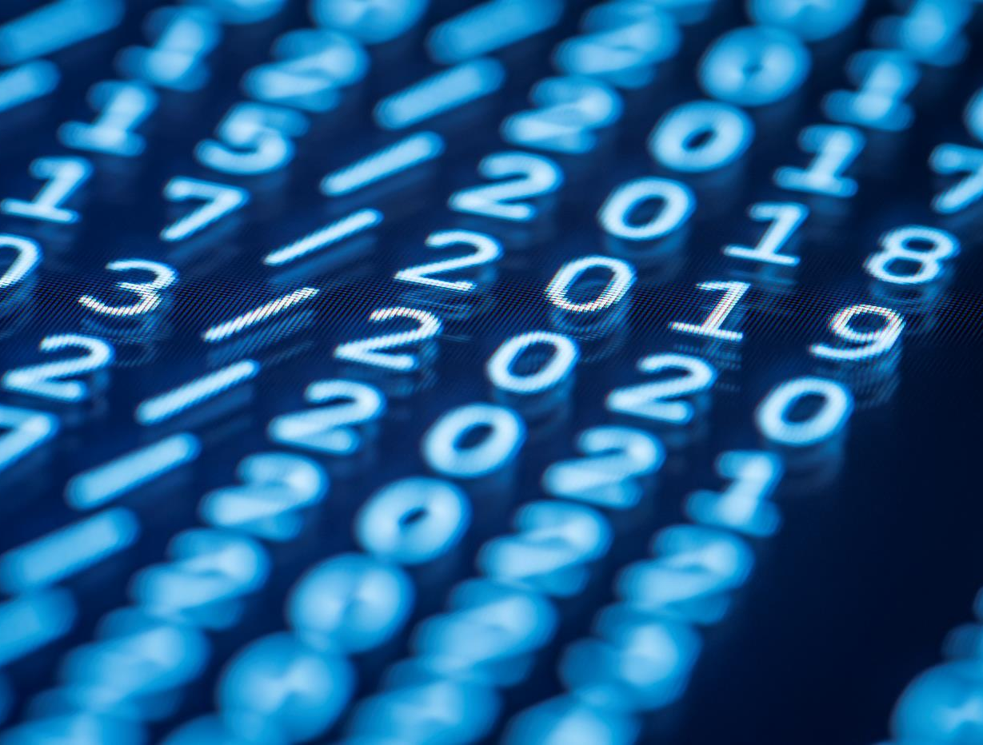
Thank YOU

