Slide 1
VespAI
Testing results

Slide 2
Contents
Models trained
Dataset index
Testing data
Dataset index
Performance observations
Headlines for the paper: 2021 models on 2022 data
Results on increasing training data size
Insect pollutants
Gotchas
Wooden Hornets
Good news

Slide 3
Models Tested
2021 Data
21all: Sets 01-06; all 2021 data [2745 images]
21h: Sets 01-05; 2021 hornets, inc. the KQ [2147 images]
21h0: Sets 01-02; original 2021; TOW & PK [1698 images]
21h00: Set 04; updated 2021 TOW & E [285 images]
21ip: Set 06; 2021 insect pollutants [598 images]
2022 Data
all-data: Sets 01-07; all labelled data [3302 images]
all-but-22ip: Sets 01-06 + 08 (excl. 2022 IPs) [3178 images]
all-hornets: Sets 01-05 + 08 [2580 images]

Slide 4
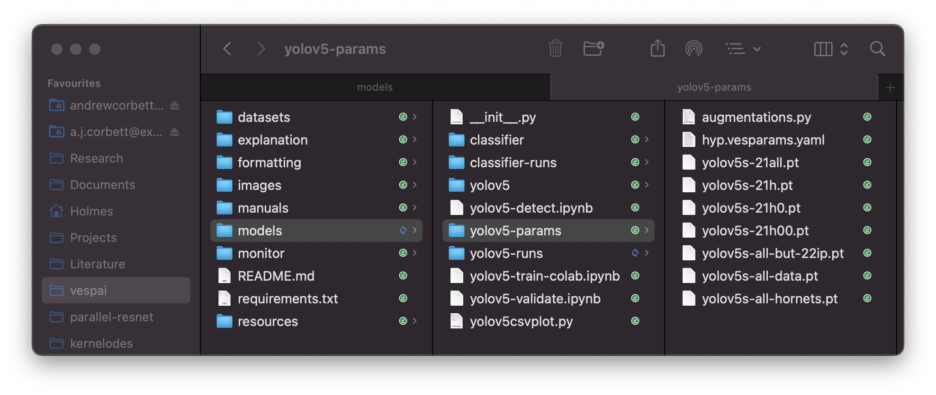

Slide 5
Datasets
22all: Set 07 (= 08 + 09); all 2022 data [557 images]
22h: Set 08; all 2022 hornets [433 images]
(22ip: Set 09; all 2022 insect pollutants [124 images])
all-ip: Sets 06 + 09; 2021 & 2022 Ips [722 images]
2022 Data

Slide 6
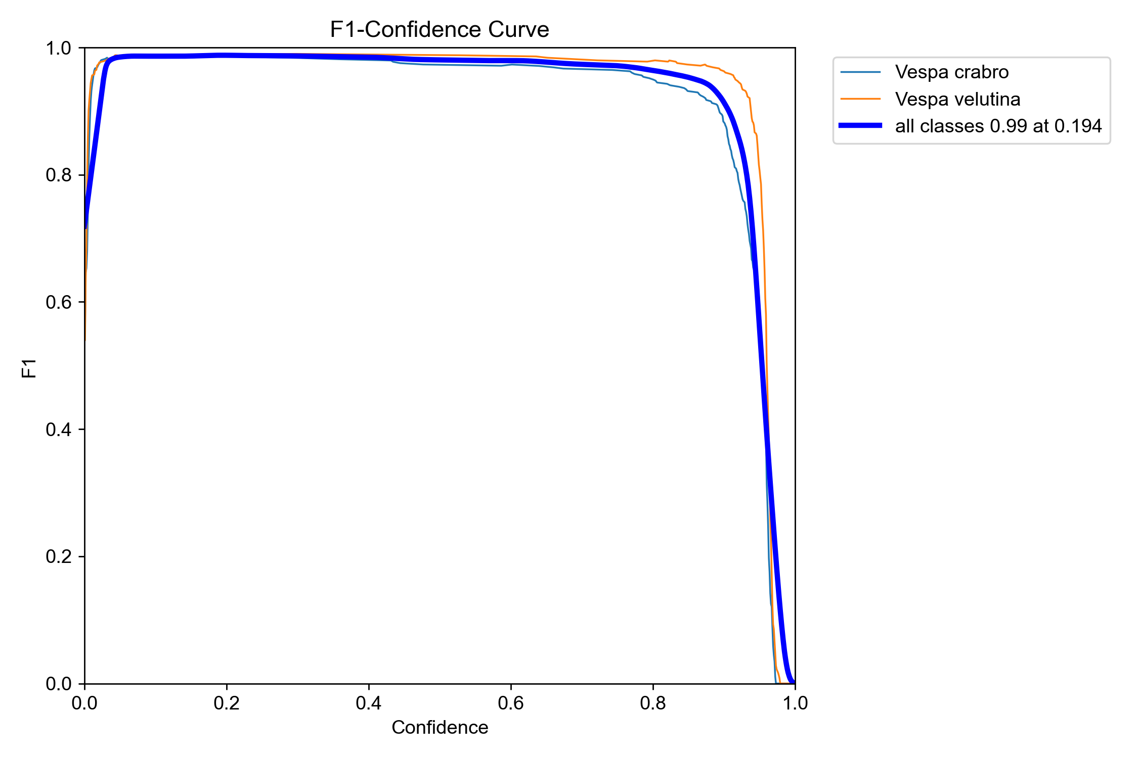
Headlines
“Models trained on 2021 data were strongly validated on 2022 testing data.”

Slide 7
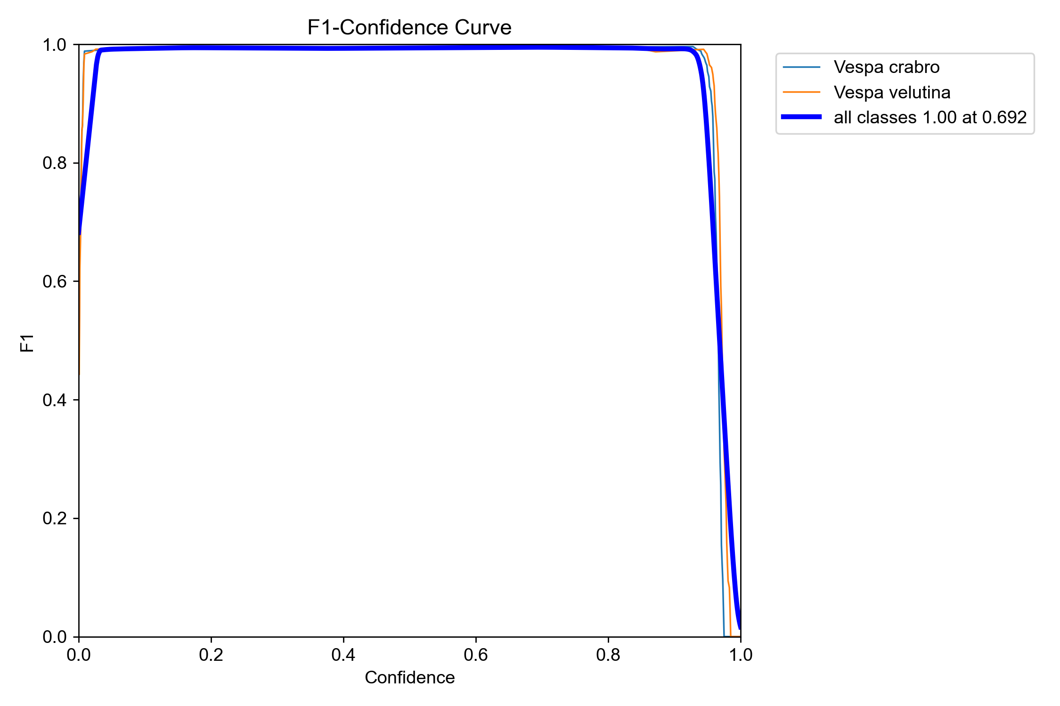
Headlines
Similar (unseen) 2021 data
Newly collected 2022 data
“Compare 2021 model performance on 2022 data vs. similar but unseen 2021 data.”

Slide 8
Improvement with more data
2021 Hornet-only trained models
21h: Sets 01-05; 2021 hornets, inc. the KQ [2147 images]
21h0: Sets 01-02; original 2021; TOW & PK [1698 images]
21h00: Set 04; updated 2021 TOW & E [285 images]
“Success on 2022 data increases from 21h00->21h0->21h.”

Slide 9
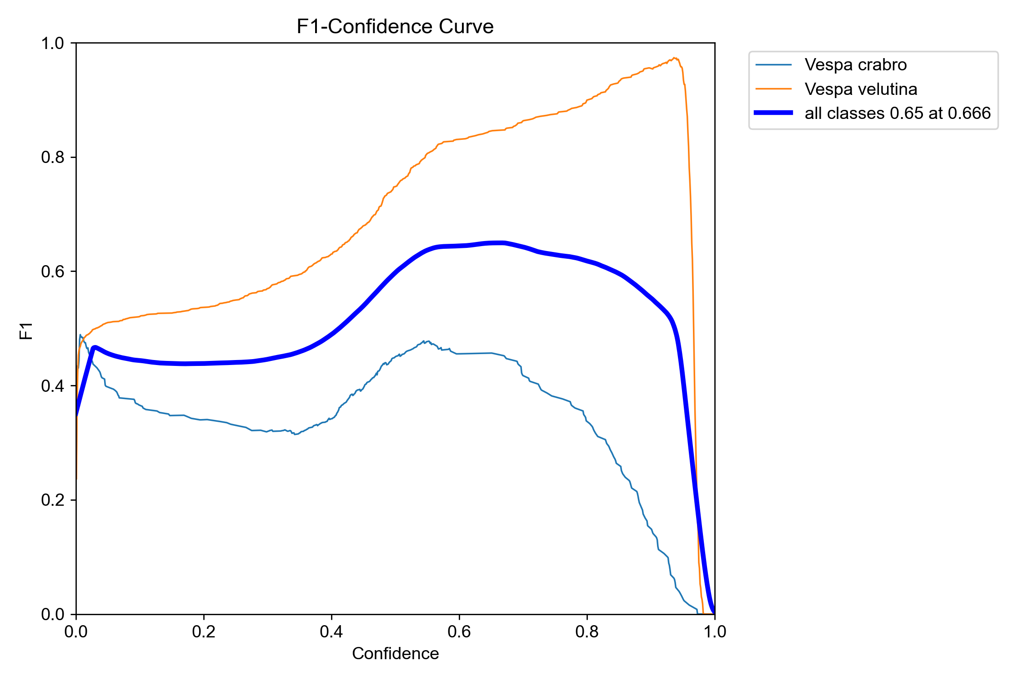
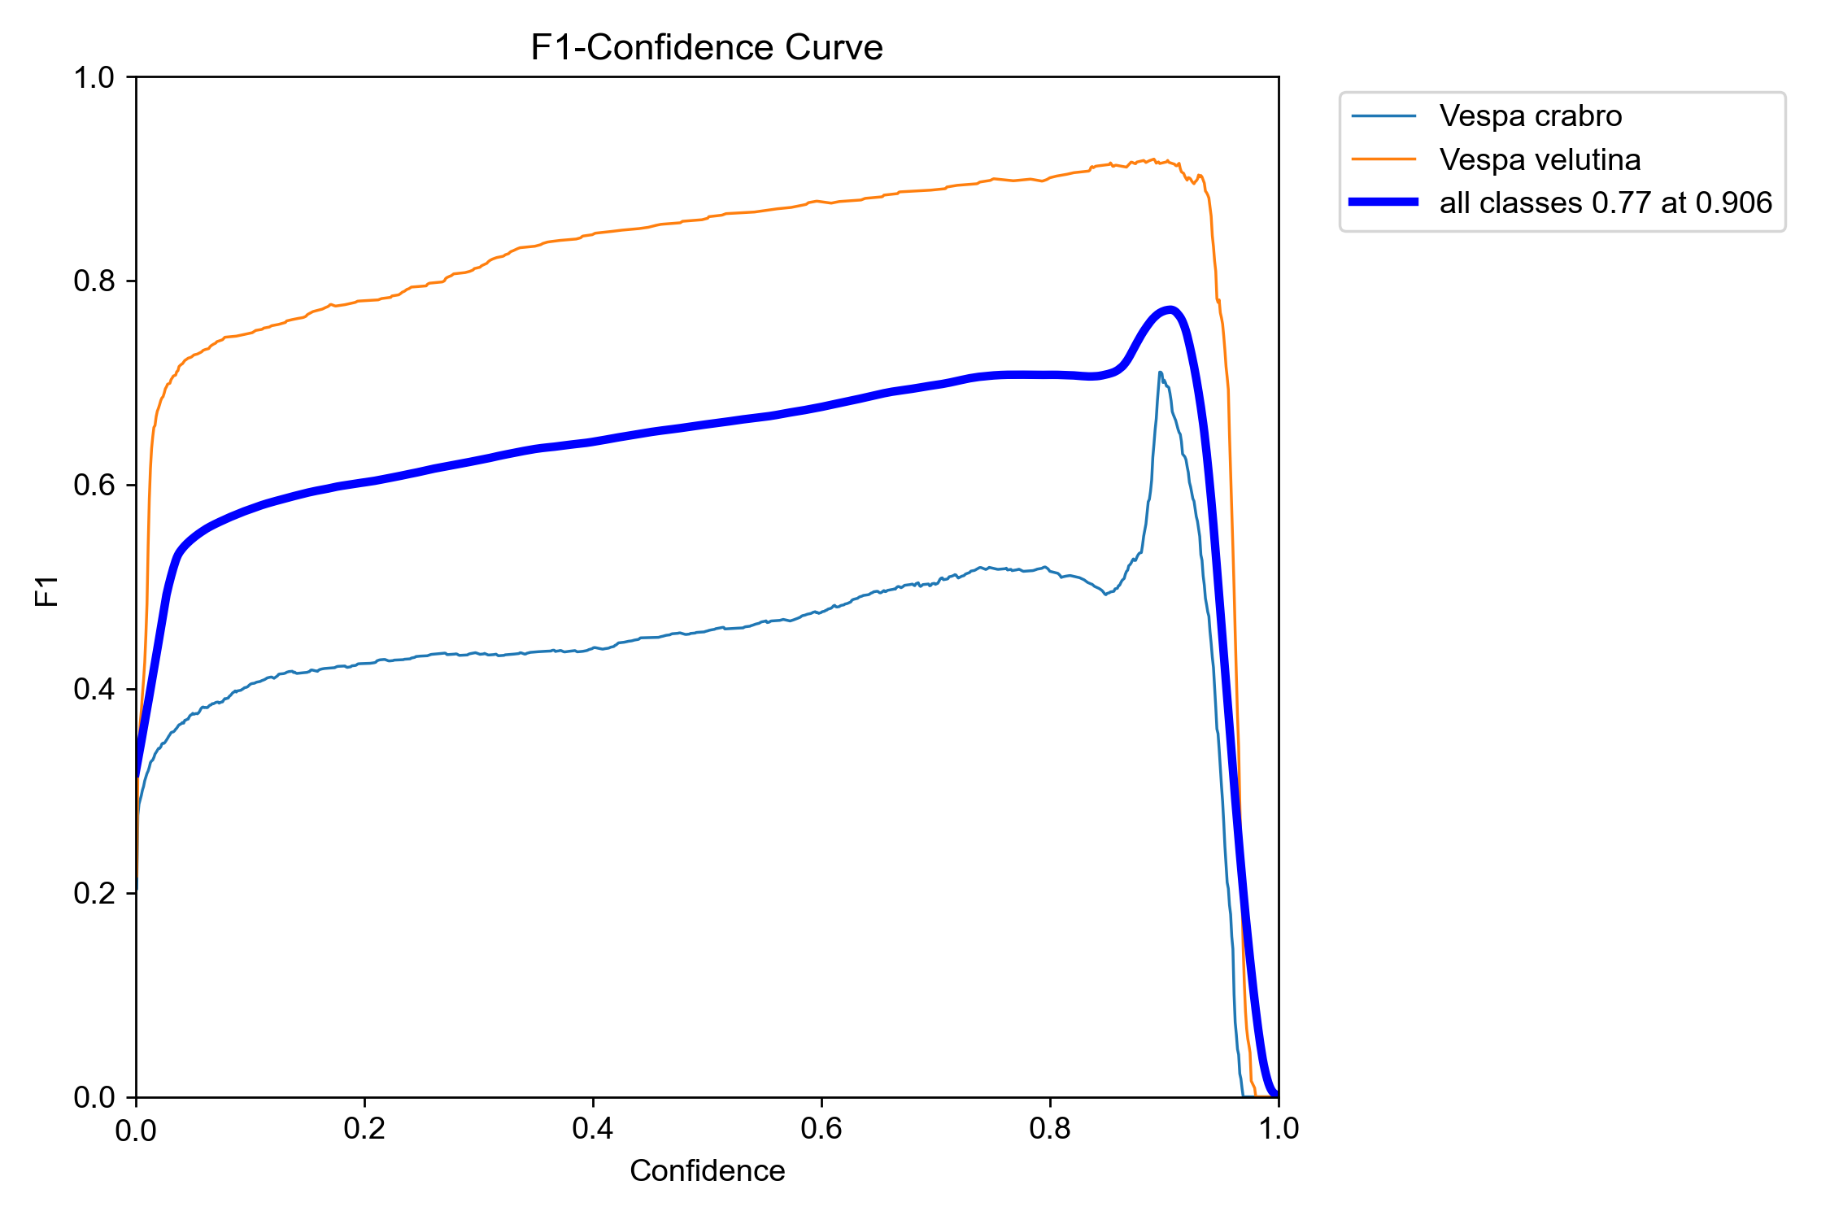
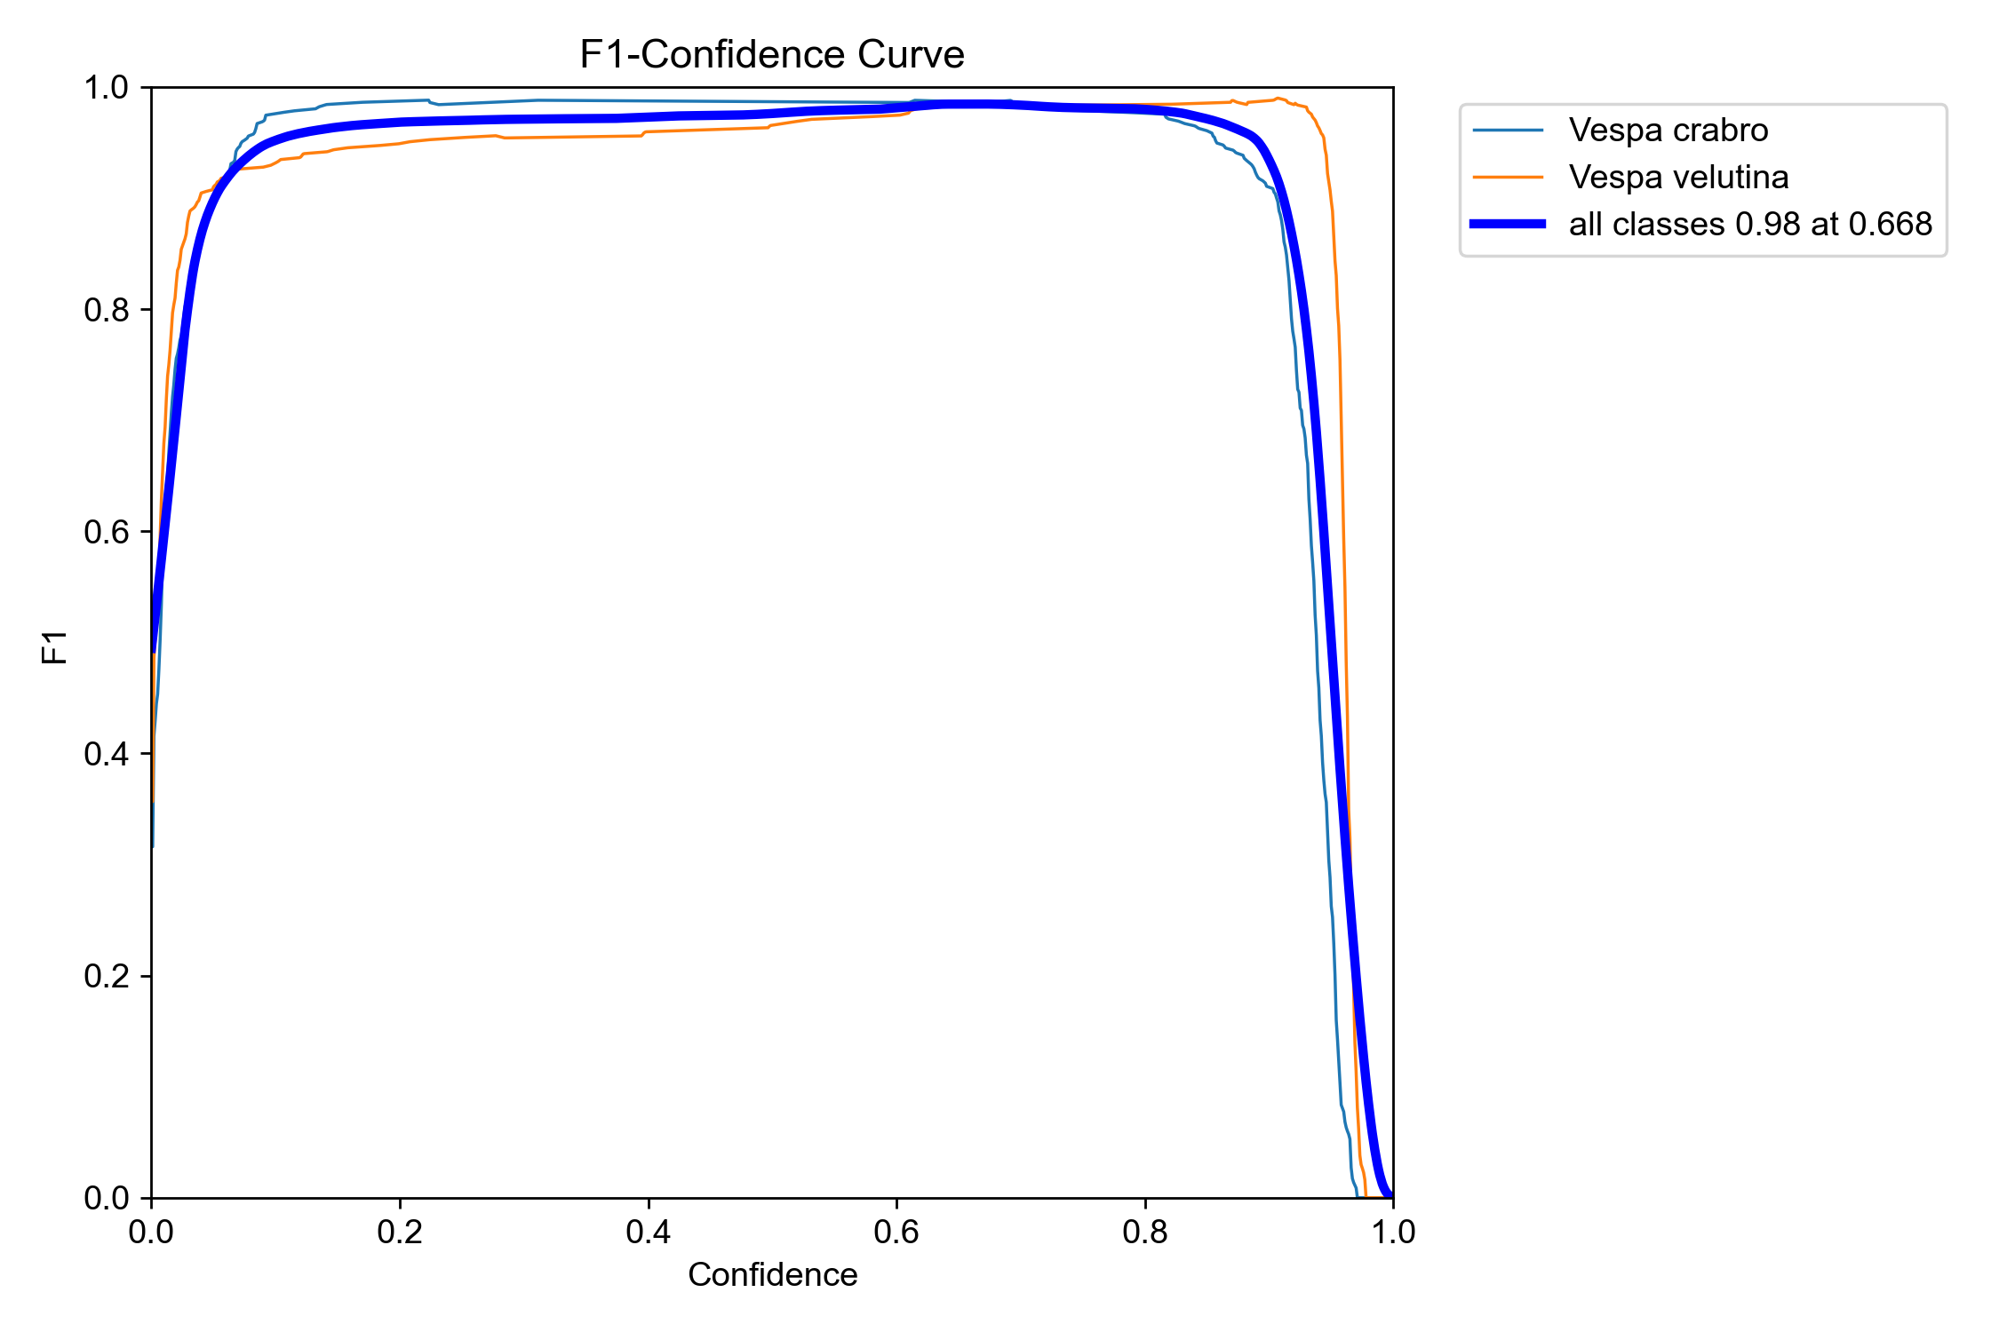
2021 Hornets-only on 2022 data
21h00 [285 images]
21h0 [1698 images]
21h [2147 images]

Slide 10
Inclusion of IPs in training data
21h (no IPs)
21all (with IPs)
“Including IPs in the training data set improves precision at lower thresholds, whilst seemingly reduces the model recall at high thresholds.”

Slide 11
Insect Pollutants
“Let’s consider the performance of hornet-only trained 2021 models on unseen insect pollutant data.”

Slide 12
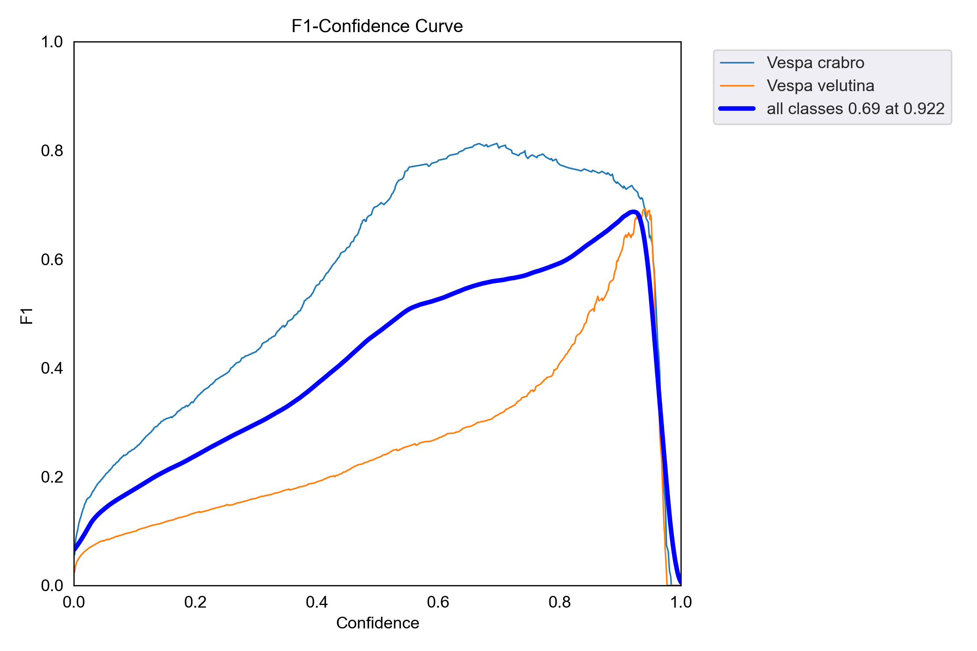
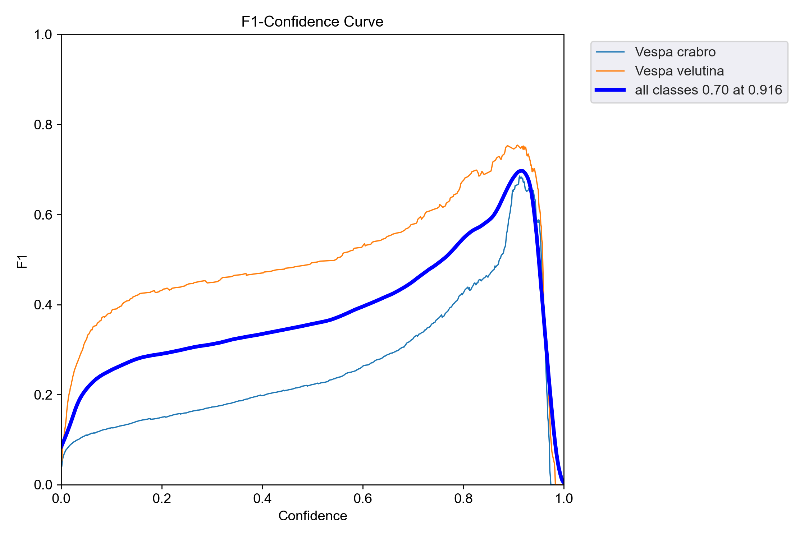
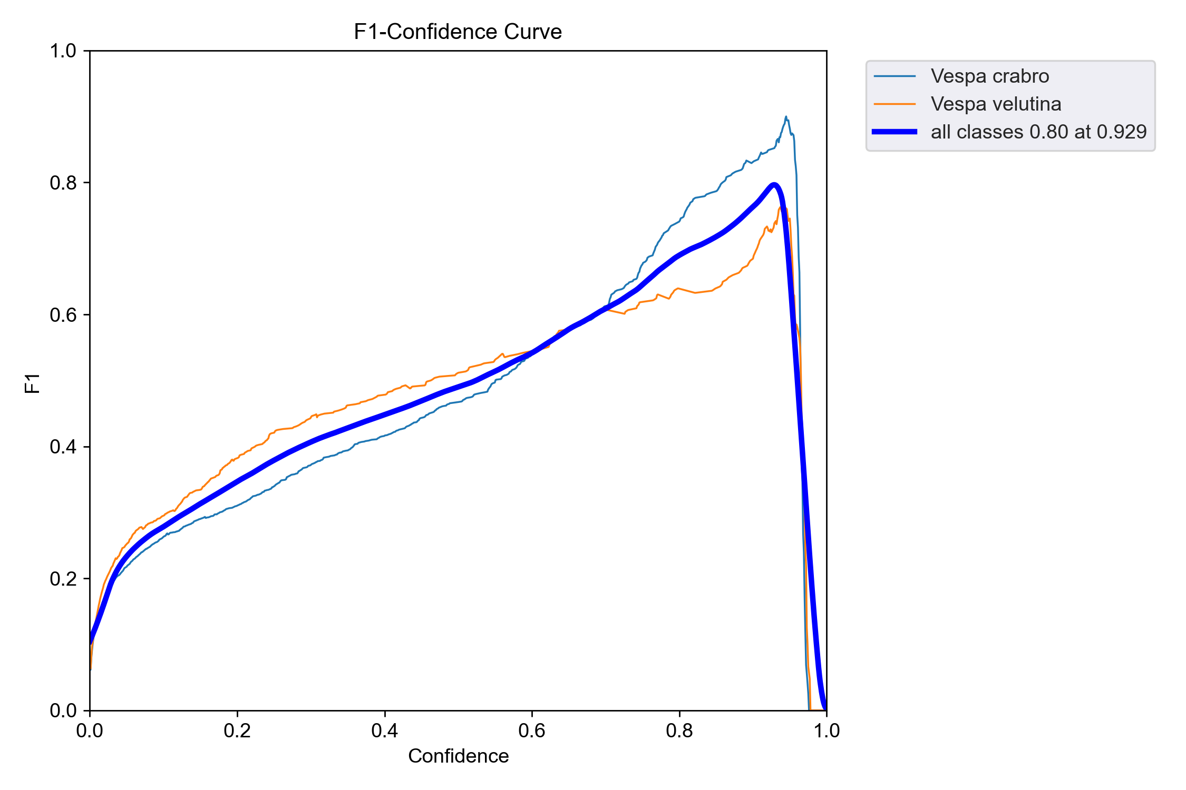
2021 Hornets-only on IP data
21h00 [285 images]
21h0 [1698 images]
all-hornets [2580 images]
“Not very impressive.”

Slide 13
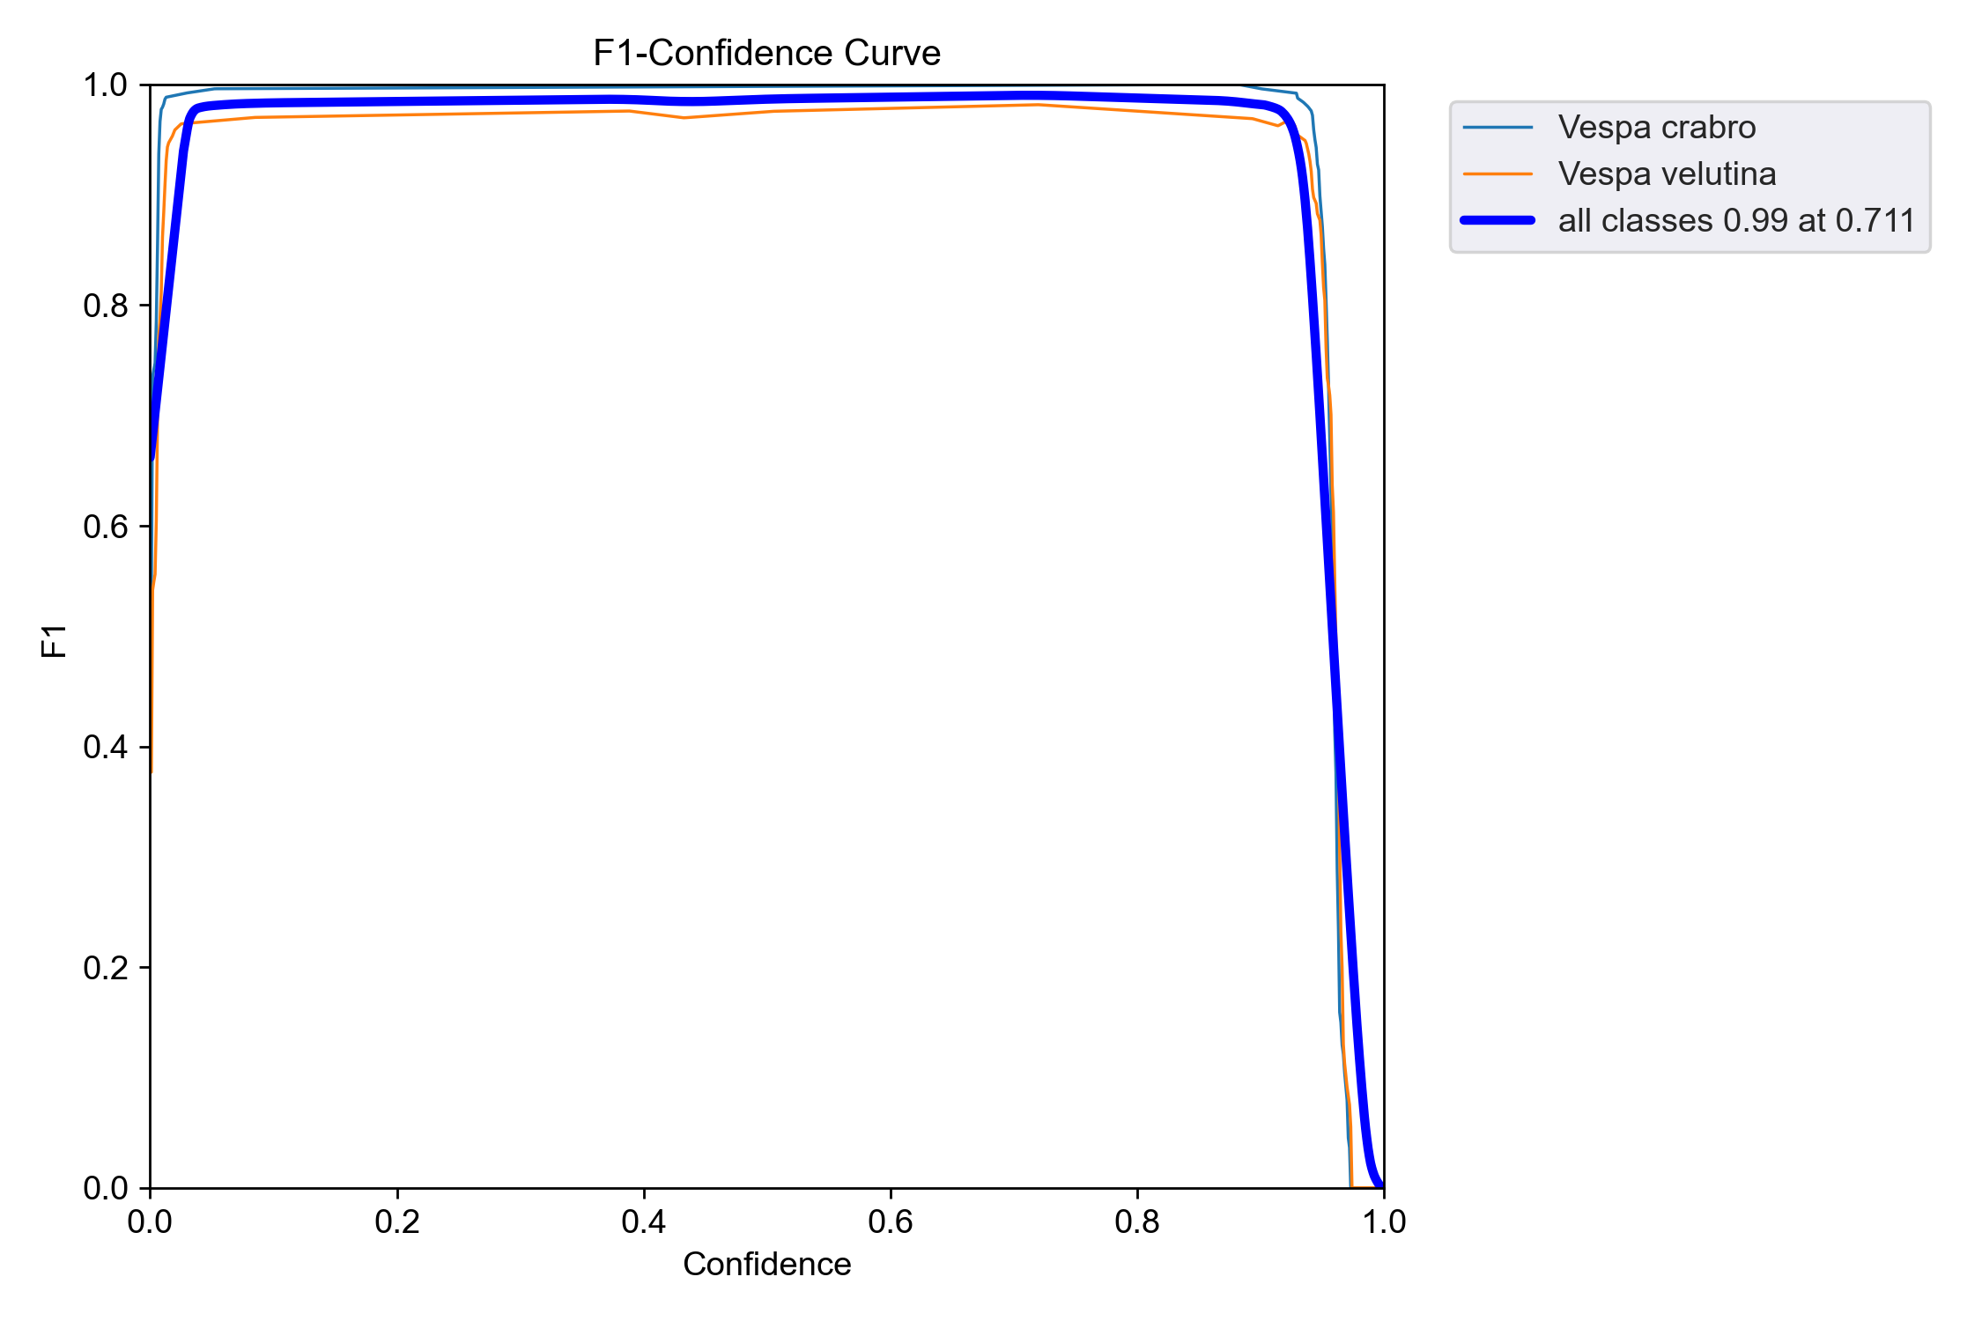
Throw in the IP data into training
all-hornets [2580 images]
all-data [3302 images]

Slide 14
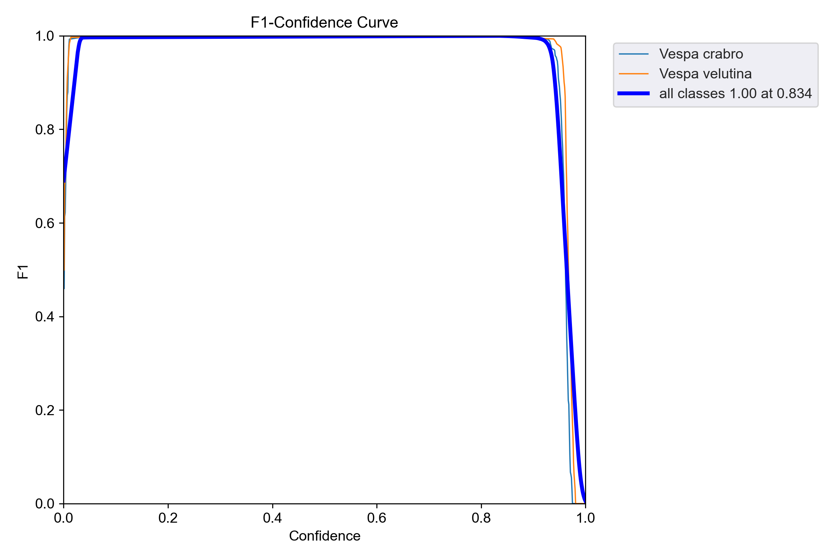
Remove the 2022 IPs (mainly blanks/wasps)
all-but-22ip
all-data
“It seems as though the model improves upon removing 2022 IP data. However, the right-hand curve is a more realistic performance curve, indicating a better representation has been learnt.”

Slide 15
Gotchas
“A note on bait station design.”

Slide 16
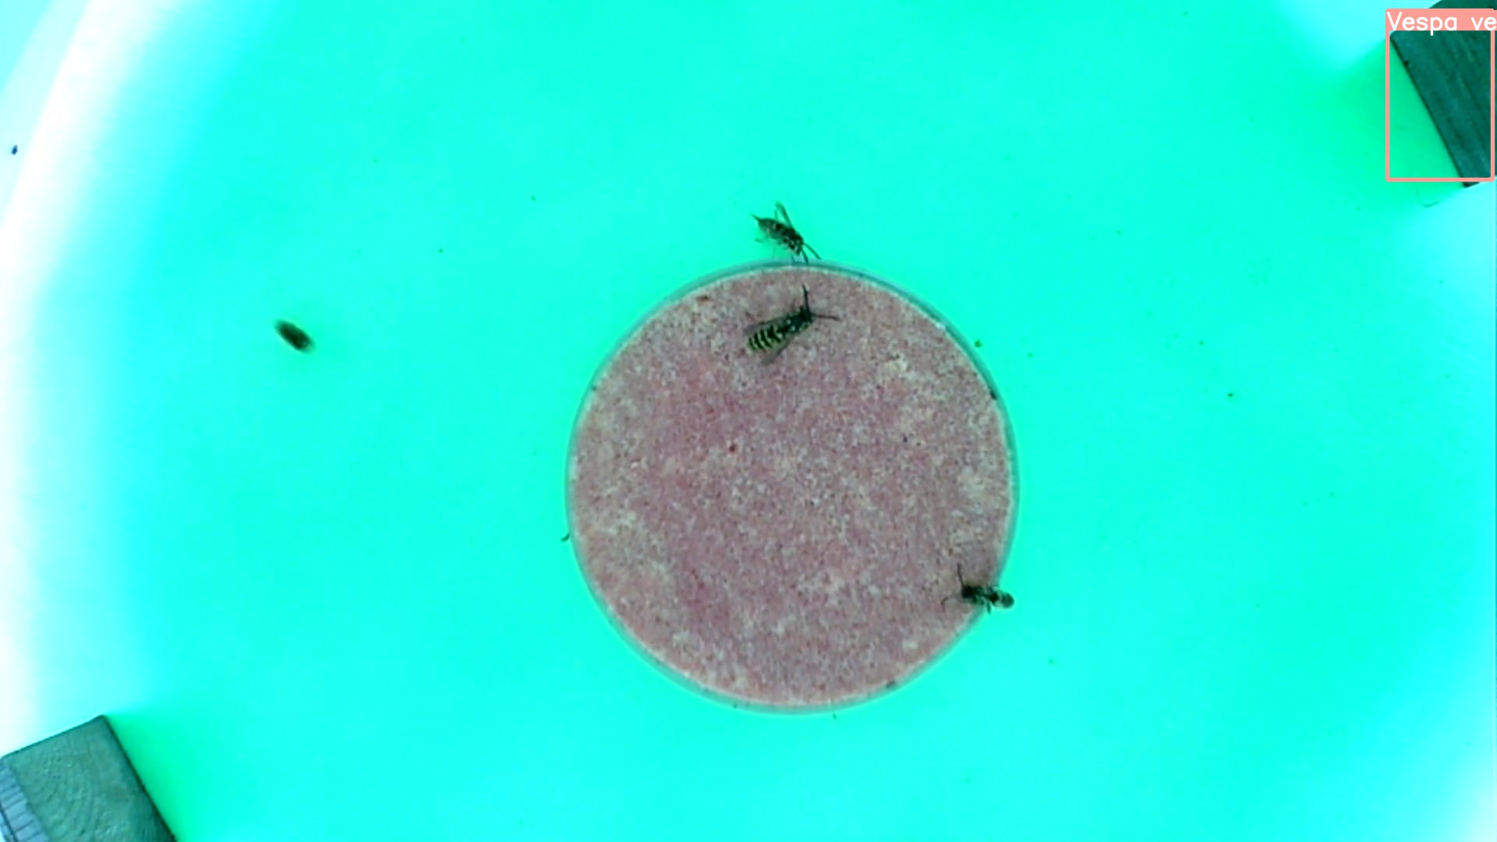
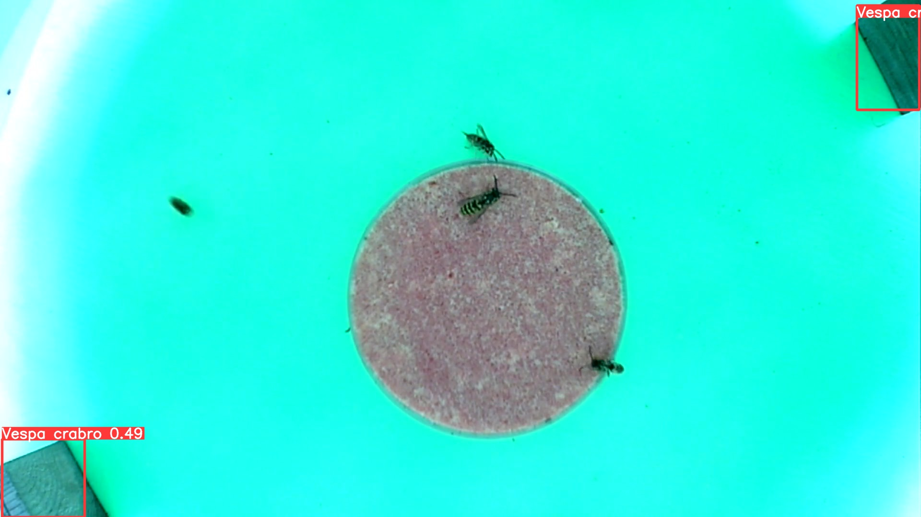
Example of false positives
Model: 21h00
Model: 21h0
We think the wooden posts are hornets
None of the ‘more data’ models mistook this
Train models on data from new bait stations

Slide 17
End on some good news

Slide 18
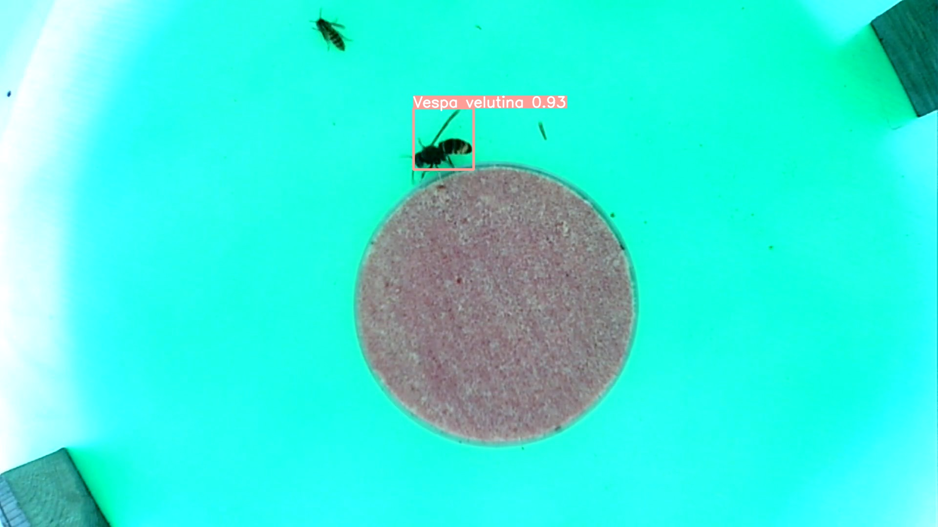
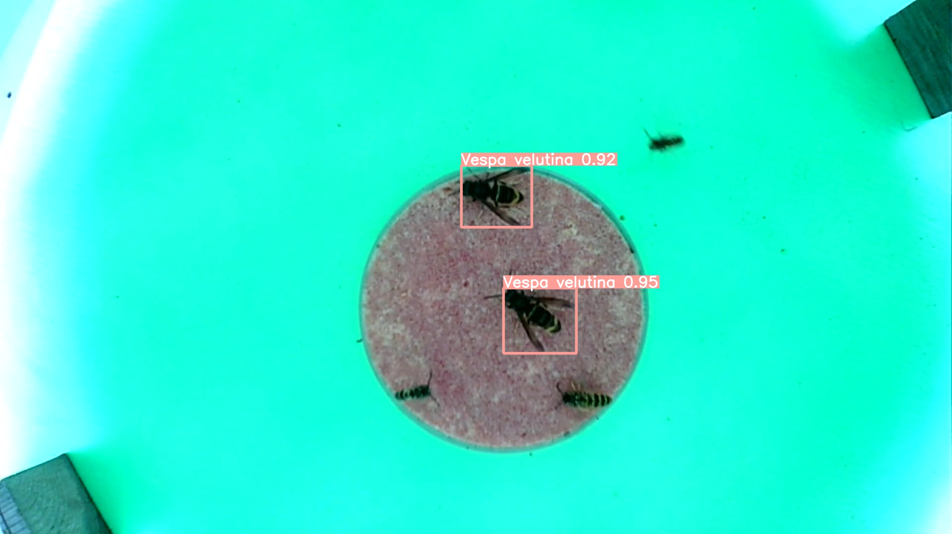
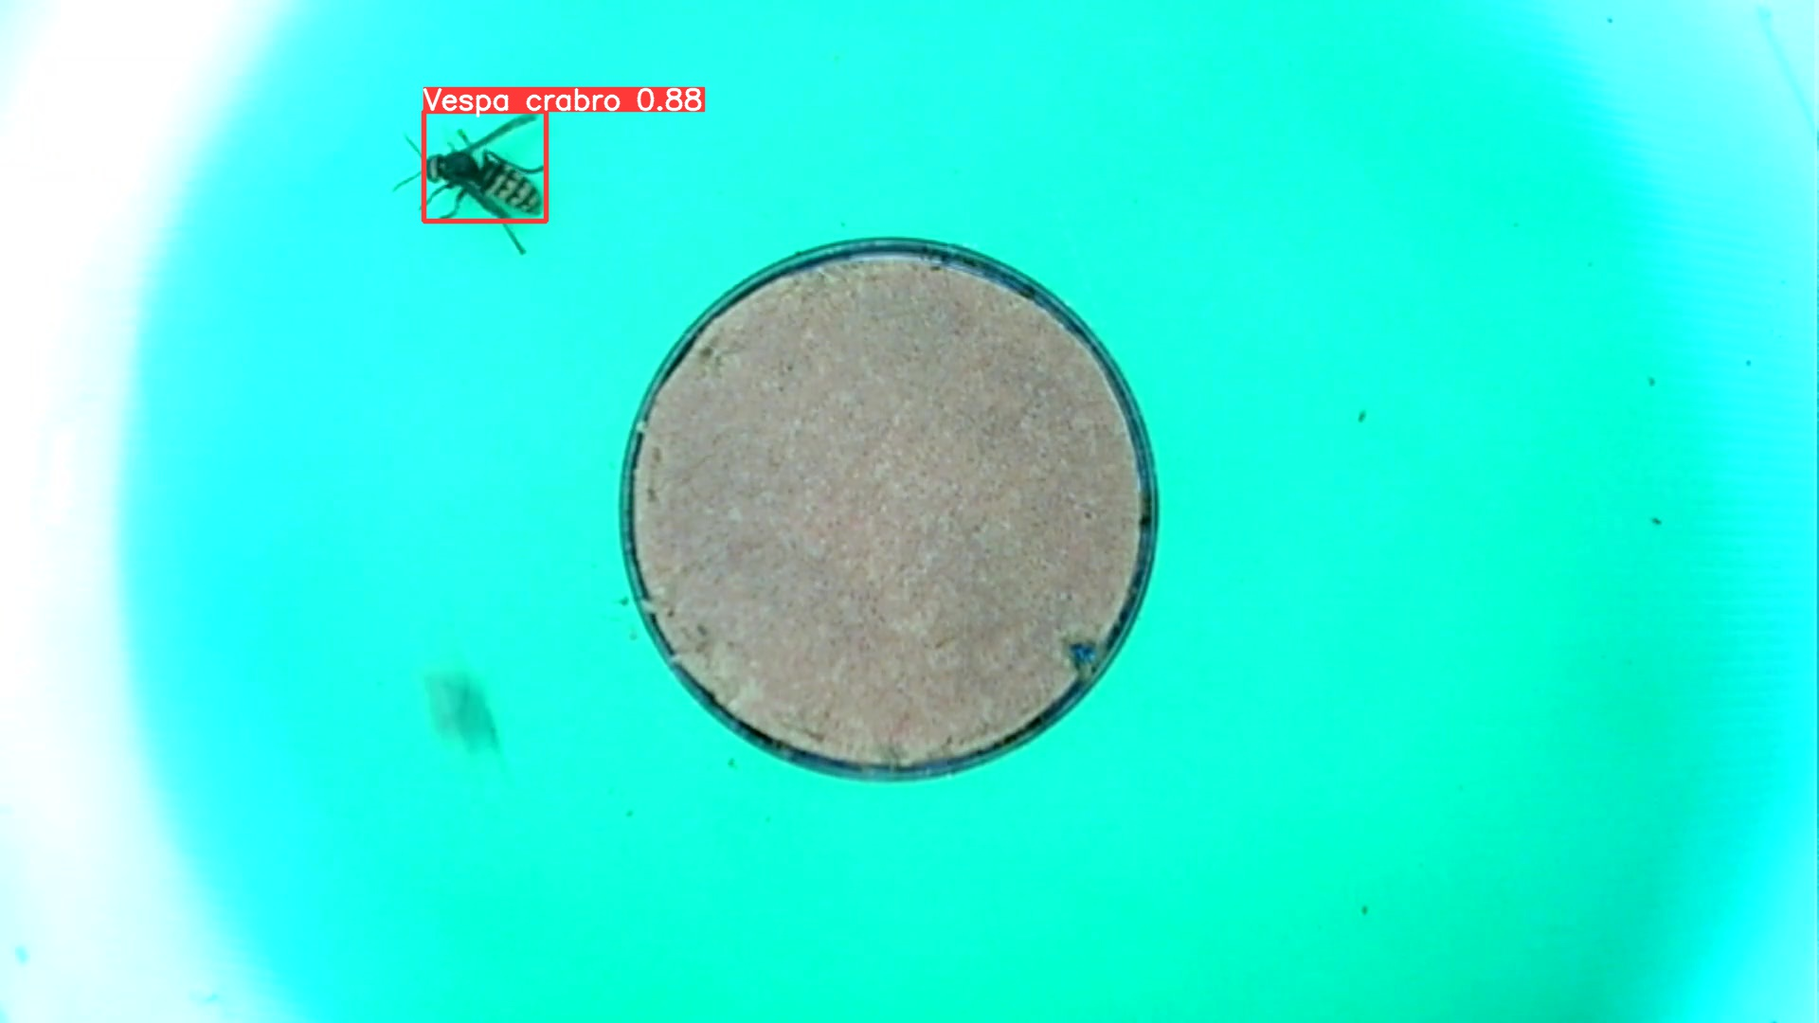
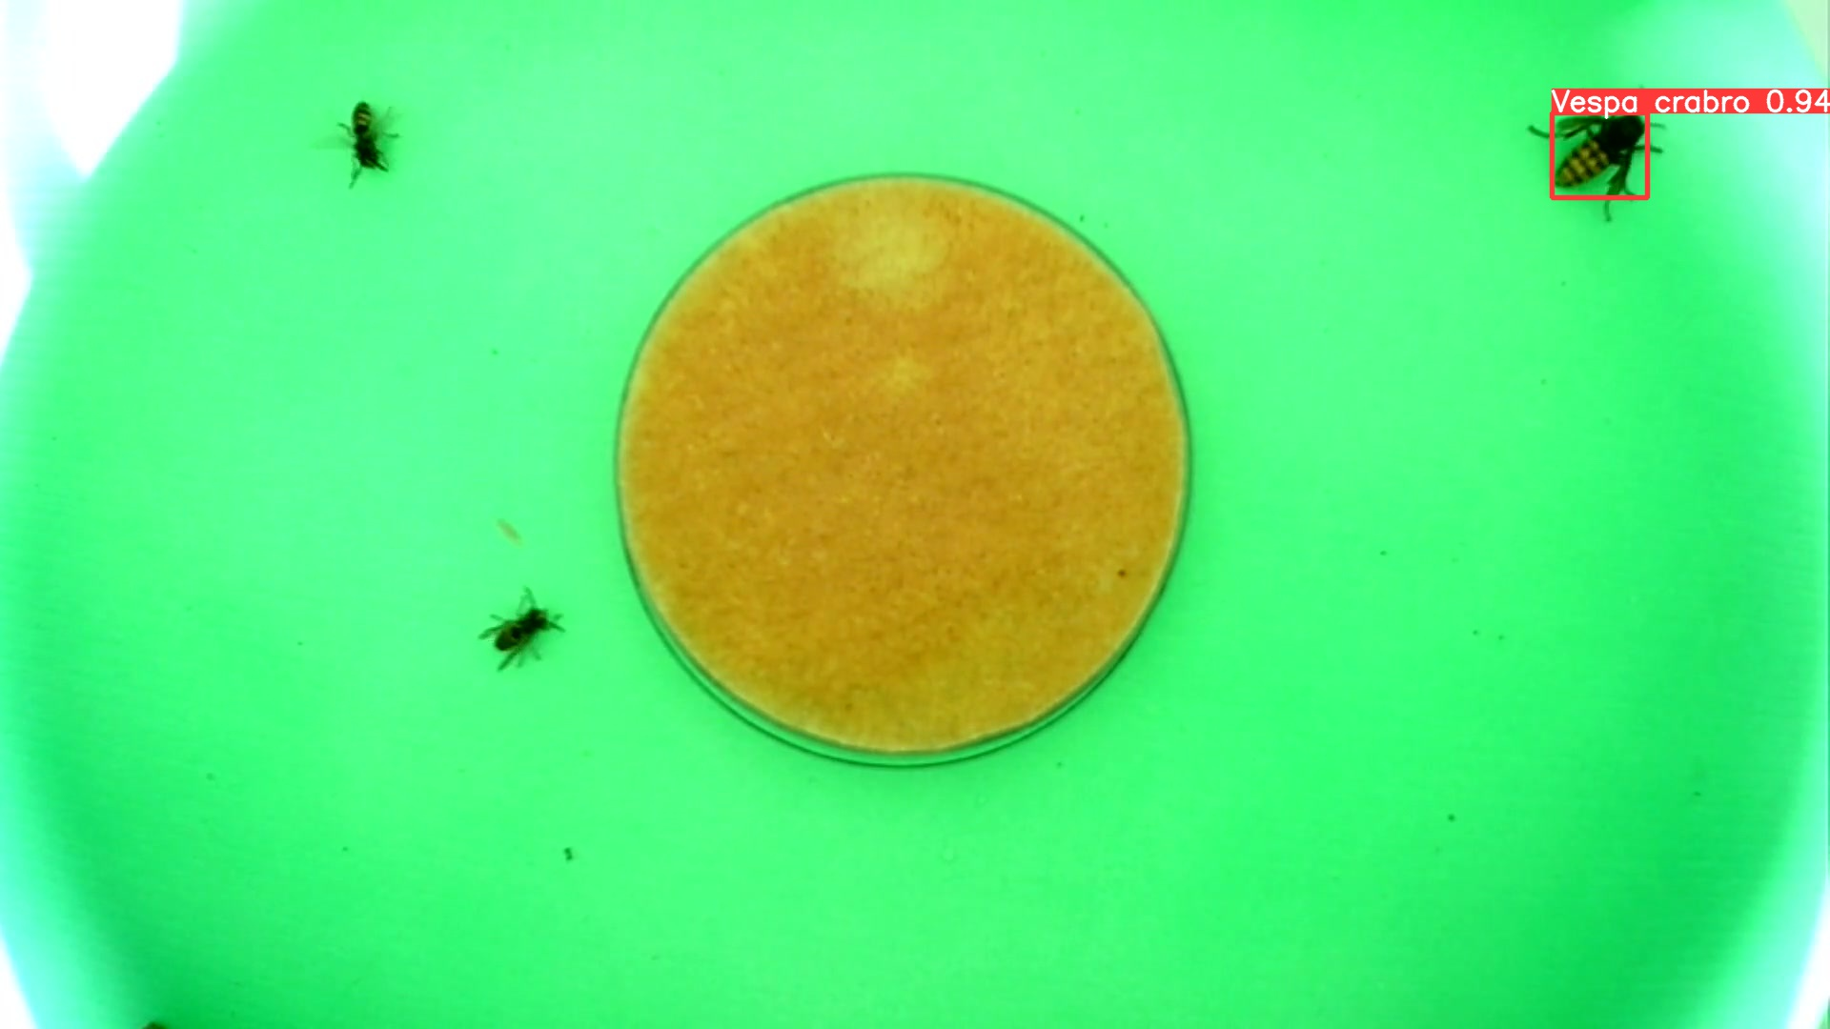
Detecting 2022 (unseen) hornets with a 2021 trained model.

Slide 19
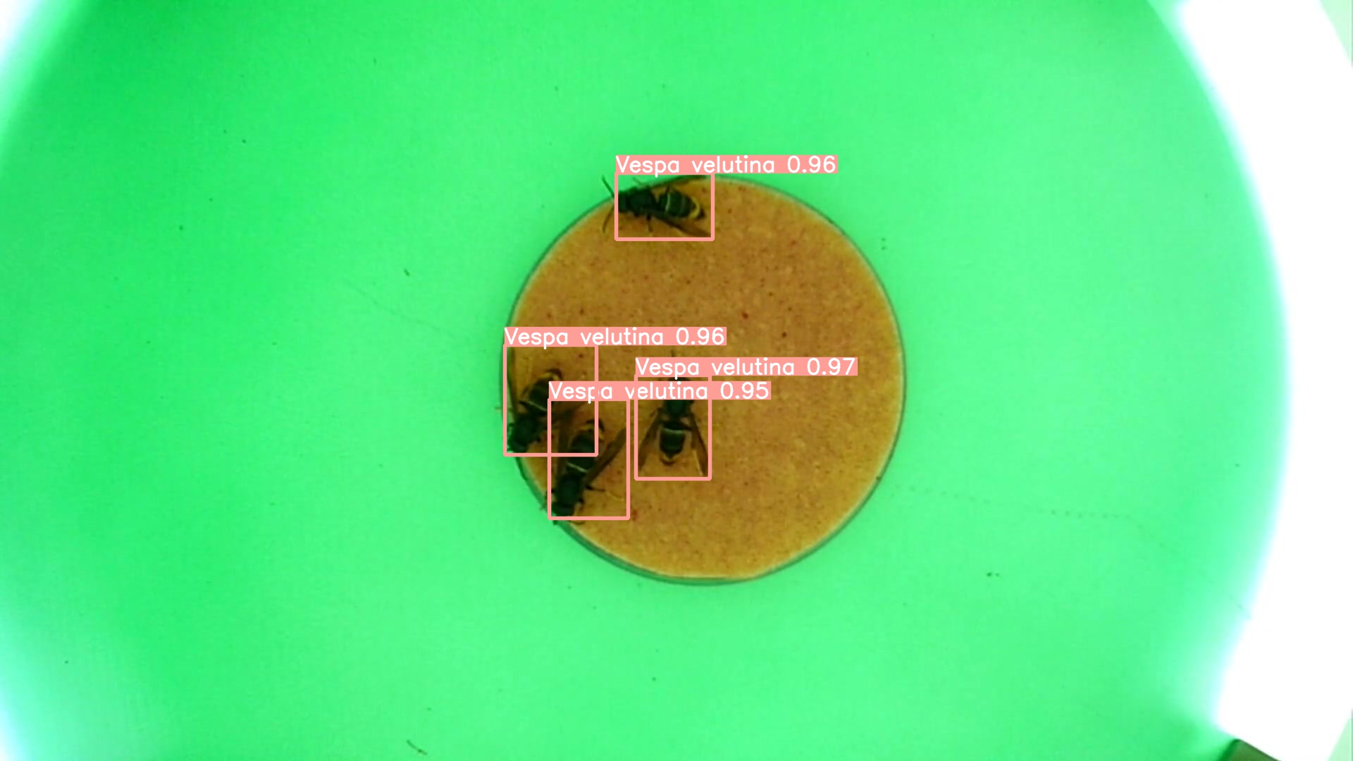
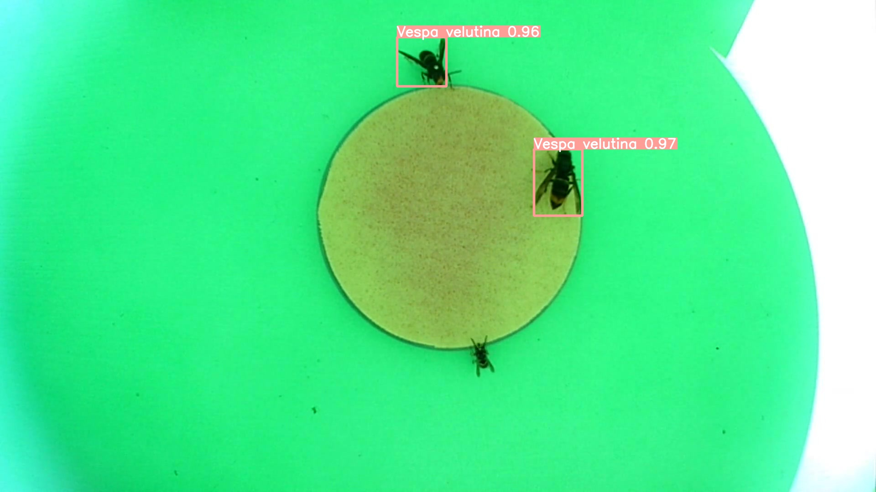
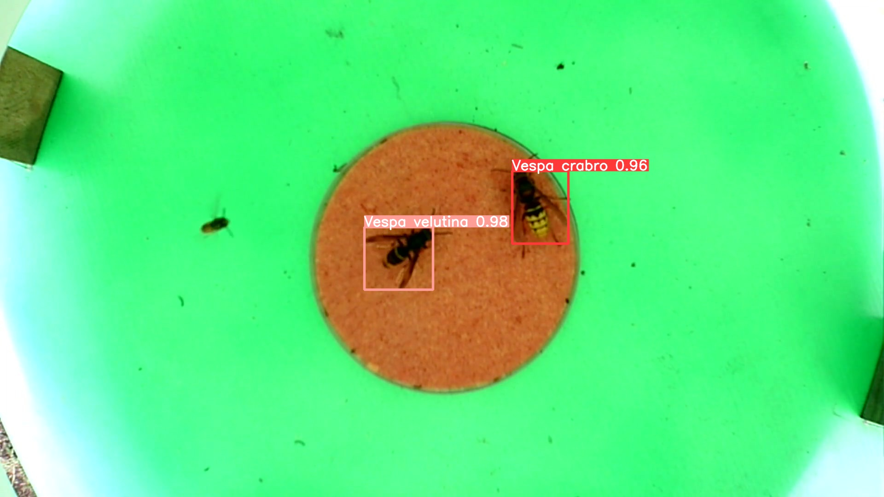
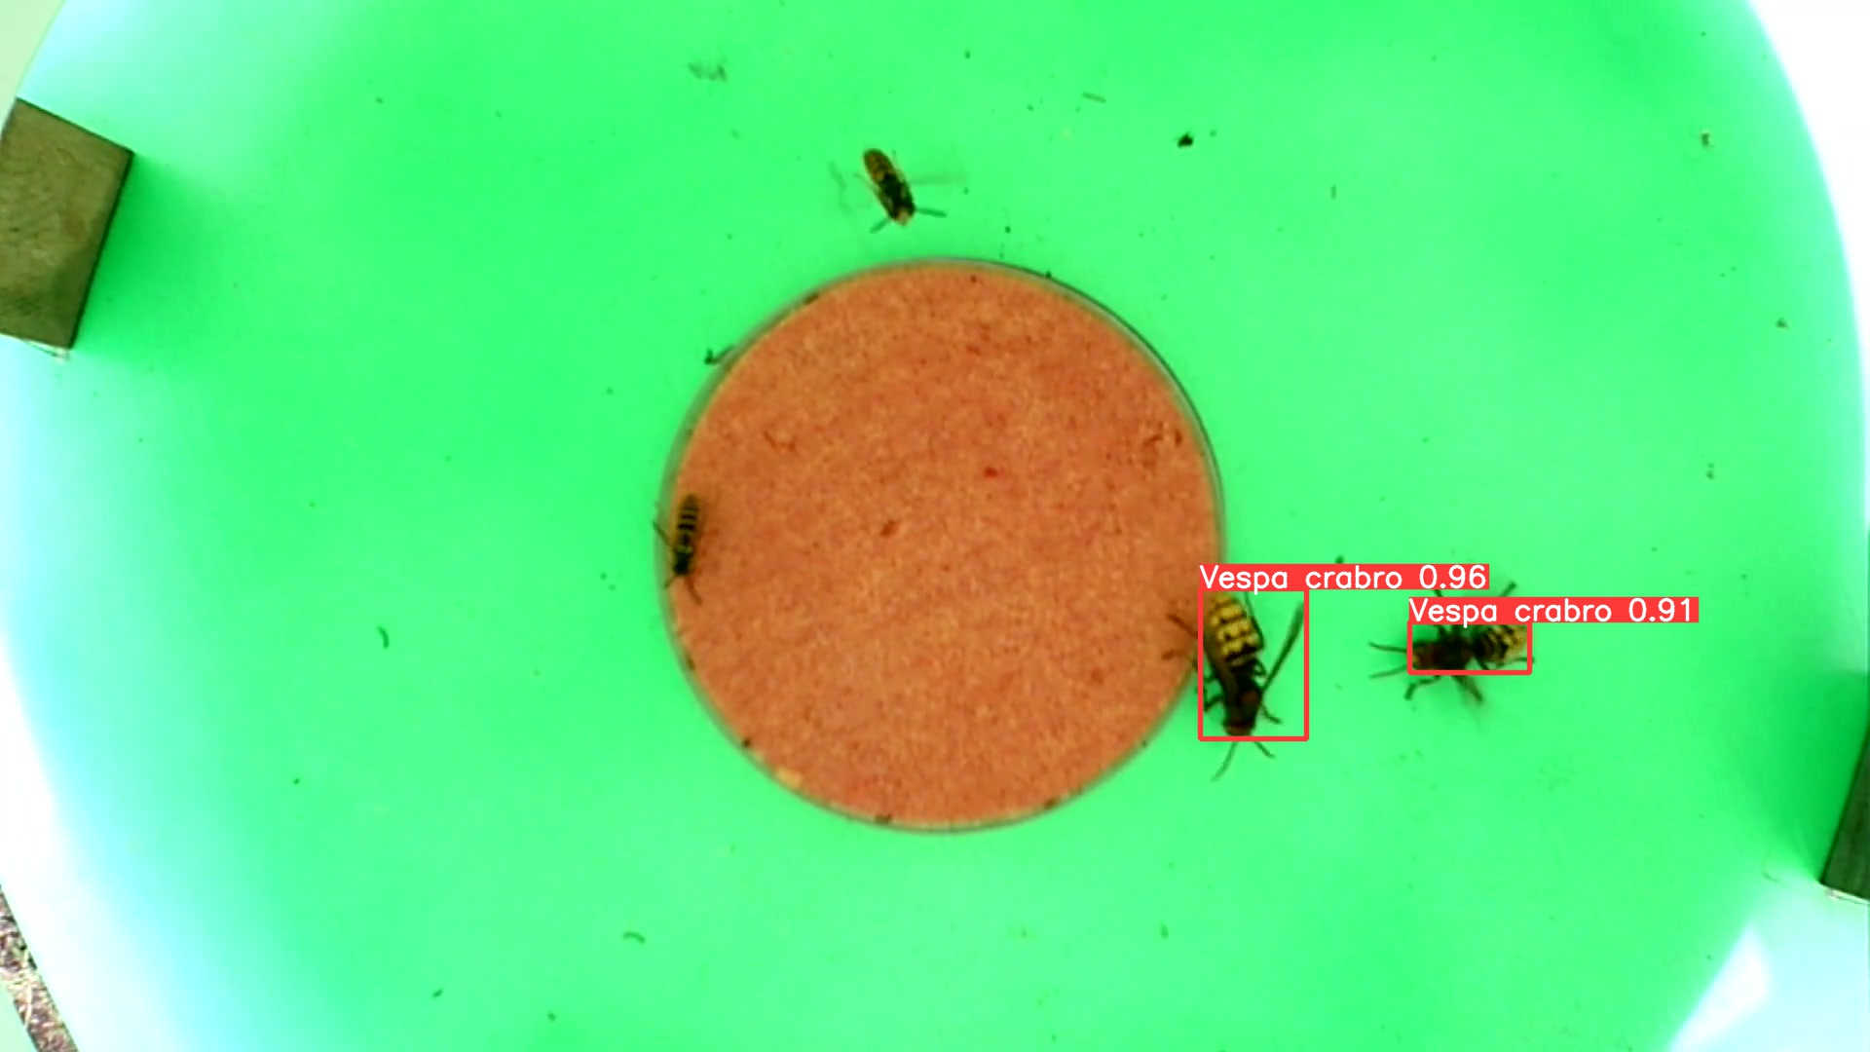
Detecting insect pollutants from 2021 (unseen) with 2021 hornet only model.

