Slide 1
CADFit++ v2: execution-verified CAD delivery
Update, Oct 23 2026
Mesh -> CadQuery program reverse engineering
All numbers are on the 60-part development cohort; the 300-part held-out run (fresh2) comes after the external review on Oct 24

Slide 2
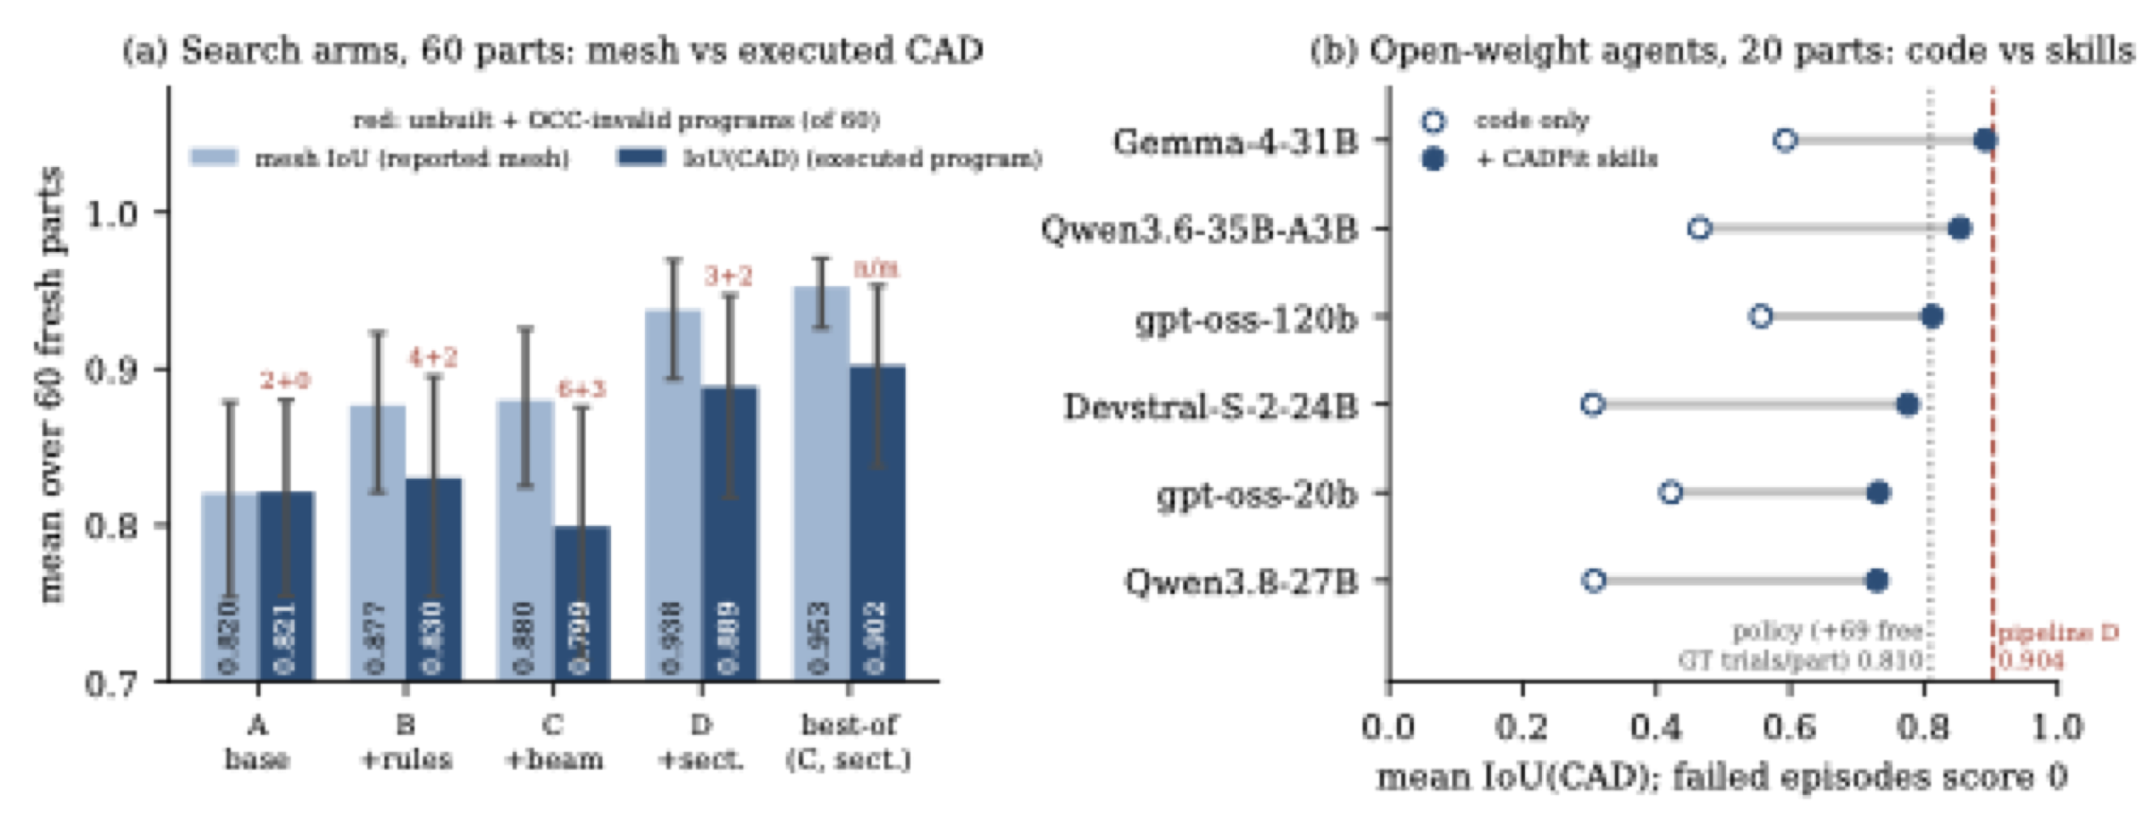
Why validity matters: mesh IoU hides failed CAD (pre-v2 pipeline)
(a) Pre-v2 search arms: the reported mesh scores well while the executed program is unbuilt or OCC-invalid (red counts)
(b) Open-weight agents: CADFit skills vs code-only tools (pre-v2 tools and harness)

Slide 3
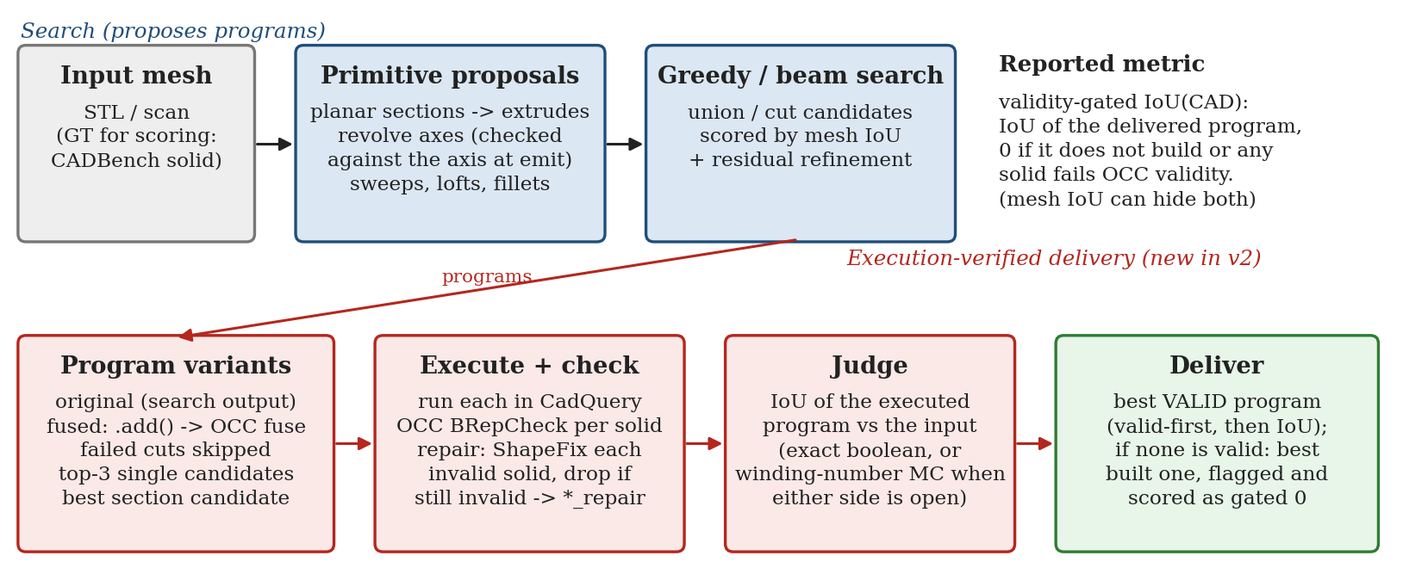
v2: run the programs, deliver the best valid one
Each candidate program is executed; every solid is checked with OCC BRepCheck
Invalid solids are repaired (ShapeFix) or dropped; overlapping .add() bodies are fused
Metric: validity-gated IoU(CAD) = IoU of the delivered program, 0 if it does not build or is invalid

Slide 4
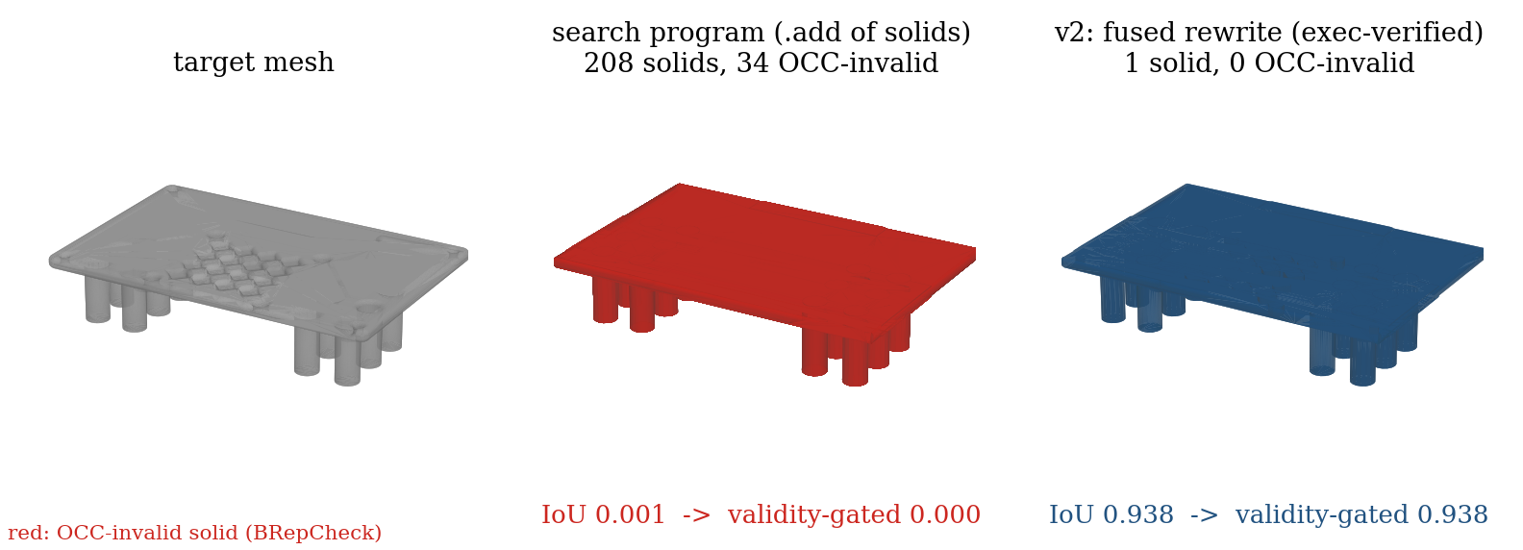
Example: fusing overlapping solids (part 00642725)
The search program stacks 208 solids with .add(); 34 are OCC-invalid and the result is not one solid
v2 executes the fused rewrite: one valid solid, IoU 0.938

Slide 5
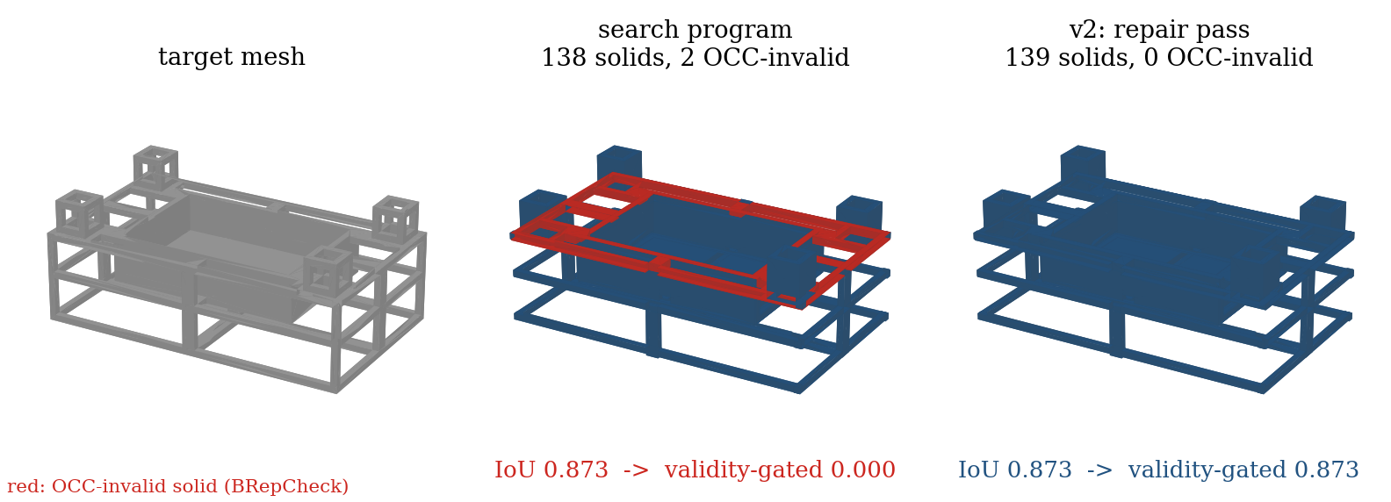
Example: repairing invalid solids (part 00232213)
2 of 138 solids fail OCC validity, so the program scores 0 under the gate
The repair pass fixes them: same geometry, valid, IoU 0.873

Slide 6
Development results (60 parts, dev4 run)
Validity-gated IoU(CAD): pre-v2 code 0.808 -> v2 0.949
Paired gain +0.141, 95% CI [+0.062, +0.233], 13 parts better / 2 worse, Holm-corrected p < 0.001
Invalid or missing deliveries: 8 -> 1
Most of the gain is avoiding zeros: on parts both versions build validly, the gain is +0.035
Fixes after round-1 review: +0.037, p = 0.10 after correction (suggestive only)
Since then fixed: an out-of-memory part that killed neighbouring jobs, and a judge error on non-watertight targets
Clean re-run (dev5) with all fixes is in progress; results chart to follow

Slide 7
Related work and next steps
Closest work: CADFather (arXiv 2610.09127, Oct 6): an agent that executes candidates and keeps the best valid one
It has no repair step and no OCC B-rep validity check; MIRAGE-CAD reports 55-70% build success, so validity is the bottleneck
Our angle: OCC validity + repair, and a controlled study of agent toolsets under matched budgets
Next: external review (Oct 24), then the 300-part held-out run for the pipeline and the open-weight agents
Questions: is this angle enough against CADFather? Target venue? Run CADFather head-to-head on CADBench?

