Slide 1
Sistem Remunerasi di Rumah Sakit
Disampaikan oleh:
Rini Juni Astuti, SE, M.Si
08122693656
rini_herlambang@yahoo.com

Slide 2
Paradigma Baru Pelayanan Kesehatan
Patient Loyalty
Patient Satisfaction
Patient Safety
Service
excellent/
Performance
kecepatan tindakan
Keterpaduan
Keakuratan
Kenyamanan
Corporate &
Clinical
governance
Ketepatan diagnosis
Sistem Kompensasi
Yang fair dan efektif

Slide 3
Millenium Management
Punishment area
Reward area
bankrupt
Financial
Performance
New investment
Costumer Satisfaction
Payer and investor
Killer
Productivity
Business Process
Complexity
Human Resource
Knowledge worker
Behavior

Slide 4
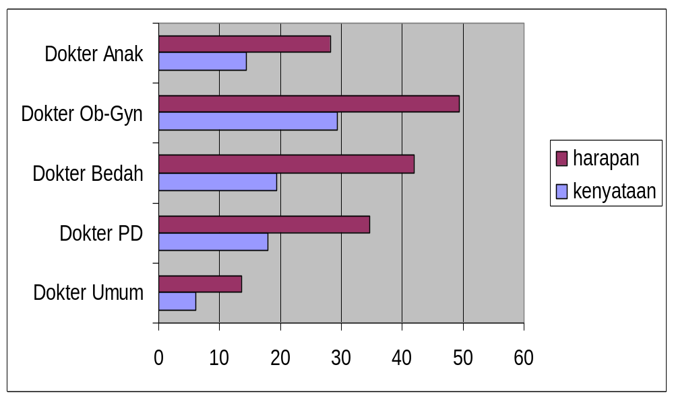
Gap Harapan dan Kenyataan

Slide 5
Cluster Tenaga Kesehatan RS
SDM Medis
SDM Non-Medis
Dokter, Perawat, Bidan, dll 1 | RM 3
Direktur, Ka Instalasi, SPI, dll - 2 | Keuangan, SIM, SDM, dll 4
Teknis Medis
Administrasi

Slide 6
ORGANISASI RUMAH SAKIT
(Mintzberg, 1990)
OPERATING CORE
(Instalasi, Staf Medis Fungsional, Staf Paramedis Fungsional)
TECHNO-
STRUCTURE
Komite Medik,
Komite
Keperawatan
MANAGER
MADYA
Wadir
Subbid,
Subbag
SUPPORT
STAFF
Administrasi,
Keuangan,
Personalia,
IPSRS, Laundry,
CS, CM, SIM
PKMRS, Farmasi,
Gizi, Diklat
TOP MANAGER
Direktur

Slide 7
The Deals
HIGHLY PAID- LOW COMMITMENT | LOW PAID- LOW COMMITMENT
HIGH PAID (?) HIGH COMMITMENT | LOW PAID HIGH COMMITMENT (?)
TRANSACTIONAL
Low----------------------------High
Low------------------------------High
RELATIONAL

Slide 8


Incentive Gap in Hospital
STRUKTURAL
PERAWAT
DOKTER
VIP
K I
K II
K III

Slide 9
Variasi Jasa Medis
Factors
TOOLS
RATER
Financing
System
Financing
System
Regulation
Financing
System
Regulation
Expectation
standard
Economic Scale
Competition
Performance
Criteria
Economic Scale
Competition
Economic Scale
Time

Slide 10
Arah ke Depan

Slide 11
The Main Concern:
loyalty
creativity
productivity

Slide 12
R-principles in HRM
Recruitment
Release
Retention
Kompensasi

Slide 13
Manajemen Kinerja
Performance
Pelayanan Administrasi
Pelayanan Klinik
Manajemen
SDM

Slide 14
Hospital Business Process
Accountability
Service excellent
Faster, Better,Cheaper, Newer
Operational cost
Cost
Cost
Training
Management
Morality,delivery,quality,safety,cost
Customer Loyalty
Owner, employee, patient
Readiness
Revenues
Benefits ?
Resources
Building, Instruments, Materials, Man power
Working capital & Fixed cost
Financing systems
Cost
Procurement
Recruitment

Slide 15
External
Tax system
Insurance
system
Tax system
Kebijakan JPSBK
Internal
Eficiency
Pendapatan
Financing Management
Resource allocation
Mutu Pelayanan
Manajemen Logistik
Stakeholder
Policy
Sarana/Prasarana
Manajemen
Organisasi
Manajemen
SDM
- Spesifikasi
Jabatan
HRU
- Persyaratan
Jabatan
- Dorongan
HRD
incentive
HRE
Kebijakan
Penempatan tenaga
Pola Karier
Kebijakan Organisasi

Slide 16
External
Tax system
Insurance
system
Tax system
Kebijakan JPSBK
Internal
Eficiency
Pendapatan
Financing Management
Reward systems
Kinerja Karyawan
Kesejahteraan Karyawan
Stakeholder
Policy
Sarana/Prasarana
Manajemen
Mutu pelayanan
Manajemen
SDM
- Spesifikasi
Jabatan
HRU
- Persyaratan
Jabatan
- Dorongan
HRD
HRE
Kebijakan
Penempatan SDM
Berbasis Kompetensi
Pola Karier
Kebijakan Organisasi RS

Slide 17






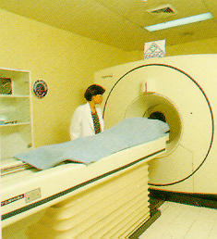

Kinerja Rumah Sakit:
SDM dan
Pembelajaran
Pengguna
Keuangan
Proses Pelayanan

Slide 18
Dasar Teori
RVU
RBRVS
STRATEGIC
POLICY
INCOME STRUCTURE
STRATEGIC OBJECTIVES
EFFICIENCY
ALIGNMENT
Work Analysis
Description
Evaluation/ Certification
INTERNAL STRUCTURE
Performance
Quality
Customer & Stockholders
Costs
COMPETITIVENESS
Market Definition
Surveys
Police Line
PAY/INCOMESTRUCTURE
CONTRIBUTORS
Seniority Based
Performance Based
Merit Guidelines
FAIRNESS
Planning
Communication
COMPLIANCE
ADMINISTRATION
Budgeting
EVALUATION

Slide 19
The Basic Thinking
1. Basic salary Safety
Gaji, Tunjangan, jasa
Tidak dipengaruhi oleh pendapatan RS
2. Incentives Motivation
Sangat dipengaruhi oleh pendapatan RS
3. Bonus Loyalty
Sangat dipengaruhi oleh keuntungan RS

Slide 20
Simple Formula
Interactional
Agenda
performance
I
I
= Motivation x Ability x Possibility
I
Individual agenda
Management
Agenda

Slide 21
Kinerja
Motivation x Ability
Performance =
Barrier
Insentif untuk
Manajemen

Slide 22
Apa yang diberikan?
Total Compensation
Intrinsic Rewards (non-monetary)
Job security
Status symbols
Social rewards
Task/self rewards
Extrinsic Rewards (monetary)
Direct Compensation
Indirect Compensation (Benefits)
. Basic Wage and Salary
Traditional pay plans
Skill-based pay plans
. Incentives
. Bonus
. Jasa Medik
. Merit system
Public protection (legally required)
social security
Unemployment
Medicare
Disability
Private protection
Pensions
Savings
Supplemental unployment
Insurance
Paid leave
On the job
Off the job
Life Cycle Benefits
Child care
elder care
Lifestyle change

Slide 23
Kepada Siapa?
Pemda?
COST CENTER
DIREKSI
ADMINISTRASI
KOMITE-KOMITE
REKAM MEDIK
REVENUE CENTER
IGD
RAWAT JALAN
RAWAT INAP
BEDAH CENTRAL
ICU
AMBULANS
PARKIR
TINDAKAN
RONTGENT
LABORATORIUM
REHAB MEDIK
APOTIK
KONSULTASI GIZI
JENAZAH
USAHA LAIN
PENUNJANG
NON MEDIS
PELAYANAN
MASYARAKAT PENGGUNA JASA R.S.

Slide 24
What to Compensate?
Kerja
Kinerja
Competence
Performance

Slide 25
Aplikasi
Besarnya take-home-pay sebanding dengan banyaknya job-description
Si Badu yang malas menerima penghargaan sama dengan si Arif yang rajin

Slide 26
INDEXING for ADMINISTRATIVE OFFICER,
NURSE AND OTHER OFFICER
1
Basic index
Ranking/working periode
2
Capacity index
Ability/Skills/education
3
Emergency index
Emergency Tasks
4
Risk index
Risks
5
Position index
Responsibility
6
Performance index
Accountability & Performance
7
Disiplin index
Loyality

Slide 27
Building Consensus
Delphy Technique
Nominal Group Technique

Slide 28

Consensus

Slide 29
Contoh sistem Pembagian Jasa Pelayanan
Jasa IGD
10%
Hak pelaksana langsung
paramedis, sopir, dan tenaga lainnya
yang langsung menghasilkan uang
Jasa Rawat Inap
Jasa Rawat Jalan
Jasa Bedah Sentral
Jasa Radiologi
60%
Depot
Kebersamaan paramedik &nonmedik
(Disini dilakukan indexing)
Jasa Laboratorium
Jasa Ambulans
Jasa Pemulasaraan
25%
Manajemen Fee,
5%
Biaya Umum,
Bonus, Biaya Pembinaan.
Jasa Konsultasi gizi
Jasa Rehabilitasi Medik
Jasa Anestesi

Slide 30
Contoh Sistem Pembagian Jasa Medik
60%
Hak pelaksana langsung
Spesialis, Dokter, Dokter Gigi,
yang langsung menghasilkan uang
Jasa IGD
Jasa Rawat Inap
Jasa Rawat Jalan
Jasa Bedah Sentral
10%
Depot
Kebersamaan antara staf medik
(Disini dilakukan Indexing)
Jasa Radiologi
Jasa Laboratorium
Jasa Ambulans
Jasa Rehabilitasi Medik
25%
Manajemen Fee,
5%
Biaya Umum,
Bonus dan Biaya Pembinaan.
Jasa Anestesi

