Slide 1
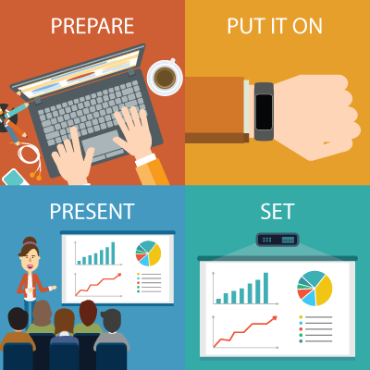
Presenterless PowerPoint

Slide 2

Presenterless PowerPoint

Slide 3

Changing slides the Old way – Slide 1
Static

Slide 4
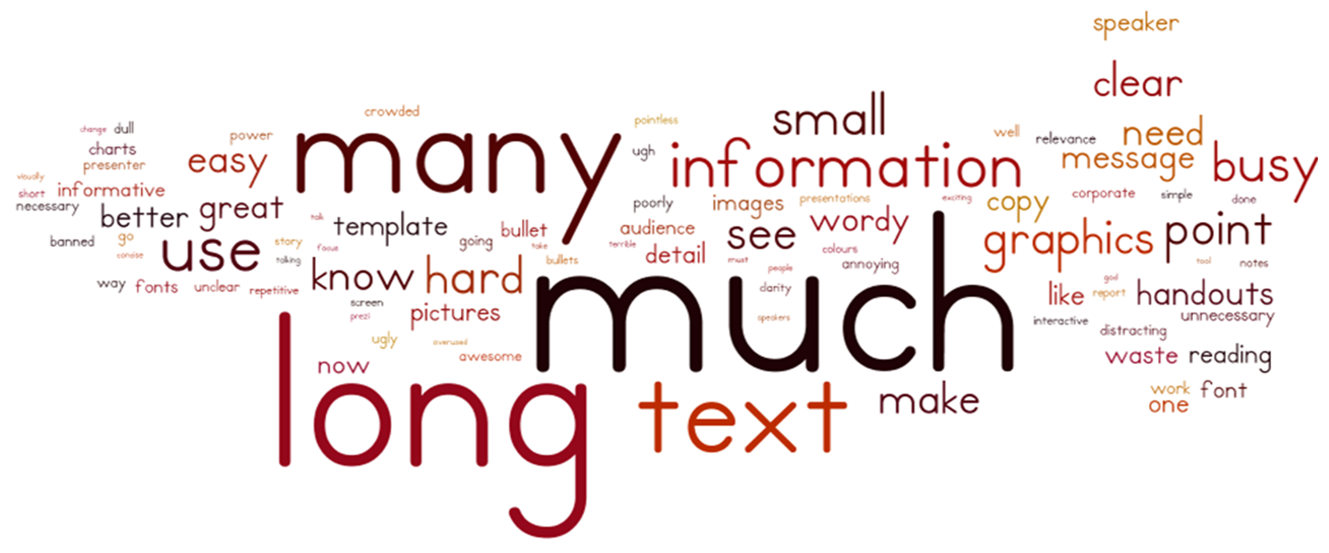
Changing slides the Old way – Slide 2
Unnatural

Slide 5
Changing slides the Old way – Slide 10000
Boring

Slide 6

Presenterless PowerPoint

Slide 7
Go Constantin Go
Slide Counter = 1

Slide 8
Slide Counter = 2

Slide 9
Slide Counter = 3

Slide 10
Slide Counter = 4

Slide 11
Slide Counter = 5

Slide 12
Slide Counter = 6

Slide 13
Slide Counter = 3000

Slide 14
Implementation details

Slide 15


Next steps - Making the detection better
Smooth, flip the page movement

Slide 16
Next steps - PowerPoint laser pointer
Point with finger and pointer should appear

Slide 17
Next steps – See how nervous you were
Track pulse and other information (Doctor)
Lie 1
Lie 2

Slide 18
Next steps - Counting calories burned ;)
How many slides can you flip per minute

Slide 19
Next steps - Removing the presenter
Only the band remains

Slide 20
Presenterless PowerPoint

