Slide 1


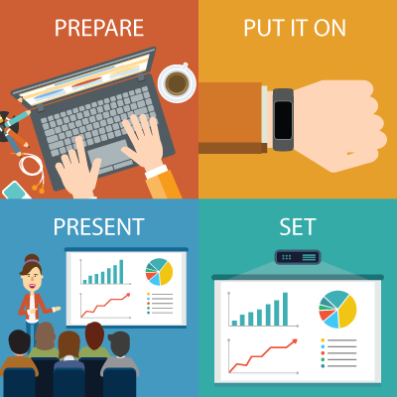
Presenterless PowerPoint

Slide 2

The Old Way

Slide 3
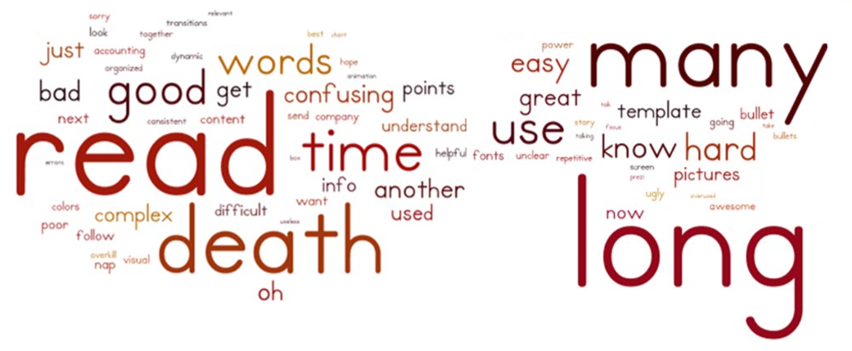
Static

Slide 4
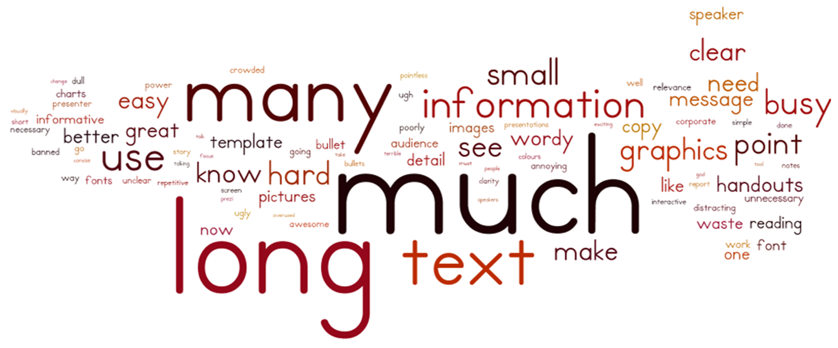
Unnatural

Slide 5
Boring

Slide 6

The New Way

Slide 7
GO GO GO

Slide 8
Slide Counter = 1

Slide 9
Slide Counter = 2

Slide 10
Slide Counter = 3

Slide 11
Slide Counter = 4

Slide 12
Slide Counter = 5

Slide 13
Slide Counter = 6

Slide 14
Slide Counter = 3000

Slide 15
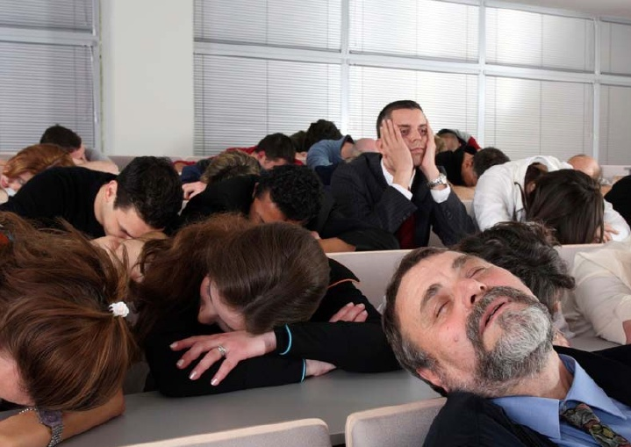
Implementation details
https://www.wolframcloud.com/objects/12542f59-8a80-4bf3-92a7-5bd0b5eb6321

Slide 16


Next steps – Better detection
Smooth “flip the page” movement

Slide 17
Next steps - PowerPoint laser pointer
Point with finger and pointer should appear

Slide 18
Next steps – See how nervous you were
Track pulse and other information (Doctor)
Lie 1
Lie 2

Slide 19
Next steps - Counting calories burned ;)
Flip the slides challenge

Slide 20
Next steps - Removing the presenter
Only the band remains

Slide 21
Thank You!

