Slide 1

Blackjack using Double Q-learning
and A2C with GAE(λ) (actor-critic)
Introduction to Reinforcement Learning
Warsaw, 22nd of January 2026
Piotr Radziszewski, Andrzej Żernaczuk

Slide 2
Game description
Environment: Gymnasium Blackjack-v1
The game starts with the dealer having one face up and one face down card, while the player has two face up cards. All cards are drawn from an infinite deck.
The card values are:
Face cards (Jack, Queen, King) have a point value of 10.
Aces can either count as 11 (called a ‘usable ace’) or 1.
Numerical cards (2-10) have a value equal to their number.
2
Piotr Radziszewski, Andrzej Żernaczuk

Slide 3
Game description cont’d
The player has the sum of cards held. The player can request additional cards (hit) until they decide to stop (stick) or exceed 21 (bust, immediate loss).
After the player sticks, the dealer reveals their facedown card and draws cards until their sum is 17 or greater. If the dealer goes bust, the player wins.
If neither the player nor the dealer busts, the outcome (win, lose, draw) is decided by whose sum is closer to 21.
3
Piotr Radziszewski, Andrzej Żernaczuk

Slide 4
Environment
Starting state:
Player current sum: {4, 5, …, 21}
Dealer showing card value: {1, 2, …, 10}
Usable Ace: {0, 1}
The observation consists of a 3-tuple containing: the player’s current sum, the value of the dealer’s one showing card (1-10 where 1 is ace), and whether the player holds a usable ace (0 or 1)
4
Piotr Radziszewski, Andrzej Żernaczuk

Slide 5
Environment cont’d
Actions:
0: Stick
1: Hit
Episode ends:
The player hits and the sum of hand exceeds 21.
The player sticks.
An ace will always be counted as usable (11) unless it busts
the player.
5
Piotr Radziszewski, Andrzej Żernaczuk

Slide 6
Training setup
We trained two different RL families on the same Blackjack environment to compare learning dynamics under identical rules.
DoubleQ: tabular TD control with epsilon‑greedy exploration and two Q‑tables to reduce overestimation bias.
A2C‑GAE: neural actor‑critic trained from rollouts; uses value estimates and advantages for stable policy updates.
Reward shaping is applied only during training; evaluation always uses the true environment reward.
6
Piotr Radziszewski, Andrzej Żernaczuk

Slide 7
Training budget & schedule
DoubleQ trained for 500,000 episodes with linear epsilon decay over 50k episodes and periodic evaluation every 25k episodes.
A2C trained for 500,000 environment steps with rollouts of 256 steps and one policy update per rollout.
Evaluation cadence: DoubleQ every 25k episodes; A2C every 10 updates (~every 2,560 steps).
This keeps compute comparable while respecting each algorithm’s natural unit (episodes vs steps).
7
Piotr Radziszewski, Andrzej Żernaczuk

Slide 8
Model size / Parameters
A2C network (obs_dim=43, hidden=64×64, actions=2) has ~7,171 trainable parameters.
Architecture: 2 shared hidden layers + separate policy and value heads.
DoubleQ is tabular: up to ~2,560 Q‑values (640 states × 2 actions × 2 tables), though only visited states are stored.
This highlights the contrast: compact neural function approximation vs exact tabular values.
8
Piotr Radziszewski, Andrzej Żernaczuk

Slide 9
Evaluation Protocol
Evaluation uses true rewards only, regardless of shaping during training.
Policies are evaluated greedily (no exploration) to measure final decision quality.
Each evaluation runs 20,000 episodes for stable statistics.
Metrics computed: mean return, win/draw/loss rate, and mean episode length.
Separate evaluation environments are seeded to keep results consistent and unbiased.
9
Piotr Radziszewski, Andrzej Żernaczuk

Slide 10
Reward shaping choices
r0 baseline uses the original Blackjack rewards (+1 win, 0 draw, −1 loss) with no shaping, so it represents the true objective and is the safest choice for fair tuning.
r1 step penalty subtracts 0.01 on each non‑terminal step, encouraging shorter episodes and more decisive play when the expected benefit of hitting is low.
r2 bust penalty subtracts an extra 0.5 on terminal losses, explicitly discouraging risky actions that increase bust probability.
Reward shaping can speed up learning and stabilize early training, but it can also change behavior; therefore, all reported evaluation metrics use the true reward to keep comparisons unbiased.
10
Piotr Radziszewski, Andrzej Żernaczuk

Slide 11
Hyperparameters tuning
Tuning on r0 keeps the objective identical for both algorithms, so the comparison is fair and not biased by shaping.
Shaped rewards can change learning incentives, so tuning on them risks optimizing for the shaping rather than true performance.
Compute cost is manageable: tuning every reward mode would multiply runs 3×.
Final approach: tune on r0, then reuse the best configs for r1/r2 experiments.
11
Piotr Radziszewski, Andrzej Żernaczuk

Slide 12
Hyperparameter tuning cont’d
Strategy: DoubleQ uses grid search (small discrete space); A2C uses random search (continuous space + log‑uniform LR).
DoubleQ grid: alpha {0.05, 0.1, 0.2}, gamma {0.95, 0.99, 1.0}, eps_end {0.01, 0.05}, eps_decay {50k, 200k}.
A2C random: lr [1e‑4, 3e‑3] log‑uniform, gamma {0.95, 0.99}, gae_lambda {0.90, 0.95, 0.97}, entropy {0, 0.01, 0.02}, hidden sizes {64, 128}.
Each config evaluated across multiple seeds to pick the most robust setting.
12
Piotr Radziszewski, Andrzej Żernaczuk

Slide 13
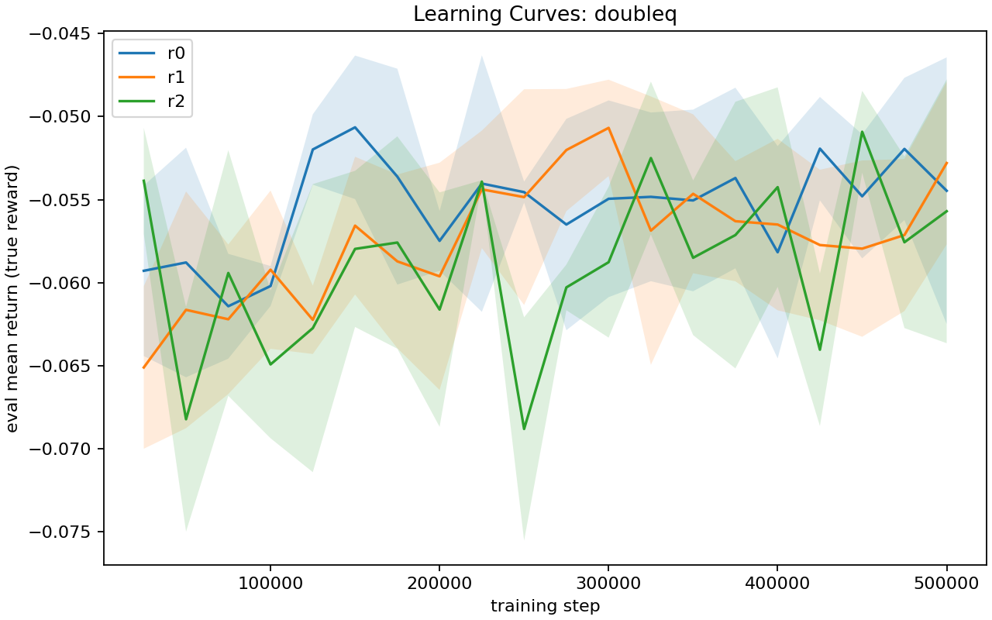
DoubleQ learning curve
13
Piotr Radziszewski, Andrzej Żernaczuk

Slide 14
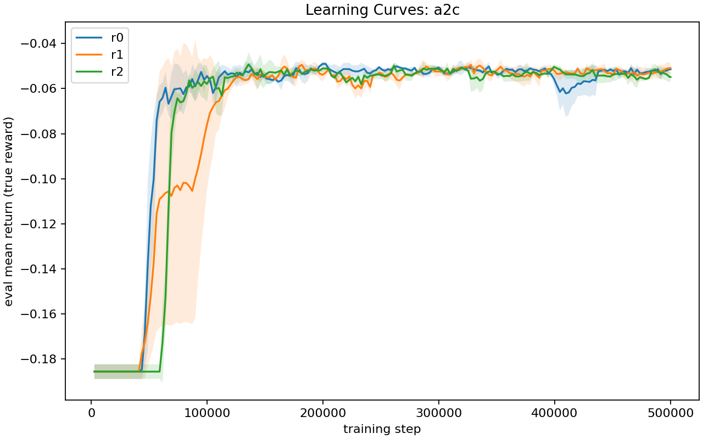
A2C learning curve
14
Piotr Radziszewski, Andrzej Żernaczuk

Slide 15
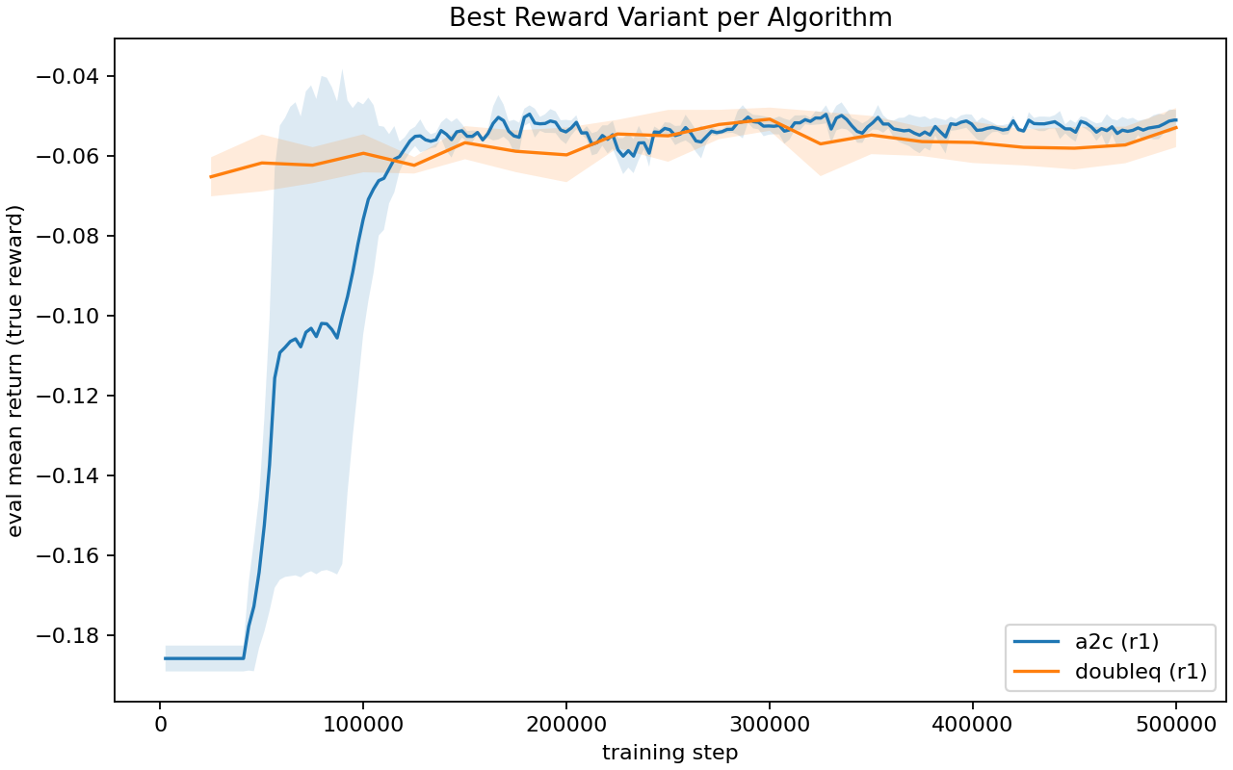
Best-config comparison
15
Piotr Radziszewski, Andrzej Żernaczuk

Slide 16
Results summary
Best overall configuration is A2C with r1, which achieved −0.0509 ± 0.0026 mean return (n=3).
Best DoubleQ configuration is r1, with −0.0528 ± 0.0049 mean return (n=3).
The difference is small, but A2C consistently edges out DoubleQ on average return.
Win rates are also close:
A2C r1 = 0.4276 ± 0.0010,
DoubleQ r1 = 0.4263 ± 0.0014.
16
Piotr Radziszewski, Andrzej Żernaczuk

Slide 17
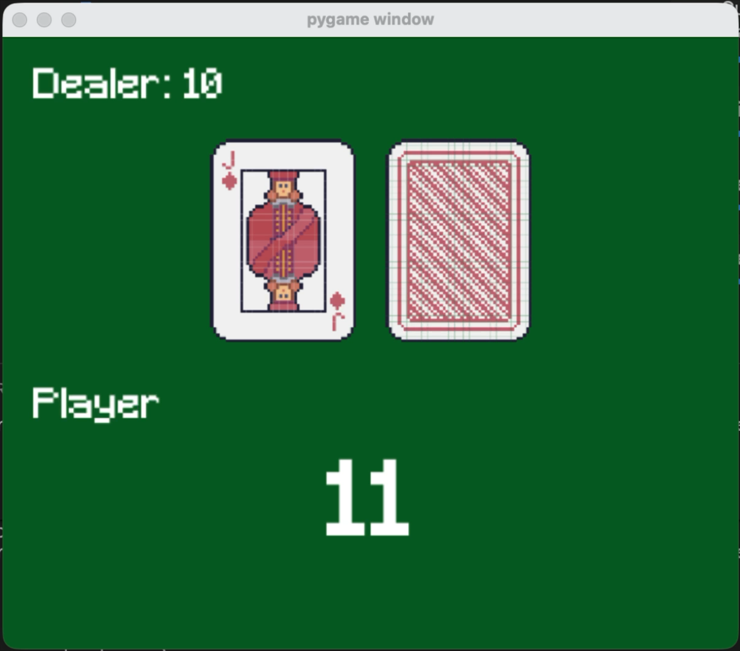
Demo
17
Piotr Radziszewski, Andrzej Żernaczuk

Slide 18
Demo - results
Ep 1 | RESULT: | LOSS | ep=-1.00 | bank=-1.00 | W/D/L=0/0/1
Ep 2 | RESULT: | WIN | ep=+1.00 | bank=+0.00 | W/D/L=1/0/1
Ep 3 | RESULT: | WIN | ep=+1.00 | bank=+1.00 | W/D/L=2/0/1
Ep 4 | RESULT: | WIN | ep=+1.00 | bank=+2.00 | W/D/L=3/0/1
Ep 5 | RESULT: | WIN | ep=+1.00 | bank=+3.00 | W/D/L=4/0/1
Ep 6 | RESULT: | LOSS | ep=-1.00 | bank=+2.00 | W/D/L=4/0/2
Ep 7 | RESULT: | WIN | ep=+1.00 | bank=+3.00 | W/D/L=5/0/2
Ep 8 | RESULT: | LOSS | ep=-1.00 | bank=+2.00 | W/D/L=5/0/3
Ep 9 | RESULT: | LOSS | ep=-1.00 | bank=+1.00 | W/D/L=5/0/4
Ep 10 | RESULT: | LOSS | ep=-1.00 | bank=+0.00 | W/D/L=5/0/5
Ep 11 | RESULT: | WIN | ep=+1.00 | bank=+1.00 | W/D/L=6/0/5
Ep 12 | RESULT: | DRAW | ep=+0.00 | bank=+1.00 | W/D/L=6/1/5
Ep 13 | RESULT: | LOSS | ep=-1.00 | bank=+0.00 | W/D/L=6/1/6
Ep 14 | RESULT: | WIN | ep=+1.00 | bank=+1.00 | W/D/L=7/1/6
Ep 15 | RESULT: | WIN | ep=+1.00 | bank=+2.00 | W/D/L=8/1/6
Ep 16 | RESULT: | LOSS | ep=-1.00 | bank=+1.00 | W/D/L=8/1/7
Ep 17 | RESULT: | WIN | ep=+1.00 | bank=+2.00 | W/D/L=9/1/7
Ep 18 | RESULT: | LOSS | ep=-1.00 | bank=+1.00 | W/D/L=9/1/8
Ep 19 | RESULT: | LOSS | ep=-1.00 | bank=+0.00 | W/D/L=9/1/9
Ep 20 | RESULT: | DRAW | ep=+0.00 | bank=+0.00 | W/D/L=9/2/9
18
Piotr Radziszewski, Andrzej Żernaczuk

