Slide 1

Blackjack using Double Q-learning
and A2C with GAE(λ) (actor-critic)
Introduction to Reinforcement Learning
Warsaw, 8th of February 2026
Piotr Radziszewski, Andrzej Żernaczuk

Slide 2
Game description
Environment: Gymnasium Blackjack-v1
The game starts with the dealer having one face up and one face down card, while the player has two face up cards. All cards are drawn from an infinite deck.
The card values are:
Face cards (Jack, Queen, King) have a point value of 10.
Aces can either count as 11 (called a ‘usable ace’) or 1.
Numerical cards (2-10) have a value equal to their number.
2
Piotr Radziszewski, Andrzej Żernaczuk

Slide 3
Game description continuation
The player has the sum of cards held. The player can request additional cards (hit) until they decide to stop (stick) or exceed 21 (bust, immediate loss).
After the player sticks, the dealer reveals their facedown card and draws cards until their sum is 17 or greater. If the dealer goes bust, the player wins.
If neither the player nor the dealer busts, the outcome (win, lose, draw) is decided by whose sum is closer to 21.
3
Piotr Radziszewski, Andrzej Żernaczuk

Slide 4
Environment
Starting state:
Player current sum: {4, 5, …, 21}
Dealer showing card value: {1, 2, …, 10}
Usable Ace: {0, 1}
The observation consists of a 3-tuple containing: the player’s current sum, the value of the dealer’s one showing card (1-10 where 1 is ace), and whether the player holds a usable ace (0 or 1).
4
Piotr Radziszewski, Andrzej Żernaczuk

Slide 5
Environment cont’d
Actions:
0: Stick
1: Hit
Episode ends:
The player hits and the sum of hand exceeds 21.
The player sticks.
An ace will always be counted as usable (11) unless it busts
the player.
5
Piotr Radziszewski, Andrzej Żernaczuk

Slide 6
Training setup
We trained two different RL families on the same Blackjack environment to compare learning dynamics under identical rules.
DoubleQ: tabular TD control with epsilon‑greedy exploration and two Q‑tables to reduce overestimation bias.
A2C‑GAE: neural actor‑critic trained from rollouts; uses value estimates and advantages for stable policy updates.
Reward shaping is applied only during training; evaluation always uses the true environment reward.
6
Piotr Radziszewski, Andrzej Żernaczuk

Slide 7
Training budget & schedule
DoubleQ trained for 200,000 episodes with tuned linear epsilon decay and periodic evaluation every 25k episodes.
A2C trained for 200,000 environment steps with 256-step rollouts and one policy update per rollout.
Evaluation cadence: DoubleQ every 25k episodes; A2C every 10 updates (~every 2,560 steps).
This keeps compute comparable while respecting each algorithm’s natural unit (episodes vs steps).
7
Piotr Radziszewski, Andrzej Żernaczuk

Slide 8
Model size / Parameters
A2C network (obs_dim=43, hidden=128×128, actions=2) has ~22,531 trainable parameters.
Architecture: 2 shared hidden layers + separate policy and value heads.
DoubleQ is tabular: up to ~2,560 Q-values (640 states × 2 actions × 2 tables), though only visited states are stored.
8
Piotr Radziszewski, Andrzej Żernaczuk

Slide 9
Evaluation protocol
Evaluation uses the true (unshaped) reward, regardless of reward shaping during training.
Policies are evaluated greedily (no exploration) to measure final decision quality.
Each evaluation runs 10,000 episodes for stable statistics.
Metrics computed: mean return, win/draw/loss rate, and mean episode length.
9
Piotr Radziszewski, Andrzej Żernaczuk

Slide 10
Reward shaping choices
r0 baseline uses the original Blackjack rewards (+1 win, 0 draw, −1 loss) with no shaping
r1 step penalty subtracts 0.01 on each non‑terminal step, encouraging shorter episodes and more decisive play when the expected benefit of hitting is low.
r2 bust penalty subtracts an extra 0.5 on terminal losses, explicitly discouraging risky actions that increase bust probability.
10
Piotr Radziszewski, Andrzej Żernaczuk

Slide 11
Hyperparameters tuning
We tuned separately on r0, r1, and r2 for both algorithms, so each reward mode has its own best hyperparameters.
That avoids optimizing for the wrong objective when shaping changes incentives.
Final approach: use the best tuned config per reward mode for the 3‑seed training runs and analysis.
11
Piotr Radziszewski, Andrzej Żernaczuk

Slide 12
Hyperparameter tuning continuation
Strategy: Both DoubleQ and A2C use grid search over discrete hyperparameter grids.
DoubleQ: 96 configurations tested (4×3×2×4), each evaluated across 3 seeds.
A2C: 96 configurations tested (4×3×2×2×2), each evaluated across 3 seeds.
Best config per reward mode is selected by mean eval return across seeds.
12
Piotr Radziszewski, Andrzej Żernaczuk

Slide 13
Hyperparameter tuning cont’d
Final DoubleQ configs:
r0: alpha=0.02, gamma=0.95, eps_end=0.05, eps_decay=100k
r1: alpha=0.02, gamma=1.00, eps_end=0.05, eps_decay=200k
r2: alpha=0.02, gamma=0.95, eps_end=0.01, eps_decay=300k
Final A2C configs:
r0: lr=1e‑3, gamma=0.99, gae_lambda=0.97, entropy=0.01, hidden=128×128
r1: lr=1e‑3, gamma=0.99, gae_lambda=0.97, entropy=0.01, hidden=64×64
r2: lr=1e‑3, gamma=0.99, gae_lambda=0.90, entropy=0.01, hidden=64×64
13
Piotr Radziszewski, Andrzej Żernaczuk

Slide 14
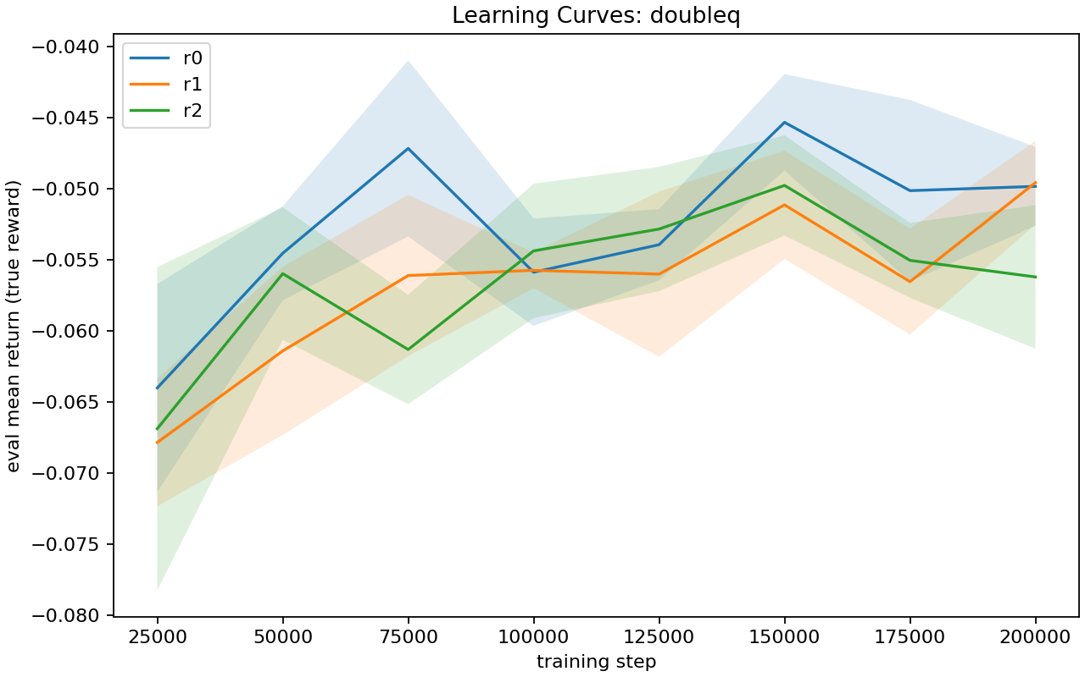
DoubleQ learning curve
14
Piotr Radziszewski, Andrzej Żernaczuk

Slide 15
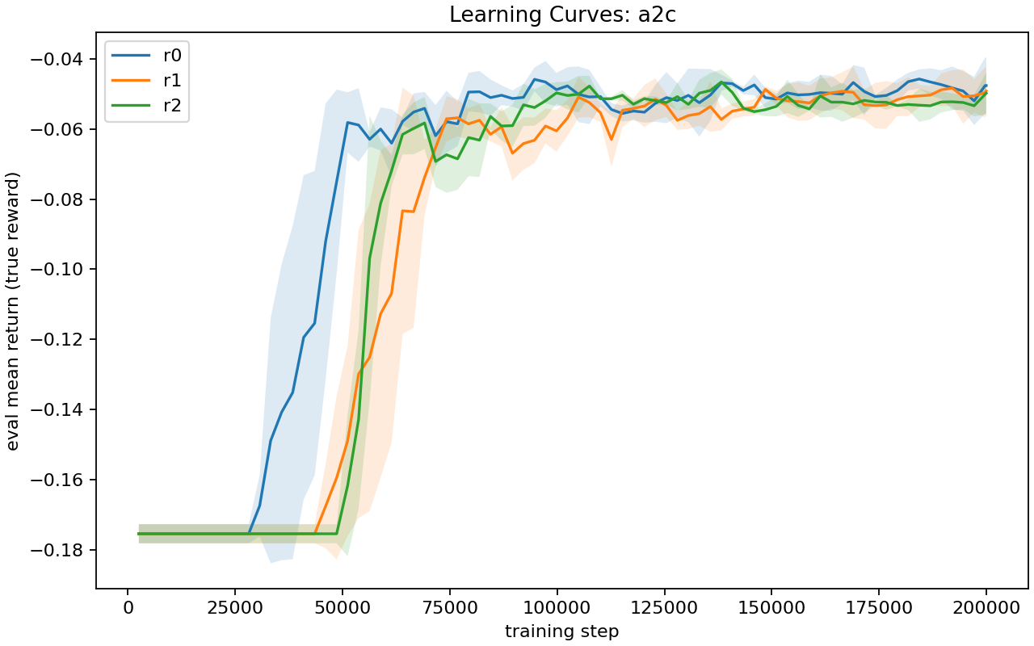
A2C learning curve
15
Piotr Radziszewski, Andrzej Żernaczuk

Slide 16
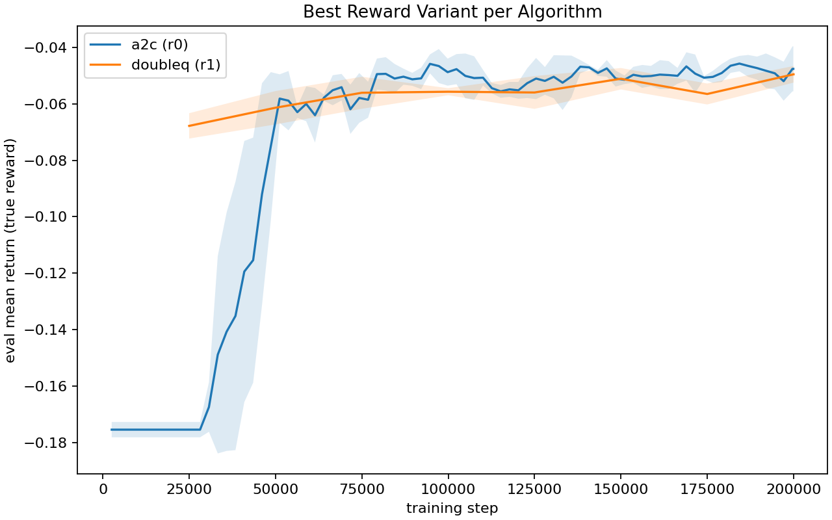
Best-config comparison
16
Piotr Radziszewski, Andrzej Żernaczuk

Slide 17
Results summary
Best overall configuration is A2C with r0, which achieved −0.0476 ± 0.0080 mean return (n=3).
Best DoubleQ configuration is r1, with −0.0496 ± 0.0029 mean return (n=3).
The difference is small; A2C r0 has the highest average return.
Win rates are also close:
A2C r0 = 0.4280 ± 0.0056,
DoubleQ r1 = 0.4287 ± 0.0010.
17
Piotr Radziszewski, Andrzej Żernaczuk

Slide 18
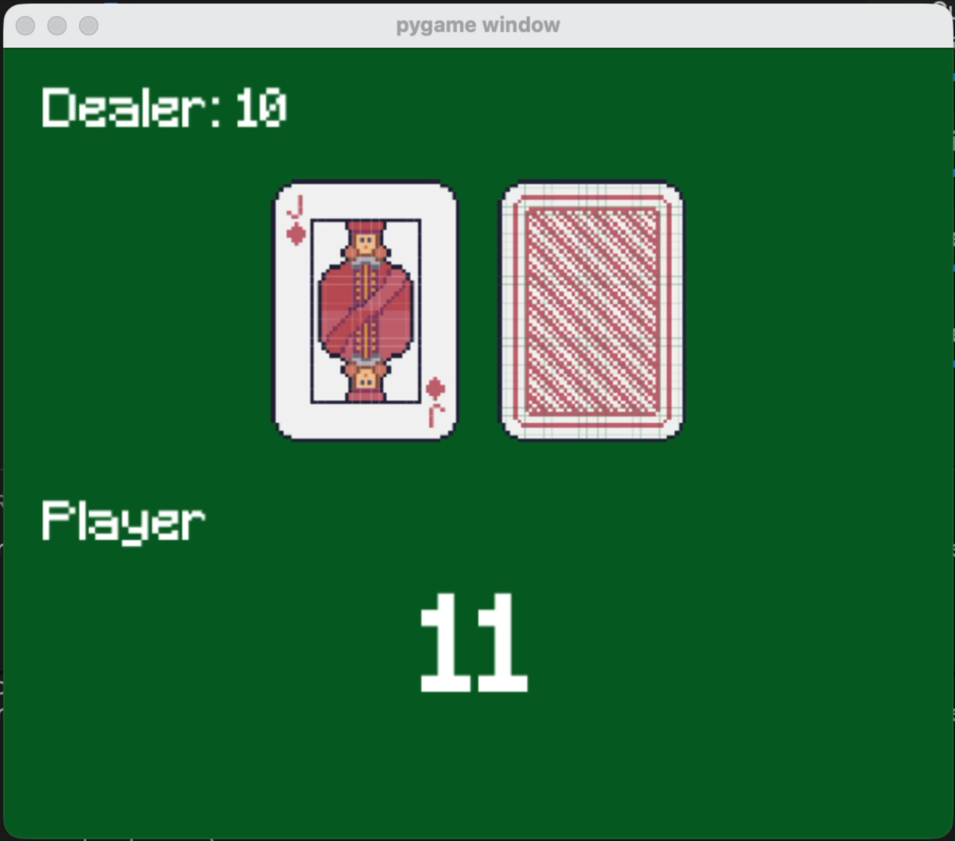
Demo
18
Piotr Radziszewski, Andrzej Żernaczuk

Slide 19
Demo - results
Ep 1 | RESULT: | LOSS | ep=-1.00 | bank=-1.00 | W/D/L=0/0/1
Ep 2 | RESULT: | WIN | ep=+1.00 | bank=+0.00 | W/D/L=1/0/1
Ep 3 | RESULT: | WIN | ep=+1.00 | bank=+1.00 | W/D/L=2/0/1
Ep 4 | RESULT: | WIN | ep=+1.00 | bank=+2.00 | W/D/L=3/0/1
Ep 5 | RESULT: | WIN | ep=+1.00 | bank=+3.00 | W/D/L=4/0/1
Ep 6 | RESULT: | LOSS | ep=-1.00 | bank=+2.00 | W/D/L=4/0/2
Ep 7 | RESULT: | WIN | ep=+1.00 | bank=+3.00 | W/D/L=5/0/2
Ep 8 | RESULT: | LOSS | ep=-1.00 | bank=+2.00 | W/D/L=5/0/3
Ep 9 | RESULT: | LOSS | ep=-1.00 | bank=+1.00 | W/D/L=5/0/4
Ep 10 | RESULT: | LOSS | ep=-1.00 | bank=+0.00 | W/D/L=5/0/5
Ep 11 | RESULT: | WIN | ep=+1.00 | bank=+1.00 | W/D/L=6/0/5
Ep 12 | RESULT: | DRAW | ep=+0.00 | bank=+1.00 | W/D/L=6/1/5
Ep 13 | RESULT: | LOSS | ep=-1.00 | bank=+0.00 | W/D/L=6/1/6
Ep 14 | RESULT: | WIN | ep=+1.00 | bank=+1.00 | W/D/L=7/1/6
Ep 15 | RESULT: | WIN | ep=+1.00 | bank=+2.00 | W/D/L=8/1/6
Ep 16 | RESULT: | LOSS | ep=-1.00 | bank=+1.00 | W/D/L=8/1/7
Ep 17 | RESULT: | WIN | ep=+1.00 | bank=+2.00 | W/D/L=9/1/7
Ep 18 | RESULT: | LOSS | ep=-1.00 | bank=+1.00 | W/D/L=9/1/8
Ep 19 | RESULT: | LOSS | ep=-1.00 | bank=+0.00 | W/D/L=9/1/9
Ep 20 | RESULT: | DRAW | ep=+0.00 | bank=+0.00 | W/D/L=9/2/9
19
Piotr Radziszewski, Andrzej Żernaczuk

Slide 20
Taxi using PPO and DQN
Introduction to Reinforcement Learning
Warsaw, 8th of February 2026
Piotr Radziszewski, Andrzej Żernaczuk

Slide 21
Problem description
Environment: Gymnasium Taxi-v3
Small grid‑world navigation task where a taxi must pick up a passenger at one of four fixed locations and drop them off at a target destination.
500 discrete states
6 actions (move N/S/E/W, pickup, dropoff).
Each step costs −1, successful delivery gives +20, and illegal pickup/dropoff gives −10.
Everything is run on MacBook Pro with M2 pro 10c CPU and 32GB RAM.
21
Piotr Radziszewski, Andrzej Żernaczuk

Slide 22
Environment
Starting state:
Taxi is placed in one of 25 grid cells
The passenger is located at one of four fixed pickup spots (R, G, Y, B)
The destination is one of those four spots (chosen independently)
The observation encodes the taxi position, passenger location, and destination into a single discrete state.
22
Piotr Radziszewski, Andrzej Żernaczuk

Slide 23
Environment cont’d
Actions:
0: South
1: North
2: East
3: West
4: Pickup
5: Dropoff
Episode ends:
Successful dropoff at the correct destination.
Max steps reached (time limit).
23
Piotr Radziszewski, Andrzej Żernaczuk

Slide 24
Reward functions
We tested four reward functions:
      Default: original Taxi rewards
  Distance‑Based: extended with +0.1 for moving closer to target and -0.1 for moving away from target.
Modified Penalty: reduced step penalty to -0.5.
  Enhanced: step penalty unchanged, +25 for successful delivery, -5 for illegal pickup/dropoff, +0.2 for moving closer to target, -0.2 for moving away from target, +2 for successful pickup.
Evaluation is always on default reward to avoid bias
24
Piotr Radziszewski, Andrzej Żernaczuk

Slide 25
Model size / Parameters
PPO:
Observation: 19‑dim (TaxiFeatureWrapper), Actions: 6
Architecture: shared MLP 256×256 + separate policy/value heads
Parameter count: 72,711
DQN:
Observation: 19‑dim (TaxiFeatureWrapper), Actions: 6
Architecture: MLP 256×256 -> Q‑values for 6 actions
Online network params: 72,454
25
Piotr Radziszewski, Andrzej Żernaczuk

Slide 26
Training setup
We trained two different RL families on the same Taxi‑v3 environment to compare learning dynamics under identical rules.
DQN: value‑based method with replay buffer and target network for stable Q‑learning.
PPO: policy‑based actor‑critic with clipped objective; uses action masking to avoid invalid actions.
Reward shaping is applied only during training; evaluation always uses the default Taxi reward.
26
Piotr Radziszewski, Andrzej Żernaczuk

Slide 27
Training budget & schedule
Environment steps (per reward function):
PPO: 200,000
DQN: 250,000
Evaluation: 200 episodes with deterministic policy; metrics include mean reward, success rate, and mean episode length.
Per‑reward tuning keeps comparisons fair, since each reward function has its own best hyperparameters.
27
Piotr Radziszewski, Andrzej Żernaczuk

Slide 28
Hyperparameter tuning - PPO
Random search per reward function with 200k training timesteps, 200 evaluation episodes and 20 random configs – 192 minutes.
Default: lr=3e‑4, n_steps=2048, batch=128, clip=0.1, ent=0.0
Distance‑based: lr=1e‑4, n_steps=2048, batch=32, clip=0.1, ent=0.05
Modified penalty: lr=3e‑4, n_steps=2048, batch=128, clip=0.2, ent=0.01
Enhanced: lr=1e‑3, n_steps=1024, batch=64, clip=0.1, ent=0.05
28
Piotr Radziszewski, Andrzej Żernaczuk

Slide 29
Hyperparameter tuning - DQN
Random search per reward function with 250k training timesteps, 100 evaluation episodes and 5 random configs – 125 minutes.
Default: lr=5e‑5, batch=32, buffer=200k, gamma=0.99, target=500, exp_frac=0.8, exp_final=0.1, starts=10k, train_freq=1, grad_steps=4
Distance‑based: lr=5e‑4, batch=32, buffer=200k, gamma=0.99, target=1000, exp_frac=0.8, exp_final=0.2, starts=20k, train_freq=4, grad_steps=1
Modified penalty: lr=2e‑4, batch=128, buffer=50k, gamma=0.95, target=2000, exp_frac=0.8, exp_final=0.1, starts=10k, train_freq=1, grad_steps=1
Enhanced: lr=2e‑4, batch=128, buffer=100k, gamma=0.95, target=1000, exp_frac=0.9, exp_final=0.1, starts=20k, train_freq=4, grad_steps=4
We tried running it on 500k, 200 and 20 but after aprox. 11 hours we were 60% done.
29
Piotr Radziszewski, Andrzej Żernaczuk

Slide 30
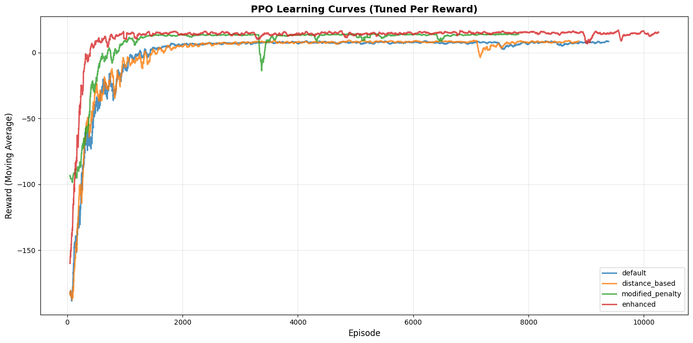
PPO learning curve
PPO converges quickly across all rewards. Enhanced achieves the highest plateau
but shows occasional dips, while default is the most stable.
30
Piotr Radziszewski, Andrzej Żernaczuk

Slide 31
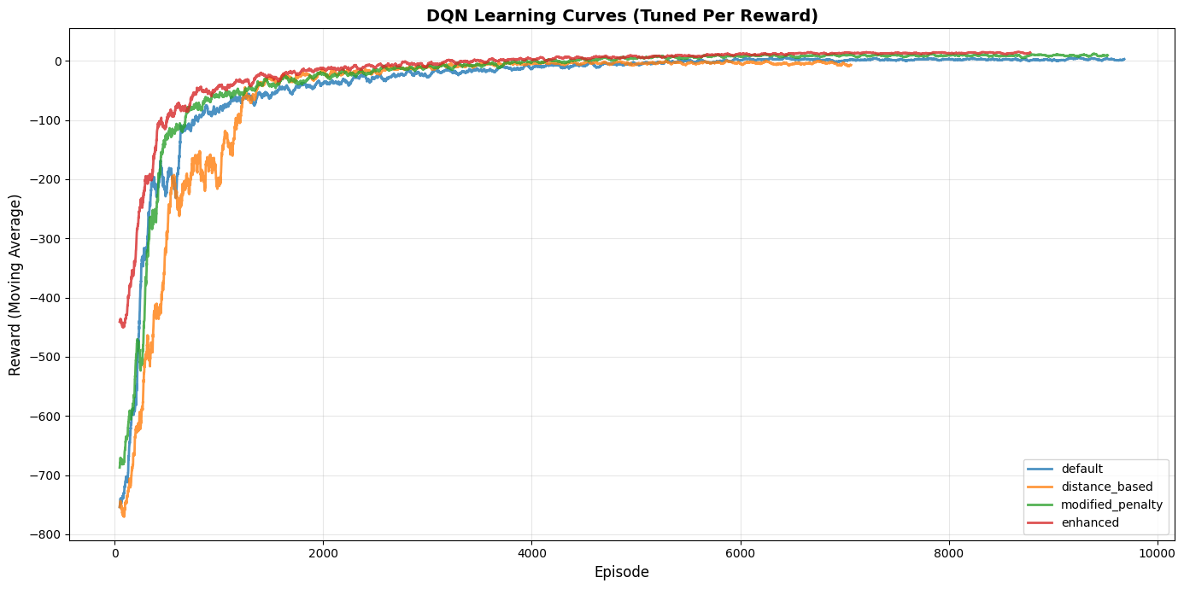
DQN learning curve
All reward variants converge to near‑optimal returns. Enhanced and modified‑penalty
rise fastest, while default converges a bit slower.
31
Piotr Radziszewski, Andrzej Żernaczuk

Slide 32
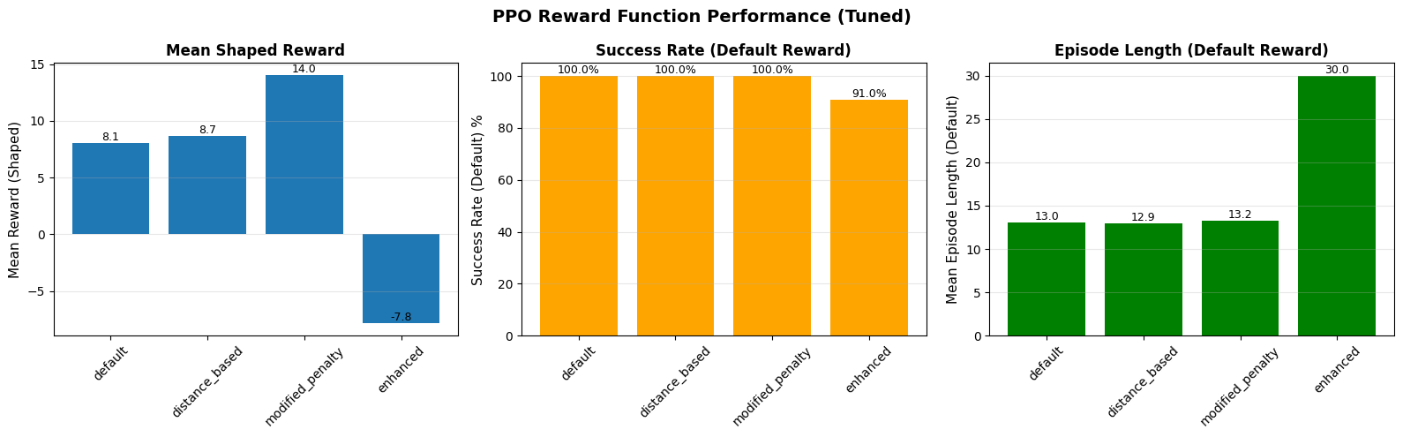
PPO rewards compared
PPO hits 100% success for default, distance‑based, and modified‑penalty.
Enhanced reward drops to ~91% success and has longer episodes (~30),
indicating the shaping pushes behaviour that doesn’t fully transfer
to default reward.
Modified‑penalty gives the best shaped reward
without sacrificing default performance.
32
Piotr Radziszewski, Andrzej Żernaczuk

Slide 33
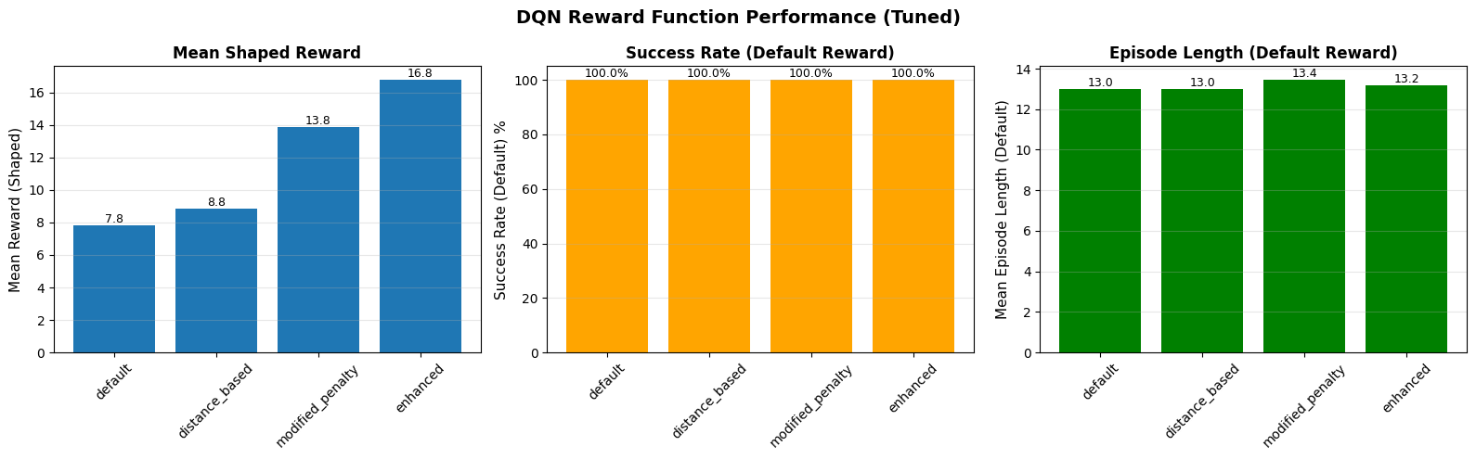
DQN rewards compared
DQN achieves 100% success across all reward functions.
Episode length is stable (~13 steps), so all rewards produce similarly efficient policies under default reward.
Enhanced reward yields the highest shaped reward but doesn’t hurt default performance.
33
Piotr Radziszewski, Andrzej Żernaczuk

Slide 34
Demo - results
Videos can be played from /results/renders. There are 3 main categories:
Example random run.
PPO and DQN baselines.
PPO and DQN different trained rewards.
34
Piotr Radziszewski, Andrzej Żernaczuk

