Slide 1
Zaawansowane Zagadnienia Programowania
Technologie wspomagające wytwarzanie oprogramowania

Slide 2
Agenda
VCS
SVN
Git
Ant
Maven
Java 1.8 features
Continous Integration (Travis)
Project management
Jira + Jira Agile

Slide 3
VCS – Version Control Systems
Source control
Maintenance and track of change
Revision based
Distributed teams
Branching / mergining

Slide 4
SVN – Apache Subversion
Centralized Version Control System (CVCS)
Global repository
Commit may cause inconsistency!
Trunk - directory where all the main development happens (usually checked out by developers to work on the project)
Branch - another line of development. It is useful when you want your development process to fork off into two different directions
Tag - used to store named snapshots of the project.

Slide 5
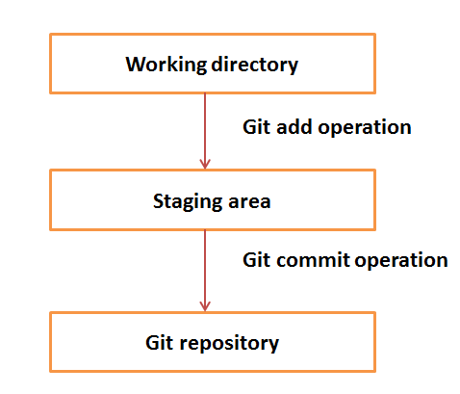
GIT
Distributed/Decentralized Version Control System (DVCS)
Mirror of the repository
Fast and small
Commits/branching even when you are offline

Slide 6
GIT
Clone - creates the instance of the repository (locally)
Pull - copies the changes from a remote repository instance to a local one (update in SVN)
Fetch - download objects and refs from another repository
Add – add objects to staging area
Push - copies changes from a local repository instance to a remote one
Reset – reset changes in staging area

Slide 7
Exercise 1 – GitHub account
Signup on GitHub
Create new repository (with readme)
Clone the repository into your local machine

Slide 8
Ant – Apache Ant
Tool for automating software build
Replacement of unix MAKE
Used for Java projects
Uses XML for build definition
Targets
Dependencies
Portability

Slide 9
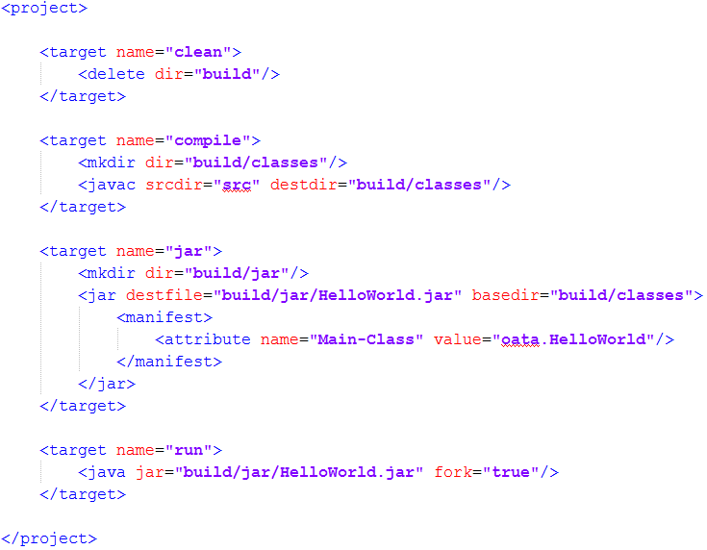
Ant build file example

Slide 10
Maven
Software project management and comprehension tool
Project Object Model (POM)
Management of dependencies
Releases
Simple usage
No need to manual download of external libraries

Slide 11
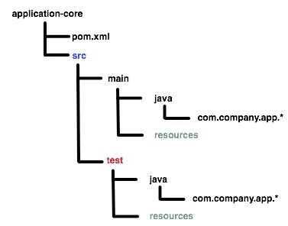
Maven project structure

Slide 12
Maven archetypes
Maven comes with number of „ready-to-go” archetypes
Extremely speeds up the develpoment preparation!

Slide 13
Maven package meta data
groupId - identify your project uniquely across all projects
artifactId - name of the package without version
Version
scope - used to limit the transitivity of a dependency, and also to affect the classpath used for various build tasks

Slide 14
Maven goals
Clean
Compile
Test
Package
Install
Deploy

Slide 15
Exercise 2 – Generate MVN project from archetype
Generate project with archetype „quickstart” (default)
Copy generated files into GitHub repository directory
Import project into IDE
Review pom.xml
Build package using Maven (using command line)
Notes:
mvn archetype:generate

Slide 16
Exercise 3 – Add test dependencies and push to GitHub
Add following dependencies to project:
jUnit 4
assertJ
Reimport the project (download of dependecies)
Commit project to staging area
Push to GitHub
Review files on GitHub

Slide 17
Project Lombok
Reducing boilerplate code
Generation of getters/setters via annotations:
@Getter
@Setter
Automatic beans creation
@Data
More features: https://projectlombok.org

Slide 18
Java 1.8
Java 1.8 comes up with several new features like:
Parallel array sorting
Standardization of Base64 encoding/decoding
New Date & Time API
VM improvements
Lambdas
Streams

Slide 19
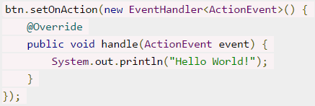
Java 1.8 – Lambda expressions
How can we improve the code?

Slide 20

Java 1.8 – Lambda expressions
Use Lambda expression!

Slide 21
Java 1.8 – Streams
A stream is a iterator that allows a single run over the collection it is called on
filter/map/reduce for Java
Streams can run sequentially or in parallel

Slide 22
Live demo – Streams & Lambda comparator
Mock-up list of persons
Count total age of all persons (using streams)
Implement and test sorting mechanism for two comparators:
Old-way comparator
Lambda anonymous function comparator
Notes:
PersonService with two methods which returns empty collections and one for sum
Tests for both

Slide 23
Continuous Integration
Merging all developer working copies with a shared mainline several times a day
All developers should commit their changes EOB
Repository stability checks
Regular releases
Reduce of costs
Early error/bug detection

Slide 24
Jenkins
Opensource continuous integration tool written in Java
Distributed as war (to be deployed on servlet container such as Tomcat)
Huge repository of plugins
Various build strategies (triggering, scheduling, etc)

Slide 25

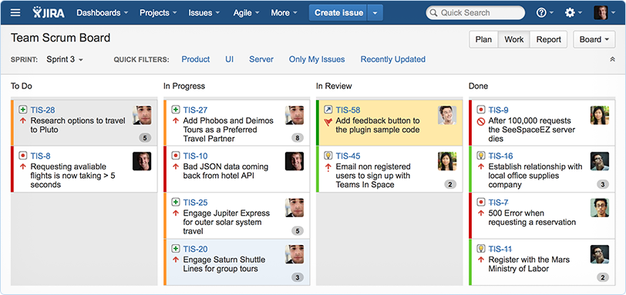
JIRA – Project Management
Commercial solution for project management and issue tracking
Workflows
Support for Agile projects (Kanban, Scrum)
VCS hooks

Slide 26
Dzięki !

