Slide 1

F1 App
Customer Experience Management
2024/25
Andrzej Janik

Slide 2

F1 App Features
Comprehensive Data Access - Centralized platform for in-depth analysis of race session data, with detailed performance insights.
Dynamic Comparisons - Visualize and compare driver performances through interactive tables and charts.
Highlighting Key Race Moments - Curated section for highlights, allowing fans to revisit the most significant moments of each race session.
Real-Time Interaction - Engage with other fans via live chat, fostering discussions as the race unfolds.

Slide 3
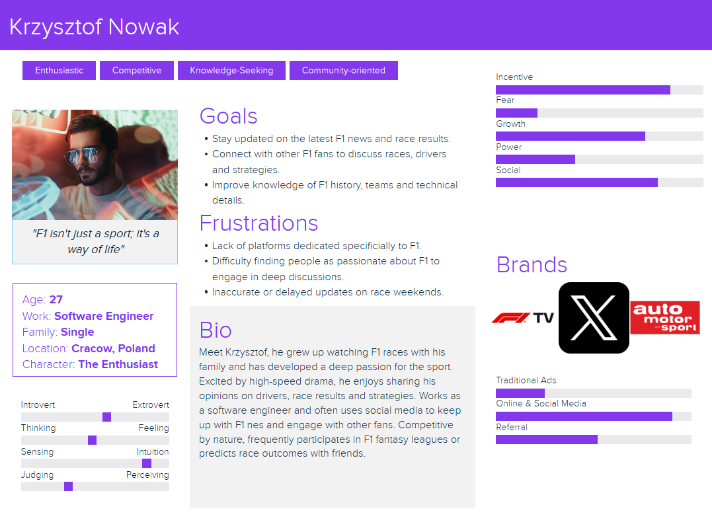
Customer Persona

Slide 4
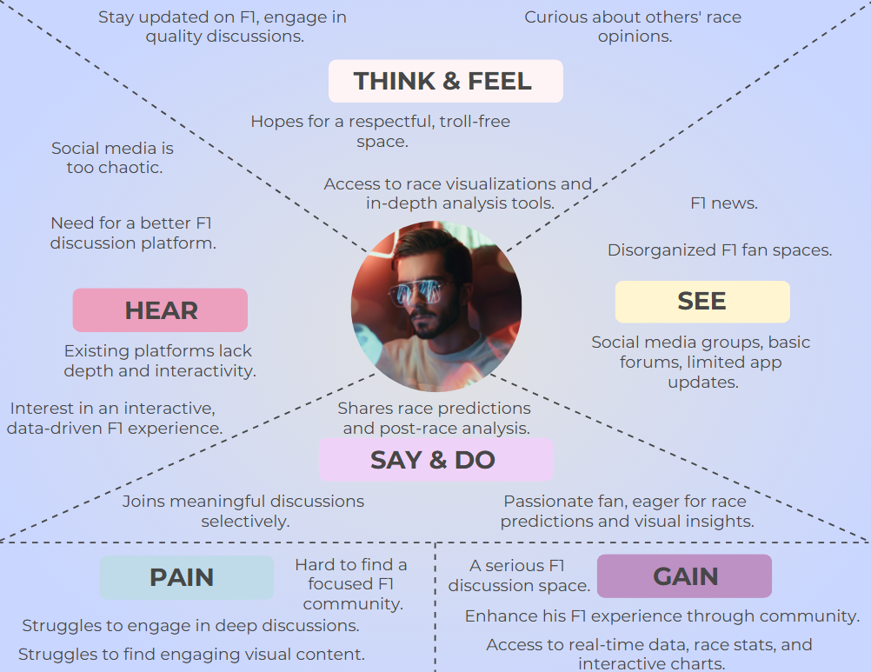
Customer Empathy Map

Slide 5
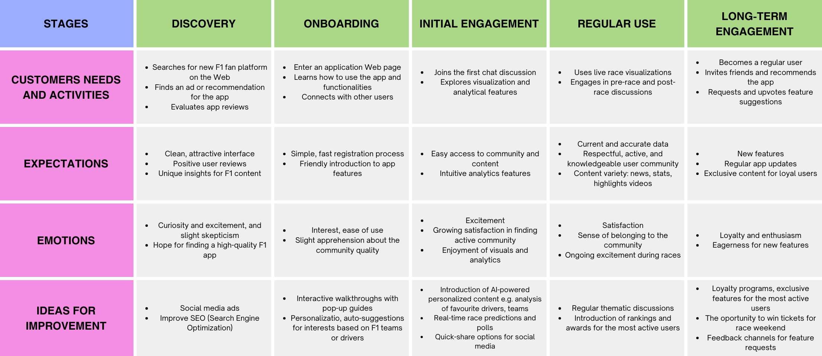
Customer Journey Map

Slide 6

Customer Satisfaction Survey

Slide 7
Customer Satisfaction Survey
Customer Satisfaction Survey consists of 10 question.
Measures customer satisfaction using Net Promoter Score (NPS).
Provides valuable insights for continuous improvement.
Designed to be quick and easy for respondents.

Slide 8
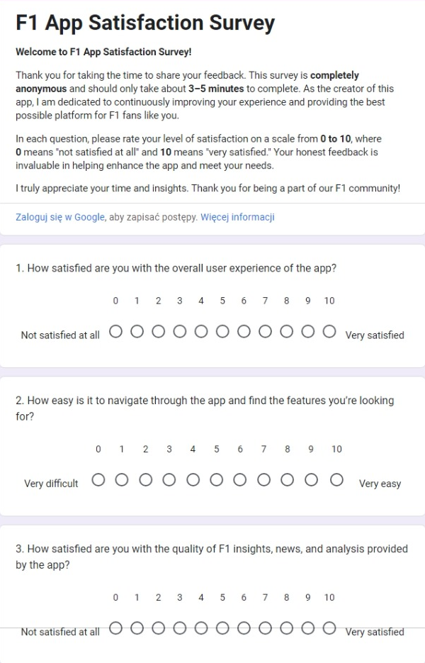
Part 1

Slide 9
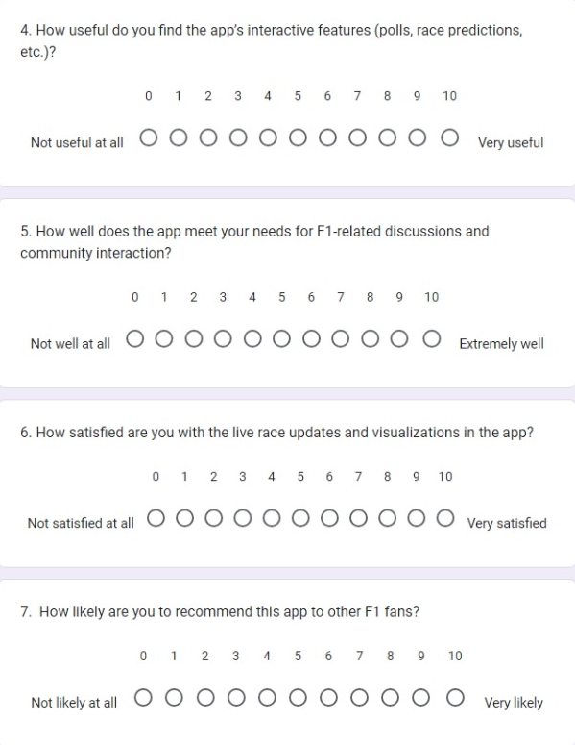
Part 2

Slide 10
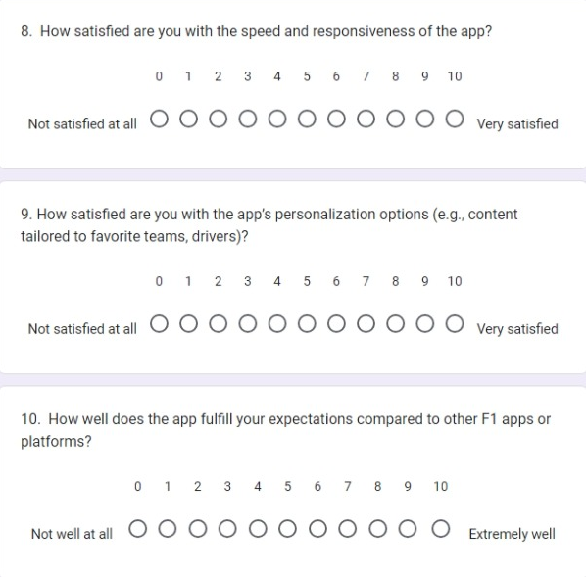
Part 3

Slide 11
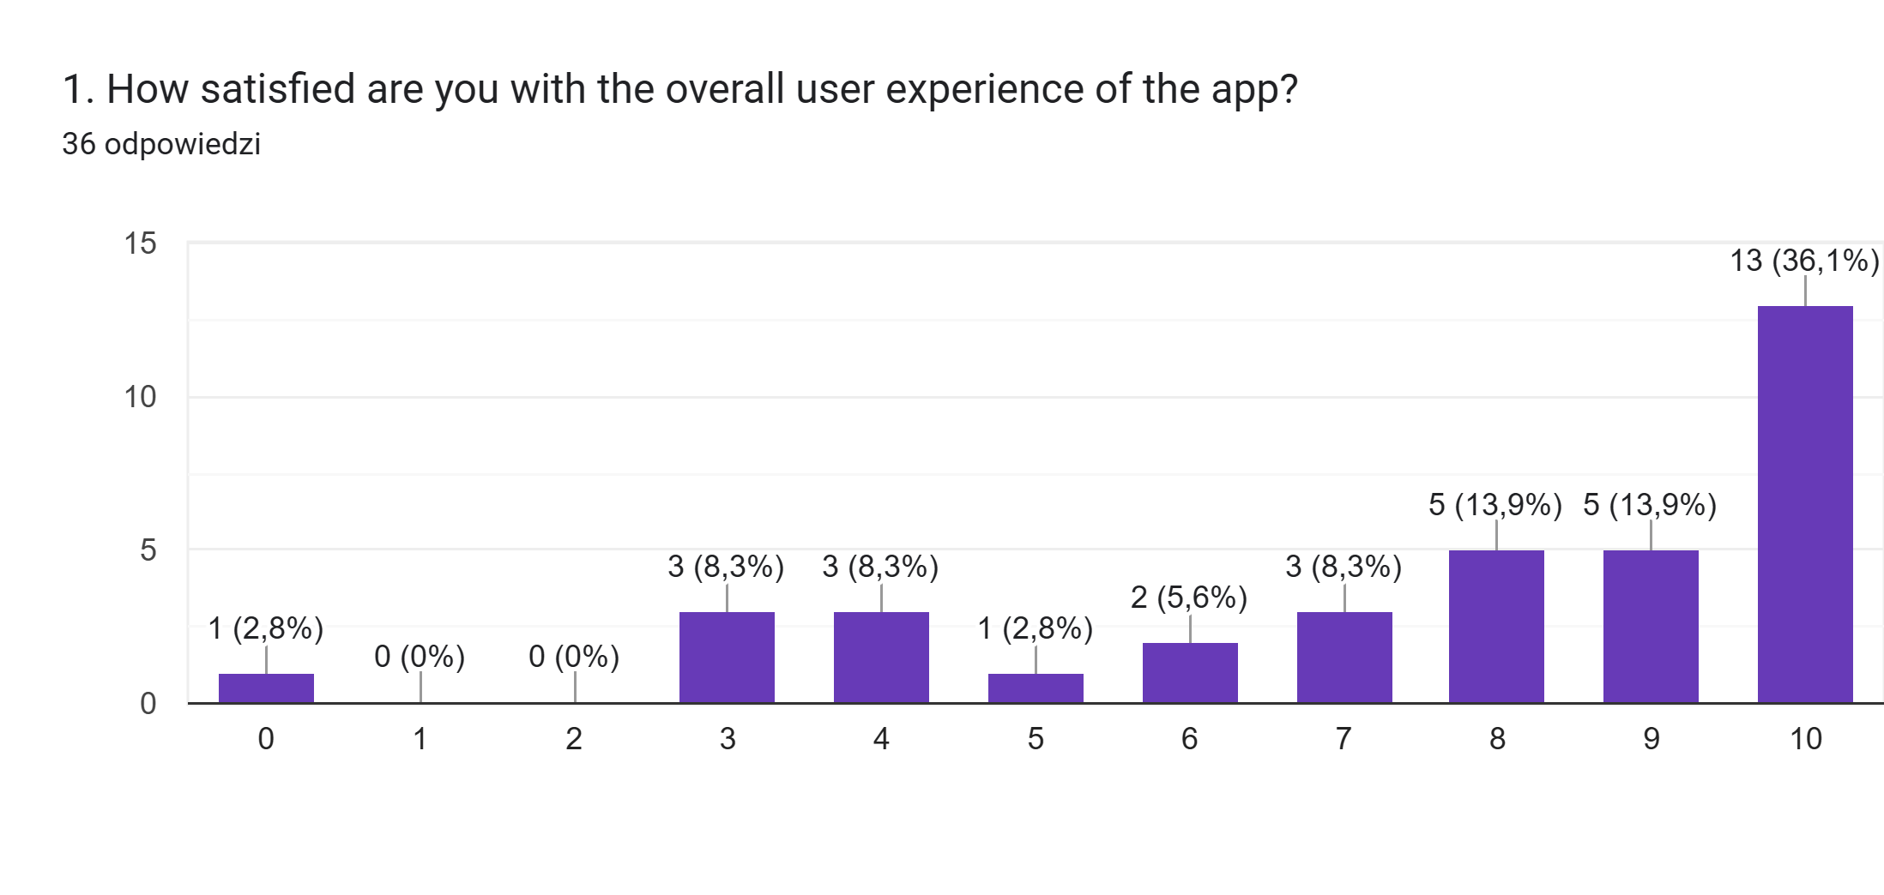
How satisfied are you with the overall user experience of the app?

Slide 12
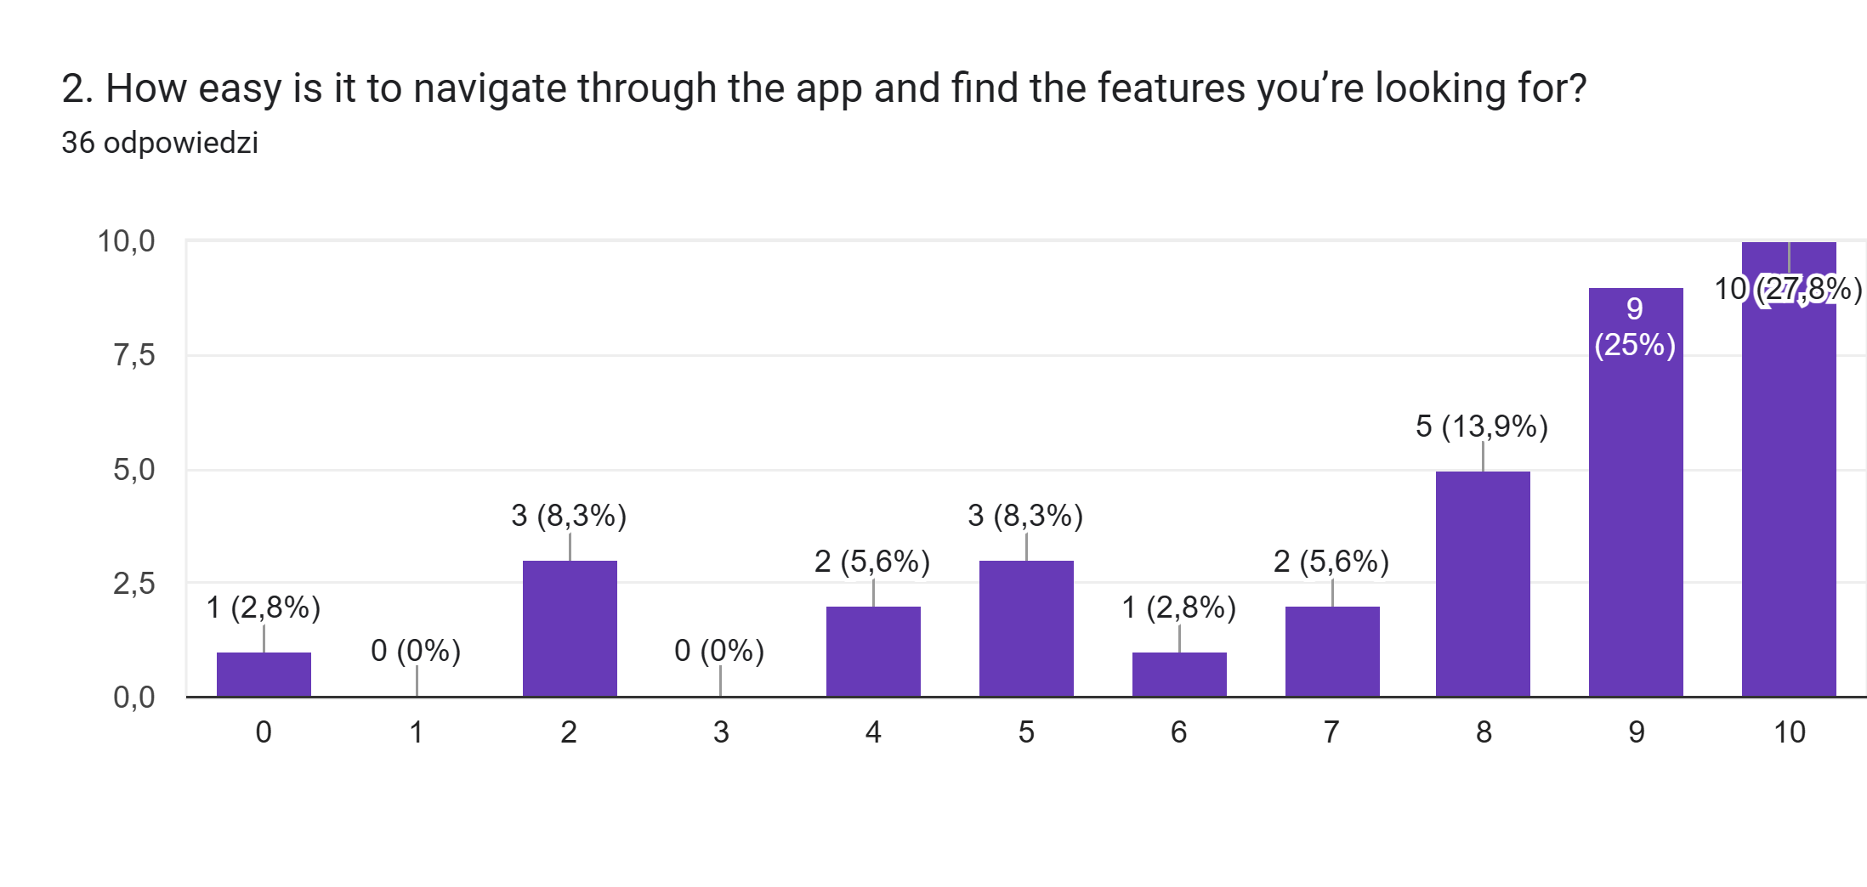
How easy is it to navigate through the app and find the features you’re looking for?

Slide 13
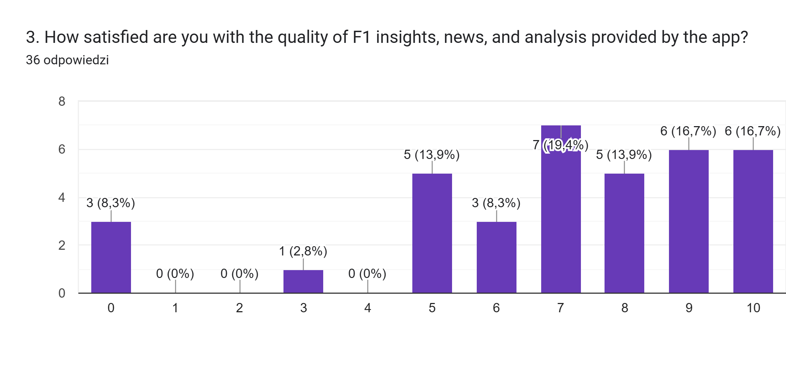
How satisfied are you with the quality of F1 insights, news, and analysis provided by the app?

Slide 14
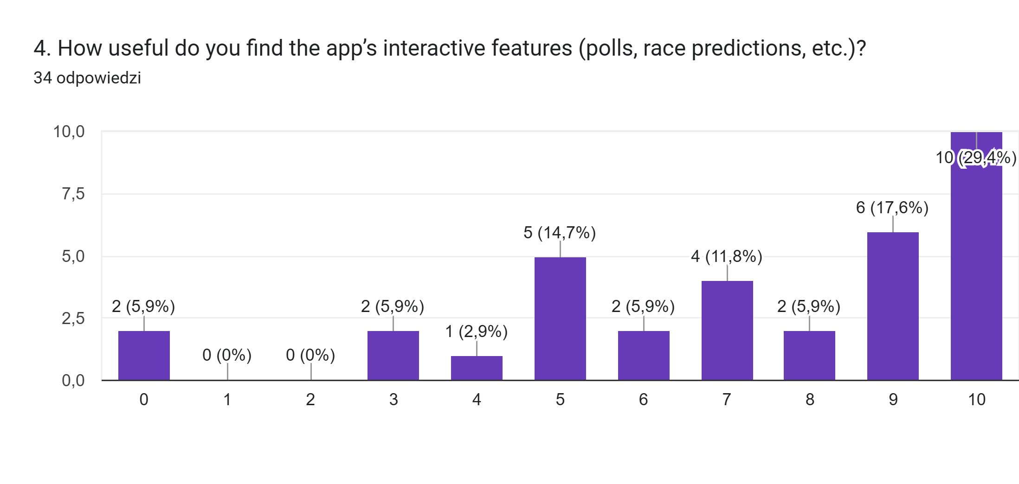
How useful do you find the app’s interactive features (polls, race predictions, etc.)?

Slide 15
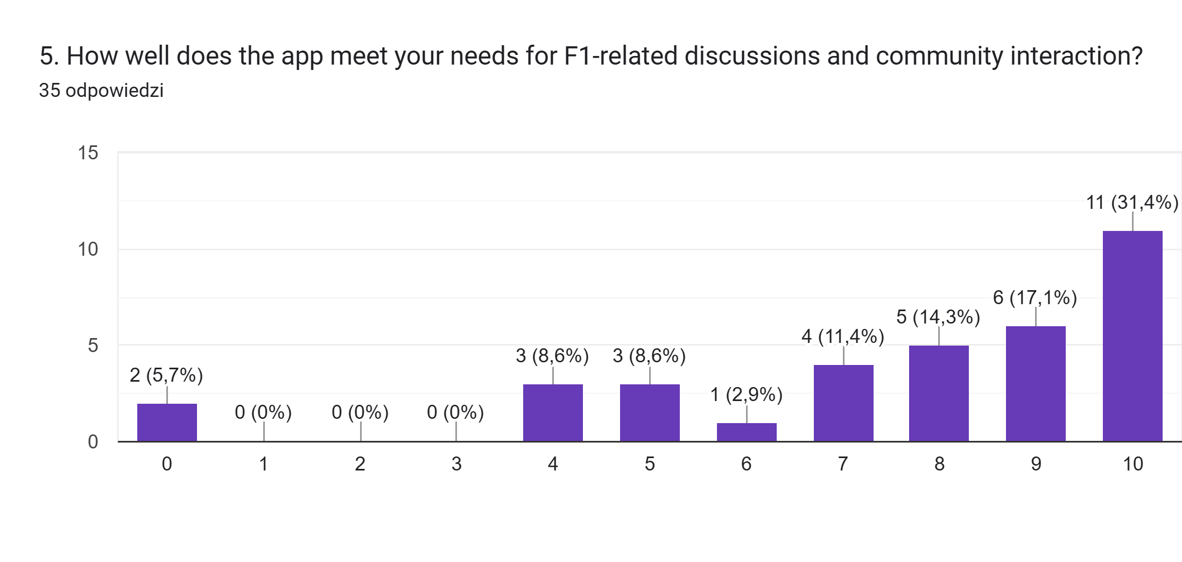
How well does the app meet your needs for F1-related discussions and community interaction?

Slide 16
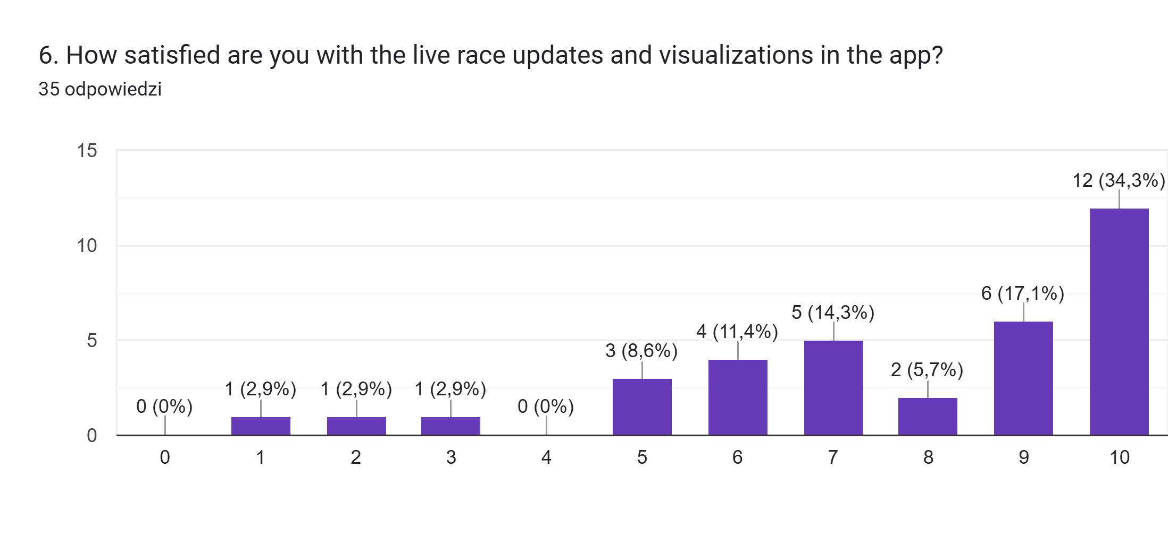
How satisfied are you with the live race updates and visualizations in the app?

Slide 17
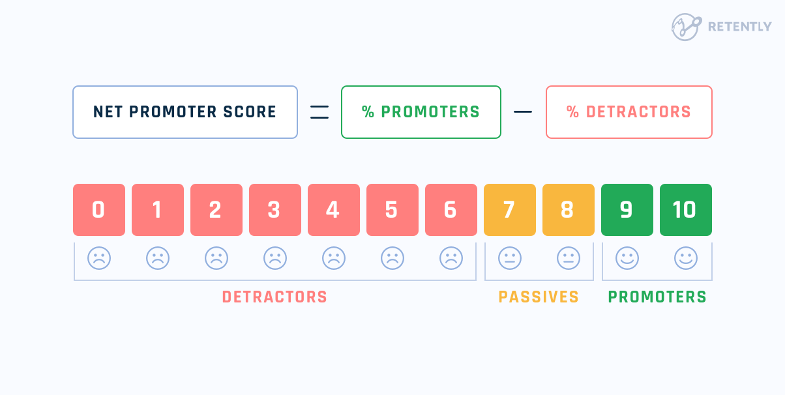
Net Promoter Score

Slide 18
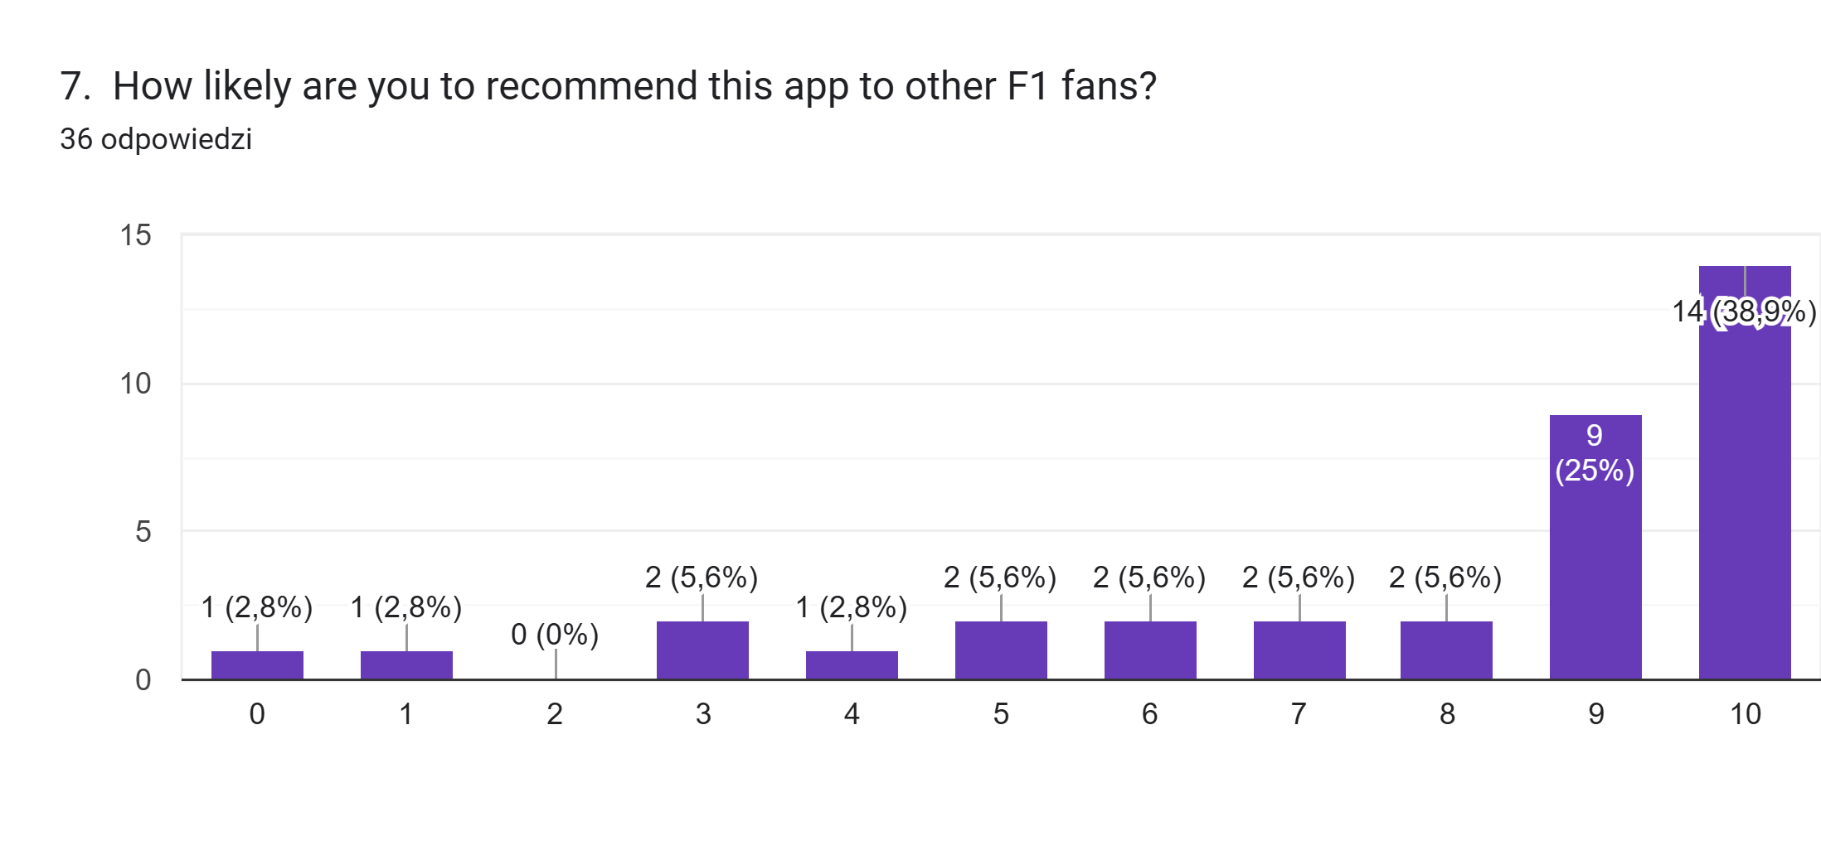
How likely are you to recommend this app to other F1 fans?

Slide 19
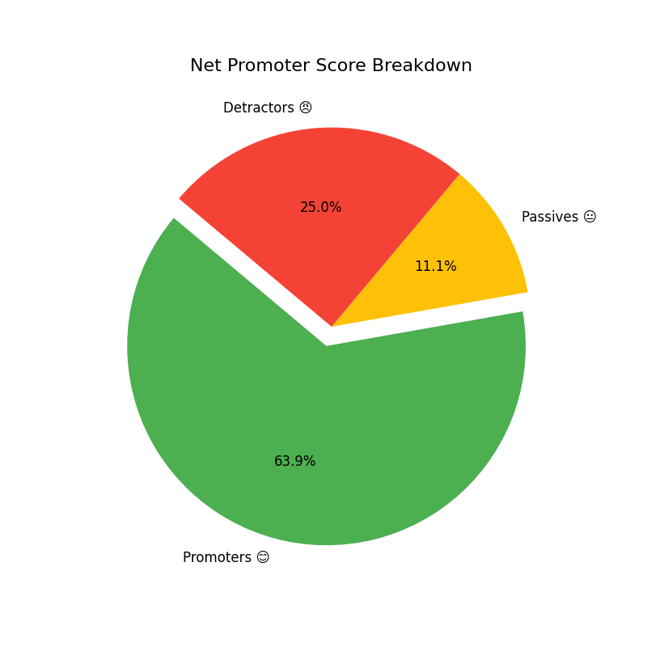
Net Promoter Score
The NPS survey gathered 36 responses. With 23 promoters, 4 passives, and 9 detractors, the Net Promoter Score achieved was 38.9%.

Slide 20
Understanding NPS Results
Positive Feedback: NPS of 38.9% reflects a strong base of satisfied users (promoters).
Opportunities for Growth: Presence of detractors (25%) highlights areas for improvement.
Encouraging Outcome: Majority are likely to recommend the app, indicating good user engagement.
Next Steps: Focus on addressing detractor concerns to boost satisfaction and retention.

Slide 21
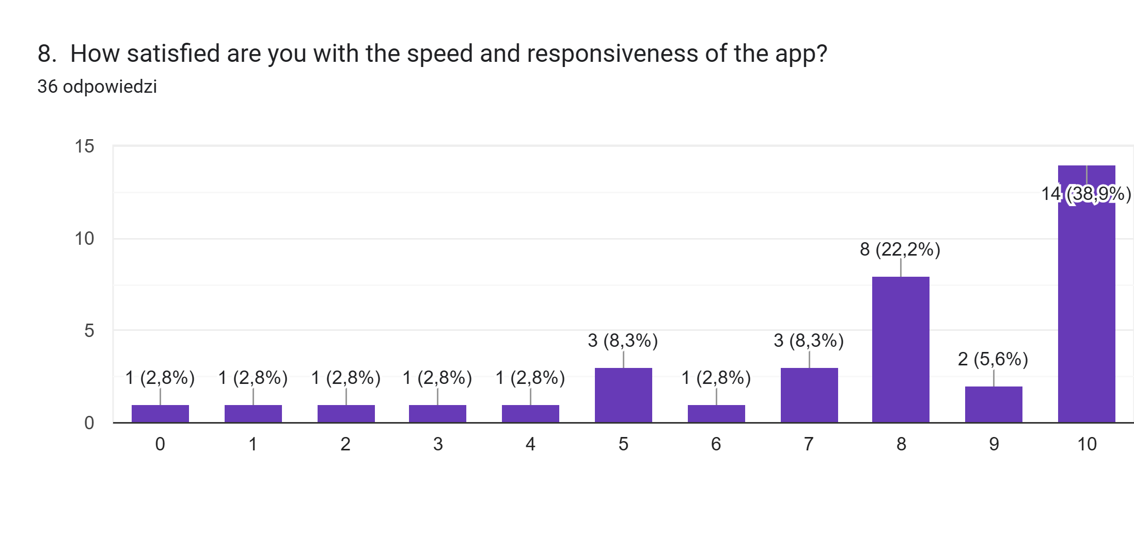
How satisfied are you with the speed and responsiveness of the app?

Slide 22
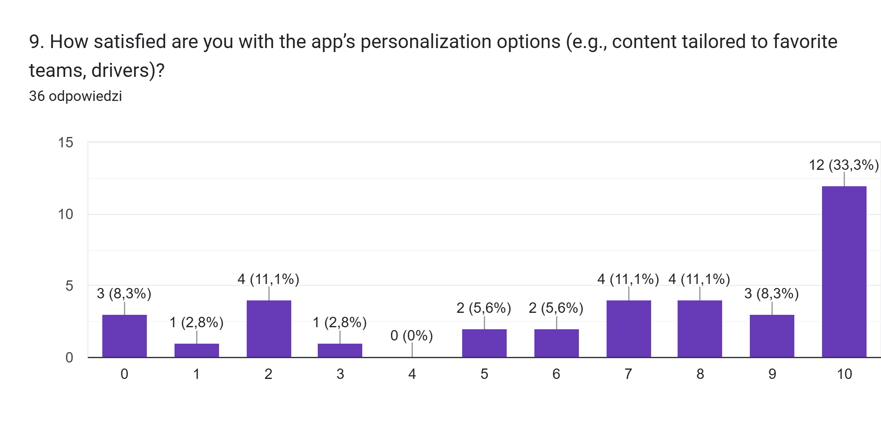
How satisfied are you with the app’s personalization options (e.g., content tailored to favorite teams, drivers)?

Slide 23
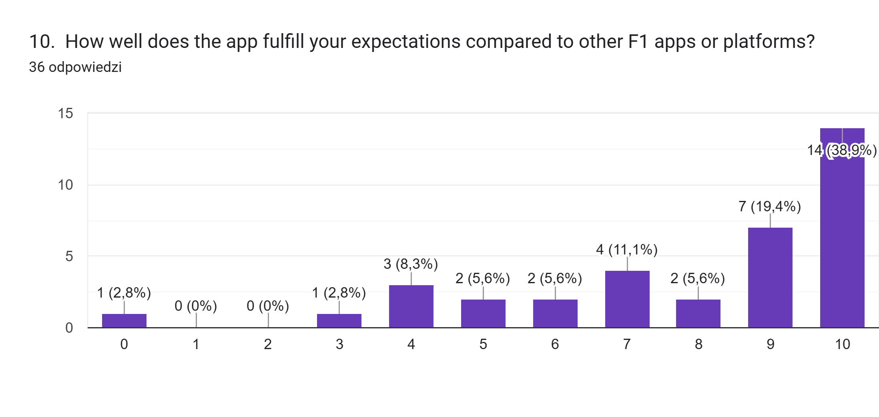
How well does the app fulfill your expectations compared to other F1 apps or platforms?

Slide 24

Thank You!

