Slide 1

F1 App
Customer Experience Management
2024/25
Andrzej Janik

Slide 2

F1 App Features
Comprehensive Data Access - Centralized platform for in-depth analysis of race session data, with detailed performance insights.
Dynamic Comparisons - Visualize and compare driver performances through interactive tables and charts.
Highlighting Key Race Moments - Curated section for highlights, allowing fans to revisit the most significant moments of each race session.
Real-Time Interaction - Engage with other fans via live chat, fostering discussions as the race unfolds.

Slide 3
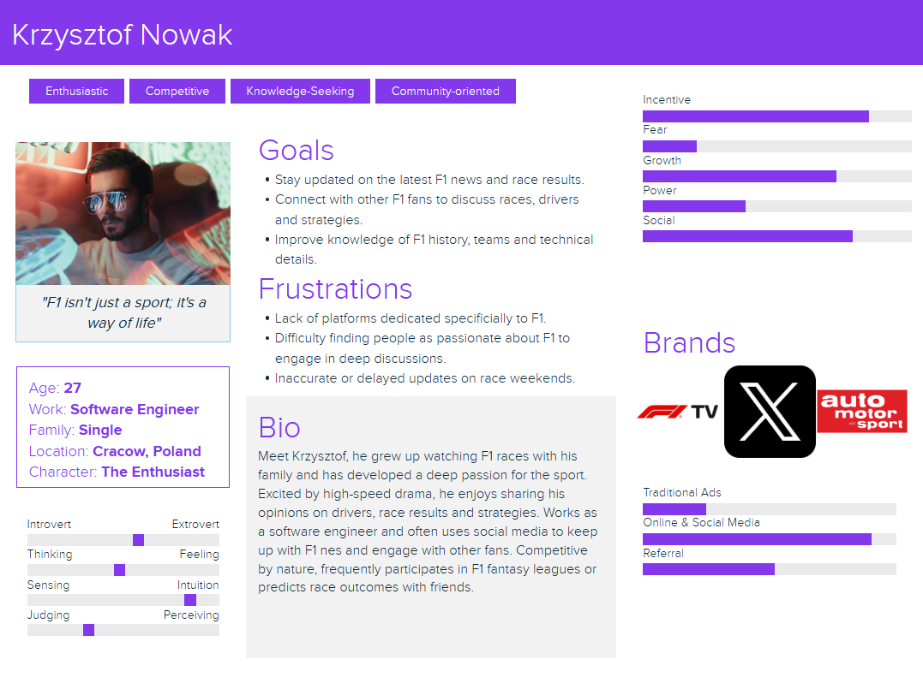
Customer Persona

Slide 4
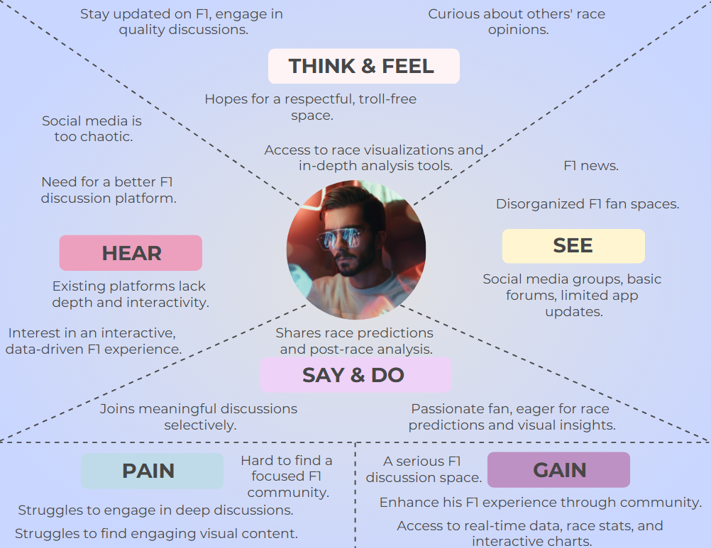
Customer Empathy Map

Slide 5
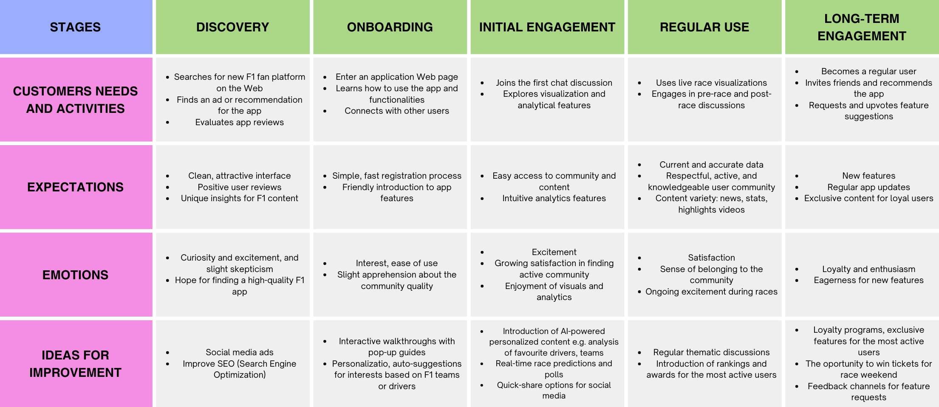
Customer Journey Map

Slide 6

Customer Satisfaction Survey

Slide 7
Customer Satisfaction Survey
Customer Satisfaction Survey consists of 10 question.
Measures customer satisfaction using Net Promoter Score (NPS).
Provides valuable insights for continuous improvement.
Designed to be quick and easy for respondents.

Slide 8
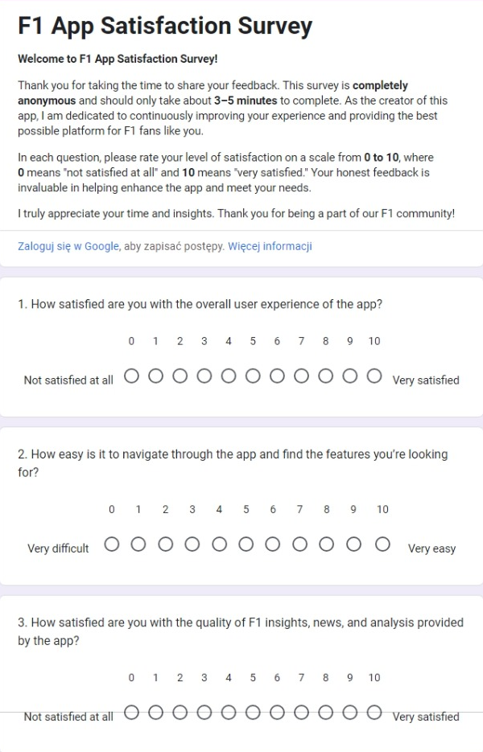
Part 1

Slide 9
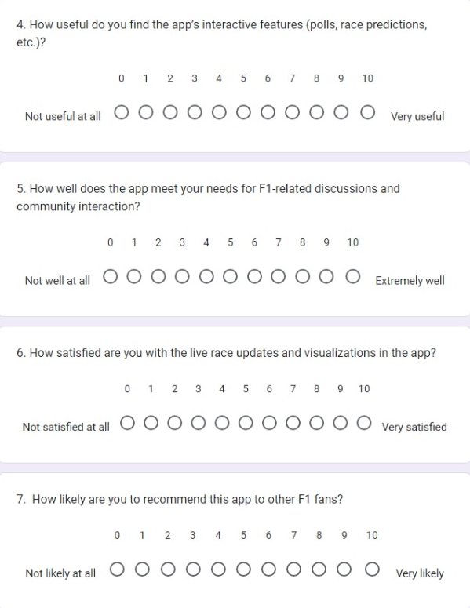
Part 2

Slide 10
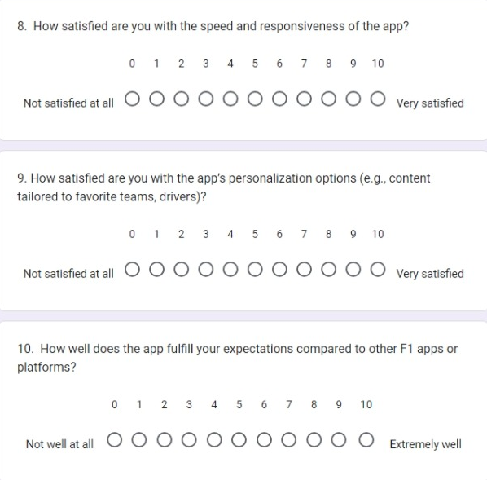
Part 3

Slide 11

Thank You!

