Slide 1
Multi-level Adaptive Prefetching based on Performance Gradient Tracking
Luis M. Ramos, José Luis Briz,
Pablo E. Ibáñez and Víctor Viñals.
University of Zaragoza (Spain)
DPC-1 - Raleigh, NC – Feb. 15th, 2009

Slide 2
Introduction
Hardware Data Prefetching
  Effective to hide memory latency
  No prefetching method matches every application
  Aggressive prefetchers (e.g. SEQT & stream buffers)
    Boost the average performance
    High pressure on mem. & perf. losses in hostile app.
    Filtering mechanisms (non negligible Hw)
    Adaptive mechanisms → tune the aggressiveness [Ramos et al. 08]
  Correlating prefetchers (e.g. PC/DC)
    More selective
    Tables store memory program behaviour (addresses or deltas)
    Megasized tables & number of table accesses
    PDFCM [Ramos et al. 07]
DPC-1 - Raleigh, NC – Feb. 15th, 2009

Slide 3




Introduction
Reasonable targets
One proposal to address each target
Using a common framework
  Prefetched blocks stored in caches
  Prefetch filtering techniques
  L1 → SEQT w/ static degree policy
  L2 → SEQT and/or PDFCM w/ adaptive degree policy based on performance gradient
I. minimize costs
II. cut losses for every app.
III. boost overall performance
DPC-1 - Raleigh, NC – Feb. 15th, 2009

Slide 4
Outline
Prefetching framework
Proposals
Hardware costs
Results
Conclusions
DPC-1 - Raleigh, NC – Feb. 15th, 2009

Slide 5
Prefetching framework
Prefetch Filters
inputs
MSHRs
Cache
Lookup
PMAF
to Queue
Prefetch Engine
Degree Controller
DPC-1 - Raleigh, NC – Feb. 15th, 2009
Notes:
Falta que vayan apareciendo poco a poco

Slide 6
Prefetching framework
Prefetch Filters
Cache
Lookup
PMAF
to L1Q
inputs
SEQT
L1
Degree Controller
Prefetch Filters
inputs
MSHRs
Cache
Lookup
PMAF
to L2Q
SEQT */ PDFCM*
L2
Degree Controller
* Depending on the proposal
DPC-1 - Raleigh, NC – Feb. 15th, 2009

Slide 7
SEQT Prefetch Engines
Prefetch Filters
Fed with misses and 1st uses of prefetched blocks
Load & stores
Includes a Degree Automaton to generate 1 prefetch / cycle
Maximum degree indicated by the Degree Controller
Cache
Lookup
PMAF
to L1Q
inputs
SEQT
L1
Degree Controller
Prefetch Filters
inputs
MSHRs
Cache
Lookup
PMAF
to L2Q
SEQT */ PDFCM*
L2
Degree Controller
* Depending on the proposal
DPC-1 - Raleigh, NC – Feb. 15th, 2009

Slide 8
PDFCM Prefetch Engine
Prefetch Filters
Delta correlating prefetcher
Trained with L2 misses & 1st uses
History Table & Delta Table
PDFCM operation
  update
  predict
  degree automaton
Cache
Lookup
PMAF
to L1Q
inputs
SEQT
L1
HT
DT
Degree Controller
PC
tag
cc
last @
history
Prefetch Filters
predicted δ
inputs
MSHRs
Cache
Lookup
PMAF
to L2Q
SEQT */ PDFCM*
L2
Degree Controller
* Depending on the proposal
DPC-1 - Raleigh, NC – Feb. 15th, 2009

Slide 9
PDFCM Operation
current
I. Update
1) index HT, check tag & read HT entry
training @: 20 22 24 30 32 34 40 …
40
δ: 2 2 6 2 2 …
2) check predicted δ and update conf. counter
3) calculate new history
2 2 6
2 6
HT
DT
4) update HT entry
PC
tag
cc
last @
history
II. Predict
last predicted δ ➔ 6
ok
6
actual δ ➔ 40 – 34 = 6
III. Degree Automaton
34
34
2 2
2 2
1) calculate speculative history
Prefetch: 40 + 2 = 42
2
+
2 6 2
2) predict next
+
Prefetch: 42 + 2 = 44
40
40
2 6
2
42
6 2
DPC-1 - Raleigh, NC – Feb. 15th, 2009

Slide 10
L1 Degree Controller
Prefetch Filters
L1 Degree Controller: static degree policy Degree (1-4)
  on miss → deg 1
  on 1st use → deg 4
Cache
Lookup
PMAF
to L1Q
inputs
SEQT
L1
Degree Controller
Prefetch Filters
inputs
MSHRs
Cache
Lookup
PMAF
to L2Q
SEQT */ PDFCM*
L2
Degree Controller
* Depending on the proposal
DPC-1 - Raleigh, NC – Feb. 15th, 2009
Notes:
- The DCs monitor the automaton degree of the prefetch engines
- Implements one of our static degree policies called

Slide 11
L2 Degree Controller
L2 Degree Controller:
Performance Gradient Tracking
Prefetch Filters
Cache
Lookup
PMAF
to L1Q
inputs
-
SEQT
Deg++
Deg- -
L1
Degree Controller
+
+
Prefetch Filters
-
inputs
MSHRs
Cache
Lookup
PMAF
to L2Q
+: current epoch (64K cycles) more performance than previous
-: current epoch less performance than previous
SEQT */ PDFCM*
L2
Degree Controller
* Depending on the proposal
Degree [0, 1, 2, 3, 4, 6, 8, 12, 16, 24, 32, 64]
-
+
DPC-1 - Raleigh, NC – Feb. 15th, 2009
Notes:
L2 degree controller is more complex
The controller has 2 states
Increasing degree
Decreasing degree
Every epoch (64? Kcycles)
more performance than previous → maintain the state
Update the degree [0, 1, 2, 3, 4, 6, 8, 12, 16, 24, 32, 64]

Slide 12
Prefetch Filters
Prefetch Filters
16 MSHRs in L2 to filter secondary misses
Cache Lookup eliminates prefetches to blocks that are already in the cache
PMAF is a FIFO holding up to 32 prefetch block addresses issued but not serviced yet
Cache
Lookup
PMAF
to L1Q
inputs
SEQT
L1
Degree Controller
Prefetch Filters
inputs
MSHRs
Cache
Lookup
PMAF
to L2Q
SEQT */ PDFCM*
L2
Degree Controller
* Depending on the proposal
DPC-1 - Raleigh, NC – Feb. 15th, 2009
Notes:
Bc it affects very much to the learning process of the PDFCM

Slide 13
Three goals, three proposals
Three reasonable targets
I. minimize costs
II. cut losses for every app.
III. boost overall performance
Mincost (1255 bits)
Minloss (20784 bits)
Maxperf (20822 bits)
SEQT
PDFCM
SEQT & PDFCM
L2 Prefetch Engine
L1 SEQT Prefetch Engine - degree policy Degree (1-4)
Adaptive degree by tracking performance gradient in L2
Prefetch Filters
DPC-1 - Raleigh, NC – Feb. 15th, 2009

Slide 14
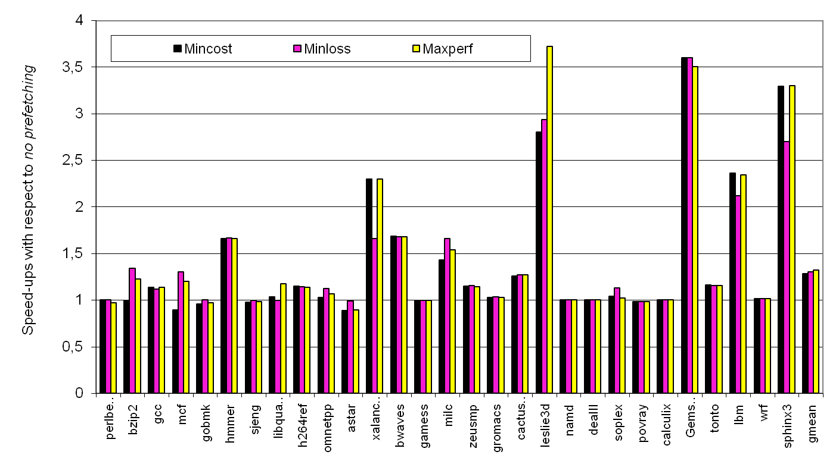
Results: the three proposals
DPC-1 environment
SPEC CPU 2006
40 bill. warm, 100 mill. exec.
DPC-1 - Raleigh, NC – Feb. 15th, 2009

Slide 15
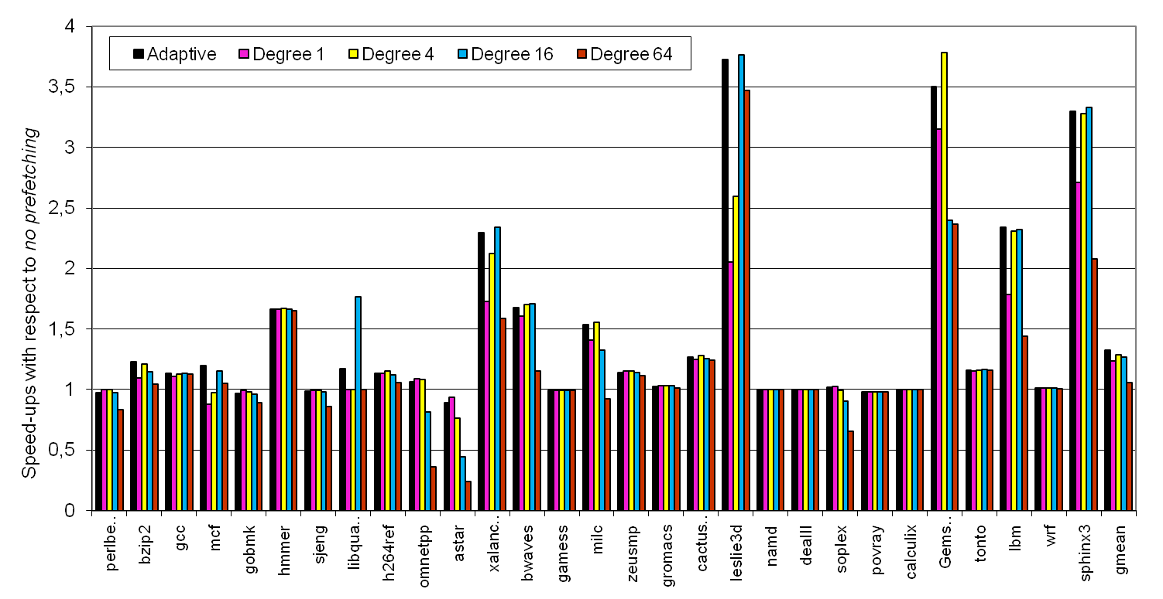
Results: adaptive vs. fixed degree
16
4
1
DPC-1 - Raleigh, NC – Feb. 15th, 2009

Slide 16
Conclusions
Different targets lead to different designs
Common multi-level prefetching framework
Three different engines targeted to:
  Mincost → minimize cost (~1 Kbit)
  Minloss → minimize losses (< 1% in astar; < 2% in povray)
  Maxperf → maximize performance (11% losses in astar)
The proposed adaptive degree policy is cheap (131 bits) & effective
DPC-1 - Raleigh, NC – Feb. 15th, 2009

Slide 17

Thank
you
DPC-1 - Raleigh, NC – Feb. 15th, 2009

Slide 18
