Slide 1
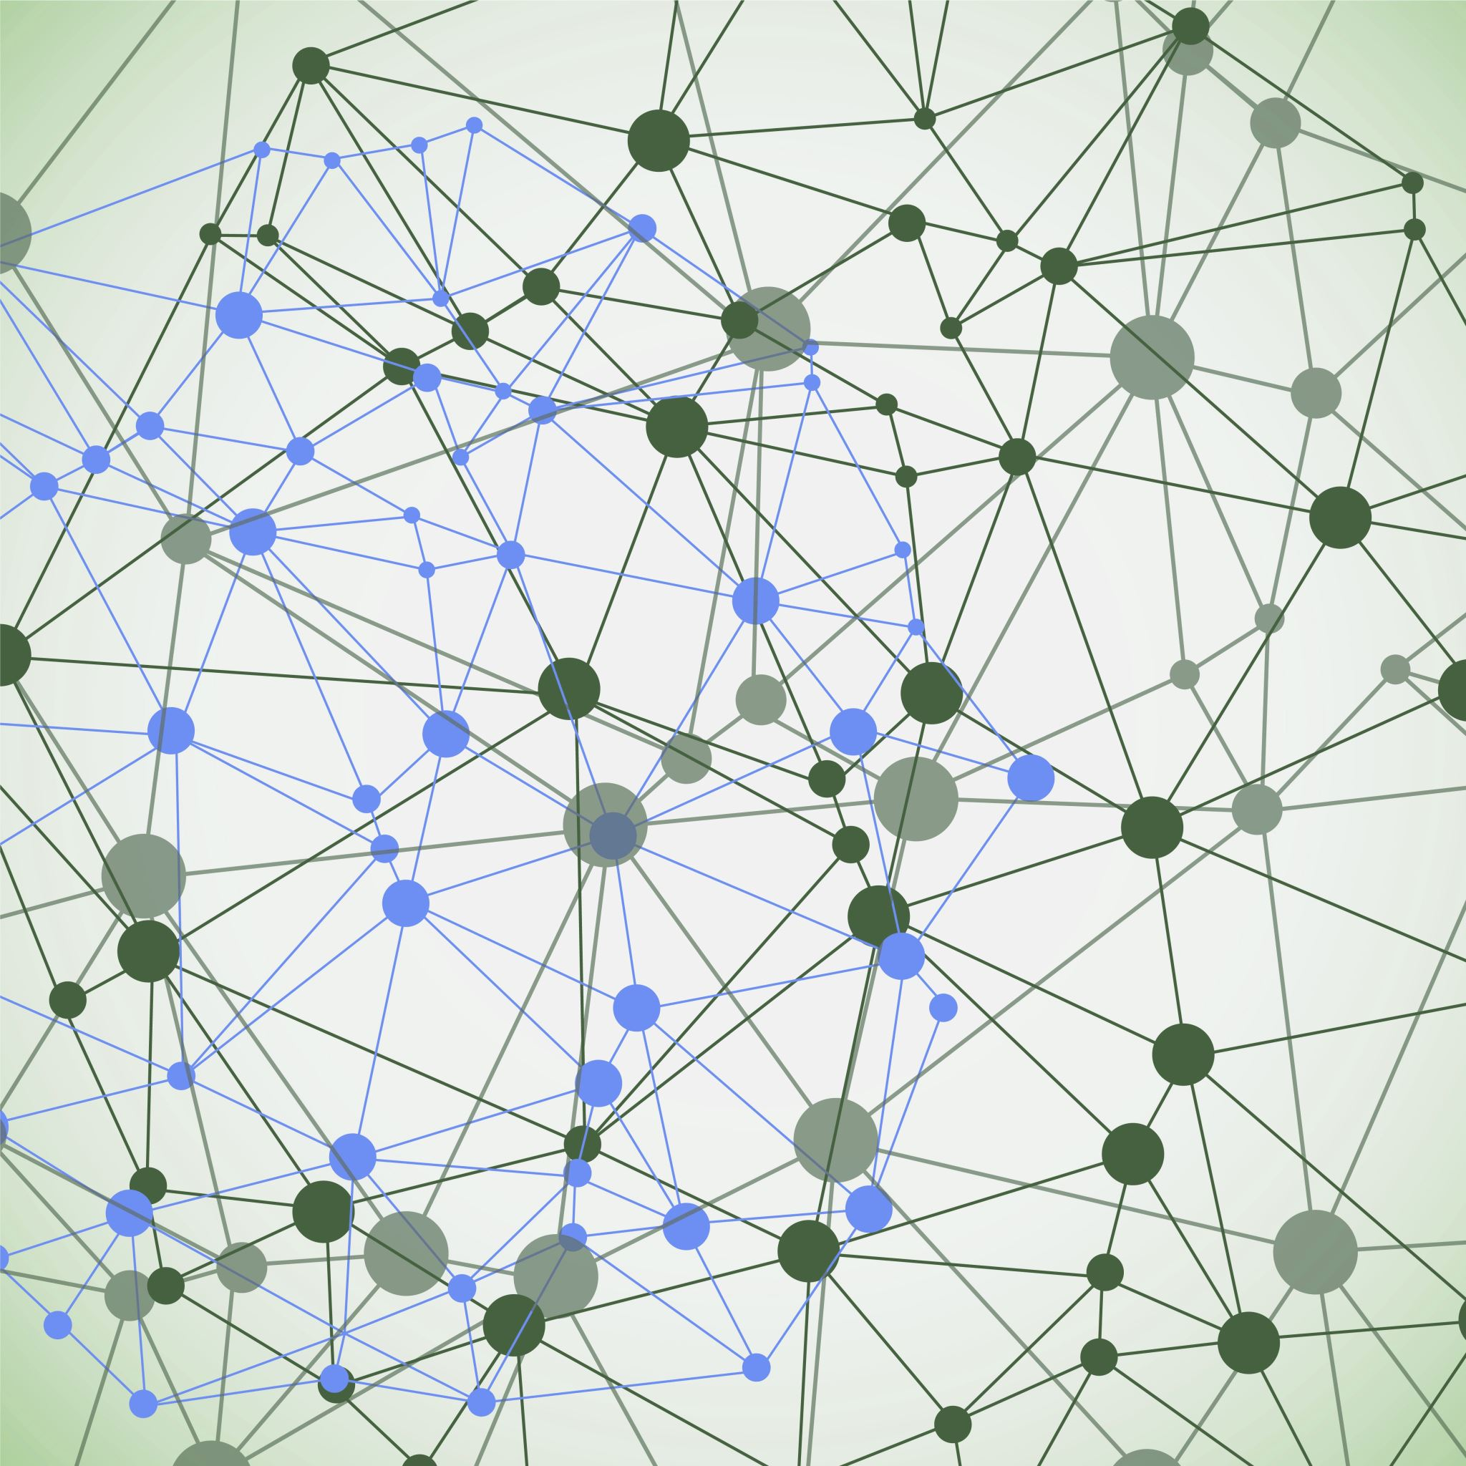
Wikipedia article and discussion analysis
Group members:
Alexander Zimmer
Andreas Stehle
Eper Stinner

Slide 2
Project idea
Analyze subset of Most Valuable Wikipedia pages
Analyze page content, correlate with history and related talk page
Find patterns in discussions, page content and history
Find page sentiments by category, discussion, page content, etc.
Find patterns in page contributions, discussions by users

Slide 3
Why do this?
Because we can.

Slide 4
Data exploration
Data scraped using Wikipedia API
Number of pages: 1000 (depending on level)
Network generated from links between pages
Add user-nodes based on article discussion or edits to network

Slide 5
Data source
Set of English Wikipedia pages: Vital articles
Contains most important pages
Multiple levels with different number of articles
Each level organized into categories
We will consider:
Page contents
related discussions
page history

Slide 6
Research questions
Do users who edit a lot also discuss a lot about an article?
Do users usually focus on editing certain categories?
Find sentiment in discussions of pages, potentially per category.
Find sentiment for article content per category
Correlate article categories with edit activity, user discussion participation, etc.
Connect pages with each other. Do page connection clusters correlate to categories?
Are there any users appearing often together in the same discussion page?

