Slide 1
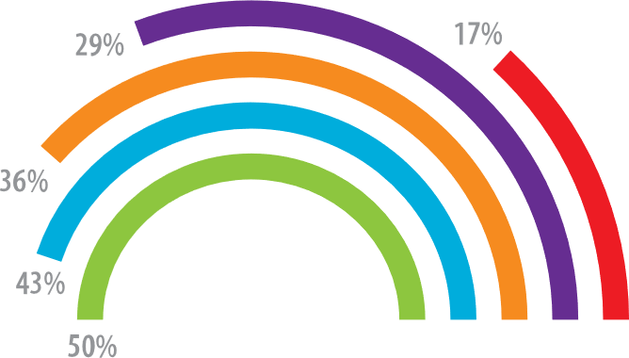
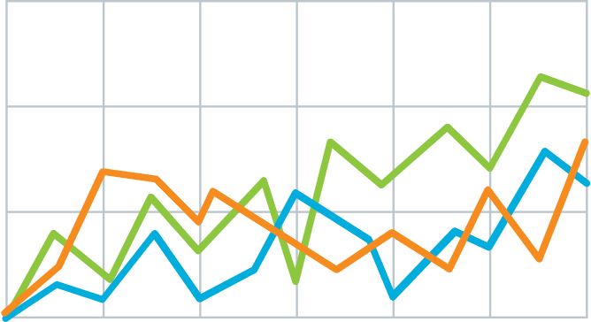


Tracking poop signals improves COVID warnings but is unreliable on its own.
v
🚑 & 🚽 󠀾󠀾 -> ⚠️
vs.
🚑 | 🚽 󠀾󠀾 -> 🤷⚠️
Explain what the graph shows. Like, spoilers are good.
Quickly explain what the graph shows. Help people think.
v
v
LEM HEWITT, Phillip Merman, Ted crisp
EXAMPLE Graphics donated by biorender.com
PrePrint

