Slide 1




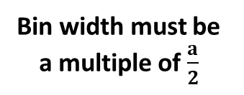



1st-nearest neighbour axes
$$120°$$
Bin edges
$$2r_{0}$$
$$a=2r_{0}\sin\left(60°\right)=\sqrt{3} r_{0}$$
$$a$$
Perpendicular to axes
$$r_{0}$$
$$\frac{r_{0}}{2}$$
$$a$$
Bin width must be a multiple of $\frac{a}{2}$
$$\frac{a}{2}$$
$$\frac{a}{2}$$

Slide 2


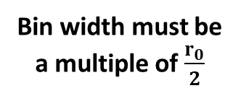


2nd-nearest neighbour axes
Bin edges
$$120°$$
Perpendicular to axes
$$2r_{0}$$
$$a=2r_{0}\sin\left(60°\right)=\sqrt{3} r_{0}$$
$$r_{0}$$
$$r_{0}$$
$$a$$
$$\frac{r_{0}}{2}$$
Bin width must be a multiple of $\frac{r_{0}}{2}$
$$\frac{r_{0}}{2}$$
$$\frac{r_{0}}{2}$$

Slide 3
Well-defined lower left hexagon
Two possible lower left hexagons

Slide 4

1st-nearest neighbour axes
Axis 1: 30° to $x$-axis

Slide 5
1st-nearest neighbour axes
Axis 1: 30° to $x$-axis

Slide 6
1st-nearest neighbour axes
Axis 1: 30° to $x$-axis

Slide 7
1st-nearest neighbour axes
Axis 1: 30° to $x$-axis

Slide 8
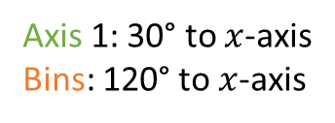
1st-nearest neighbour axes with well-defined lower left hexagon
Axis 1: 30° to $x$-axis
Bins: 120° to $x$-axis

Slide 9
1st-nearest neighbour axes with undefined lower left hexagon
Axis 1: 30° to $x$-axis
Bins: 120° to $x$-axis

Slide 10
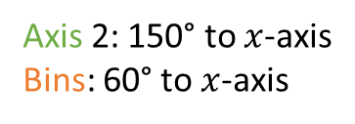
1st-nearest neighbour axes with well-defined lower left hexagon
Axis 2: 150° to $x$-axis
Bins: 60° to $x$-axis

Slide 11
1st-nearest neighbour axes with undefined lower left hexagon
Axis 2: 150° to $x$-axis
Bins: 60° to $x$-axis

Slide 12

1st-nearest neighbour axes with well-defined lower left hexagon
Axis 3: 90° to $x$-axis
Bins: 0° to $x$-axis

Slide 13
1st-nearest neighbour axes with undefined lower left hexagon
Axis 3: 90° to $x$-axis
Bins: 0° to $x$-axis

Slide 14

2st-nearest neighbour axes with well-defined lower left hexagon
Axis 1: 60° to $x$-axis
Bins: 150° to $x$-axis

Slide 15
2st-nearest neighbour axes with undefined lower left hexagon
Axis 1: 60° to $x$-axis
Bins: 150° to $x$-axis

Slide 16

2st-nearest neighbour axes with well-defined lower left hexagon
Axis 2: 120° to $x$-axis
Bins: 30° to $x$-axis

Slide 17
2st-nearest neighbour axes with undefined lower left hexagon
Axis 2: 120° to $x$-axis
Bins: 30° to $x$-axis

Slide 18
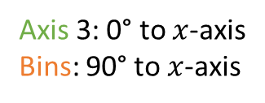
2st-nearest neighbour axes with well-defined lower left hexagon
Axis 3: 0° to $x$-axis
Bins: 90° to $x$-axis

Slide 19
2st-nearest neighbour axes with undefined lower left hexagon
Axis 3: 0° to $x$-axis
Bins: 90° to $x$-axis

Slide 21
30°
60°

