Slide 1
Exploration of US COVID-19 Outbreak Time-Series Data And U. Turken Galvanize Capstone 1

Slide 2
Data description: Daily updates of reported COVID-19 cases for each state and county in the United States (states and oversears territories) starting from 01-22-2020
Data source: https://www.nytimes.com/coronavirus-county-data-us.html
Description of data: Open source web data; aggregated from multiple source and made available to the public by New York Times
No quality issues specific to this dataset noted. However, there are several caveats regarding the interpretation of COVID-19 case reports that are available

Slide 3
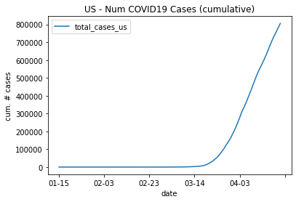
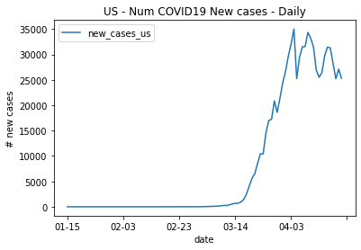
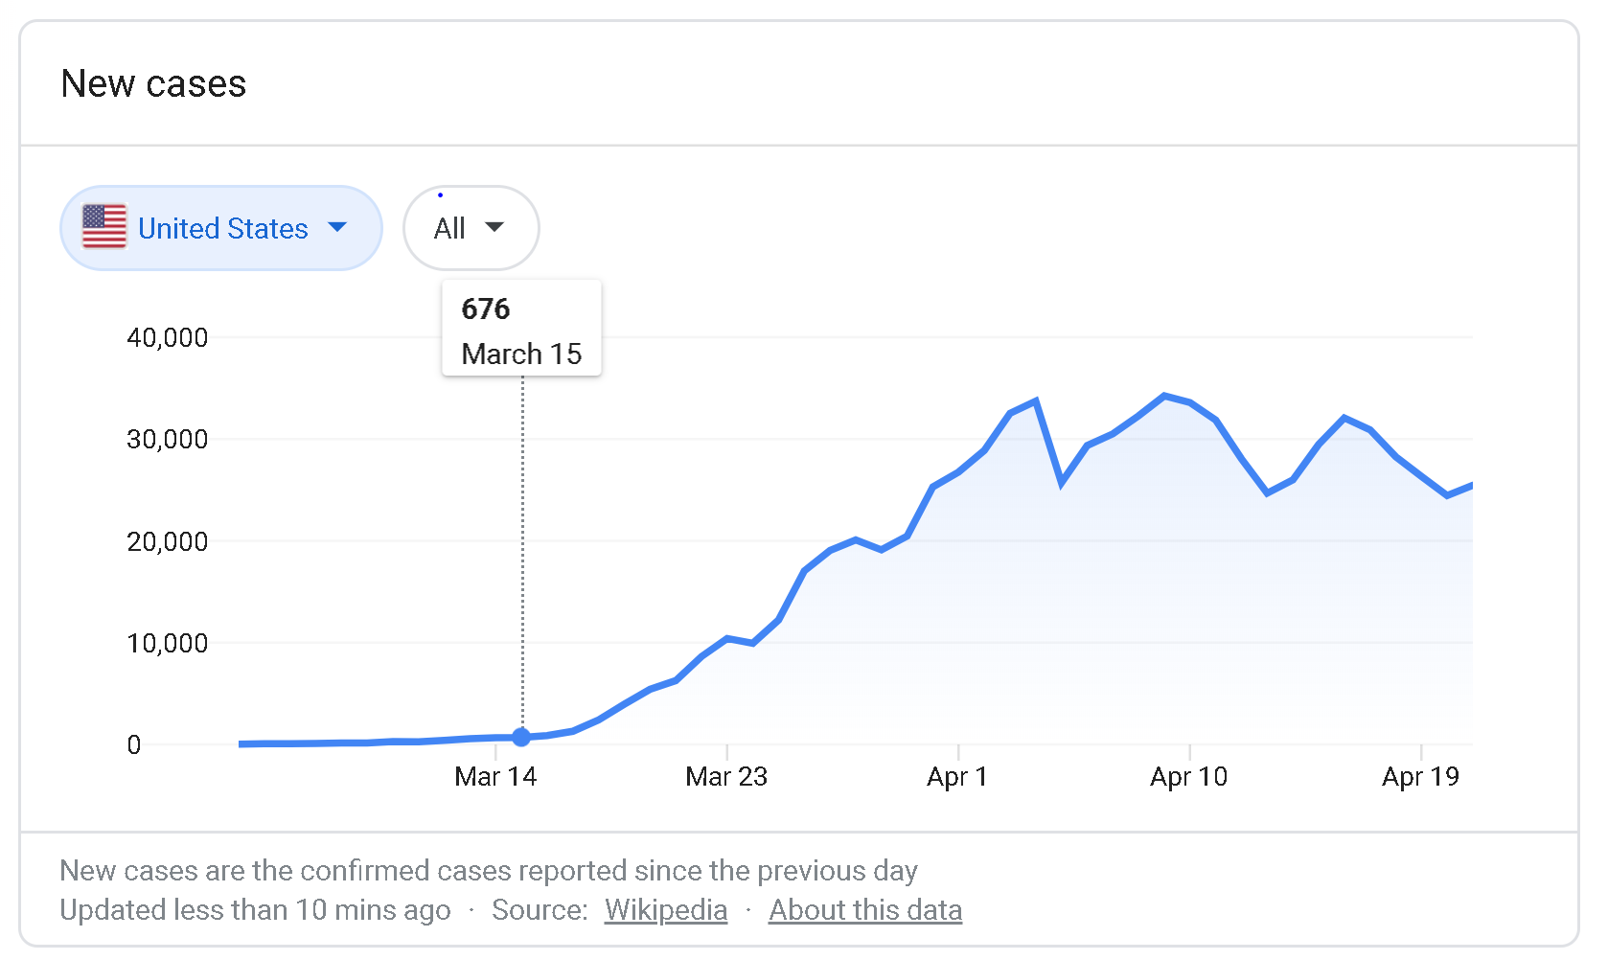
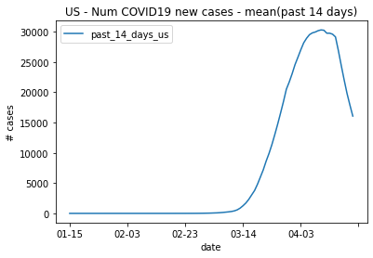

Slide 4
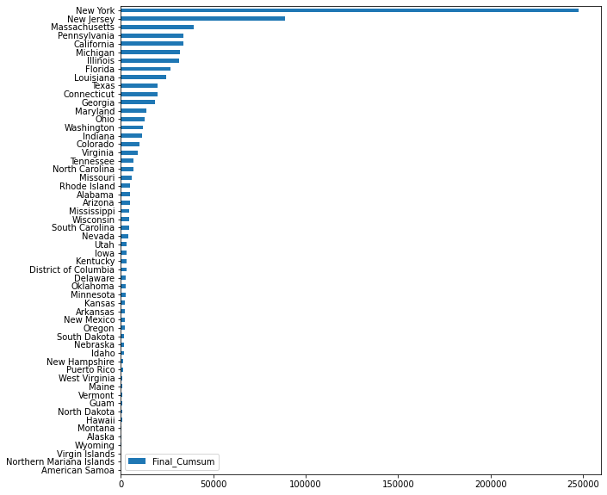
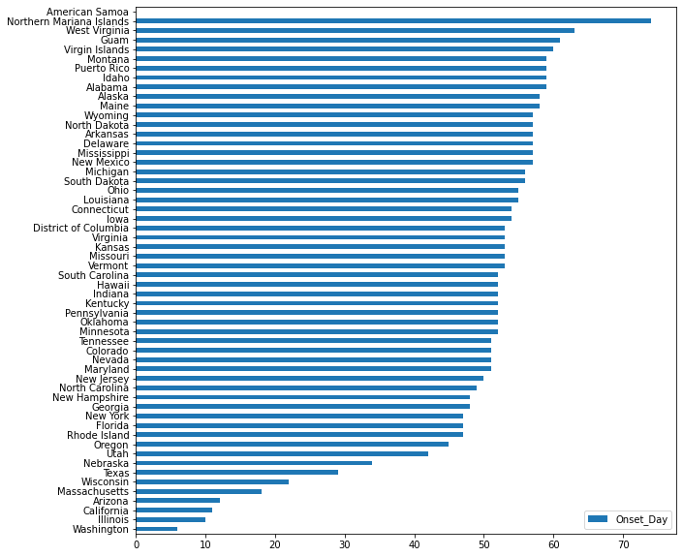
Reported number of cases (cumulative) by state
Date 04/22/2020
Day on which the first case was reported for
each state, Day 0 = 01/15/2020

Slide 5
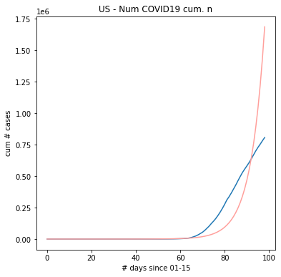
Exponential growth model fit for cumulative number of reported COVID-19 cases in the US since 01/15/2020
Red: Predictions from exponential growth model
(Estimated growth rate: 1.17)
Blue: Actual number of cases in the US *cumulative)

Slide 6
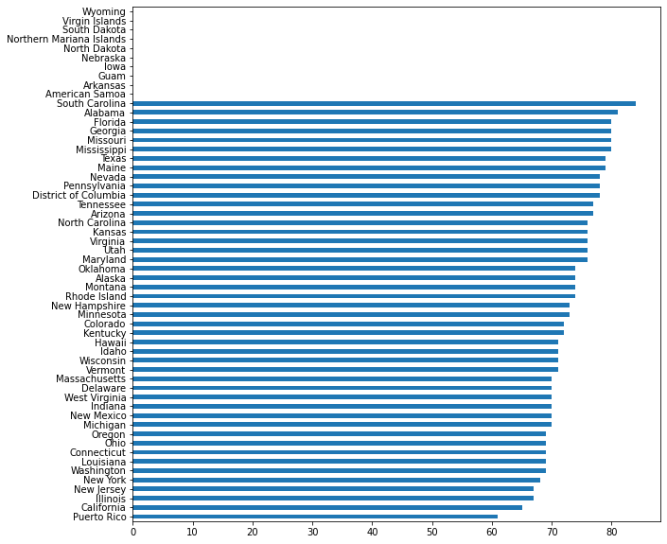
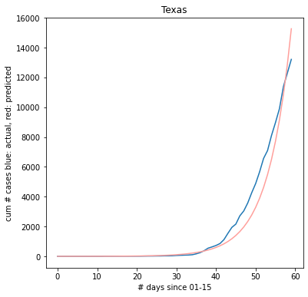
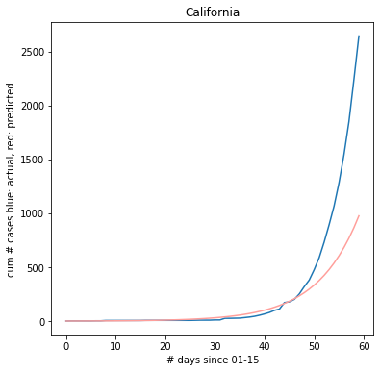
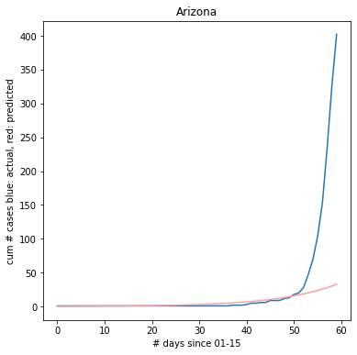
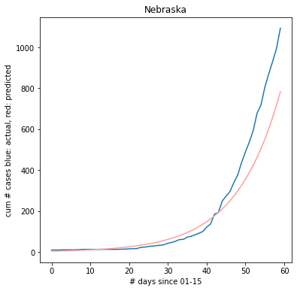
US total case # growth curve is actually a superposition of multiple growth curves, each specific to infection dynamics and public health policies in each part of US. Exponential growth model fits are highly variable across states
Left: Day on which stay-home orders were issued Day 0 = 01/15

Slide 7
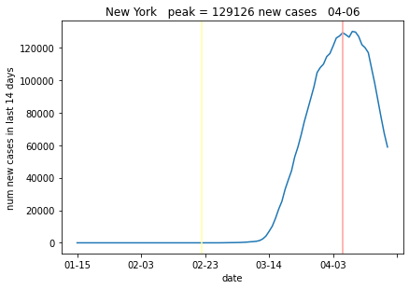
- Gave up on time series model fitting, given several complications in the exploration - However, another approach appeared to be more promising
Smoothed time series: Daily number of cases for each state, convolved with a 14 day moving average window
Find date at which peak number of cases have been reported
Examine whether there has truly been a reduction in the number of new COVID-19 cases by quantifying how many days before 04/21/20 (day of last analysis) a peak (if any) can be found

Slide 8
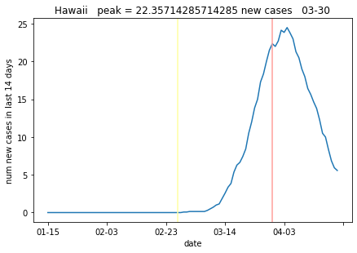
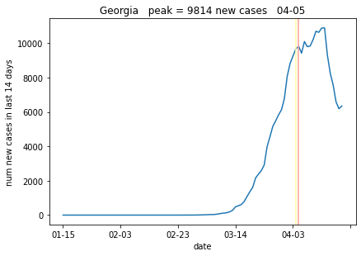
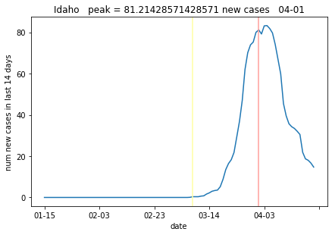
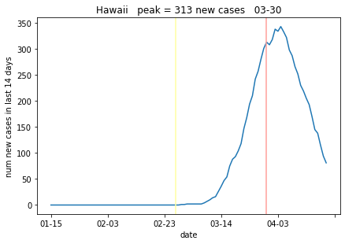

Slide 9
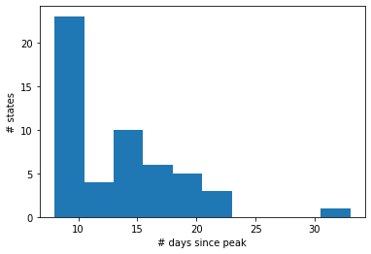
-By 04/03/2020, the majority of states in the US had stay-home orders -Within two weeks of 04/03/2020, observation of peaks state-wide case time series suggests a reduction in the number of new cases reported - However, peak identification has at least one obvious error - Need better approach for analyzing case report time series

