Slide 1
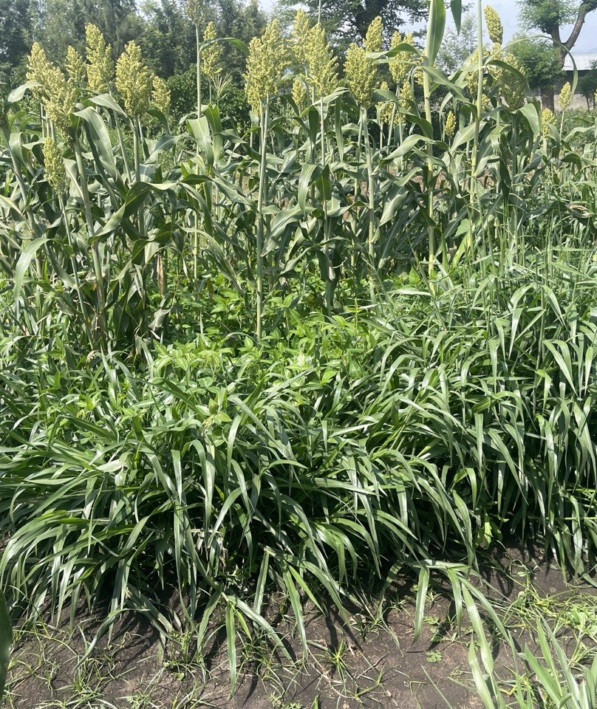
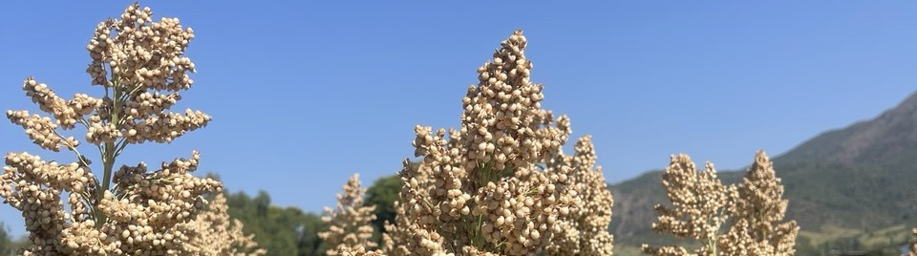



Scaling Push–Pull Technology for Sustainable Sorghum Production in Ethiopia
Evidence and Policy for Ethiopia
Implementation • Investment priorities • Evidence gaps
November 9, 2026 · Adulala Resort, Bishoftu, Ethiopia.
Mr. Ghebremedhin Belay, Getnet Atenafu (PhD), and Mr. Andargachew Detebo.
Notes:
Push–Pull Technology in Ethiopian Sorghum Production
Evidence and scaling options for the sorghum policy dialogue.
9 November 2026 · Adulala Resort, Bishoftu
Sorghum presenter · Getnet Atenafu (PhD), Debre Markos University
Evidence paper · Andargachew Detebo Chafamo, Institute for Sustainable Development (ISD), Ethiopia
Policy question. Where should Ethiopia support sorghum push–pull first, and what evidence should guide expansion?
Sources [Workshop programme, p. 1] [Presentation outline, slide 1] [Doc 1, cover and pp. 6, 8] [Doc 2, slide 1]. Supplied hero image.

Slide 2
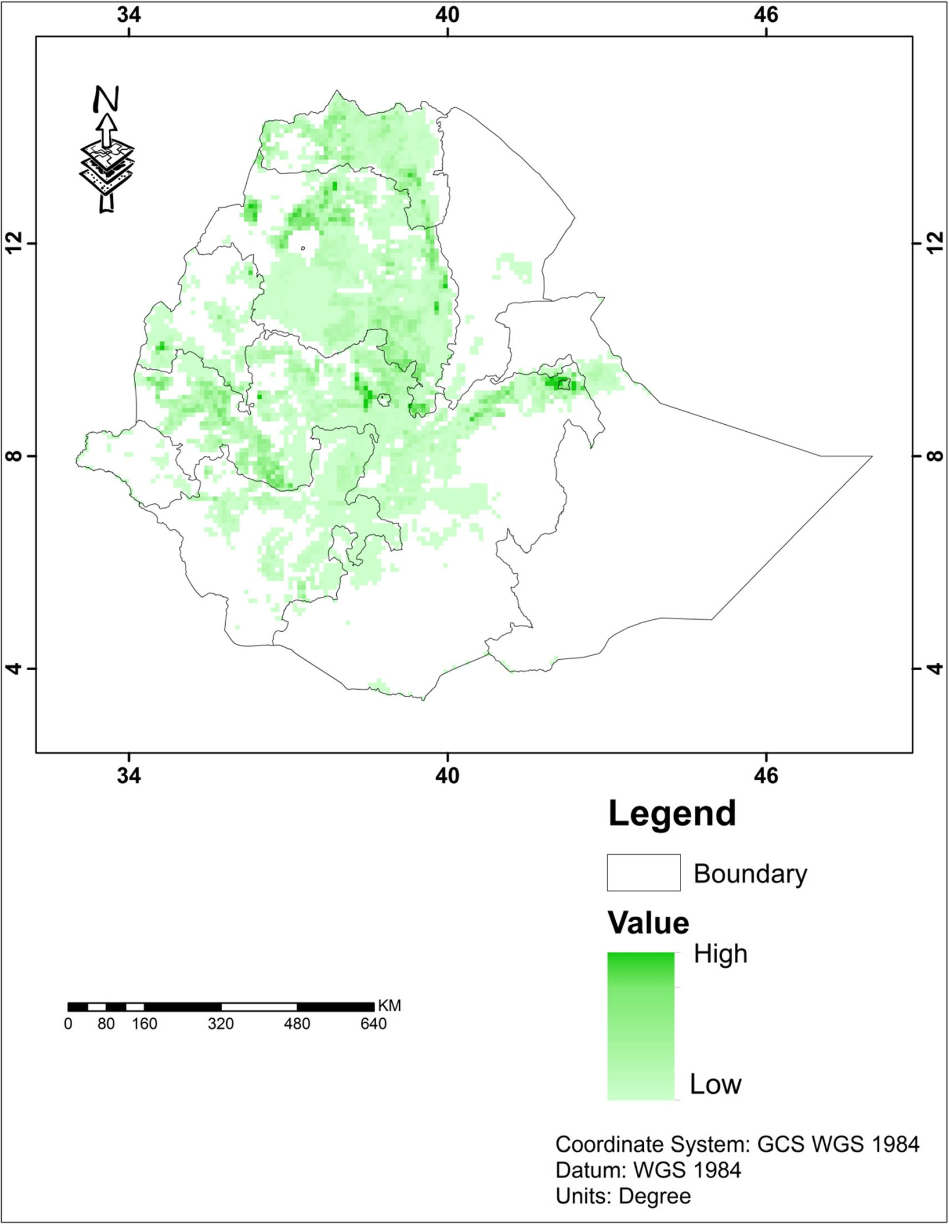



Sorghum production potential in Ethiopia
National production figures and evidence of yield gains
Sorghum production areas
National production scale
Marketing year | 2025/26 | 2026/27 Forecast
Area (million ha) | 1.60 | 1.65
Production (million tonnes) | 3.90 | 4.10
Yield (t/ha) | 2.44 | 2.48
Relative
area
High
Low
Main belts: northern Ethiopia, Hararghe,
Rift Valley and the southwest
Notes:
Source paper supplied by the user: Biyensa Gurmessa, Haile Deressa, Alem G. Tsadik, Abnet Dereje and Wondimu Tesfaye (2019). Effects of improved practices on grain sorghum stalk borer and weeds: case studies from three regions of Ethiopia. Phytoparasitica 47:227–239. https://doi.org/10.1007/s12600-019-00719-0.
National figures from the supplied Executive Summary: Key Figures at a Glance (image(6).png): MY 2025/26 production 3.90 million tonnes, area 1.60 million hectares, national yield 2.44 t/ha. MY 2026/27 forecast production 4.10 million tonnes, area 1.65 million hectares, national yield 2.48 t/ha. The forecast label applies to all three 2026/27 figures. The supplied executive summary does not identify the primary statistical source for these figures. Values are reproduced from that supplied slide. MY means marketing year.
Constraints in the same executive summary: market disincentives, Striga infestation, stemborers and drought stress.
Map: original Figure 1, journal page 229. The paper attributes the underlying distribution data to You et al. (2014), Spatial Production Allocation Model (SPAM) 2005 v2.0. The administrative boundaries and distribution are historical. The map shows production area distribution, not suitability, production volume, or measured yield potential. The legend indicates relative high and low values because the source does not provide numeric classes.
Main belts: the paper identifies southern Tigray, northern Wollo, central Rift Valley lowlands, west and east Hararghe, and southwest Ethiopia, including Jimma and Ilubbabor (journal page 230).
Trial performance: the abstract reports a 68% increase in sorghum grain yield to 5600 kg per hectare, equal to 5.6 tonnes per hectare, in southern Tigray. Journal page 232 describes the integrated treatment as removal of stubbles, ash application, and pesticide application. The southern Tigray study covered four localities and twenty farms, with six treatments in a randomized complete block design using farms as replicates. These results are site specific, not national attainable yields. This experiment did not test push–pull. The slide does not recommend the pesticide used in the historical study.
Interpretation: the statement about higher yields synthesises the paper's findings that stalk borers, weeds and nutrient limitations constrain yields, with management options differing by location. The national production forecast is taken from the supplied executive summary. No national yield target or push–pull impact estimate is calculated.
Copyright: map reproduced from the supplied article, © Springer Nature B.V. 2019. Attribution retained in the slide and notes.
Partner logos: original ISD(1).jpg, ICIPE(1).jpg and Biovision(1).jpg supplied by the user for the policy dialogue materials.

Slide 3
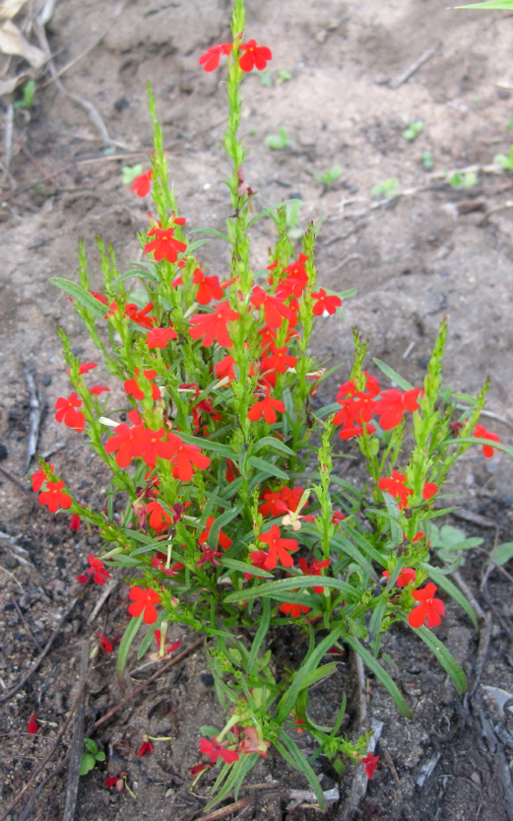
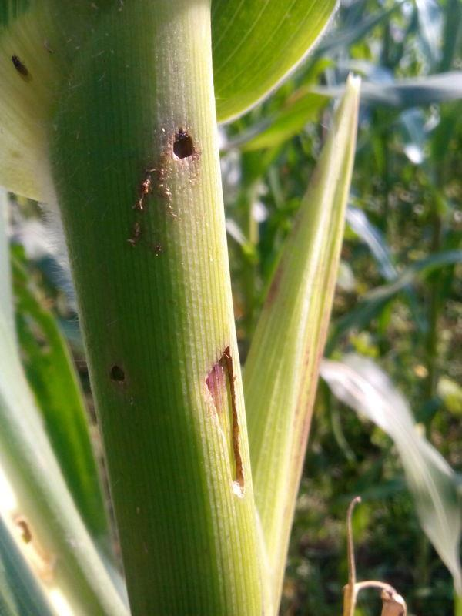
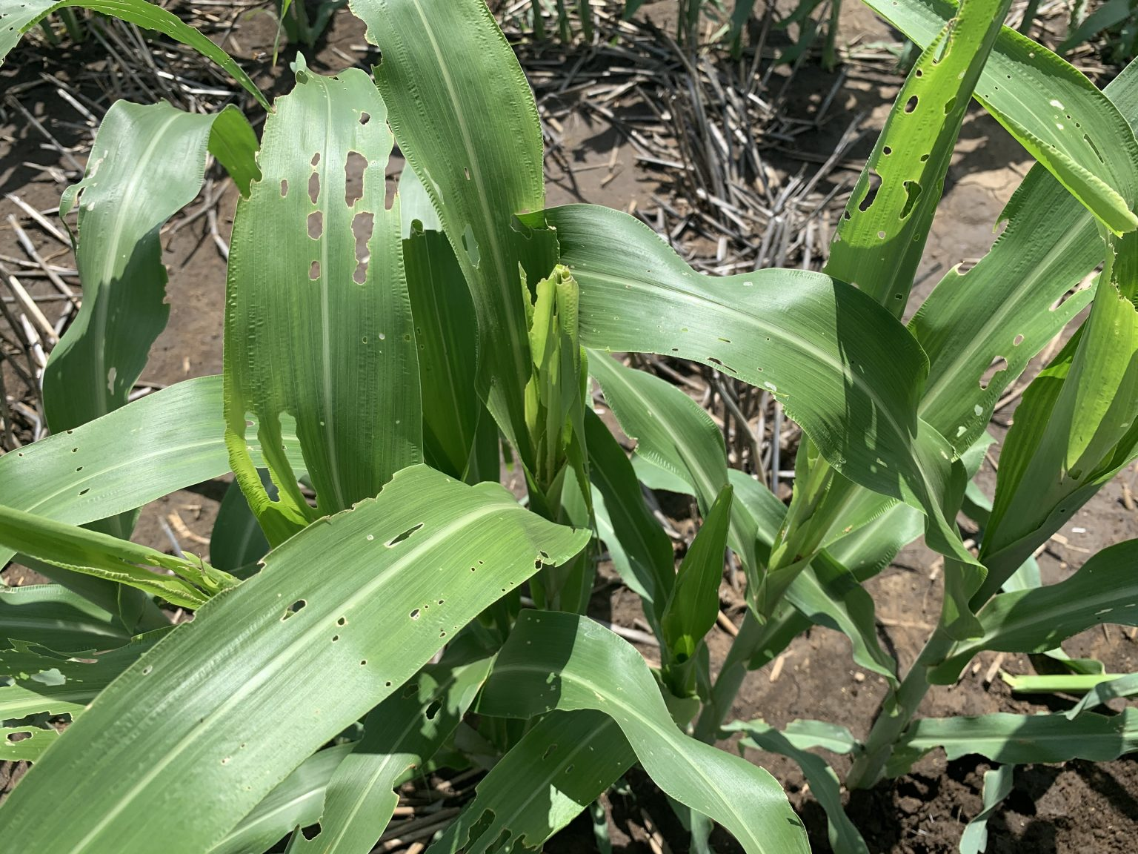
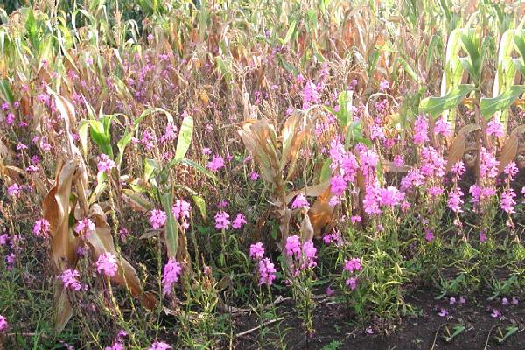
BASELINE CONSTRAINTS
Sorghum Production Challenges in Ethiopia
Parasitic Striga weeds
Stemborers and fall armyworm
Severe Striga infestation threatens sorghum grain production.
Stemborer leaf damage reached 50.8–76.2% in sole-sorghum trials (Asmare, 2014).
Striga hermonthica
Striga asiatica
Stemborer damage
Fall armyworm damage
Shewarobit, 2023
Kalu woreda, 2025
Kalu woreda and
Shewarobit, 2021
Kalu woreda and
Shewarobit, 2021
Soil fertility and moisture stress
Declining soil fertility, erratic rainfall and prolonged dry periods add to production risks.
Notes:
Asmare (2014): https://connectjournals.com/file_full_text/2143302H_176-183.pdf
Asmare et al. (2022): https://doi.org/10.1007/s42690-021-00637-x
These two sorghum studies support the stemborer and Striga evidence. They do not provide fall armyworm trial results.
Photo captions supplied by the presenter: Striga hermonthica, Shewarobit, 2023; Striga asiatica, Kalu woreda, 2025. Stemborer and fall armyworm photographs: Kalu woreda and Shewarobit, 2021. The locations and years apply jointly to the two pest photographs. These photographs illustrate damage and are separate from the cited experiments.

Slide 4
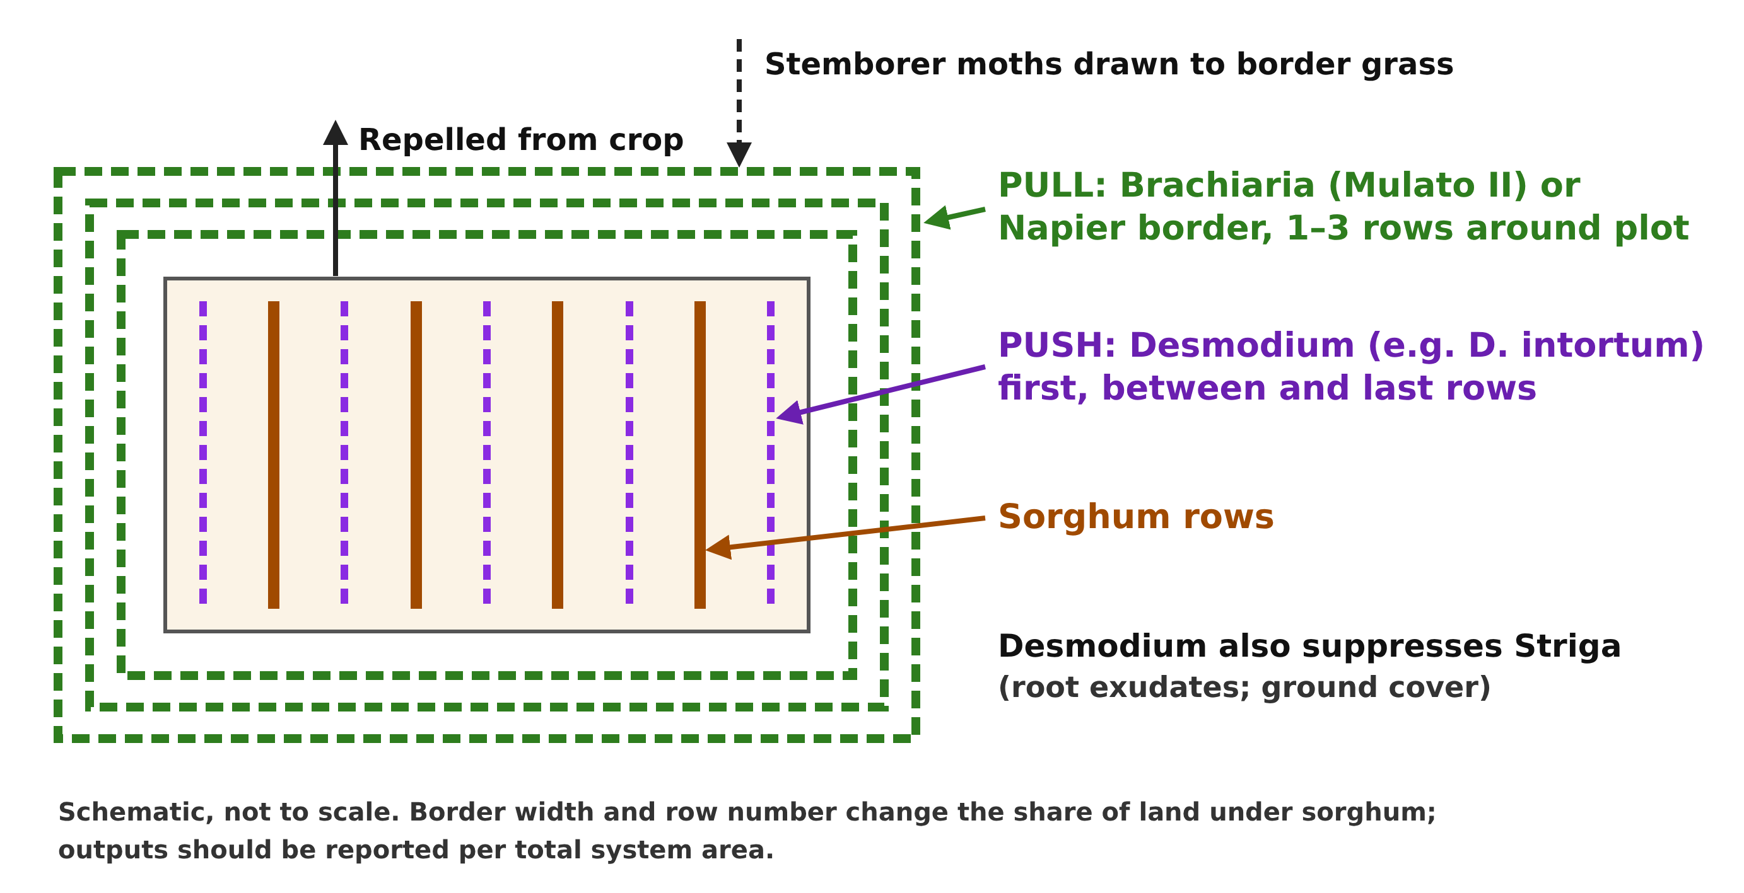
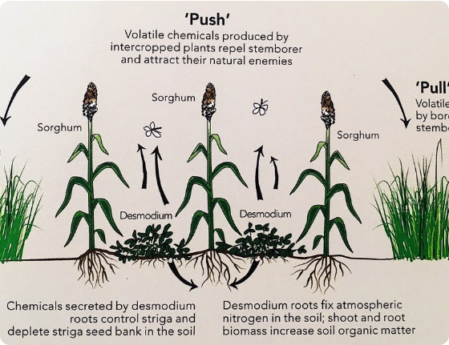
FIELD EVIDENCE
Push–Pull Setup and Pest Management
04 / 25
Notes:
- Setup. Sorghum grows with a *Desmodium* intercrop and an outer grass border, such as Napier or *Brachiaria*. The intercrop suppresses *Striga* and helps deter stemborer moths. The border functions as a trap crop and provides forage. [Doc 1, pp. 8–12]
- **Emerged *Striga*. In Eastern Amhara, 2017–2018, the study reported 3 versus 15 plants m⁻²** under push–pull and sole sorghum, respectively. The published study reports 61 farmers’ fields. [Asmare et al., 2022, abstract]
- Stemborer leaf damage. In Chefa and Lenchedima, 2009–2010, the reported range was 7.3–11.9% versus 50.8–76.2% under push–pull and sole sorghum across 12 farmers’ fields. [Asmare, 2014, Tables 1 and 3] [Doc 1, pp. 13, 21–23]
Sources [Asmare, 2014, Tables 1 and 3] [Asmare et al., 2022, abstract] [Doc 1, pp. 8–13, 21–23] [Doc 2, slides 3–4, 9, 11].
Asmare (2014): https://connectjournals.com/file_full_text/2143302H_176-183.pdf
Asmare et al. (2022): https://doi.org/10.1007/s42690-021-00637-x
These two sorghum studies support the stemborer and Striga evidence. They do not provide fall armyworm trial results.

Slide 5
Push–Pull Farming System in Sorghum
Ecological pest diversion, Striga suppression, and companion fodder generation
PUSH COMPONENT
(Intercropped Legume)
• Companion: Silverleaf Desmodium (D. uncinatum) or Greenleaf (D. intortum).
• Mechanism: Emits volatile chemicals that repel stemborer moths.
• Striga Control: Root exudates induce suicidal germination of Striga seeds without host attachment.
• Agronomic Benefit: improve soil fertility (Fixes atmospheric nitrogen) and provides high-protein livestock forage.
Desmodium fixes atmospheric nitrogen and covers soil to preserve moisture. Both companion crops provide year-round nutrient-dense livestock fodder.
MAIN CROP
(Sorghum bicolor)
• Layout: Planted in regular rows intercropped with Desmodium.
• Protected Zone: Dramatic reduction in pest moth oviposition and Striga seedbank attachment.
• Yield Realization: Field grain yields increased from 2.4-2.5 t ha⁻¹ to 4.0-4.6+ t ha⁻¹ under full system protection.
• Stover Quality: Complementary feed source combined with companion grasses/legumes.
PULL COMPONENT
(Border Forage Grass)
• Companion: Napier Grass (Pennisetum purpureum) or Brachiaria (Mulato II / Xaraes).
• Layout: 2 to 3 border rows surrounding the sorghum-Desmodium plot.
• Mechanism: Attracts stemborer moths; secretes sticky gum that traps larvae, preventing adult emergence.
• Economic Output: Provides abundant, cut-and-carry fodder throughout the season.
Notes:
Asmare (2014): https://connectjournals.com/file_full_text/2143302H_176-183.pdf
Asmare et al. (2022): https://doi.org/10.1007/s42690-021-00637-x
These two sorghum studies support the stemborer and Striga evidence. They do not provide fall armyworm trial results.

Slide 6
National Sorghum Production Challenges in Ethiopia
Biophysical, environmental, and market constraints limiting smallholder productivity
1. Biological Pests & Weeds
• Striga hermonthica causing 60-90% yield loss in Northern/Eastern Ethiopia.
• Stemborers (Chilo partellus) causing high leaf damage (up to 76%) & chaffy heads.
• Fall Armyworm (Spodoptera frugiperda) emerging as key threat.
2. Climate & Soil Degradation
• Rainfall variability leading to moisture stress at sowing and grain fill.
• Widespread soil nutrient depletion, organic matter loss, and low CEC(cation exchange capacity).
• Crop-companion competition risks under erratic moisture onset.
3. Value Chain & Disincentives
• FAO 2026 analysis highlights price disincentives & weak market links.
• High input costs for chemicals with low efficacy against internal stemborers.
• Forage deficits restricting crop-livestock integration and dairy productivity.
Systemic Impact on Smallholders
• Chronic yield gap: Current national average of 2.44–2.48 t ha⁻¹ remains far below potential station/demonstration yields (4.5+ t ha⁻¹).
• High vulnerability of resource-poor farmers who cannot afford chemical pesticides or synthetic fertilizers.
• Interlocking feed-food shortages requiring integrated cropping options that yield both cereal grain and high-quality livestock forage.
Notes:
Asmare (2014): https://connectjournals.com/file_full_text/2143302H_176-183.pdf
Asmare et al. (2022): https://doi.org/10.1007/s42690-021-00637-x
These two sorghum studies support the stemborer and Striga evidence. They do not provide fall armyworm trial results.

Slide 7
THE POLICY QUESTION
Why Policy Action Is Needed
Household grain and income
Striga and stemborer damage reduce harvests in affected fields. The net household benefit of push–pull depends on additional grain, usable forage, establishment costs and labour.
Land and water
Companion crops add soil cover and forage, while the border occupies land and live companions use water. Local comparisons should measure these effects together.
Delivery
Farmers need timely planting material, practical establishment advice and locally tested recommendations. The dialogue should assign responsibilities across seed supply, extension and research.
03 / 25
Notes:
- Household grain and income. *Striga* and stemborer damage reduce harvests in affected fields. The net household benefit of push–pull depends on additional grain, usable forage, establishment costs and labour. [Doc 1, pp. 10, 21–23, 27–31]
- Land and water. Companion crops add soil cover and forage, while the border occupies land and live companions use water. Local comparisons should measure these effects together. [Doc 1, pp. 23–25, 30–31, 44–45, 57–59]
- Delivery. Farmers need timely planting material, practical establishment advice and locally tested recommendations. The dialogue should assign responsibilities across seed supply, extension and research. [Doc 1, pp. 41–43, 60–65, 74]
Sources [Doc 1, pp. 10, 21–31, 41–45, 57–65, 74] [Doc 2, slides 2, 6, 14].

Slide 8
POLICY OPTIONS
Existing Policies and Programmes
Policy instrument | Connection to sorghum push–pull
Sorghum Sector Development Strategy, 2015–2020 | Historically recommended push–pull for stalk borer control and wider demonstration for Striga management.
National Agroecology Strategy, 2026–2040 | Includes repellent and trap crops in its pest-management framework.
National Regenerative Agriculture Strategy, 2026–2036 | The evidence paper identifies support for push–pull in sorghum. The Ministry’s launch notice identifies soil health, biodiversity and water management as priorities.
10 / 25
Notes:
| Policy instrument | Connection to sorghum push–pull |
|---|---|
| Sorghum Sector Development Strategy, 2015–2020 | Historically recommended push–pull for stalk borer control and wider demonstration for *Striga* management. [MoA and ATA, 2015, p. 39] |
| National Agroecology Strategy, 2026–2040 | Includes repellent and trap crops in its pest-management framework. [MoA et al., 2025] [Doc 1, p. 51] |
| National Regenerative Agriculture Strategy, 2026–2036 | The evidence paper identifies support for push–pull in sorghum. The Ministry’s launch notice identifies soil health, biodiversity and water management as priorities. [Doc 1, p. 4] [MoA, 2026, launch notice] |
Delivery question. Which extension guidance, planting-material requirements and financing route apply to the proposed sorghum workstream? Confirm the responsible offices before assigning delivery. [Doc 1, pp. 46–48, 51–54, 64]
Sources [Doc 1, pp. 4, 46–54, 64] [Doc 2, slides 7, 16].

Slide 9
METHODOLOGY
Evidence Assessment Approach & Confidence Levels
Evidence Stream | Study Basis | Primary Findings | Confidence Level
Direct Sorghum Efficacy | Asmare et al. (2014); Asmare et al. (2022) [North & East Amhara](ISD and WU) | 80-90% Striga reduction; +57-82% yield gain on plot area
Animal forage | Asmare et al. (2022) [Eastern Amhara](ISD and WU) | Brachiaria: 1.7–24.6 t DM ha⁻¹ | Desmodium: 0.47–2.43 t DM ha⁻¹.
Soil Dynamics | Amboka et al. (2026) [ISD and UPSCALE) | Lower CEC/Cu in 3yr plots; no SOM/N differences
Economic Returns | Murage (2015), Mulungu (2024)(ICIPE) | 109.2% ex-ante MRR; 8:1 BCR combined program
Adoption & Retention | Teshome & Roba (2020), Årevall (2015)(ISD , SLU and ICIPE). | Seed shortages & grazing constraint drive discontinuation | Qualitative / Contextual
Moderate Locally
Moderate Locally
Observational Only
Low for Realized Profit
Notes:
Asmare (2014): https://connectjournals.com/file_full_text/2143302H_176-183.pdf
Asmare et al. (2022): https://doi.org/10.1007/s42690-021-00637-x
These two sorghum studies support the stemborer and Striga evidence. They do not provide fall armyworm trial results.

Slide 10
Push–pull results in Ethiopian sorghum trials
Grain yield gains and lower pest pressure in Amhara
Asmare et al (2014)
Asmare et al. (2022)
12 farmers’ fields. Chefa and Lenchedima, 2009–2010
61 farmers’ fields. Eastern Amhara, 2017–2018
80% fewer Striga plants
Brachiaria row treatments all include Desmodium
Grain yield by Brachiaria border rows
1 row: +50.0% 2 rows: 3.7 t ha⁻¹ (+62.2%)
3 rows: 4.5 t ha⁻¹ (+104.2%)
Striga: <2–3 (PPT) versus >30–33 (sole) plants m⁻²
Forage: Brachiaria 1.7–24.6 and Desmodium
0.47–2.43 t DM ha⁻¹ (2022)
2014 yield gains use the tabulated cereal-plot means. 2022 yield gains as reported.
Sources: Asmare (2014), Tables 1–4; Asmare et al. (2022)
Notes:
Asmare (2014): https://connectjournals.com/file_full_text/2143302H_176-183.pdf
Asmare et al. (2022): https://doi.org/10.1007/s42690-021-00637-x
These two sorghum studies support the stemborer and Striga evidence. They do not provide fall armyworm trial results.
Full references
Asmare, D. (2014). On-farm Evaluation of Push-Pull System for Stem borers and Striga Management on Sorghum in Northeastern Ethiopia. Biopesticides International, 10(2), 176–183.
Asmare, D., Muluken, G., Seid, H., Tewodros, A., & Rahmet, Y. (2022). The effect of Brachiaria rows on stem borer damage on sorghum in Eastern Amhara, Ethiopia. International Journal of Tropical Insect Science, 42, 2065–2071. https://doi.org/10.1007/s42690-021-00637-x
Trial measurements and interpretation
2014 grain yield (t ha⁻¹), sole sorghum / push–pull: Chefa 2009 2.42 / 4.05; Chefa 2010 2.57 / 4.67; Lenchedima 2009 2.56 / 4.02; Lenchedima 2010 2.47 / 4.18. Percent gains calculated from these means are 67.4%, 81.7%, 57.0%, and 69.2%, respectively. Grain yields refer to the cereal plot area. Whole-system returns need to account for border land.
2014 Striga counts are bounded ranges (<2–3 under push–pull versus >30–33 under sole sorghum), so they remain text rather than exact-value bars. Leaf damage ranges are 7.3–11.9% versus 50.8–76.2%.
2022 Striga chart: 15 plants m⁻² in sole sorghum versus 3 in push–pull, an 80% reduction. The stemborer chart compares border-row configurations, all with Desmodium: one row 33.6%, two rows 16.4%, and three rows 17.2%. The one-row treatment is not a sole-sorghum control. The two charts therefore use different comparators and different units.
2022 reported grain yield gains: one row +50.0%; two rows 3.7 t ha⁻¹, +62.2%; three rows 4.5 t ha⁻¹, +104.2%. No absolute yield is imputed for the one-row treatment. Forage ranges: Brachiaria 1.7–24.6 and Desmodium 0.47–2.43 t DM ha⁻¹.
Sources: Asmare (2014), Tables 1–4, and Asmare et al. (2022), abstract. Interpret the results within the study sites, seasons and comparison groups described above.
Stemborer leaf-damage means from the published 2014 trial, Table 1 (Chefa) and Table 3 (Lenchedima): Chefa 2009 sole sorghum 54.6%, PPT 11.9%; Chefa 2010 sole 50.8%, PPT 9.4%; Lenchedima 2009 sole 60.4%, PPT 9.5%; Lenchedima 2010 sole 76.2%, PPT 7.3%. The chart shows the reported means without uncertainty bars. PPT in that trial used Desmodium and two Napier border rows. The separate 2022 border-row chart compares Brachiaria-row treatments, each with Desmodium. All three bars in that chart denote push–pull treatments. Primary source: https://connectjournals.com/file_full_text/2143302H_176-183.pdf, journal pages 178 and 180.

Slide 11
National Implementation Framework
PHASE 1: Seed Systems & Capacity
Establish community seed multiplication for Desmodium and Brachiaria. Train extension agents (DA) via Farmers Training Ceneter .
PHASE 2: Regional Cluster Rollout
Deploy targeted PPT packages across high-priority sorghum belts: Hararghe (Oromia), North Wollo (Amhara), and Tigray.
PHASE 3: Institutional & Market Linkage
Integrate forage value chains with local dairy cooperatives and embed PPT into national agricultural extension curricula.

Slide 12
ECONOMICS & LIVELIHOODS
Hypothetical Enterprise Budget Scenarios (Per Total Hectare)
Economic Evaluation Principles
• Distinction: Public delivery budget (extension/training) must be kept separate from the Farmer Enterprise Budget.
• Setup Costs: Year 0 requires cash outlay for seed/vines (ETB ~12,000/ha) and extra labor (40 person-days).
• Payback: Maintenance years (Y1–Y3) see lowered weeding costs, sustained grain premium, and high-value feed credits.
Scenario Condition | Y0 Cash Required | Y0 Net Return | Y1 Net Return | 3-Yr Discounted NPV
Higher Response (+1.0t grain, 1.75t feed) | 18,000 ETB | +46,000 ETB | +69,250 ETB | +166,186 ETB
Modest Response (+0.5t grain, 1.05t feed) | 18,000 ETB | +11,000 ETB | +32,150 ETB | +66,798 ETB
Y0 Establishment Failure (Replanted Y1) | 18,000 ETB | -24,000 ETB | +26,150 ETB | +26,343 ETB
Joint Drought Downside (Y1 Drought + Stand Loss) | 18,000 ETB | +11,000 ETB | -40,100 ETB | -3,843 ETB
*Note: All values are illustrative framework scenarios (Assumed grain ETB 70/kg, feed ETB 3/kg DM, labor ETB 300/day). Local empirical ETB budget required.

Slide 13
Social, Gender & Institutional Evidence
Addressing workload, inclusion of resource-poor farmers, and community institutions
Gender & Workload Dynamics
• Labor Allocation:
- Initial establishment, weeding, and fodder harvesting add tasks.
- Sowing/weeding often falls on women and youth.
• Intra-Household Benefit Sharing:
- Must measure who controls fodder sales, milk income, and grain sales.
• Safeguards:
- Time-use tracking across peak seasons.
- Ensure participation targets do not overburden female farmers.
Inclusion & Smallholder Barriers
• Land Constraints:
- Smallholder plots require flexible border widths and geometry.
• Capital Barriers:
- Upfront companion seed cost requires targeted establishment support.
• Open Recruitment:
- Move beyond 'model farmer' networks to include resource-poor households.
• Tenure Security:
- Perennial companion crops require multi-year plot access agreements.
Institutional & Collective Action
• Grazing Protection:
- Dry-season communal grazing can destroy Desmodium/Brachiaria stands.
- Requires kebele-level bye-laws and community agreements.
• Extension Integration:
- Farmer Field Schools (FFS) for peer-to-peer agroecological learning.
• Multi-Sector Coordination:
- Joint oversight between Crop Directorate and Livestock Directorate.

Slide 14
SCALING CONSTRAINTS
Planting-Material Bottlenecks & Adoption Barriers
Top Discontinuation Drivers
Planting-Material Strategy
•
Companion Seed Shortages: High cost of imported Desmodium seed.
Desmodium Vines: Kebele-level vegetative bulking reduces cash cost.
•
Free Grazing Damage: Uncontrolled dry-season livestock grazing destroys stands.
Brachiaria Root Splits: Use registered cultivars (e.g., Xaraes) from research centers.
•
Land Constraints: Small holding sizes limit border space allocation.
Native Candidates: Evaluate D. dichotomum (Chimero) research candidates.
•
Establishment Failures: Poor initial germination leading to abandonment.

Slide 15
Environmental Sustainability & Climate Resilience
Evaluating soil health, drought tolerance, and environmental trade-offs
Soil Health Evidence
• Observational Soil Survey (Amboka et al. 2026):
- Evaluated 3-year-old push-pull plots in Amhara.
- Found lower CEC and C:N ratio (siting on less fertile land likely).
- No significant difference in SOM, pH, N, P, or infiltration.
• Recommendation:
- Site-specific nutrient management rather than assuming automatic soil fertility improvement.
Climate Stress & Drought
•(Clough et al. 2026):
-Ethiopian Sorghum Application:
- Perennial ground cover reduces evaporation, but live companions transpire.
- Requires local soil moisture monitoring across multi-season dry spells.
Ecosystem Services & Energy
• Carbon & Energy Accounting:
- Erar sorghum energy study (12.19 GJ ha⁻¹) highlights input balance needs.
• Integrated Feed System:
- High crude protein companion forage (14.6–20%) mitigates livestock feeding gaps.

Slide 16
National Policy Alignment & Decision Framework
Connecting Push–Pull to national agricultural strategies & Proposal for formal decision/intervention
Policy Strategy Anchors in Ethiopia
1. Sorghum Sector Development Strategy (2015–2020): Explicitly recommends push–pull for stalk borer control and Striga management (p. 39).
2. National Agroecology Strategy (2026–2040): Mandates repellent and trap crops within the national pest-management framework.
3. National Regenerative Agriculture Strategy (2026–2036): Supports push-pull integration across Ethiopian farming systems.
DECISION 1: Scope & Lead
• Mandate MoA Coordination as Lead.
• Restrict scaling to evidence supports implementation in comparable environments (with concurrent measurement) supported domains.
• uncertainty requiring adaptive trials first domains start strictly as adaptive trials.
DECISION 2: Financing Route
• Establish dedicated Gov budget line.
DECISION 3: Gate Criteria
Proper and regulation evolution of the implementation

Slide 17
REGIONAL CONTEXT
Cross-Country Evidence Synthesis
Country | Crops / Design | Key Outcome Evidence | Transferability to Ethiopian Sorghum
Ethiopia | Sorghum (Asmare 2014, 2022) | Striga >80% drop; +57–82% grain yield on plot area
Kenya | Maize & Sorghum (Khan, Clough) | Long-term pest suppression; + climate insurance
Uganda | Maize (Chepchirchir 2017) | Income +$135-273; poverty probability reduced
Tanzania | Adoption survey (Murage et al., 2015) | 92.1% willing to adopt climate-smart push–pull Adoption intentions assessed in a 2012 survey
Direct Basis
Biological Rationale
Socioeconomic Analogue
Adoption potential and scaling insight
Validate uptake under Ethiopian conditions
Notes:
Tanzania adoption evidence: Murage, A. W., Midega, C. A. O., Pittchar, J. O., Pickett, J. A., and Khan, Z. R. (2015). Determinants of adoption of climate-smart push-pull technology for enhanced food security through integrated pest management in eastern Africa. Food Security 7, 709–724. https://doi.org/10.1007/s12571-015-0454-9
The baseline survey was conducted in March–May 2012. The Tanzania sample comprised 240 respondents from selected districts: Bunda, Tarime, Sengerema and Igunga. After explanation of the technology, 92.1% expressed willingness to adopt climate-smart push–pull. This is stated adoption intention, not an observed uptake rate or a current national adoption estimate.
Primary source: https://thehive.icipe.org/all-prp/971/ and the published article.
The other three countries retain the evidence and references shown on the supplied comparison slide. Their estimates concern different outcomes and study designs.

Slide 18
Summary
National agricultural context, field trial outcomes, and policy anchors for Ethiopian sorghum
+45% Livestock Income
Boost in household income from milk and meat sales via continuous forage harvesting.
National Sorghum Baseline
• Production: 3.90M t (MY 2025/26) → 4.10M t forecast (MY 2026/27)
• Area: 1.60M ha → 1.65M ha forecast
• National Yield: 2.44 – 2.48 t ha⁻¹
• Constraints: Market disincentives, Striga infestation, stemborers, drought stress
Pest & Weed Burden
• Prevalence: 23–92% in Hararghe; 60–90% yield losses in N. Ethiopia
• Under Push-Pull: <2-3 plants m⁻² vs >30-33 in 2009-10; 3 vs 15 in 2017-18 (80% reduction)
• Stemborer Damage: Leaf damage fell to 7.3-11.9% vs 50.8-76.2%; chaffy heads 6.0-12.8% vs 34.3-43.5%
Agronomic Performance
• On-Farm Grain Gains: 4.02-4.67 t ha⁻¹ vs 2.42-2.57 t ha⁻¹ (+57.0% to +81.7% CEREAL YIELD GAIN, Recalculated on plot area (Asmare 2014)
• Border Row Trial: 4.5 t ha⁻¹ with 3 Mulato II rows (+104.2% reported)
• Companion Forage: Mulato II (1.7-24.6 t DM ha⁻¹), Desmodium (0.47-2.43 t DM ha⁻¹)
Policy Anchors
• Sorghum Strategy (2015-20): Named push-pull for stalk borer & Striga
• Agroecology Strategy (2026-40): Repellent/trap crops framework
• Regenerative Strategy (2026-36): Supports push-pull across systems
• Operational Requirement: Agreed lead, regional mandate & funded workstream
Notes:
Asmare (2014): https://connectjournals.com/file_full_text/2143302H_176-183.pdf
Asmare et al. (2022): https://doi.org/10.1007/s42690-021-00637-x
These two sorghum studies support the stemborer and Striga evidence. They do not provide fall armyworm trial results.

Slide 19
Operational Implementation Roadmap & Key Actions
Phased implementation plan from institutional endorsement to national scaling
Stage 1: Months 0–6
Phase 1
Governance & Setup
Phase 2: Pre-planting
Supply & Capacity
Stage 2: Months 6–36
Field Delivery
Stage 3: Year 3+
Review & Expansion
Confirm MoA Sorghum Coordination lead.
Map recommendation domains.
Inventory existing fields & suppliers.
Establish standard evaluation protocol.
Contract certified companion seed/vines.
Conduct lot germination tests.
Train woreda extension experts & DA staff.
Establish kebele bulking plots.
Conduct baseline farm surveys.
Execute layout & sowing (border 1 week early).
Conduct 3 extension visits (weeks 2, 4, 8).
Enforce dry-season grazing protection.
Evaluate 3-season performance data.
Independent review against set criteria.
Expand where evidence supports implementation in comparable environments, with concurrent monitoring.
Redesign or withdraw poor configurations.
Notes:
Stage 1, Months 0–6, comprises two phases: Phase 1, Governance & Setup, and Phase 2, Pre-planting Supply & Capacity. Stage 2 covers Months 6–36 and Field Delivery. Stage 3, Year 3+, covers Review & Expansion.

Slide 20
Monitoring, Evaluation & Learning (MEL) Framework
Core indicators, data custodians, and rigorous impact protocols
Indicator Category | Specific Measurement & Unit | Data Source & Method | Custodian & Frequency
Sorghum Grain Yield | t ha⁻¹ (total system area & cereal area separately at standard moisture) | Harvest quadrat weighings & moisture meters | Crop production Team (Seasonal)
Pest & Weed Control | Emerged Striga plants m⁻²; % stemborer damaged plants | Standard field sampling quadrats at key stages | Crop Protection Team (Bi-weekly)
Companion Forage | Harvested kg DM ha⁻¹; usable feed after storage loss | Sample weighing & drying oven subsamples | Livestock Production Team (Per cut)
Net Farmer Return | ETB per total ha & per household cash surplus | Farmer enterprise budget diaries | Socio Economists study Team(Seasonal)
Labor & Gender | Person-days by task, sex, and age; benefit control share | Time-use tracking & intra-household surveys | Social Researchers (Annual)
Sustained Adoption | Active functional plots / original entrants (retention rate) | Cohort registry tracking (including exits) | Monitoring, evalution & Learnig Unit (Annual)

Slide 21
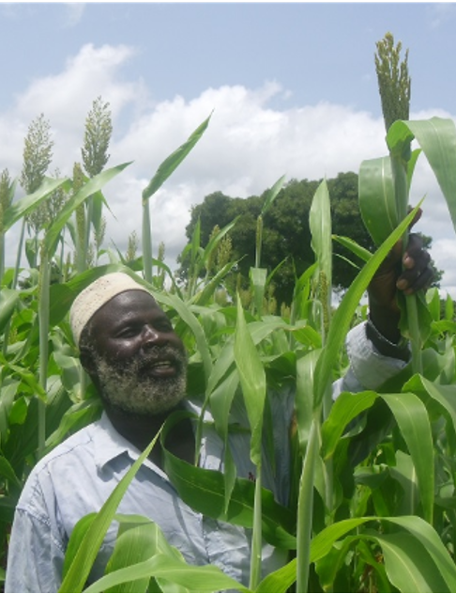
Strategic Recommendations for Policy Formulation
Recommendations 1–3
1. Formalize the institutional mandate
Assign a MoA lead and joint regional task forces across crop and livestock directorates.
Embed PPT in national extension manuals and mandate DAs to train farmers through FTCs and existing networks.
2. Prioritize domains supported by evidence
Start in high-Striga/stemborer areas where evidence supports use in comparable environments, with monitoring.
Use adaptive trials in uncertain domains before wider rollout.
Verify local companion seed/vine supplier capacity before launch.
3. Enforce rigorous evaluation
Report grain yields per total system area, including borders.
Pre-agree criteria to expand, adapt or withdraw implementation.
Track farmer cohort retention and reasons for sustainblity
Notes:
Recommendations 1–3: institutional leadership, evidence-supported implementation domains, and rigorous evaluation. MoA: Ministry of Agriculture. PPT: push–pull technology. DA: development agent. FTC: Farmer Training Centre.
Photo: user-provided photograph. Visit to Kedir Endris’s PPT farm plot, Bedeno Kebele, Dawachefa Wereda, 2025. The caption names the farm and event.

Slide 22
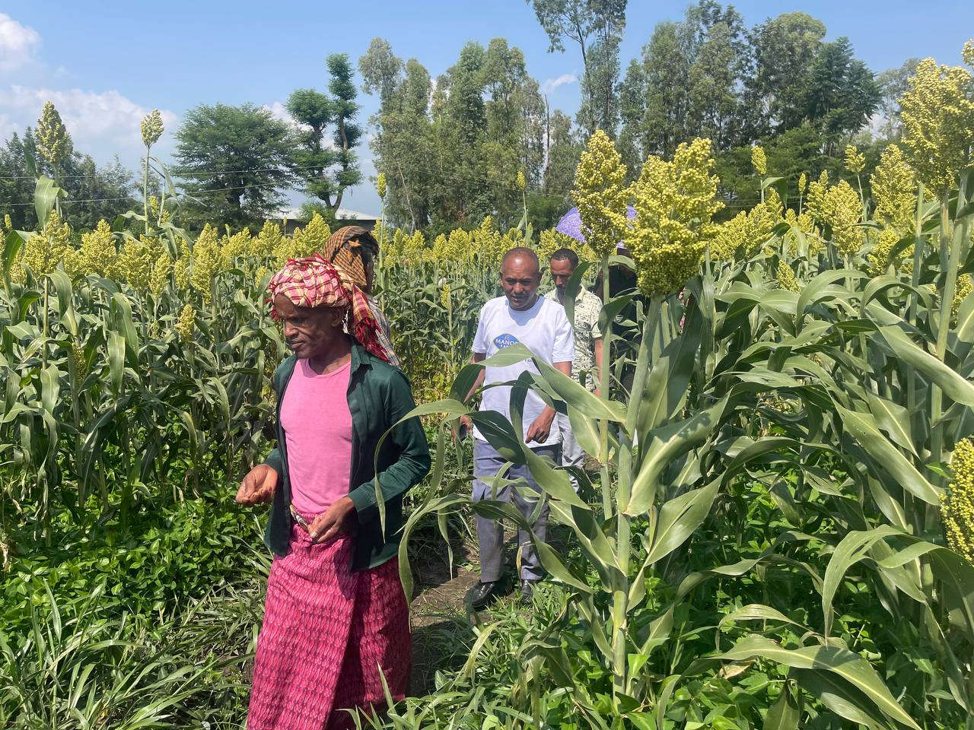
Financing and Private Sector Engagement
Recommendations 4–5
4. Secure sustainable financing
Establish a dedicated public delivery budget for regional scaling.
Fund kebele bulking plots to reduce reliance on imported seed.
Align donor co-financing with public delivery.
5. Promote private sector engagement
Partner with seed enterprises to ensure Desmodium and Brachiaria seed availability.
Involve private sector partners throughout PPT expansion and delivery.
Visit to Kedir Endris’s PPT farm plot
Bedeno Kebele, Dawachefa Wereda, 2025
Notes:
Recommendations 4–5: sustainable public delivery finance, local companion planting-material multiplication, donor co-financing, and private sector engagement throughout PPT expansion.
Photo: user-provided field-visit photograph. Visit to Kedir Endris’s PPT farm plot, Bedeno Kebele, Dawachefa Wereda, 2025.

Slide 23
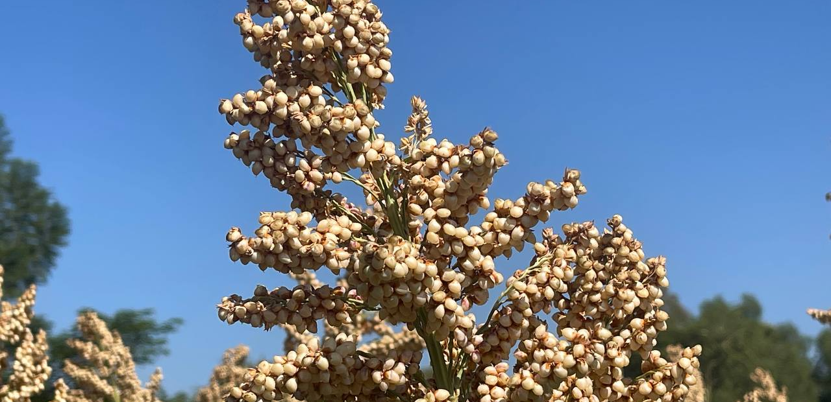
Thank You
Questions & Discussion
Notes:
Closing discussion. Sorghum photograph supplied by the user. Partner logos: Institute for Sustainable Development (ISD), icipe, and Biovision.

