Slide 1

CS3560 Maze Solver Milestone 2
Spring 2023

Slide 2
Project details
Members (5):
-Nick Andujar
-Chase Deweese
-Tyler Hixon
-Norman Lee
-Max Shumaker
Class:
CS 3560 (11-12:20, T/TH)
Github Repo Link
https://github.com/OU-CS3560/maze-solver
Intended Project:
A system that when fed a maze through an image or through node mapping will systematically step through each junction and output the solution.
Platform:
This project will be completed through C++, and is intended to be compiled on any Windows or Linux platform with a C++ compiler
Instructions to Compile and Run:
-Run “g++ -Wall map.cc” in the bash.
-Then run “./a.out”.
-Alternatively, a make file is available

Slide 3
Technology Stack/Tool Chain
WSL on Windows Laptops
Github
Visual Studio Code
Xcode on Mac Device
Terminal on the Mac Device

Slide 4
Device Access
All members have sufficient technology to be able to access and complete the project

Slide 5
Responsibilities and Assigned Tasks
Nick Andujar
Manager
Add function
Backtracking function
Chase Deweese
Is intersection function
Copy node function
Tyler Hixon
Add to directions function
Print directions function
Norman Lee
Organizing meetings
Count directions function
Backtracking function
Max Shumaker
Scribe
Choose directions function

Slide 6
Next Milestones
Milestone 3
Ensure backtracking works and make it as efficient as possible
Assigned to Nick and Max
Implement output function
Assigned to Chase, Tyler, Norman
Milestone 4
Configure program to take input from a picture of a map that is in a text file
Max and Tyler
Automatically make an input file for a given maze with all maze information
Nick, Norman, Chase

Slide 7
Git Repo walk-through

Slide 8
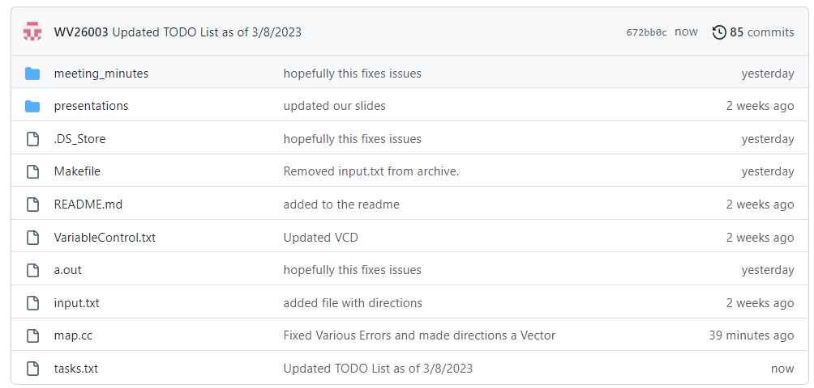
Git Repo Overview
Project functionality is mostly within map.cc
Two more folders containing meeting minutes and presentations.
DS_Store file used to ensure compilation works properly
Tasks.txt file serves as a to do list of work.
Input.txt used to send directions to build a maze in the main program.

Slide 9
Team Communication Plan
Utilize MS Teams, Discord, and SMS to plan meetings, discuss the project, and fix issues
Meeting Time Slots:
Mondays @ 8pm
Fridays @ 5pm

Slide 10
Team Workflow For Checkpoint 2
Each person implements assigned functions on own machine on personal copy of repository
Clone project repository on machines
One member commits and pushes implemented and working function to project repository
Each member performs “git pull” to update on personal machine
Steps 3 and 4 continue until all members have implemented their assigned function for the working session
Test and run code with all implemented functions
Assess errors and assign updated tasks to each team member
1
2
3
4
5
6
7

