Slide 1
Download data radiasi
https://www.esrl.noaa.gov/psd/data/gridded/data.ncep.reanalysis.surfaceflux.html

Slide 2
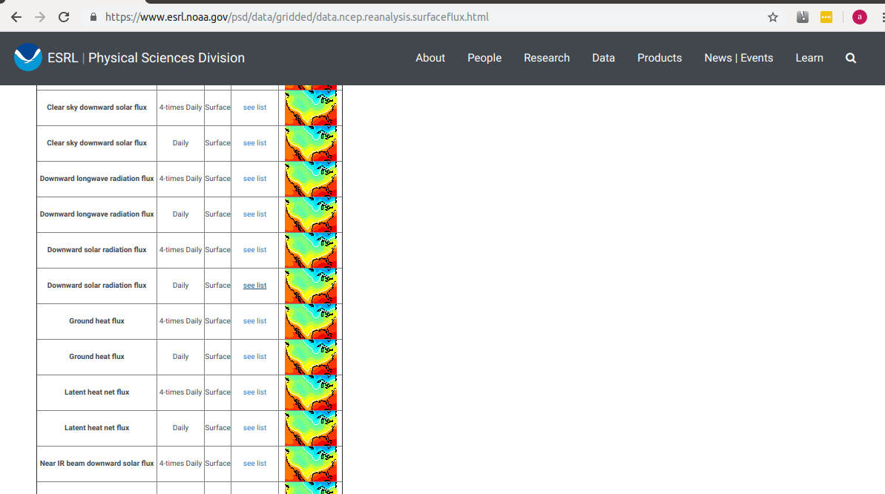

Slide 3
Download data
1. Downward shortwave radiation flux (daily)
2. Upward shortwave radiation flux (daily)
3. Downward longwave radiation flux (daily)
4. Upward longwave radiation flux (daily)
!!! Jika ada pilihan top of atmosphere/surface, Pilih yang surface

Slide 4
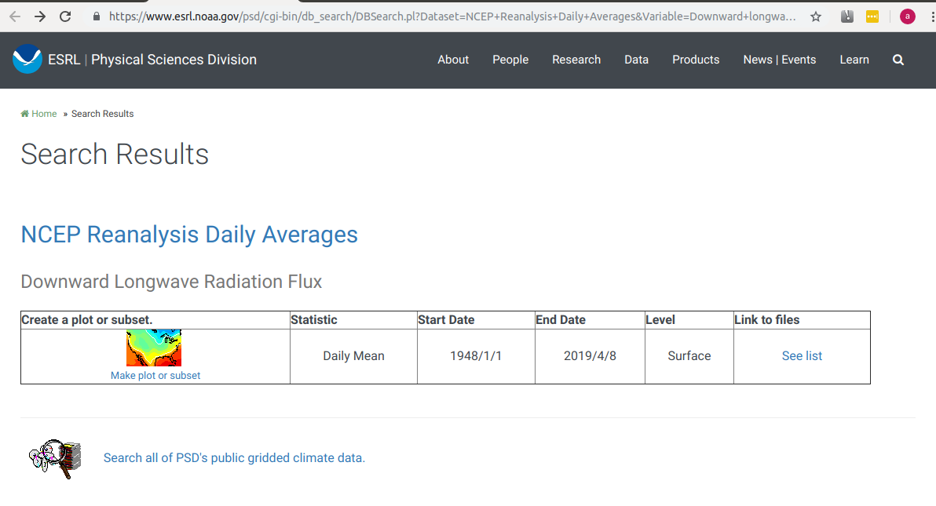

Slide 5
Cara download
1. Pilih See List
2. Tentukan tahun yang akan diambil

