Slide 1
Download data temperatur at 2 m

Slide 2
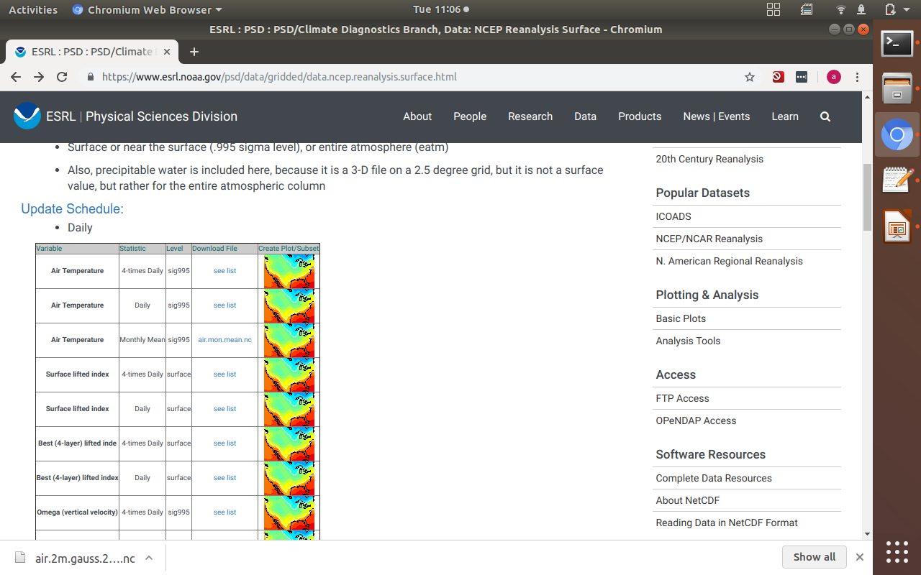

Slide 3
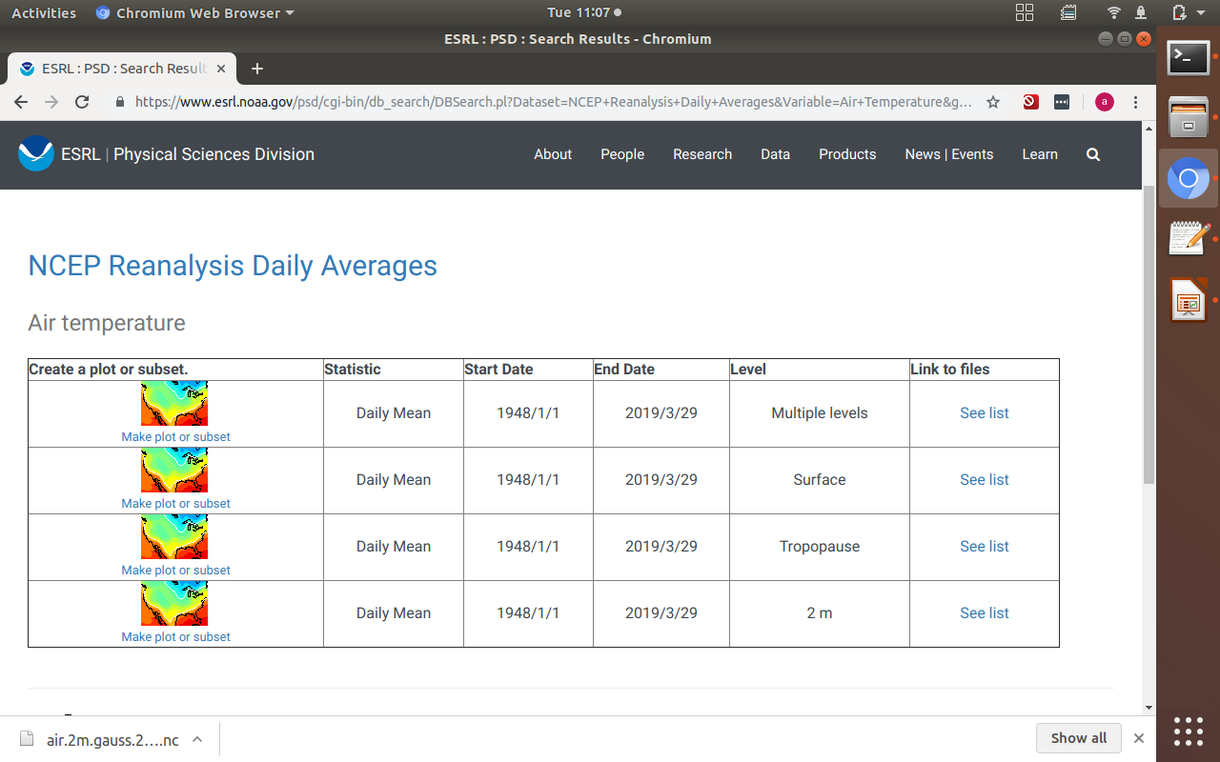

Slide 4
