Slide 1
HtmlJs - New approach for MVVM in web development
Author
Nhan Nguyen

Slide 2
Agenda
Introduction (About me) ( 5m)
The inception - Why (10m)
Architecting a Framework (15m)
A first demo ( 5m)
Adding features (10m)
Making the framework production ready (15m)
Live demo (15m)
Q&A (15m)
Questions are welcome any time during the presentation!

Slide 3
Introduction
.NET developer
JavaScript developer
NodeJs developer

Slide 4
The inception, why?
I really love MVVM pattern and I want to know how MVVM works
I wish to have an MVVM that I can debug the binding
People always ask me why I re-invent the wheel. I don’t re-invent it, I make it faster, easier to use based on legacy.

Slide 5
Architecting Htmljs framework
MVVM
Observer
Rendering engine
Dependency tracking
Detect dependency
Notify change
Validation
Validation rules
Displaying validation message

Slide 6
MVVM – quick overview
Observer
Wrapper for data
Subscribe and notify change
Html controls
Rendering engine
Update DOM Element when data change

Slide 7
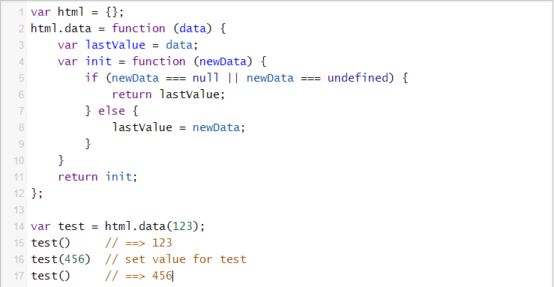
MVVM – Simplest observer
The idea is here is from KnockoutJs.
Basically, we create a closure to save “lastValue”
When we want to get, return “lastValue”
When we want to set, set “lastValue”, we will implement how to notify change to UI here

Slide 8
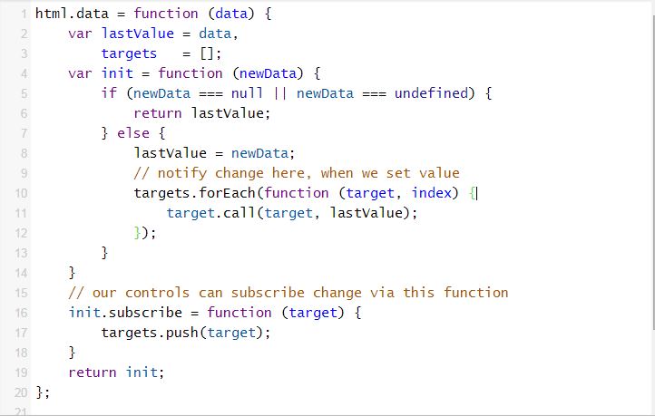
MVVM – How to notify change
Adding subscribe function, this function to save all reference functions to update DOM
When we set value, run every target function

Slide 9
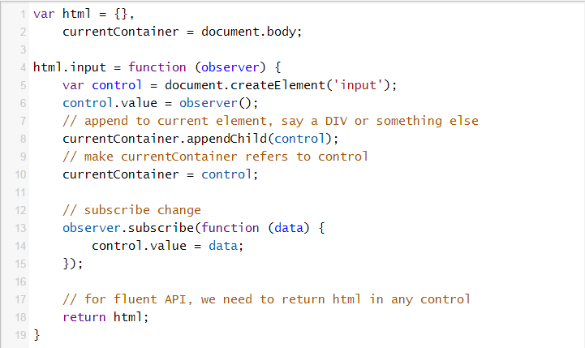
MVVM – How to render DOM
This way is how every control even custom control is written
Create control, set its value, append to currentContainer
Subscribe changes, this function only update DOM state
Return html

Slide 10
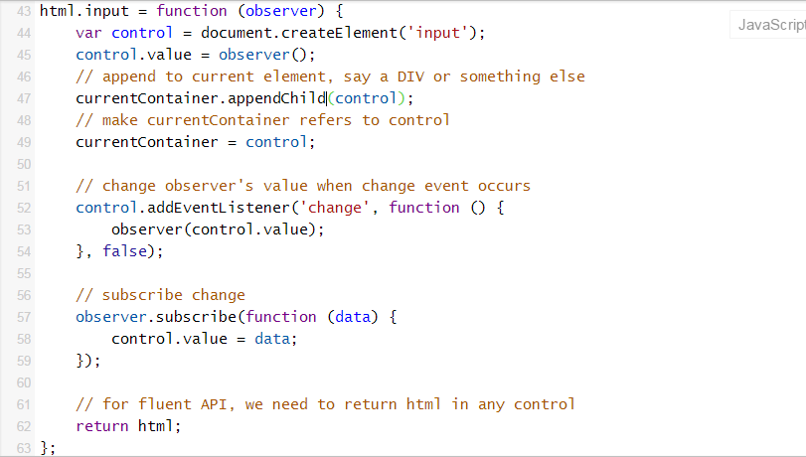
MVVM – How to update observer
One thing we need to do is register change event, then set value for observer
NOTE: we need to care about cross browser issue for registering event

Slide 11
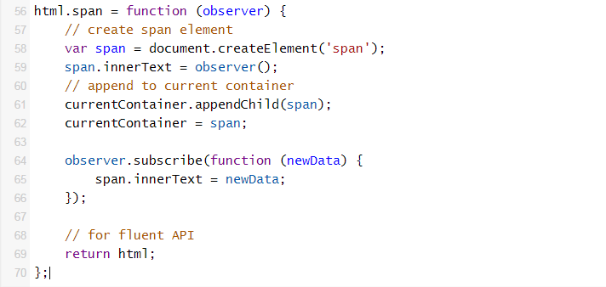
MVVM – Another example
We also need to do three steps
Create SPAN element
Subscribe change
Return html

Slide 12

MVVM – Usage
Done a simple MVVM, View would be updated when
Change INPUT value
Change helloWorld value
Dollar function indicates that we has nothing else to do with current control (INPUT control here). This is because we use fluent API, we must end and go back to parent element

Slide 13
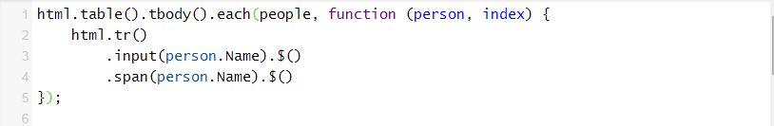
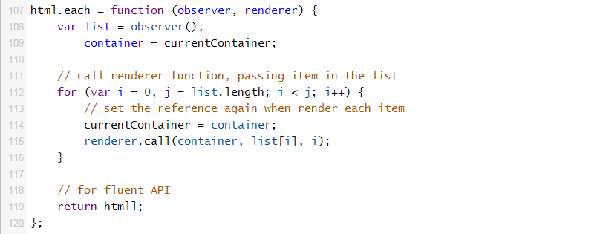
MVVM – Array
The API that I wished to create
Simplest “each” function for html
Call renderer
Subscribe change (implement later)
Return html

Slide 14
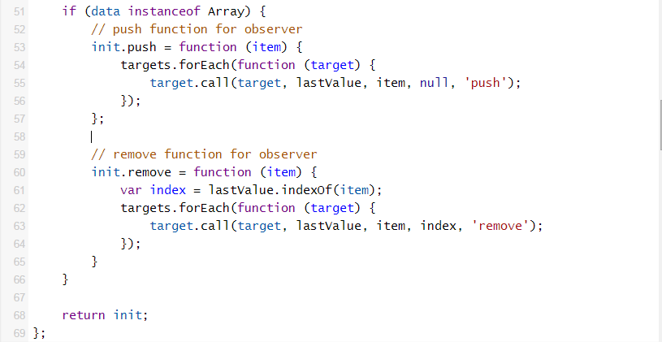
MVVM – Array
Add more functions named “push” and “remove” into html.data

Slide 15
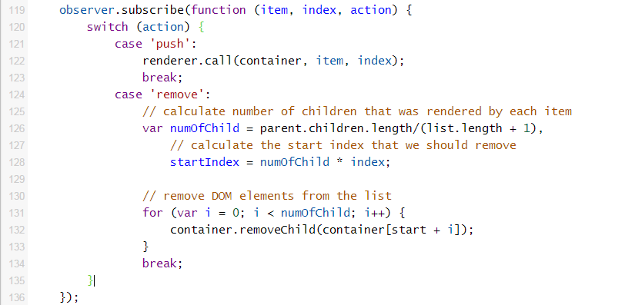
MVVM – Update DOM
Subscribe change in “each” function
Working version at: https://jsfiddle.net/5sj9jmwr/

Slide 16
Demo

Slide 17
Adding features
Dependency tracking
Save all dependencies to an array (in html.data)
Notify change and notify dependencies at the same time
Register dependencies when executing the function inside
Validation
Register rules in fluent API.
Validate data when changing observer’s value
Array utilities: each, select, where, find, first, firstOrDefault, swap, orderBy,…
Working version in JsFiddle:

Slide 18
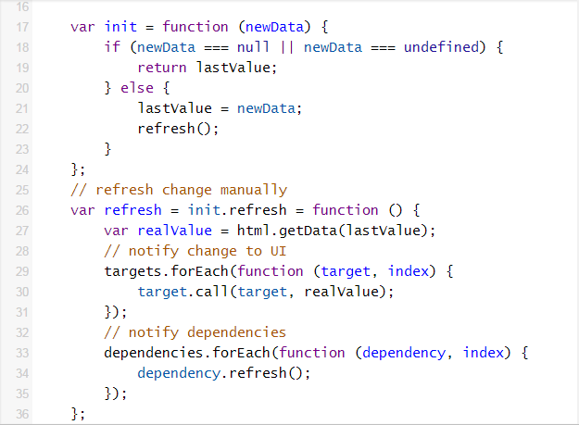
Dependency tracking
Working version in JsFiddle: https://jsfiddle.net/bof8jrye/1/

Slide 19
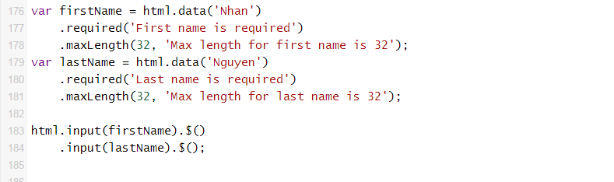
Validation – wishful API

Slide 20
Validation – Implementation
Implementation at: https://jsfiddle.net/q5psb0ue/2/

Slide 21
Adding features
Routing
Ajax
Script loading
Module loading
Array utilities

Slide 22
Making the framework production ready
Unit tests (code coverage 49%), most of critical paths are covered
Integration: all jQuery plugins
Community:
https://github.com/nhanfu/htmljs/issues/
https://groups.google.com/forum/#!forum/htmljs
API
http://nhanfu.github.io/htmljs/api/
http://nhanfu.github.io/htmljs/api/tutorial.html

Slide 23
Making the framework production ready
Demo for integration with jQuery datepicker

Slide 24
Thank you!

