Slide 1
CMG TRAINING · MAFUNZO YA VIKUNDI
A digital tool to implement CMG capacity building
From an author's desk to a village meeting and back
Notes:
Slide 2 is the whole journey. Slide 3 zooms in on two of its stops, planning and scheduling. Slides 4 and 5 are the people: slide 4 shows the five levels (national, region, district, area, village) and the two sides, and explains what an area is; slide 5 shows what changes when operations are handed from TAMISEMI to the BDS partner. Updated on 21 September 2026 for the district coordinator and the district officer.

Slide 2
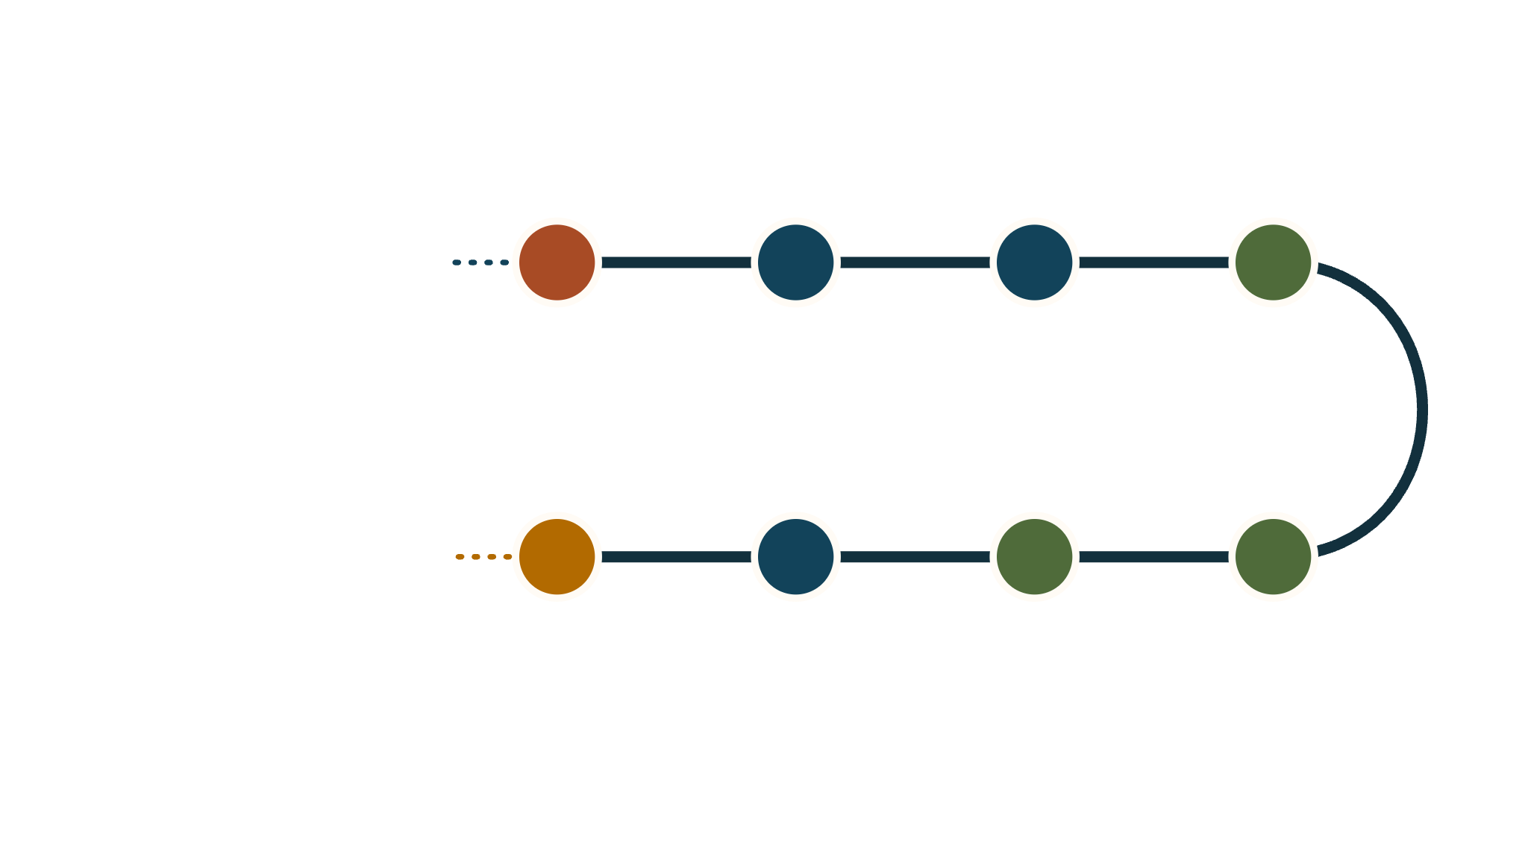












The training cycle
BEFORE THE JOURNEY
Lessons built, groups registered
Train the trainers
Plan
Schedule
Print and travel
Write · content author
Workshop, quiz at 90%, certified
Allocating trainers to CMGs
A certified trainer posted there, on a date
Session sheet and facilitator pack
Review, publish · a second author
Translate · translator
Register groups · district officer
NO SIGNAL NEEDED · PAPER ONLY
What we learn comes back: quiz scores to authors, progress to planners.
Oversee
Accept
Co-sign and report
Deliver
Spot checks, progress by area
The coordinator checks delivery reports
Offline, in the village
Two members sign; typed in afterwards
BDS partner · TAMISEMI: content and coordination · In the field · Oversight
Notes:
Start in the depot: a lesson is written, reviewed by a second author and translated, and the district officer registers the groups, before anything moves. "The coordinator" is the district coordinator, or the area coordinator where the district has been divided into areas. First stop: the partner trains its trainers, who must pass a quiz at 90 percent to be certified. Walk the line, round the bend, and back. Pause at the green band: the platform is not open during a session. The trainer carries a printed sheet, the group signs on paper, and the report is typed in afterwards.

Slide 3



A plan is pencil. A schedule is ink.
PENCIL
INK
The plan
The schedule
Does the work fit, and what are the trips?
Who goes where, on which day?
Six weeks, one area or district
Trainer 1, Trainer 2: Trainer n
Counts trainer-days against visits
Redraw it as often as you like
A named trainer on a fixed date
Certified, posted there, available
The trainer sees it, prints the sheet, is told of changes
To change it: reschedule or cancel, with a reason
OPTIONAL · A STICKY NOTE
A draft session, when schedules are tentative
Use it when the trainer is not decided yet, or when a rule refuses the booking. Nobody is told, and its modules are held: the scheduler will not book them again.
The planner proposes. The scheduler decides. Every rule is checked at the moment of scheduling.
Notes:
The normal path is plan, then schedule. The planner answers a capacity question for an area over six weeks and never names a person. Assigning a trainer is what runs the rules: registered group, certified and posted trainer, one session a day, module order, the duration limit. A draft session is the exception, not a stage: it parks a visit whose trainer is not decided, and it is where a booking lands, with the reason, when a rule refuses it.

Slide 4
TAMISEMI working with the BDS partner
NATIONAL
Administrator, TAMISEMI
standards down, certified trainers up
Partner manager
Owns the platform
Certifies the trainers
REGION
Regional coordinator
postings confirmed; 1 report in 20 sampled
Partner regional lead
Oversees the districts, covers
Posts trainers where needed
DISTRICT
The coordinator
only registered groups can be trained
No counterpart yet
With the district officer, who registers the groups
Partner mirrors region and area
AREA
Area coordinator + stand-in
handed across, one area at a time
Partner area coordinator
Plans, schedules, accepts
Takes over after a handoff
VILLAGE
Trainer
session delivered; two members sign
The group
From the BDS partner; on paper
Chair and secretary co-sign
AREA
An area is made up, not on any map. It is a named subset of wards inside one district, which the coordinator draws and can redraw so that one person has a workable patch. Records stay by region, district and ward.
Not in the building: content authors and translators, who make what is taught, and an evaluator, who reads everything and changes nothing.
Notes:
TAMISEMI is the government side; the BDS partner is the delivery partner. The hierarchy is national, region, district, area, ward, village, group. "The coordinator" means the district coordinator, who runs training in a district, draws its areas and appoints their coordinators. The district officer is a separate role that keeps the register: only they add groups. The regional coordinator oversees and covers, and alone confirms postings, hands over and does spot checks. The partner has no district-level counterpart for now. Coordination moves from the left wing to the right wing on the area floor, one area at a time.

Slide 5

Key roles: TAMISEMI vs BDS partner, before and after the operations handover
The assumption here is that the BDS provider is on the hook for training, although we might get things started out with consultant + TAMISEMI master trainers. The system therefore provides for a hand-over; the register of groups always stays with TAMISEMI's district officers.
Before a handoff
After a handoff
Regional coordinator
Partner regional lead
Regional coordinator
Partner regional lead
confirms postings, oversees, covers
posts trainers
samples 1 report in 20
posts trainers, covers
HANDOFF
District coordinator
No counterpart yet
one area at a time
District coordinator
No counterpart yet
runs training, draws the areas
carries on in the rest of the district
Area coordinator
Partner area coordinator
Area coordinator
Partner area coordinator
plans, schedules, accepts
reads only
reads only
plans, schedules, accepts
TAMISEMI
BDS partner
acts
reads only
checks
Notes:
TAMISEMI is the government side; the BDS partner is the delivery partner. Before a handoff TAMISEMI coordinates the area and the partner supplies the trainers and watches. After it, the partner coordinates that area and TAMISEMI steps back and checks. The district coordinator is "the coordinator": they draw the areas, and carry on coordinating the parts of the district that have not been handed over. The partner has no district-level counterpart for now. Only an administrator or the regional coordinator can hand an area over, by typing its name, and only once the partner has a coordinator there. Supervision afterwards is by sampled reports and the progress page. One rule holds on both sides: nobody accepts a report for a session they delivered.

Slide 6








The people, one at a time
Many people help deliver a lesson from a training content author's desk to a village meeting and back. Key roles are listed here.
Administrator
Content author
District officer
Partner manager
The coordinator
Trainer
Regional coordinator
M&E officer
Choose a person, and see their functions
andvraman.github.io/cmg-cap/personas.html
TAMISEMI · BDS partner · In the field · Monitors
Notes:
Open the linked page and walk the line with the arrow keys, or choose a person. Start with the coordinator: the rest of the system turns round that job. Each person shows five things they do, their goal, and the success line from the personas spec. The district coordinator's success line is written from their goal, because the spec gives none yet. The page is private until it is shared, like this deck.

