Slide 1


Lecture 1: Introduction EAS 503: Programming and Database Fundamentals for Data Scientists CDA 501: Introduction to Data Driven Analysis and Programming for Data Scientists
Dr. Nikolay Simakov

Slide 2


Outline
Organizational (Syllabus)
Course Outline
Programming and Python Overview

Slide 3
Civid-19
Follow university policy/guidance
All UB students are required to be fully vaccinated against COVID-19 to attend classes in-person
Face Masks and Physical Distancing
Daily Health Check
https://www.buffalo.edu/coronavirus/latest-update.html
https://www.buffalo.edu/studentlife.html
If you are sick stay home!

Slide 4

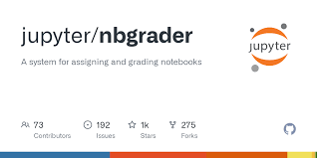
Organizational
https://eas503.ccr.buffalo.edu - homework, lab, project submission and jupyter notebook site
GitHub account will be used for authentication on
Set up your GitHub account (https://github.com/)
Complete Google Form at
https://forms.gle/6pG6GzZru1WALPAt5
binds your UBIT username and GitHub
By September 2nd

Slide 5
EAS 503 Course Waiver
If you good with python, databases, plotting and introductory machine learning then contact me to receive waiver assignment.
Complete it as soon as possible (recall class dropping deadline)!

Slide 6
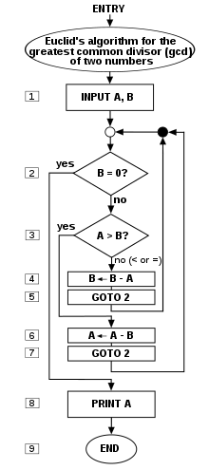
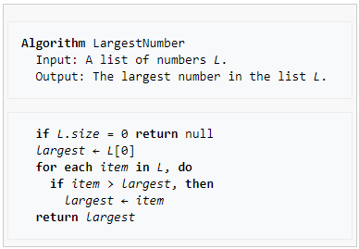
Programming and Algorithms
Flowchart:
Algorithm is a finite sequence of well-defined, computer-implementable instructions (wikipedia)
Unambiguous
More abstract than program
A program is a set of detailed step-by-step instructions to a computer.
A particular implementation of an algorithm
Pseudocode:

Slide 7
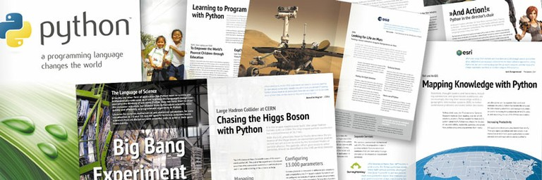
Python: General Purpose Programming Language
Python
General Purpose
High level
Functional and Object-Oriented programming
Multiplatform
Run everywhere
Interpreted
No need to compile
Can be slow on itself (use optimized libraries)
Written in C
Programs and libraries can be optimized to use modern CPUs and GPUs
Support number of way to integrate high preforming code (cython, swig, cpython,…)
Some older programs/libraries might still use python 2 (discontinued in 2020). If you have a choice stick to python 3+ (3.6+)
Used in …
Web
Frameworks (django)
Programs
Command line
GUI
Scientific Calculations
Data Analysis
Education (particularly jupyter notebooks)
Integration

Slide 8
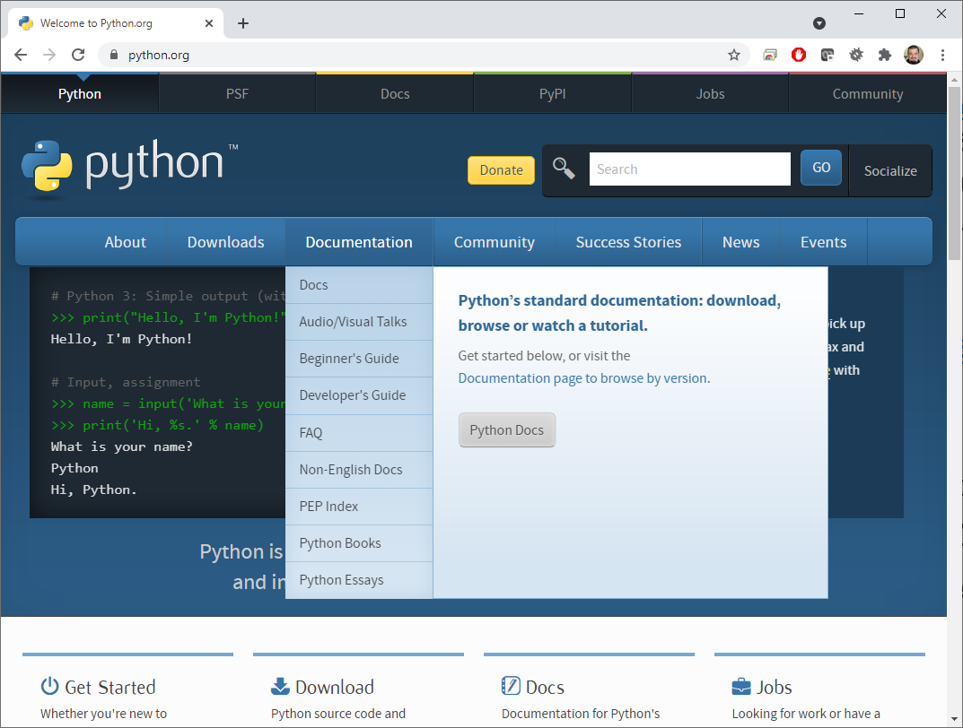
Python: Where to look for Docs/Help
https://www.python.org/ – documentation and tutorials
Language documentation
Build-in library documentation
Documentation of the library
https://stackoverflow.com/ - Q and A from people around the world
Books
The course one
Find your own
Google it

Slide 9
Python and Libraries
Core Python – provides core language capabilities
Built-in libraries – add functionality for common programmatic tasks
datetime – date and time
re – regression expression
sqllite3 - SQLite databases
Libraries – add custom functionality
pandas – data analysis
TensorFlow - neural network
Libraries
Built-in Libraries
Python

Slide 10
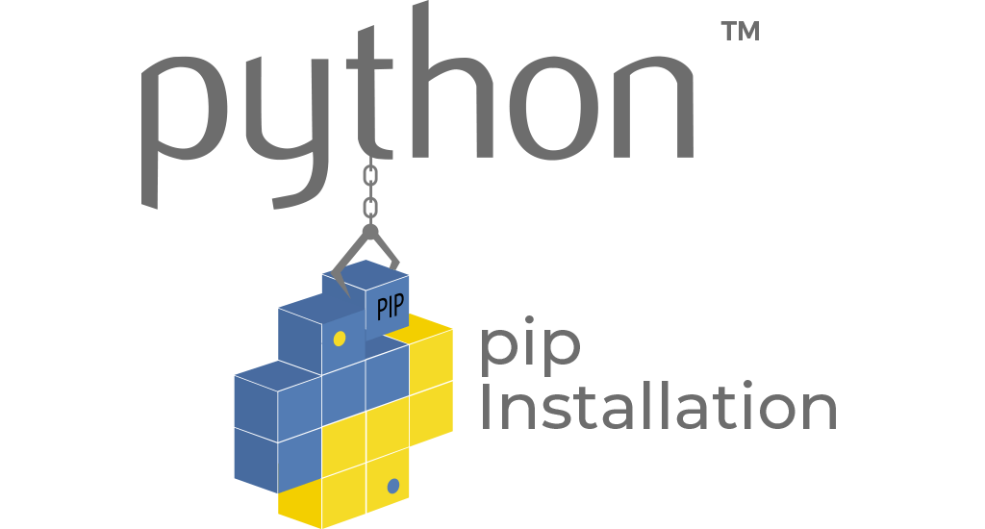

Installing Python and Libraries
Manually all components
Labor intensive
Manually Install Python and PIP, use PIP to install needed library
Still labor intensive for some dependencies
Using system provided packaging
Largely used only on Linux OS
Using 3rd party packaging
Homebrew on Mac OS
Using Python specific package manager.
Anaconda (Use it unless you know why you should not use it)
Use Anaconda for all your python packaging needs
unless you know why you should other methods!

Slide 11




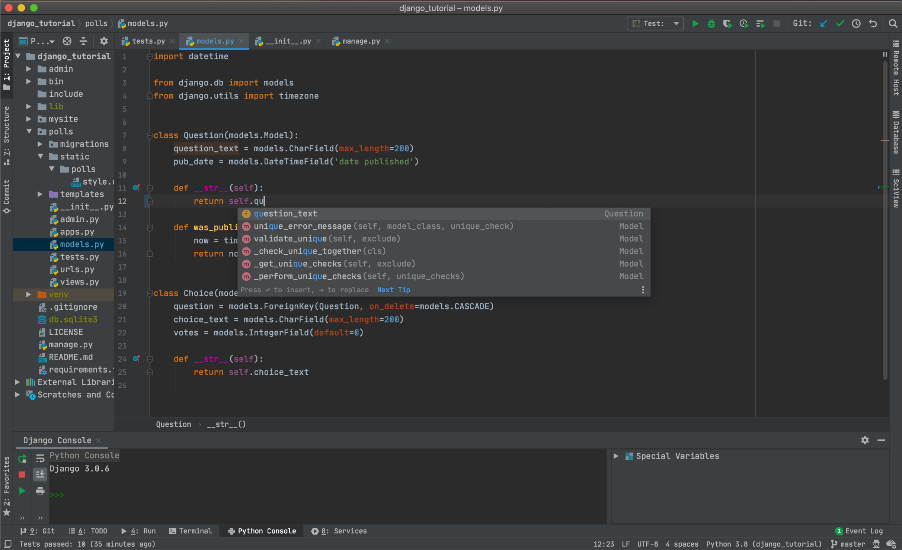
Development Environment
Plain Text Editors (good for small edits)
vi/vim, nano, emac
Windows: notebook
Linux: Kate, gedit
Integrated Development Environment (IDE)
PyCharm (try this one)
Visual Studio Code
Sublime text
Eclipse
Jupiter Notebook
Why to use good IDE?
Integration with other tools
Version Control (git)
Debugger
Testing
Autocompletion
Auto-help
Spellchecking
Code-structure View

