Slide 1
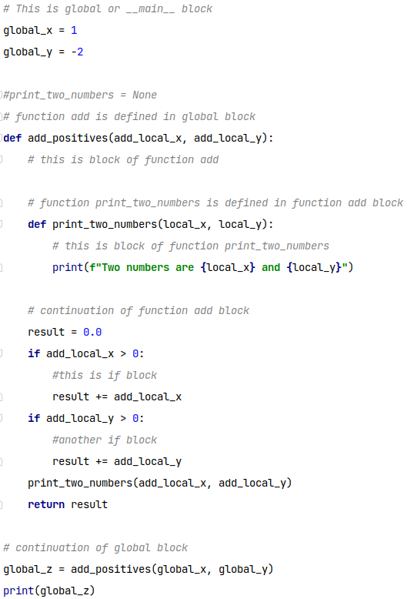
Blocks and Indentations

Slide 2
3 levels
Level 0
Level 1
Level 2
Blocks and Indentations

Slide 3
Blocks and Indentations

Slide 4
Global Block
Func. add_pos Block
Func. Print_two Block
Blocks and Indentations
Func. add_pos Block
(continue)
If block
Func. add_pos Block(continue)
Another if block
Func. add_pos Block
(continue)
Global Block
(continue)

Slide 5
Global Block
Func. add_pos Block
Func. Print_two Block
Blocks and Indentations
Func. add_pos Block
(continue)
If block
Func. add_pos Block(continue)
Another if block
Func. add_pos Block
(continue)
Global Block
(continue)

