Slide 1

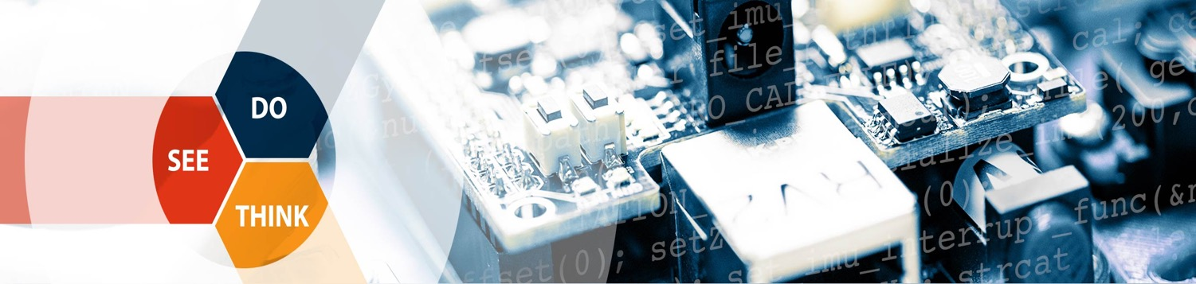
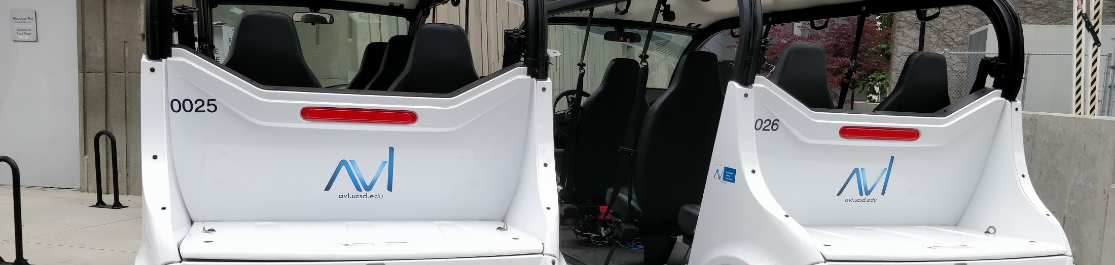


Auto-Calibration with Stop Signs
Yuhan Liu, Yunhai Han
Jul 31, 2020

Slide 2

Overview
calibrate intrinsics using estimated stop sign corners
Calibration Results on AVL Dataset
System Pipeline (Revisit)
Line Improvement Method
Problems Unsolved and Future Works

Slide 3
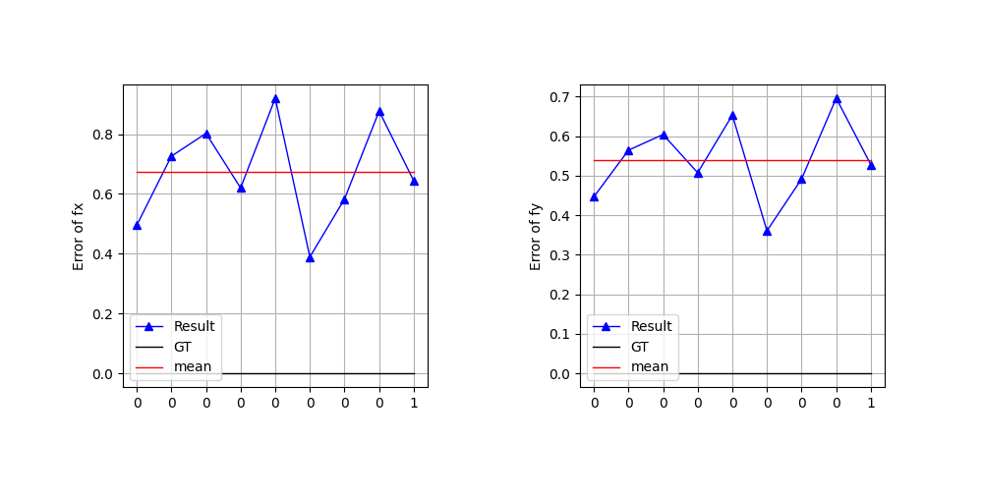
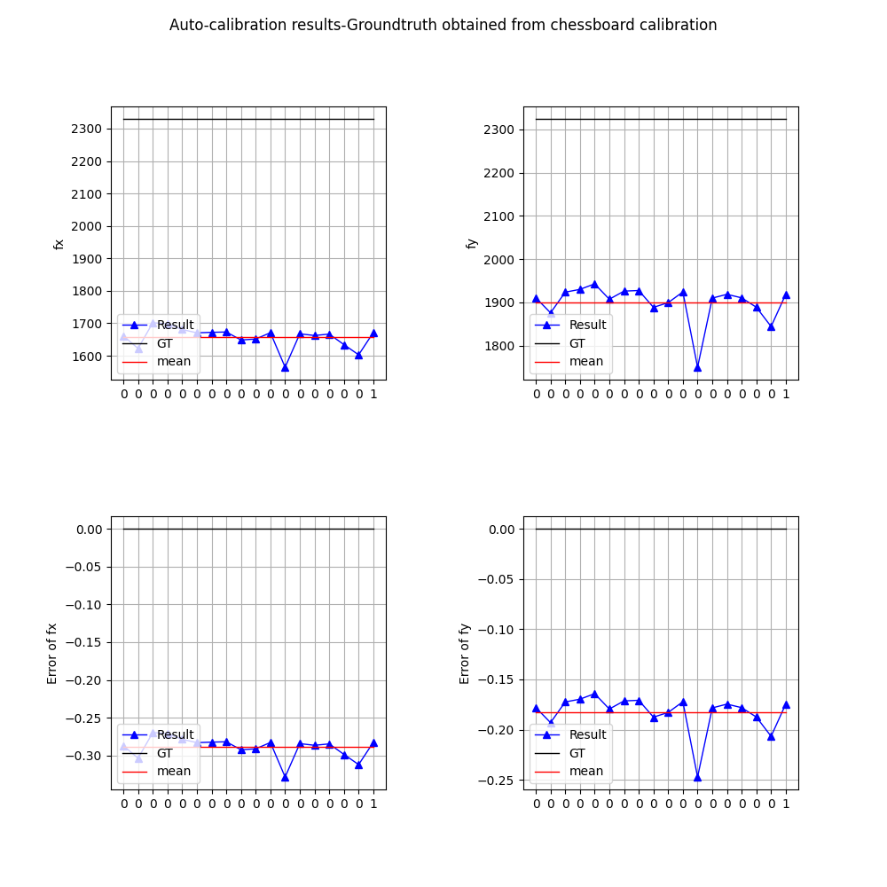
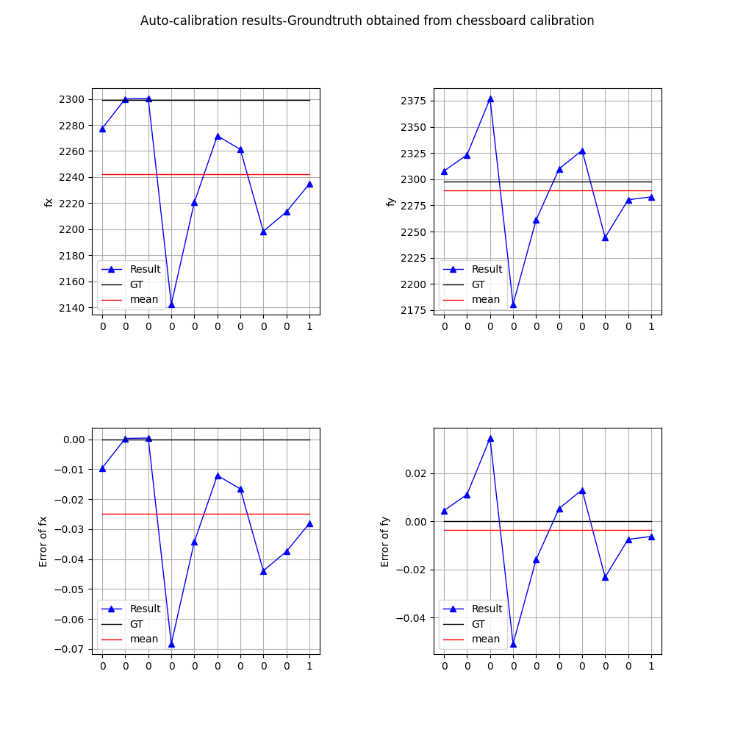
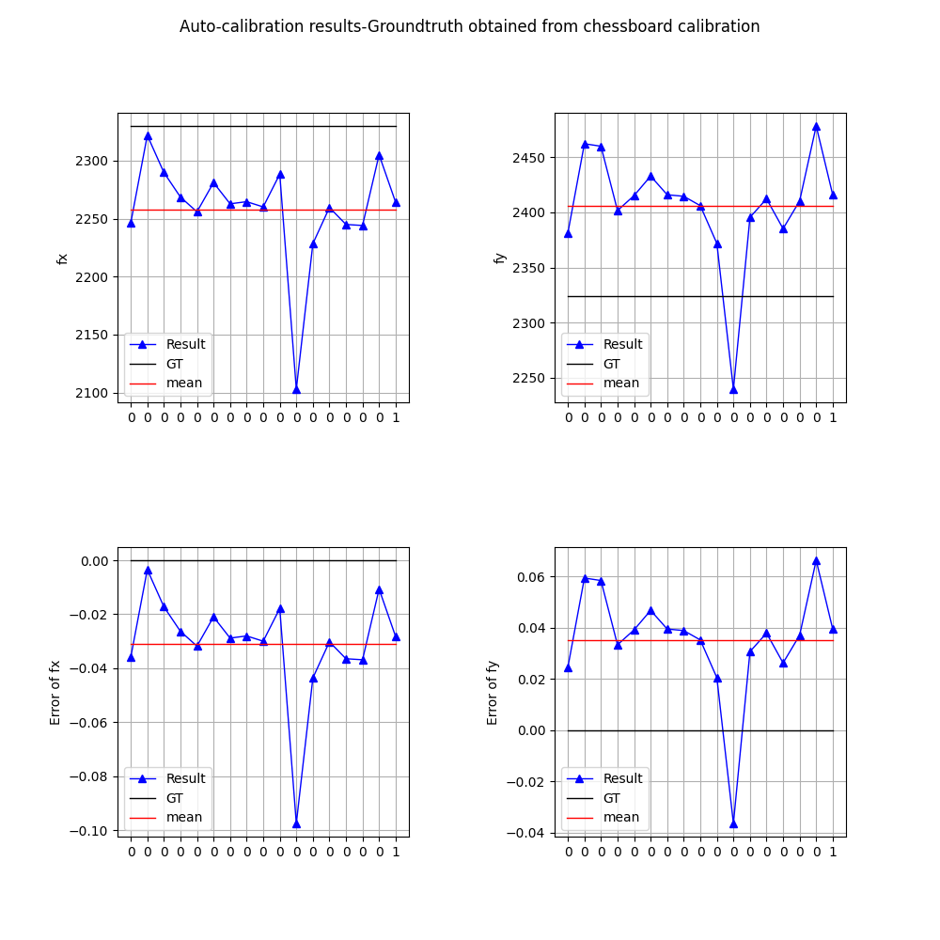
Calibration Results on AVL Dataset
Extract the images in rosbag’s, and then calibrate both camera 1 and camera 6 (intrinsic matrices);
Compare the calibration results with the groundtruth obtained using chessboard calibration;
Compare the relative errors before and after improvement.
Improved
Improved
Camera 1
Camera 6

Slide 4
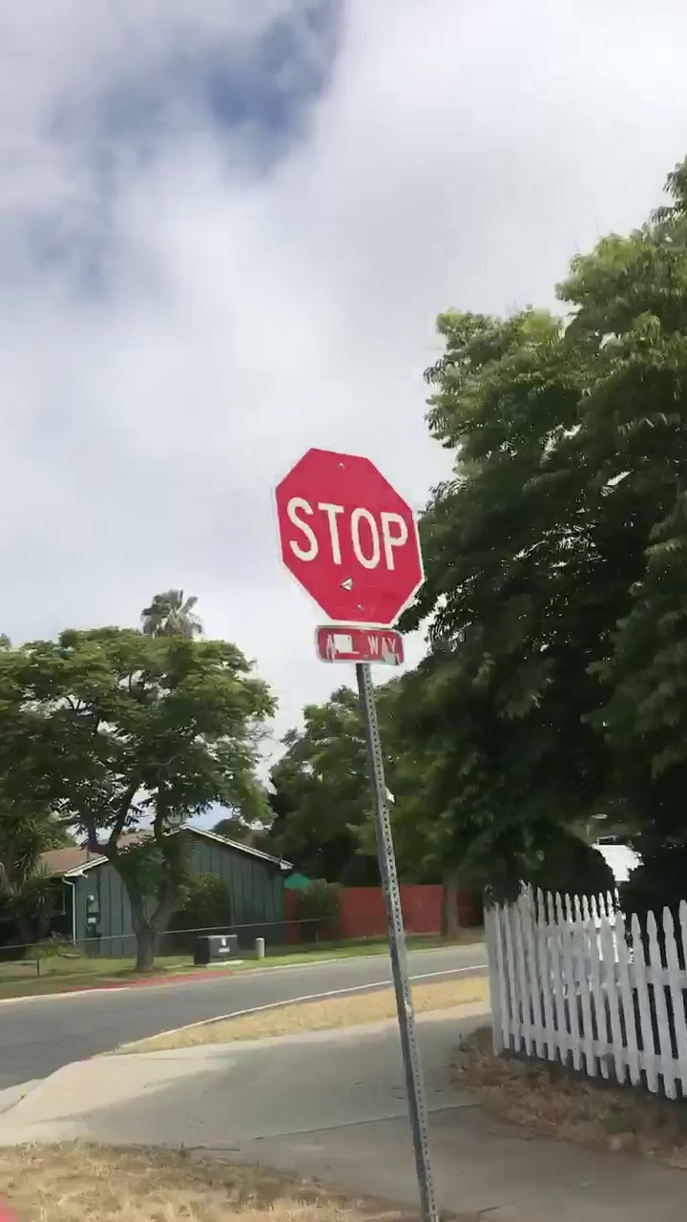


System Pipeline
Doing
- YOLO
- RCNN
Current
HSV
Video Frame
Bounding Box
Pixel-wise Mask

Slide 5

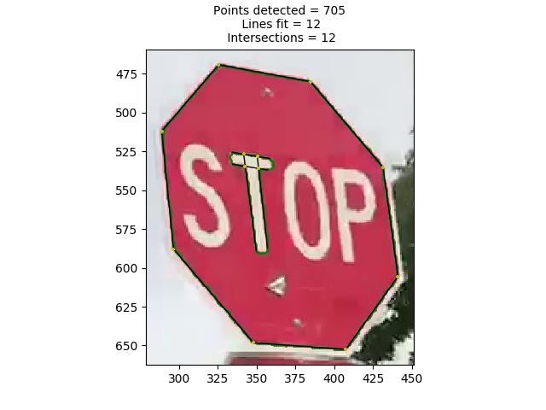
System Pipeline
Current
Canny Edge
+Devernay
Sub-Pixel
Correction*
Current
SVD
+RANSAC
+Line Improvement
Future
+Data
Association
Edge Points
Line Estimation + Intersections
*: R.G. Gioi & G. Randall(2017), “A Sub-Pixel Edge Detector: an Implementation of the Canny/Devernay Algorithm”

Slide 6
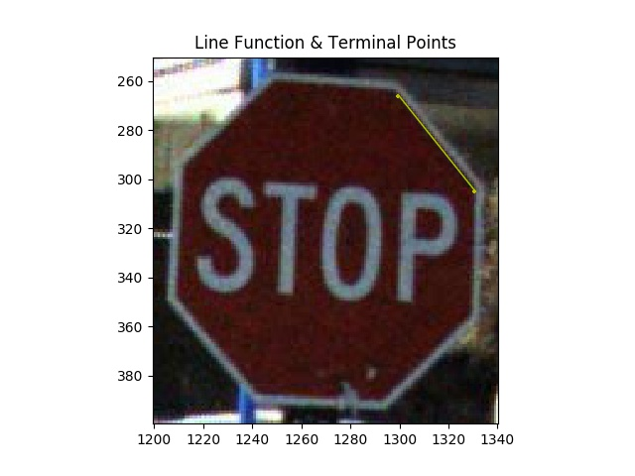
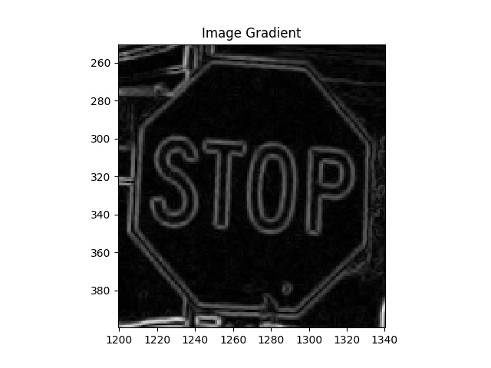
Line Improvement Method - Inputs

Slide 7
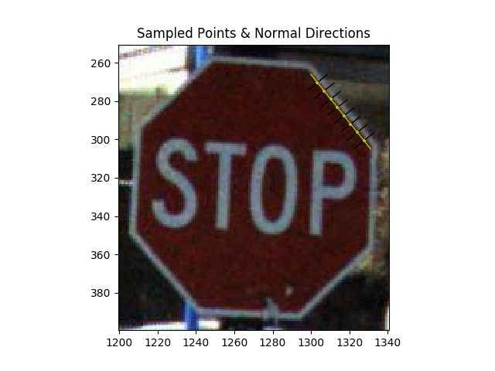
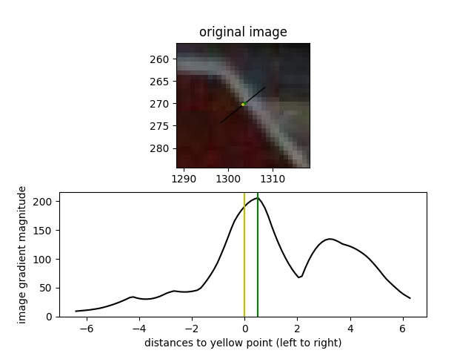
Line Improvement Method - Steps

Slide 8
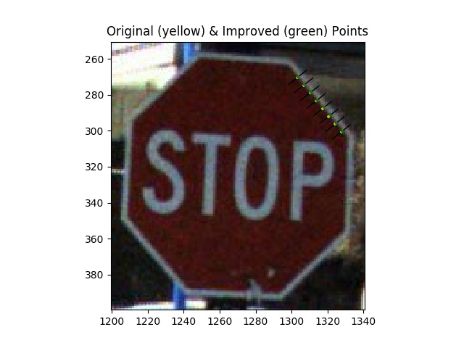
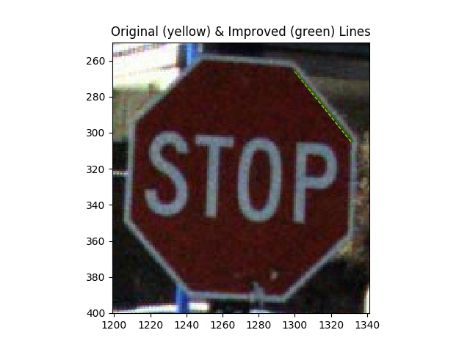
Line Improvement Method - Steps

Slide 9
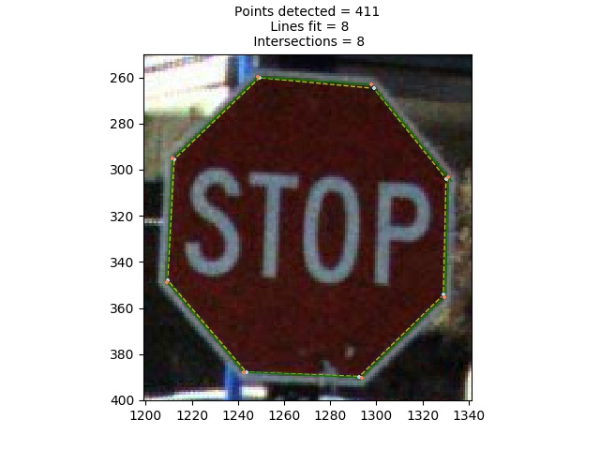
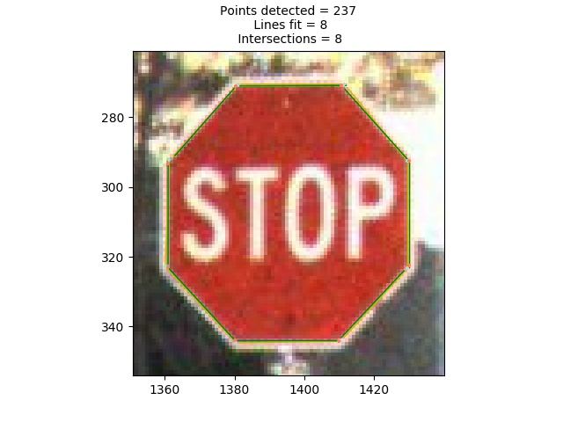
Line Improvement Method - Results
Example 1
Example 2

Slide 10
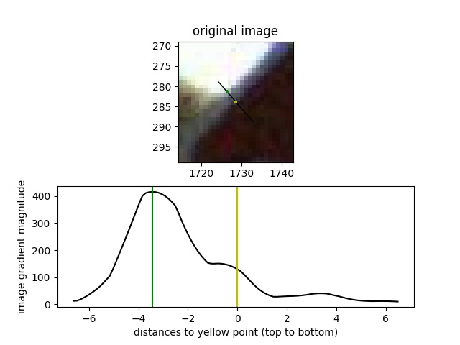
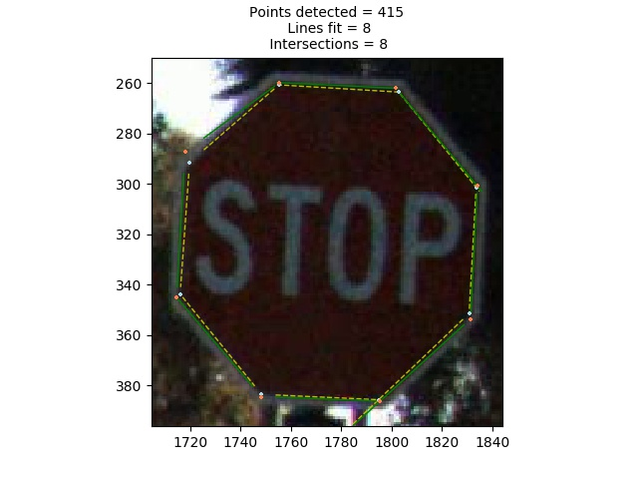
Line Improvement Method - Problem

Slide 11
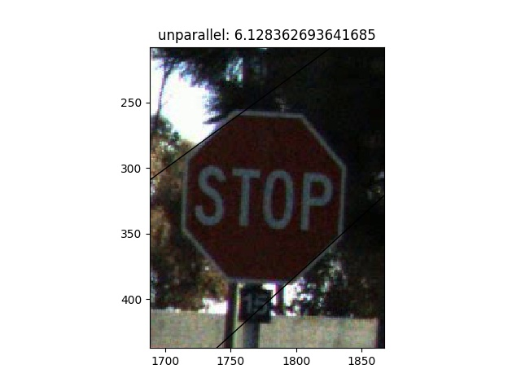
Line Improvement Method - Problem

Slide 12
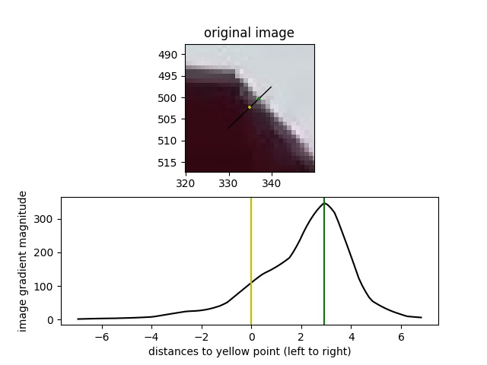
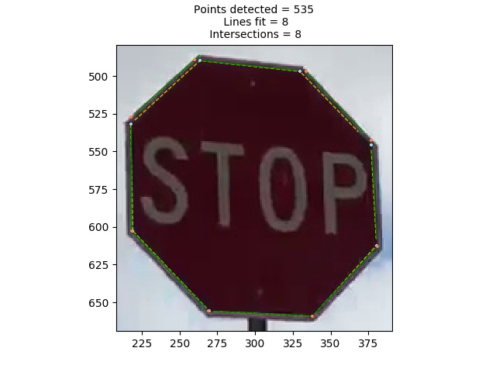
Line Improvement Method - Problem

Slide 13
Problems Unsolved & Future Works
Experiment on More Datasets
AVL Dataset
Waymo Open Dataset
Stop Sign Detector
Improvement Method 2
combine sequential info from video frames
Manual Bad Result Removal -> Automatic Algorithm

Slide 14
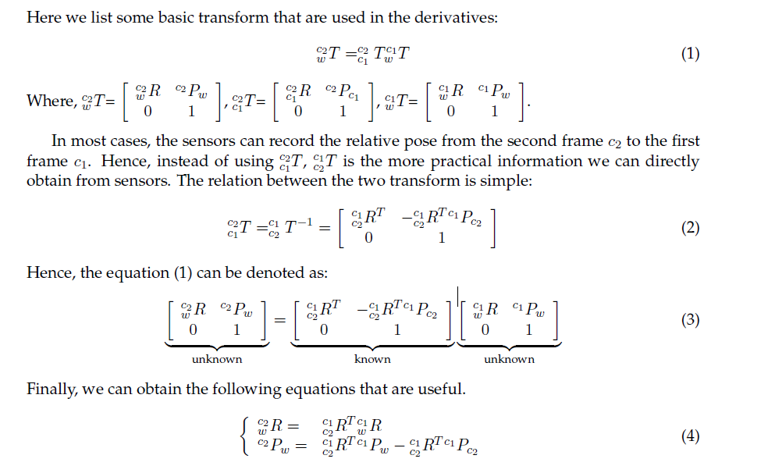
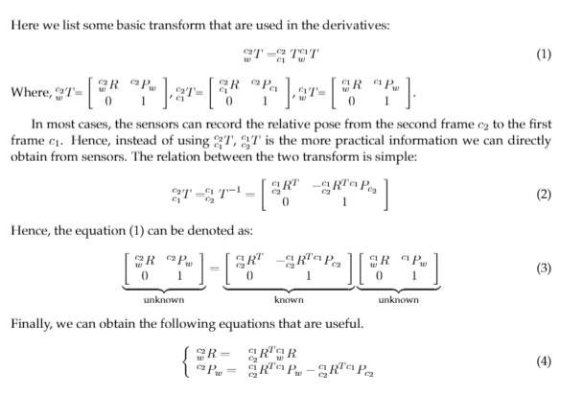
Improvement 2 - Bundle Adjustment

Slide 15
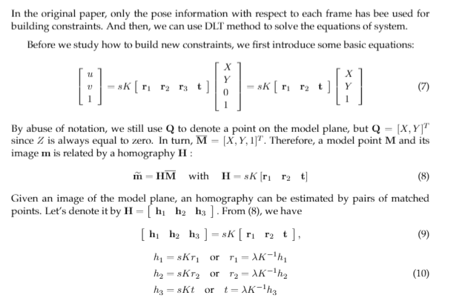
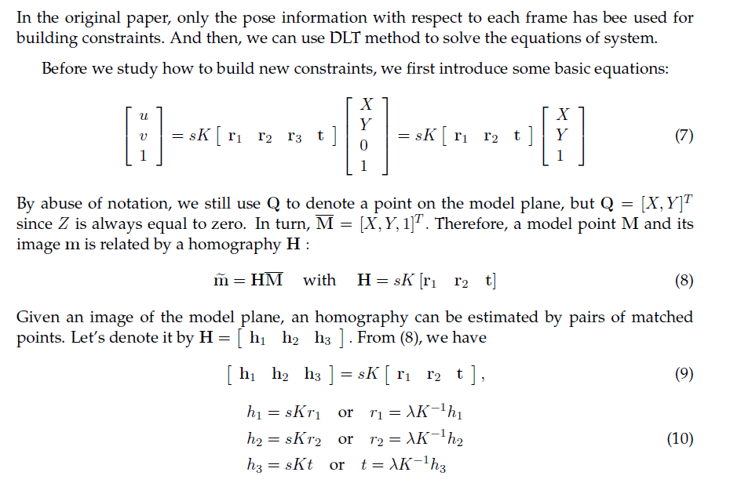
Improvement 2 - Bundle Adjustment

Slide 16
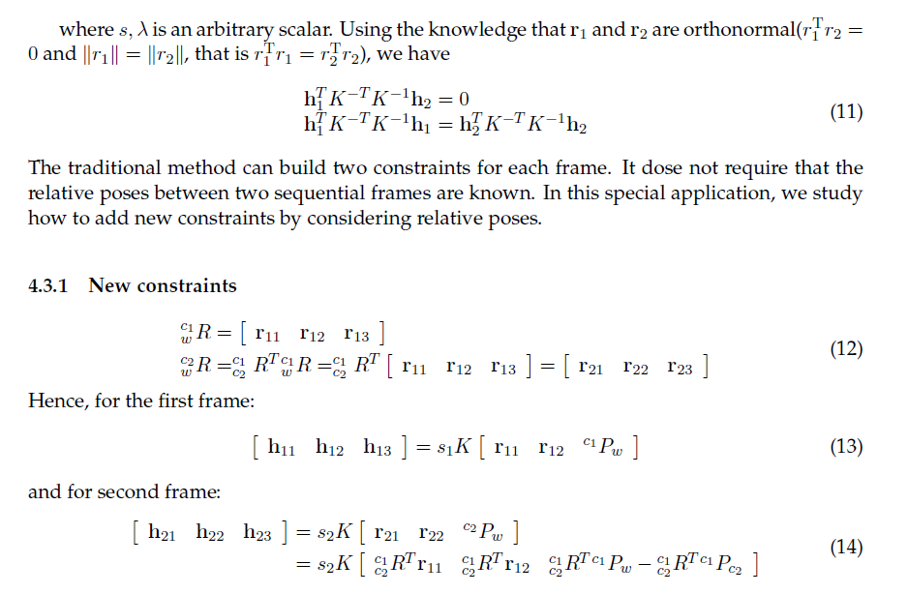
Improvement 2 - Bundle Adjustment

Slide 17
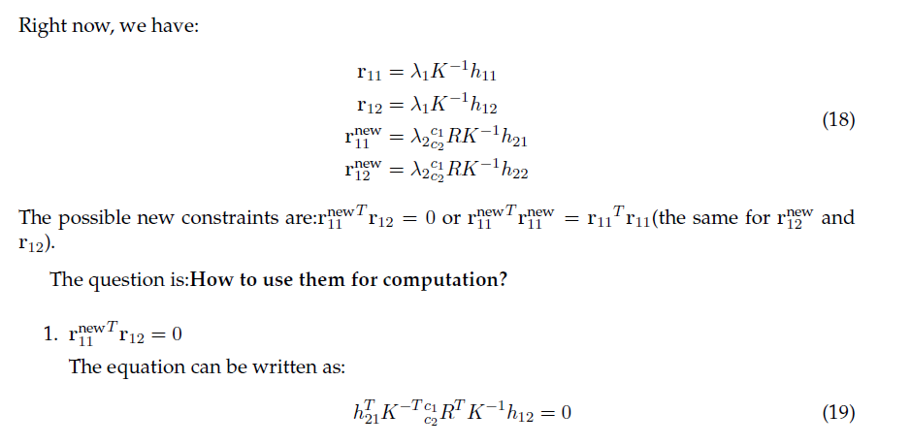
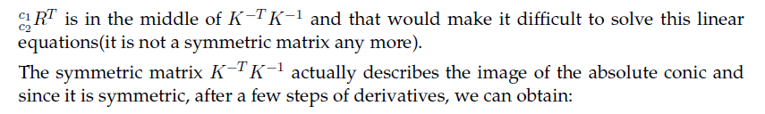
Improvement 2 - Bundle Adjustment

Slide 18
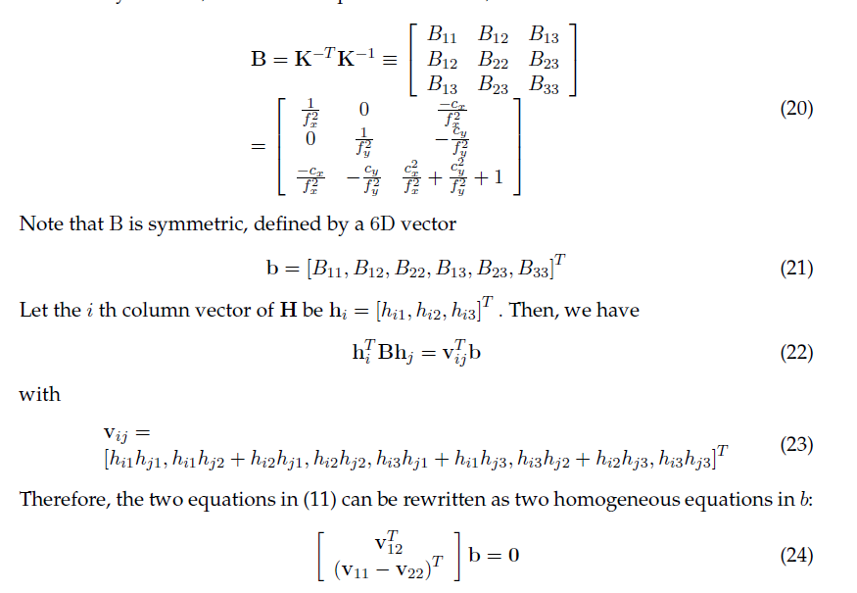
Improvement 2 - Bundle Adjustment

Slide 19
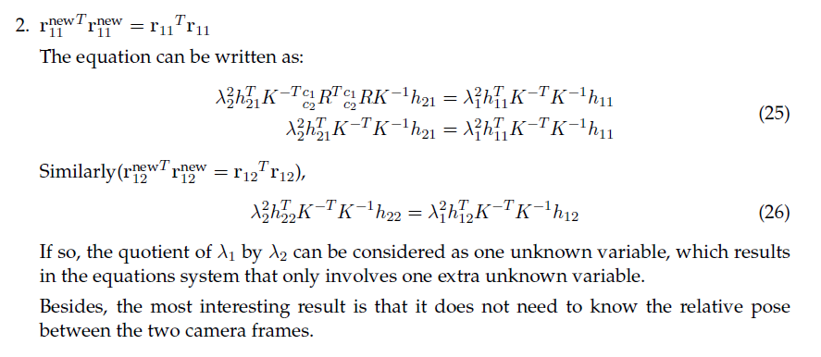
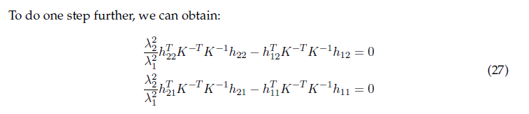
Improvement 2 - Bundle Adjustment

Slide 20
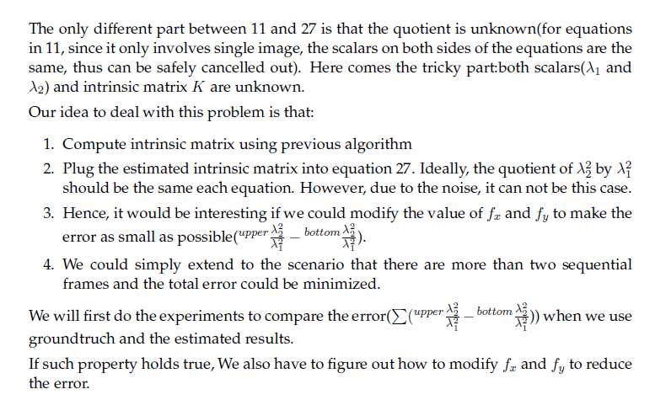
Improvement 2 - Bundle Adjustment

Slide 21
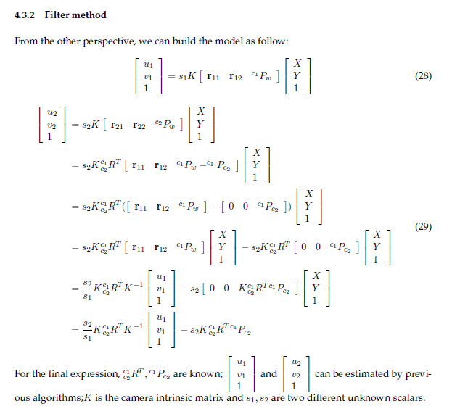
Improvement 2 - Filter
Problems:
1.Accuracy of relative pose estimation
2.Unsynchronized sensor data record

Slide 22
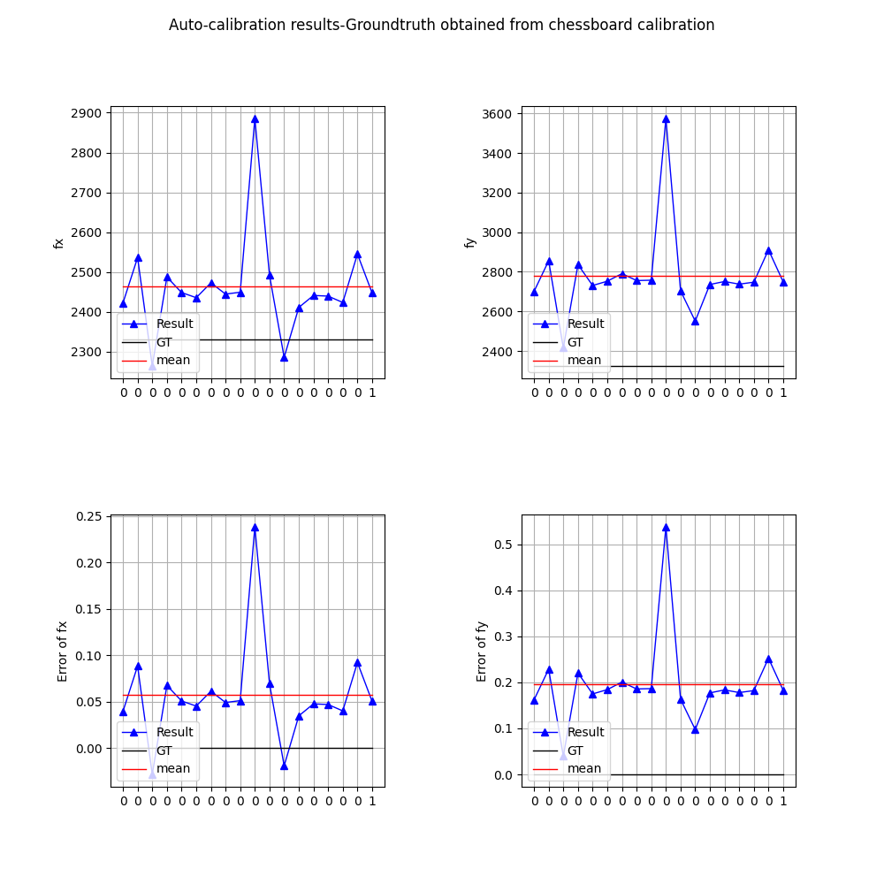
Manual Work
Bad frame/stop sign 3 removed (manually)

Slide 23
Thank you!

