Slide 1

Fine-Grained Bird Recognition
on CUB-200 with DINOv2 and a Linear Probe
Andrew Eby · Indiana University
200 species
89.40% Top-1
98.36% Top-5
< 5 min
CUB-200-2011
test accuracy
test accuracy
training time
Notes:
~30 sec. Introduce yourself, state the task (fine-grained bird classification on 200 species), and call out the headline numbers.

Slide 2
Fine-Grained Bird Recognition · Andrew Eby
2 / 7
The Problem
CUB-200-2011 Dataset
The Challenge
200 North American bird species
11,788 images total
~30 training images per class
Fine-grained: visually similar species
Species look nearly identical to non-experts
Low data regime — very few samples per class
Standard classifiers struggle here
Need strong visual features from the start
Notes:
~45 sec. Explain what makes fine-grained recognition hard: low data, near-identical species. The dataset has only ~30 images per class.

Slide 3

Fine-Grained Bird Recognition · Andrew Eby
3 / 7
Two-Stage Pipeline
1
Feature Extraction
2
Linear Probe Training
3
Evaluation
DINOv2 ViT-B/14 (frozen)
86M parameters
768-d [CLS] token
L2-normalized
Run once, cached to .npz
StandardScaler +
LogisticRegression
5-fold GridSearchCV
C sweep: {15, 17.5, 20, 22.5}
Best C = 17.5
Top-1 & Top-5 accuracy
Confusion heatmap
t-SNE visualization
Per-class accuracy
All auto-generated
Key insight: extracting features once saves all future training iterations — GPU only needed once.
Notes:
~60 sec. Walk through the three stages. Emphasize that Stage 1 is the expensive step (GPU) but runs only once. Stages 2 and 3 are fast CPU operations.

Slide 4
Results
CUB-200-2011 Test Set · DINOv2 ViT-B/14 · C = 17.5
89.40%
98.36%
88.98%
< 5 min
Top-1 Accuracy
Top-5 Accuracy
CV Best Score
Training Time
test set
test set
5-fold validation
after feature cache
GridSearchCV Results
C | Mean CV | Std CV
15.0 | 88.96% | 0.53%
17.5 ✓ | 88.98% | 0.59%
20.0 | 88.96% | 0.56%
22.5 | 88.98% | 0.55%
CV scores are tightly clustered (88.96–88.98%) — the model is not sensitive to small changes in C at this scale.
Notes:
~45 sec. Walk through the four stat cards. Note that Top-5 at 98.36% means the correct species is almost always in the top 5 predictions. CV scores are nearly identical across all C values.

Slide 5
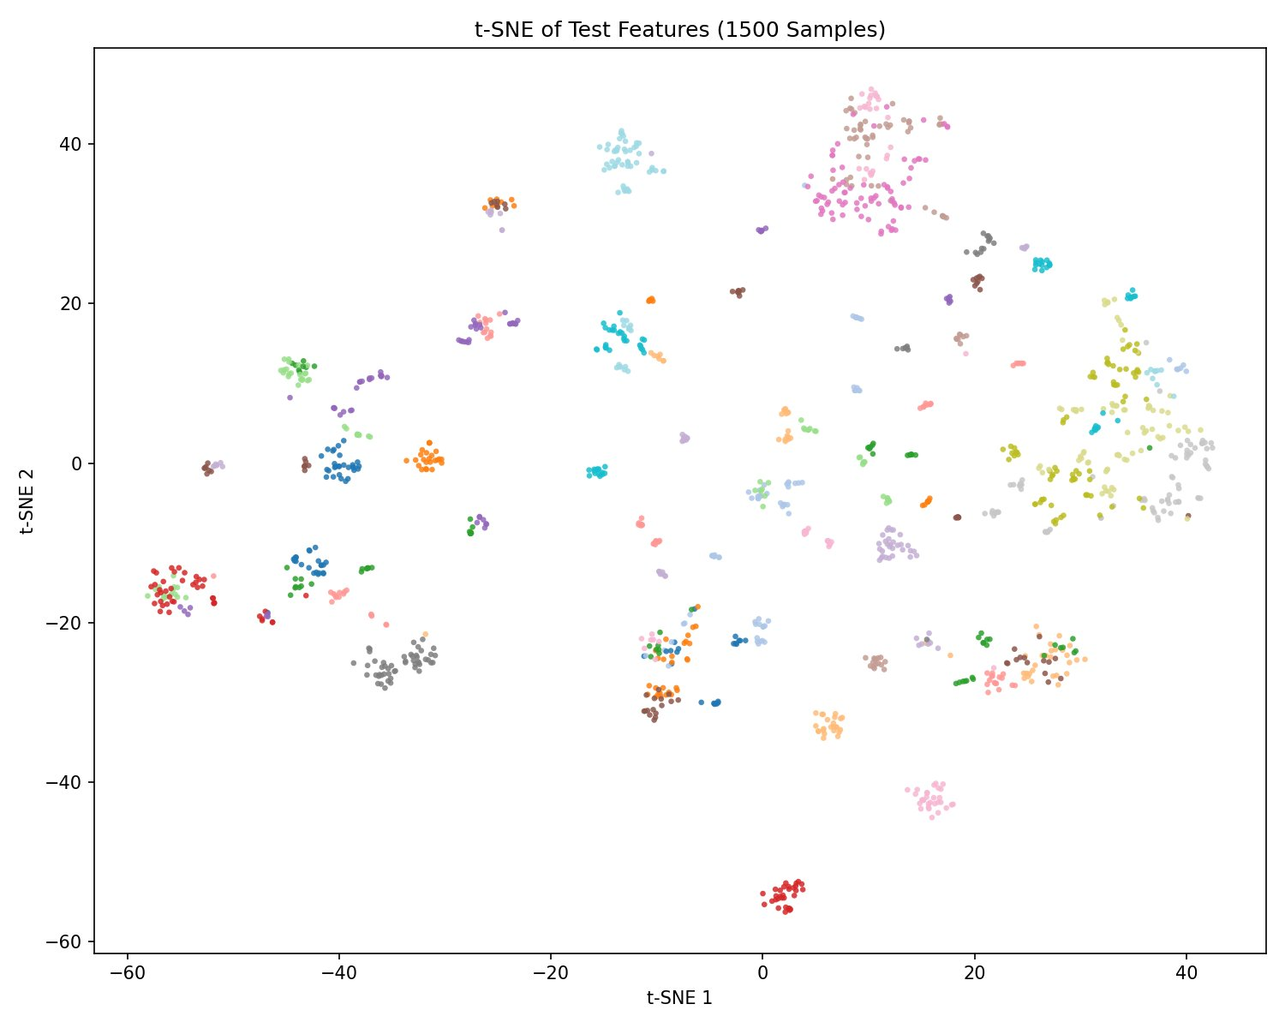
Fine-Grained Bird Recognition · Andrew Eby
5 / 7
Feature Quality: t-SNE Visualization
1,500 samples
Balanced draw from 200 classes; perplexity=30, PCA init.
Clear clusters
Most species form tight, well-separated groups in 2D.
Why it matters
Cluster quality explains the high accuracy — logistic regression only needs to draw linear boundaries.
Notes:
~40 sec. Each dot is a test image colored by species. Point out that tight clusters = good features. The linear probe simply draws boundaries between these clusters.

Slide 6
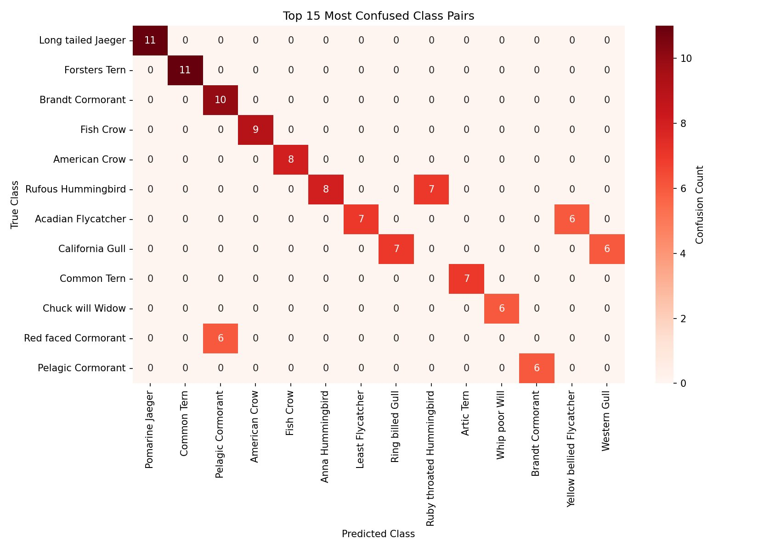
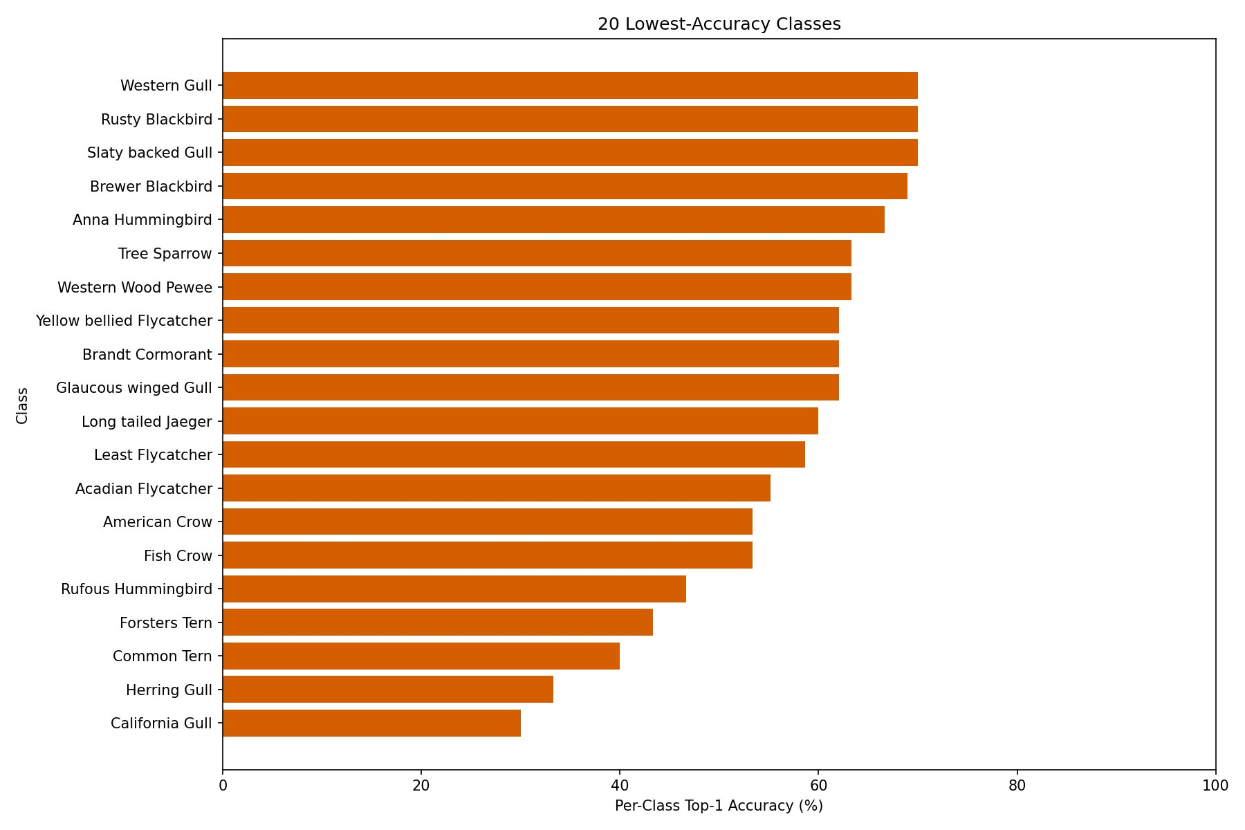
Fine-Grained Bird Recognition · Andrew Eby
6 / 7
Where the Model Struggles
Top-15 Most Confused Pairs
20 Lowest Per-Class Accuracies
Errors cluster within similar-looking groups: gulls, terns, corvids, hummingbirds — near the limits of human expert identification too.
Notes:
~45 sec. The heatmap shows errors are within species families, not random. California Gull (30%) and Herring Gull (32%) are the hardest — even expert birders struggle with these. This tells us the remaining errors are near the ceiling of what's possible without additional data.

Slide 7
Conclusions & Next Steps
What We Showed
Future Directions
89.40% Top-1 / 98.36% Top-5 accuracy
Training in under 5 minutes (CPU only)
Frozen DINOv2 features are highly discriminative
Errors are near the biological limit of similarity
Simple pipeline — easy to reproduce
DINOv2 with registers for cleaner features
ViT-S + ViT-B feature concatenation
Crop images using CUB-200 bounding boxes
Replace logistic regression with small MLP
Broader C sweep (logarithmic scale)
Thank you · github.com/andy-eby/Bird-Recognition-on-CUB-200-with-DINOv2-and-Linear-Probe
Notes:
~35 sec. Summarize key takeaways quickly. Mention that the full code is on GitHub. Leave ~30 seconds for questions.

