Slide 1
Predicting Income Classifications from Historical US Census Data
By Andy Block
Oct 25, 2021

Slide 2
Results
Resampling scheme | Upsample to 1/3 the majority, downsample the majority to match the minority
Selected model algorithm | XGBoost
Training metric | ROC AUC
Training performance | 0.949
Test metric | P-R curve AUC
Test performance | 0.543
Top 5 features by importance | 1) education (0.096), 2) detailed occupation recode (0.090), 3) major occupation code (0.071), 4) age (0.061), 5) detailed industry recode (0.058)
Notes:
these are the results of my implementation, if you don’t understand this table or the meaning of the values in it, don’t worry, I will explain it all in the following slides in (hopefully) a cogent and comprehensive way

Slide 3
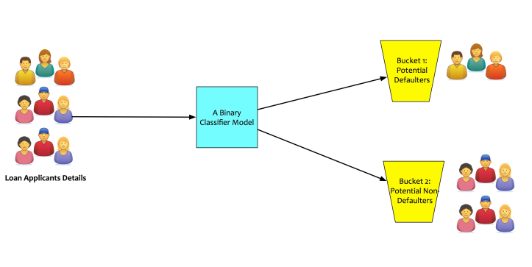
Classification – Predicting the class of a sample
≥50k
US Population
<50k
Notes:
Classification
the idea behind classification is that the user wants to bin their sample data into unique groups that help convey some larger point
each person in the US population has a unique collection of traits (education, age, industry, etc.) that lead to earning a given income
classification can help us understand what recipe of person will most likely lead to higher or lower income levels
the two other most common types of data science problems are regression and clustering
regression problems seek to provide a numerical output, like the sale price of a new house on the market
clustering problems seek to classify “unstructured” data into groups, like the topics for a corpus COVID research papers (PPE, vaccinations, public health, disease transmission, etc.)
these are simply context details for you, they won’t be relevant in this analysis

Slide 4
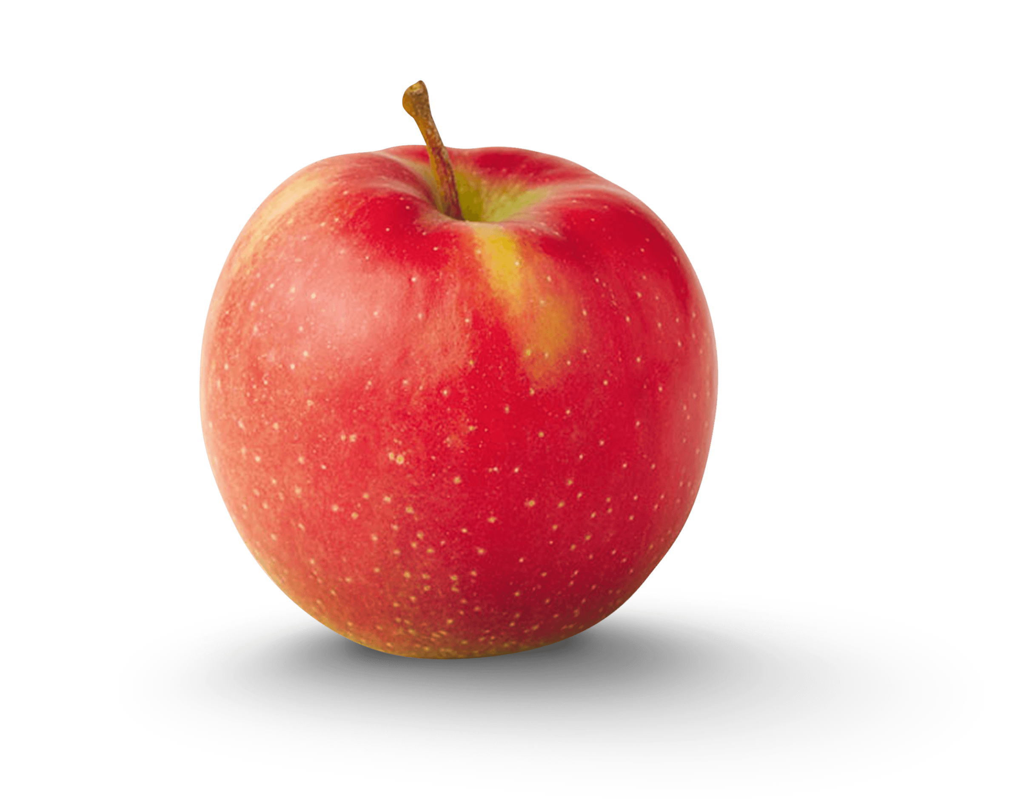
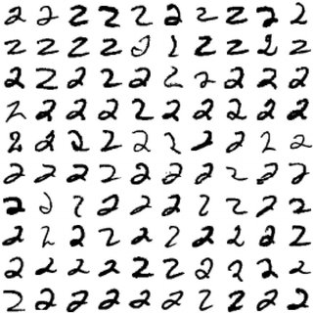
Supervised Learning = “Humanistic” Learning
2
“Apple”
Notes:
Supervised learning
supervised learning is the machine analog for the way humans learn
when you’re born, you don’t inherently know what an apple is, but once you’ve been told “this thing on the left” is an apple and you’ve experienced enough apples in your life, you learn what’s identifiable about them, whether it’s their weight, color, shape, smell, etc.
a machine can learn in the same sort of way
MNIST dataset
if you provide a machine many instances of the number 2 and you tell the machine “this thing you’re observing is a 2”, the machine can learn what makes a two identifiable
the bend of the shape, the swirl at the bottom, etc.
learning these features can allow a computer to recognize a 2 in the same way that it can recognize the attributes of a person making more or less than 50k

Slide 5
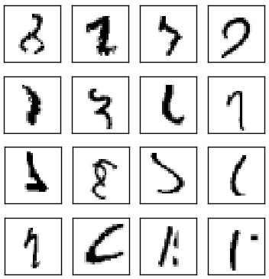
Data Quality
“what?”
Notes:
Bad data, good luck learning anything from this ugly mess

Slide 6

Data Quality
“Garbage in, garbage out”
Understanding your data
Verifying your data
Notes:
Data quality
before doing anything, we need to examine the quality of the data. always remember: "garbage in, garbage out“
your model outputs are only as good as the data that is fed to it, so data quality is of paramount importance
understanding your data
what sort of data do you have? numerical and categorical data in tabular form? video data? images?
don't be misled by missing values. good data sources can be both verifiably accurate and also incomplete
verifying your data
can we trust this data? does it come from a quality source? who collected it?
in this case, the census bureau is the authority on high level demographic data in the US so we have to have some faith that their collection processes are solid and that the data is trustworthy

Slide 7
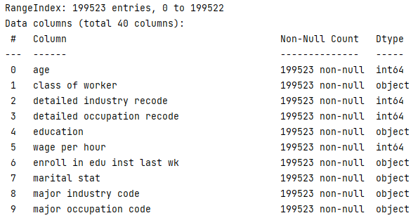
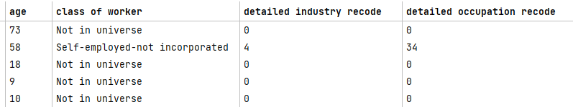
Data Cleaning
Get column names
Descriptive statistics
Handling placeholder values
Notes:
Data Cleaning
once we have verified that our data is trustworthy, we can start working on cleaning and preparing it
for our dataset, the first thing we need to establish are the names for our features, so that we know column A is “age” and column B is “class of worker” etc.
we can then quickly pull some descriptive statistics about the dataset, like finding null values or looking at the mean and standard deviation of each column of data
lastly it’s important to have look at your data and see what it looks like, otherwise you wouldn’t know these strange values like “not in universe” were in your data

Slide 8
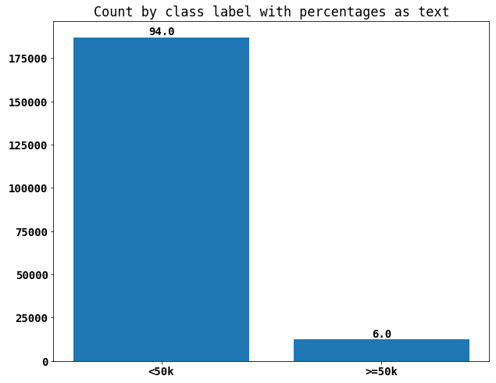
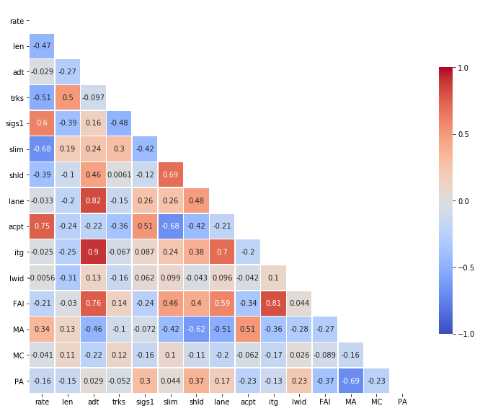
Exploratory Data Analysis
Feature distributions
Feature correlation
Multicollinearity
Notes:
EDA
EDA is an exercise in gaining a deeper understanding of your data, trying to identify patterns, and performing any necessary transformations to your data before modeling begins
EDA is an open-ended process of exploring the patterns in your data, there’s no right or wrong way to go about it
the EDA is a good place to examine the distributions of your features. are your numerical features really numerical? the “detailed industry recode” feature is numerical, but don’t those numerical values really represent categories?
in our case, we can see that the distribution of our target is highly imbalanced, where the instances of <50k income samples far outnumber those of >50k
we will have to deal with that later
also, the EDA is a good time to examine feature correlation, or in other words, the linear relationships between features. if I change the value for feature 1, does that likely change the value of feature 2?
this information is very important because multicollinearity can really obfuscate the outcome of your model
let’s say two features are highly correlated, so a change in feature 1 elicits the same exact change in feature 2. how will we know whether a change in feature 1 really affects the model performance? how do we know feature 2 is not responsible for affecting the model?

Slide 9
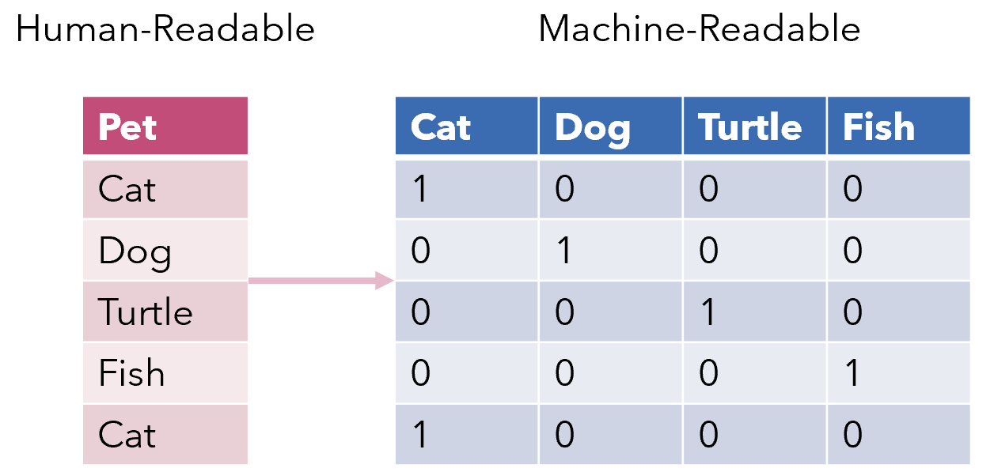
Encoding: the bridge from human to machine
Cardinality (unique values)
Dimensionality
Notes:
Encoding
as if you needed reminding, machines don’t understand things like we do, they’re built of transistors that only exist as 0’s and 1’s
thus, a machine cannot learn what a “dog” or “cat” is, but merely a numerical representation of these things
encoding is the means by which we can turn this categorical data with rich meanings into the 0’s and 1’s that a machine understands
there are numerous ways in which we can encode our data and picking an appropriate method is very important
the image on the right is an example of an encoding method called “one-hot encoding”, where each feature gets a unique column
while this technique can be highly effective, we need to understand the cardinality of each feature, which really just means how many unique values are in the column
if each unique value is getting its own column, we don’t want to encode a feature with 300 unique features because it will create a very sparse matrix with lots of 0’s and only a few 1’s
for our specific dataset, I chose to use “target encoding” or ”mean encoding”, which replaces the values in a column with a weight according to how likely it will produce a positive or negative target value
I used this because it’s relatively agnostic to unknown features like “not in universe” that we can’t resolve to another label

Slide 10
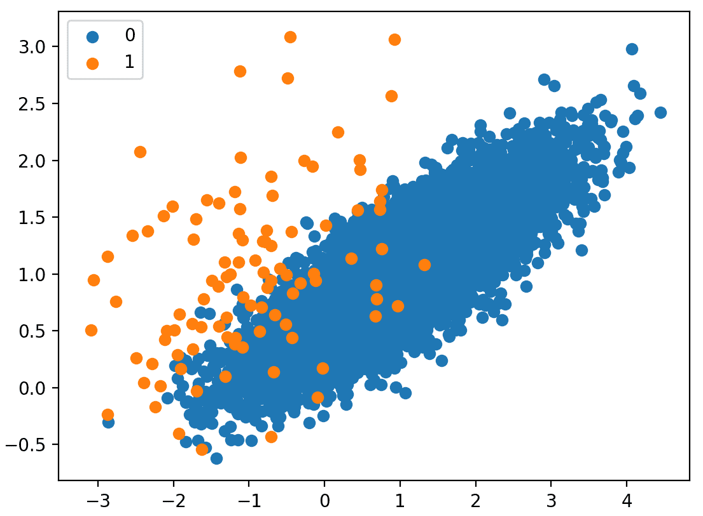
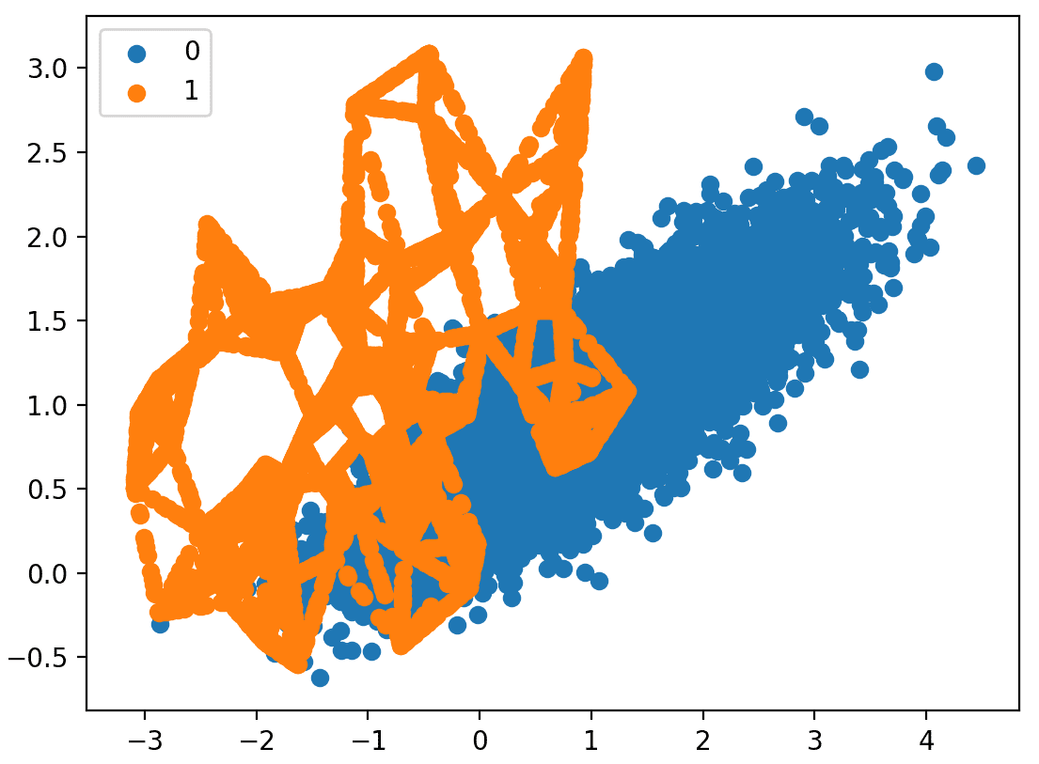
Class Imbalance and Resampling
1
Algorithms designed for balanced classes
Minority class usually more important
Under/Oversampling
2
Notes:
Class imbalance
most modern data science algorithms are built for balanced datasets, or datasets with a nearly equal representation of the output classes
as we saw a couple slides ago, we are working with a very unbalanced dataset (96-4 in favor of <50k), so we need to take some action to try to make the classes more balanaced
Minority class importance
the other big problem is that in class imbalance problems, the minority class is usually of higher importance to us than the majority
for instance, look at credit card fraud detection. hundreds of millions of valid transactions are happening on a daily basis while only a small number are fraudulent
the credit card company doesn’t care about the valid transactions, they don’t lose money on those. the ones they need to understand are the fraudulent transactions
the same thing with our dataset, we understand that the vast majority of people have <50k in income, we want to identify what goes into the >50k samples
Resampling
there are loads of different techniques that try to address class imbalance by resampling the data
SMOTE and ROSE are two commonly used oversampling techniques that generate synthetic data that is roughly similar to that of the existing minority samples
additionally, undersampling may be paired to the approach by specifically or randomly dropping instances of the overrepresented class

Slide 11
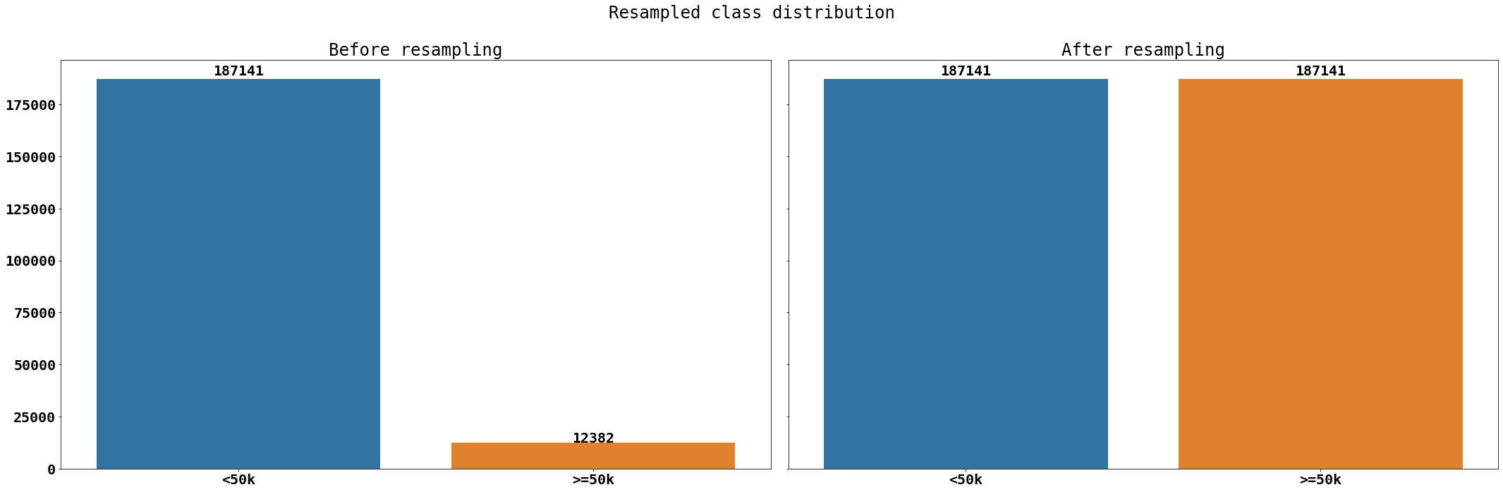
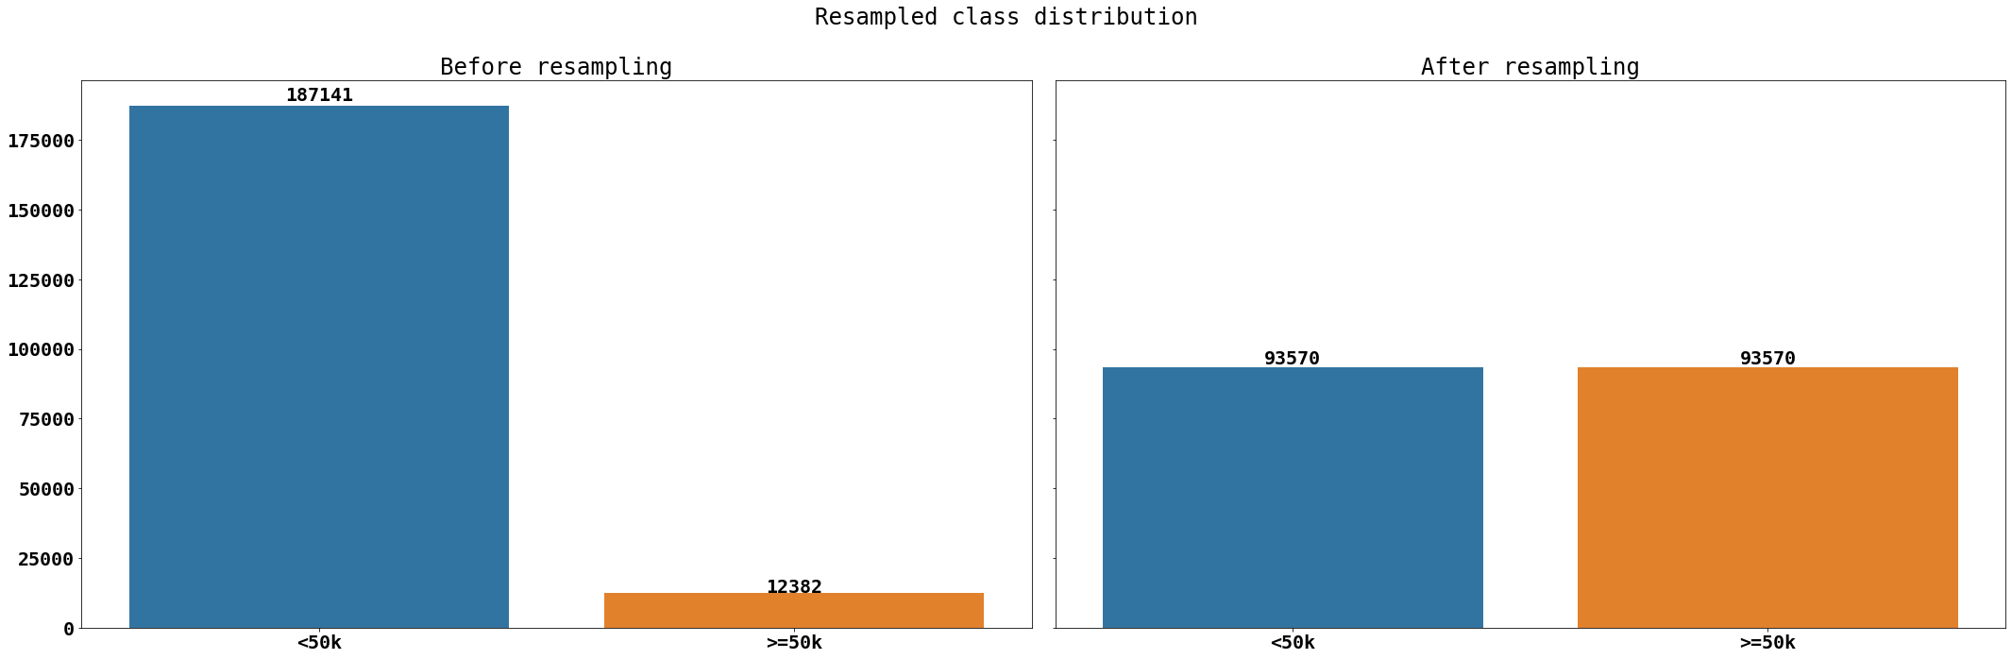
Class Imbalance and Resampling
Notes:
Examples of class balancing outputs

Slide 12
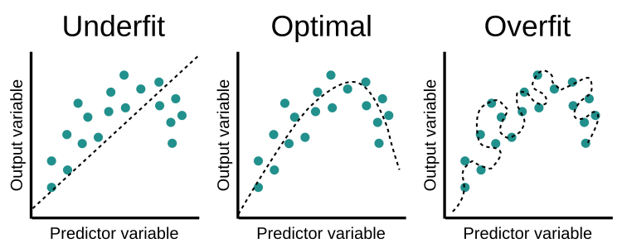
Training Models
≥50k
Problem statement
Selecting candidate algorithms
Minimizing loss and over/underfitting
US Population
<50k
Notes:
Training Models
let’s first revisit our problem statement, we’re trying to bin sample users into two specific classes, income greater or less than 50k
thus we are going to need classification specific algorithms like random forest, logistic regression or xgboost
ultimately, we are trying to minimize the difference (or “loss”) between our predictions and the reality
if we underfit our data, our model will have a hard time classifying new data, after all it had a hard to classifying the data we already had
if we overfit our data, our model will have a hard time classifying new data, it has so specifically learned the data that we already have that once a bit of real world variability is added, the predictions will fall apart
we are looking to find the middle ground between our model fitting the data very well but also being able to well classify new data inputs

Slide 13
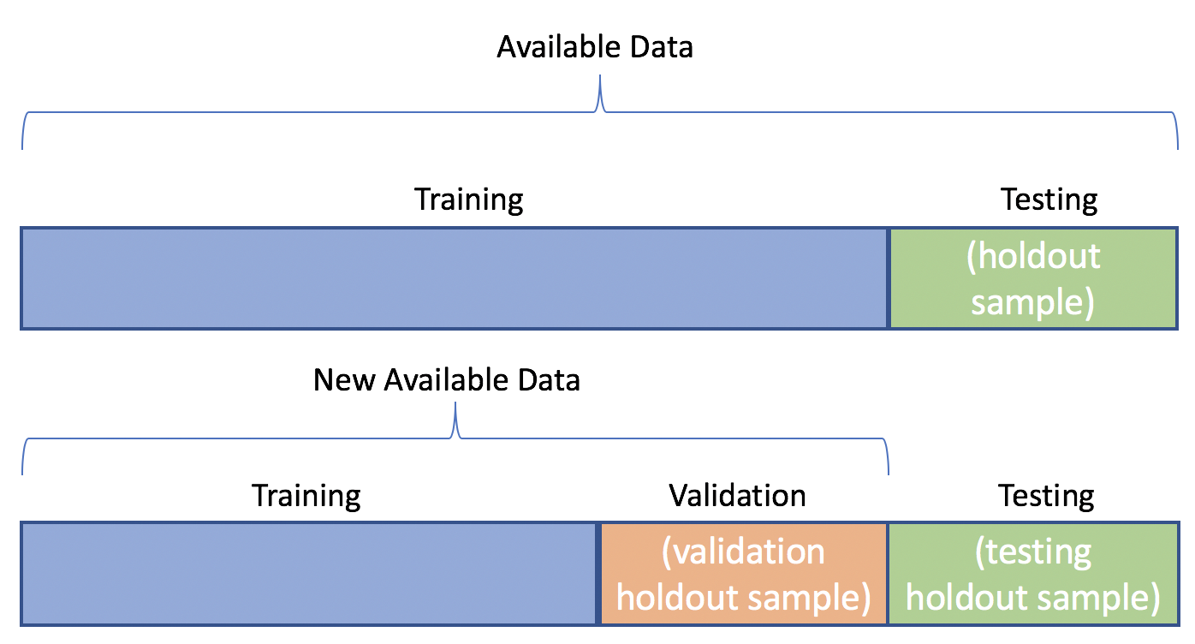
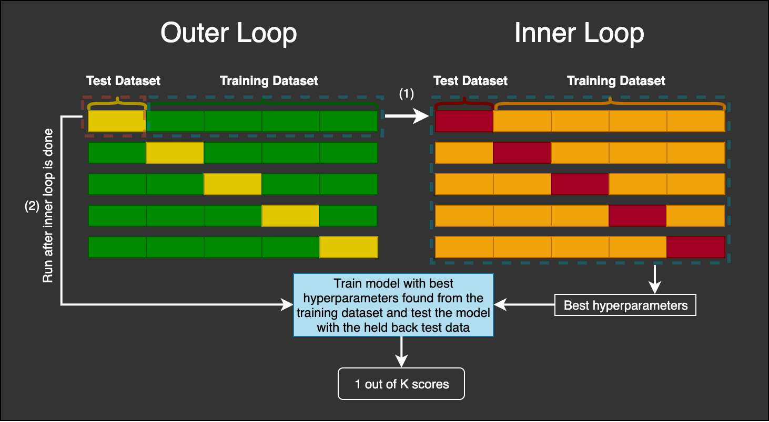
Cross Validation
1
Train, validation, test sets
Nested k-fold
Parameters and hyperparameters
2
Notes:
Cross validation helps the user choose a model in an unbiased way
Train, validation, test sets:
first split your data into a train and test set, where the test set is supposed to represent “new data” or unseen handwritten images of the number 2
within your training data, it’s useful to split the data again into a train and validation sets
once your model has seen the training set, you can test it on the validation set to understand how it performs on unseen data
maximize the performance of your model against the validation set and then test it on the test set to get an understanding of how the model would perform in the wild
Nested k-fold:
cross validating your cross validation
create training, validation, and test sets out of just your training data
helps with both model selection and model scoring
in this example (image 2), for each row on the left, you get five trained models, or 25 training models for all 5 left rows. select the best model for each left row, reducing the number to 5 models. test those models on the remaining test dataset (scoring) and choose the model with the best performance on the test datasets
provides the user with an understanding of over/underfitting before the test set is ever encountered
Parameters and Hyperparameters:
parameters are like the spices or ingredients, hyperparameters are like the pots and pans or the stove type
you need both to cook a meal but they’re fundamentally different to one another
a cook can vary the amounts of salt, pepper, and garlic whenever they’re cooking, while changing from a pan to a wok or from the stove to the oven changes the whole meal

Slide 14
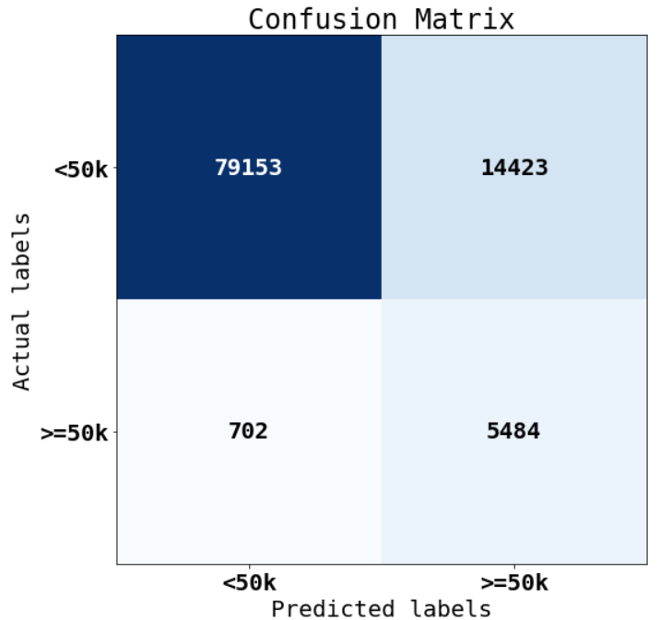
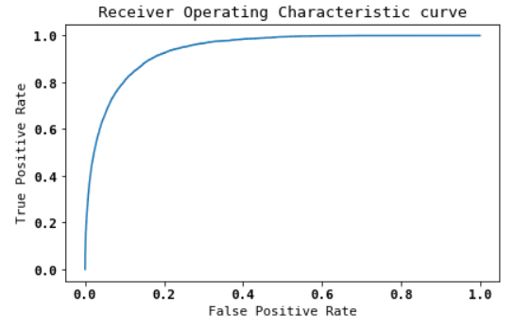
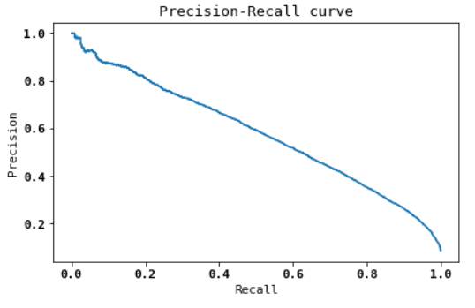
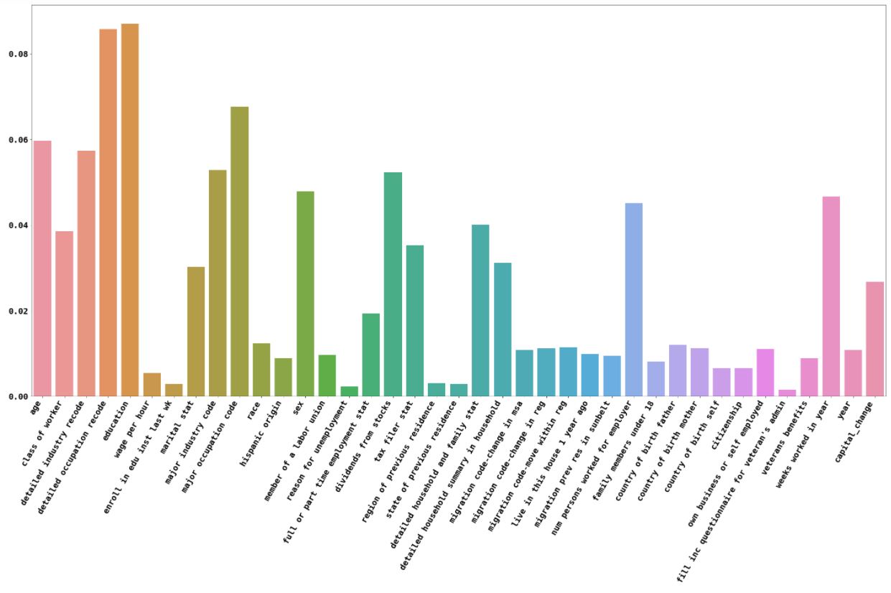
Evaluating Models
Confusion matrix
Receiver Operating Characteristic and Precision-Recall curves
Feature importance
Notes:
Evaluating Models
creating a confusion matrix is a quick and handy first step of analyzing the performance of any classifier
a confusion matrix provides all the information required to calculate other important metrics like precision, recall, and accuracy
the receiver operating characteristic (ROC) and precision-recall (P-R) curves are useful tools in understanding model performance when applied at the correct time
the mathematics behind the ROC curve don’t appreciate class imbalance, so in this particular instance, it is only useful in the model training loop when our classes are balanced thru resampling
the P-R curve is much more sensitive to imbalanced classes and thus is the more useful metric for this data
the area under each curve is the quantitative measure of how well the model is performing, ROC ranges from [0.5, 1] whereas the P-R curve ranges from [0, 1]
feature importance is a quantitative measure of how much each feature is influencing the model’s predictions
these values can be calculated via built-in methods in sci-kit learn, and if you have them, you may as well use them instead of creating the calculations yourself

Slide 15
Next Steps/Improvements
Mixed encoding: one-hot for the low cardinality, target for the high
Add a resampling loop to the cross validation
Modify the training loss function, maybe use accuracy instead

