Slide 1
Predicting Income Classifications from Historical US Census Data
By Andy Block
Oct 25, 2021

Slide 2
Results
Notes:
these are the results, here’s how I got there, and this is how you can get there yourself

Slide 3
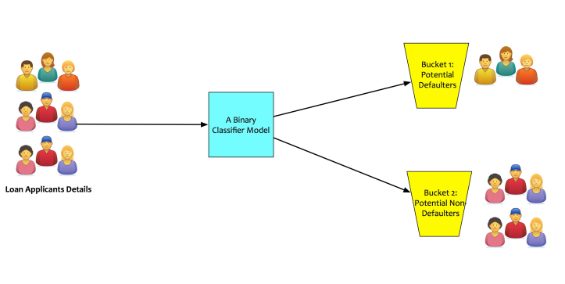
Classification – Predicting the class of a sample
≥50k
US Population
<50k

Slide 4
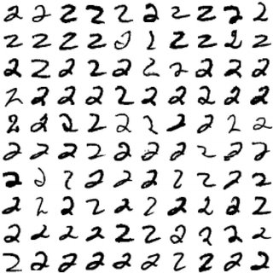
Supervised Learning = “Humanistic” Learning
2

Slide 5
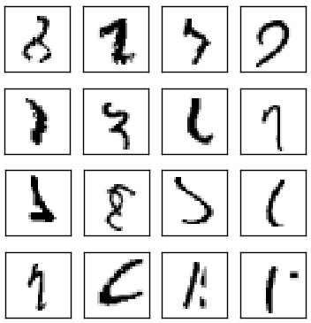
Data Quality
“what?”

Slide 6

Data Quality
“Garbage in, garbage out”
Verifying your data
Understanding your data
Notes:
Data quality
- before doing anything, we need to examine the quality of the data. always remember: "garbage in, garbage out". can we trust this data? does it come from a quality source? don't be misled by missing values. good data sources can be both verifiably accurate and also incomplete

Slide 7
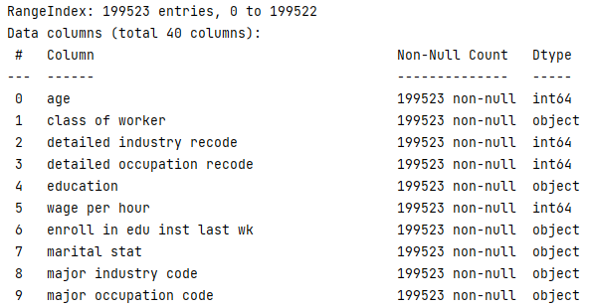
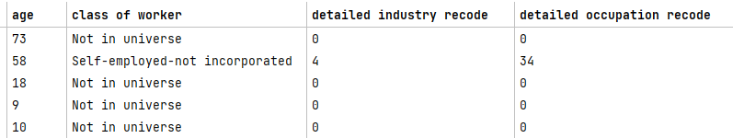
Data Cleaning
Get column names
Descriptive statistics
Handling placeholder values

Slide 8
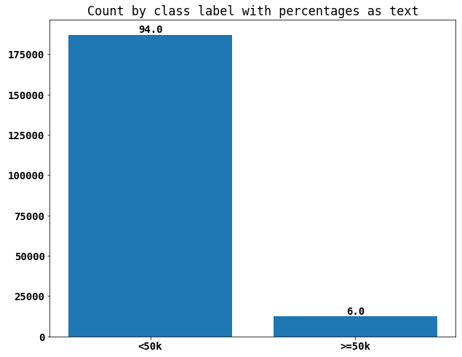
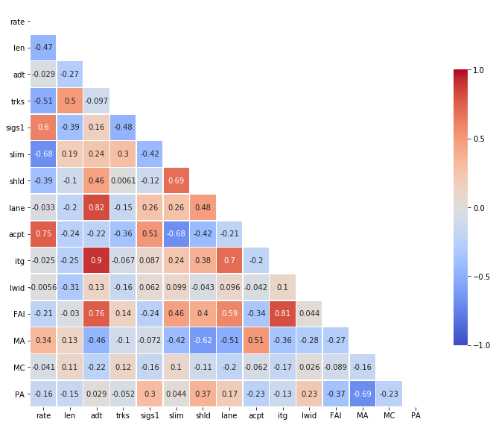
Exploratory Data Analysis
Feature distributions
Feature correlation
Multicollinearity

Slide 9
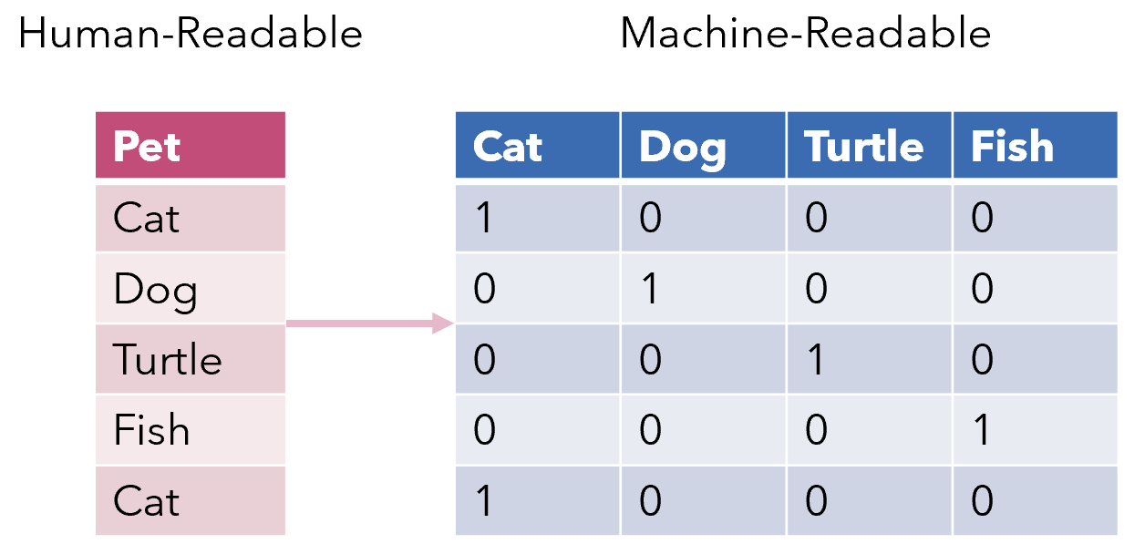
Encoding: the bridge from human to machine
Cardinality (unique values)
Dimensionality
Notes:
- in the case of making the features more machine-friendly, let's look at the feature 'education'. we know as humans that earning a higher level of degree, like a master's or phd, will increase the probability that you make more money. a computer isn't a human and only understands 0's and 1's. thus, it's useful to turn those types of categorical variables into a number of some sort, which is a process called encoding. there are lots of possible encoding schemes, the most popular of which are label encoding and one-hot encoding. each of these has their own strengths and weaknesses, which we can discuss

Slide 10
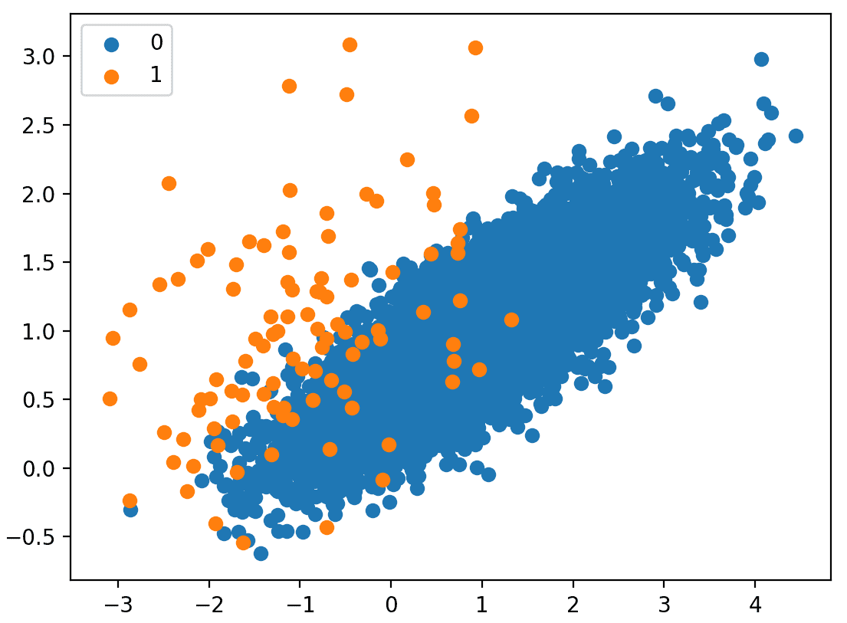
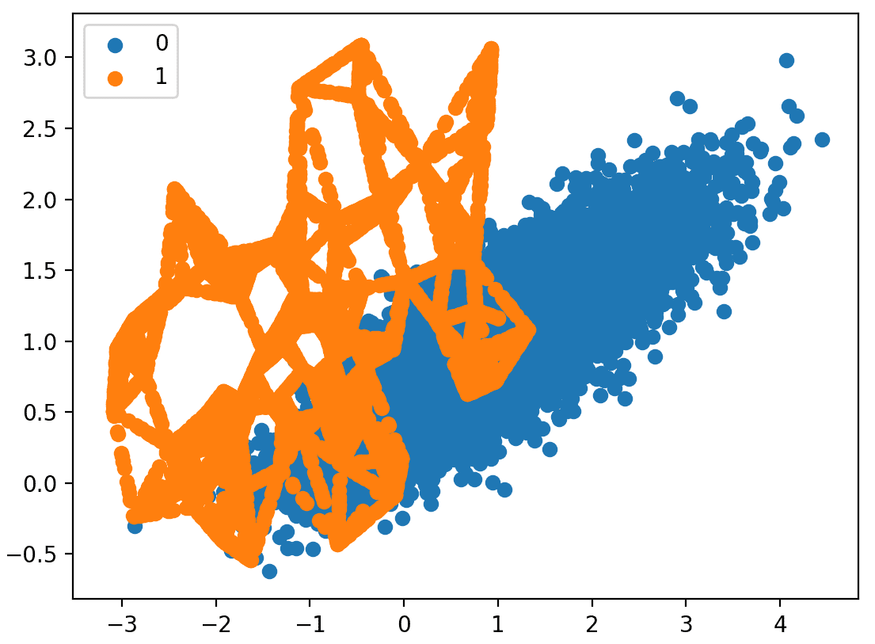
Class Imbalance and Resampling
Algorithms designed for balanced classes
Minority class usually more important
Under/Oversampling (Random, SMOTE, ROSE)

Slide 11
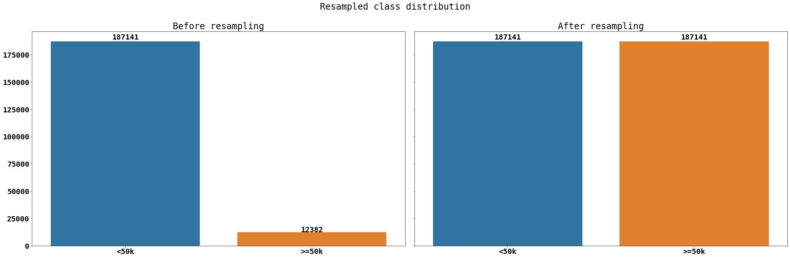
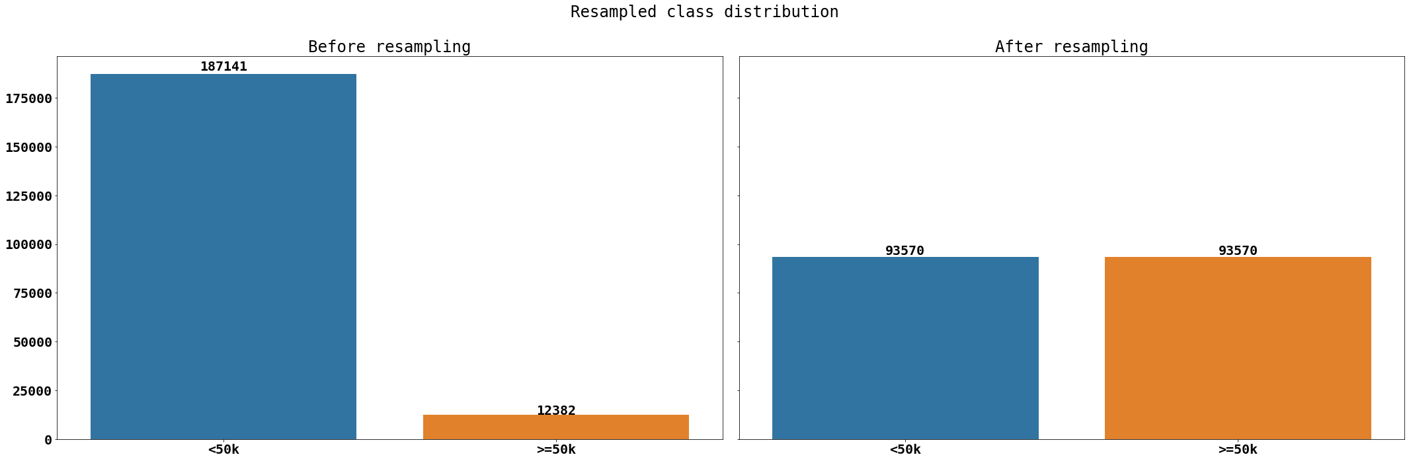
Class Imbalance and Resampling

Slide 12
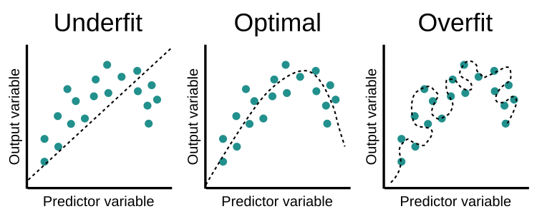
Training Models
≥50k
Problem statement
Training data for learning, test data for evaluating
Minimizing loss and over/underfitting
US Population
<50k

Slide 13
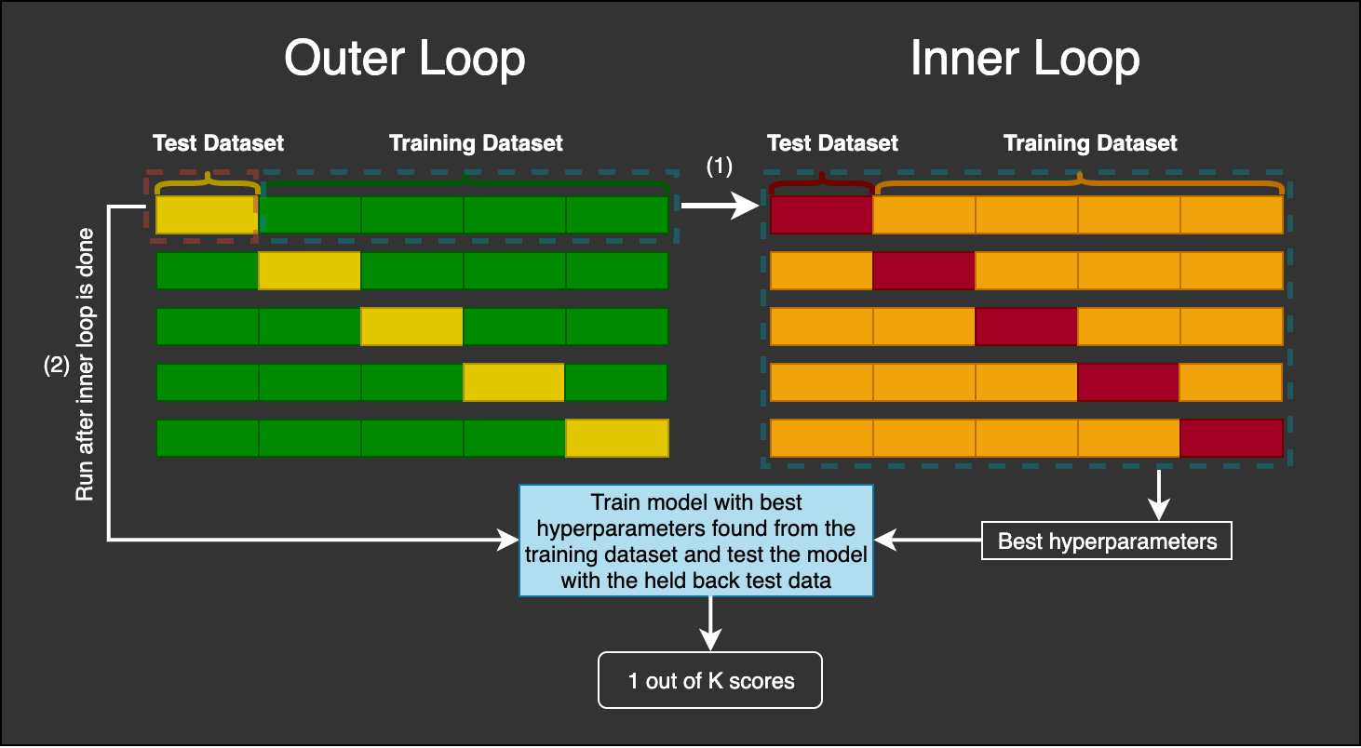
Cross Validation

Slide 14
Evaluating Algorithms

