Slide 1
Predicting Income Classifications from Historical US Census Data
By Andy Block
Oct 25, 2021

Slide 2
Topics
Problem overview, prototypical types of DS problems
Supervised learning, machine has the answers, can learn how to determine the answer from learned experience
Data cleaning, feature engineering, encoding
EDA, class imbalance, resampling
Cross validation, holding out sets
Models
Results

Slide 3
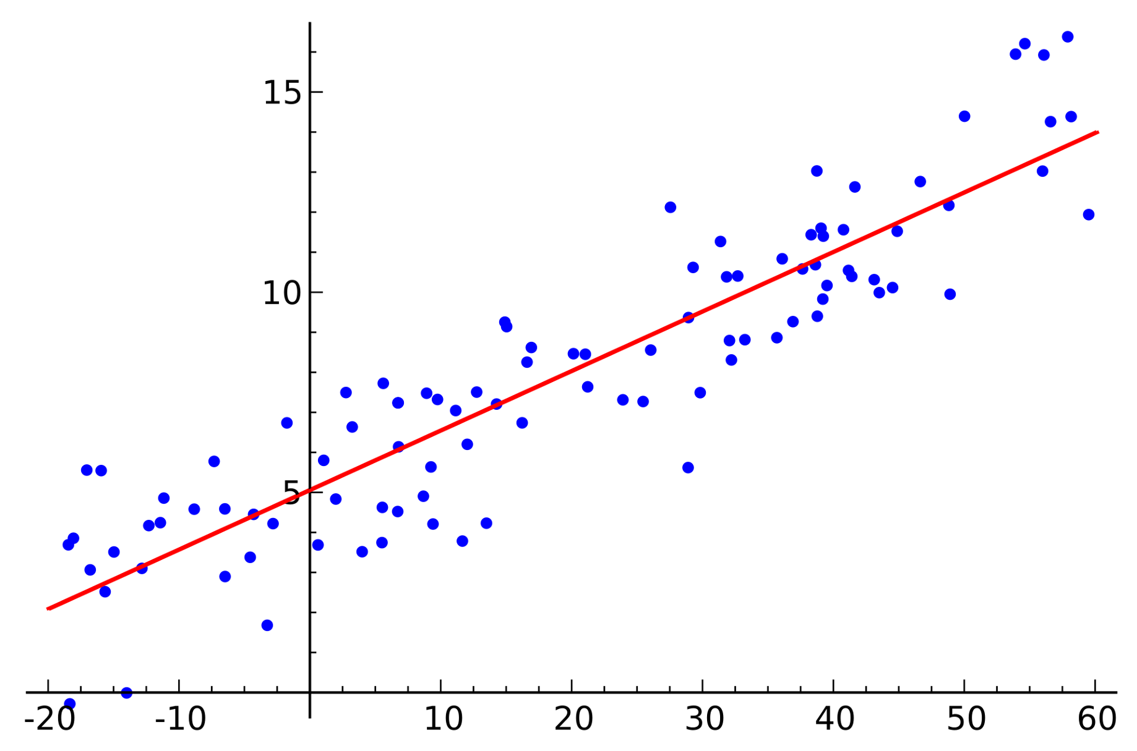
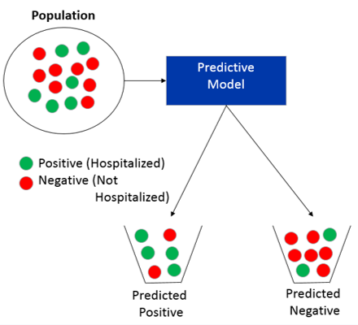
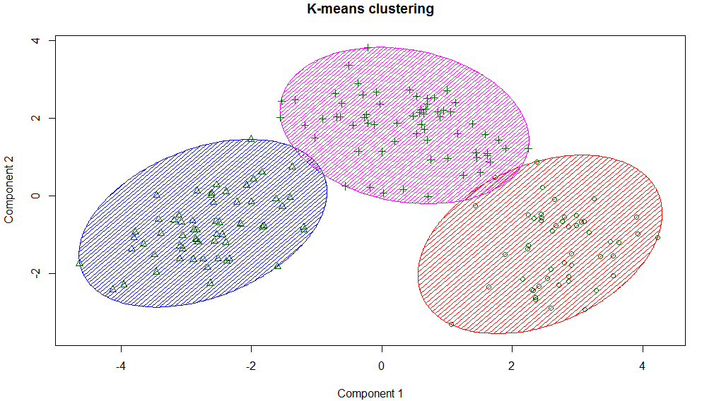
Regression, Classification, and Clustering
Predict a numerical output
Predict the class of a sample
Create groupings of samples

Slide 4
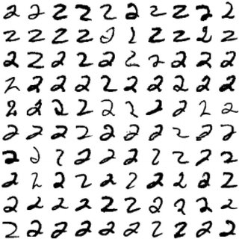

Supervised Learning = “Humanistic” Learning

Slide 5
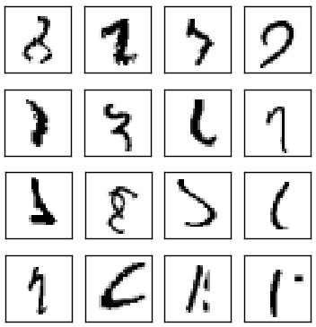

Data Quality

Slide 6

Data Quality
Garbage in, garbage out
Verifying your data
Understanding your data

Slide 7
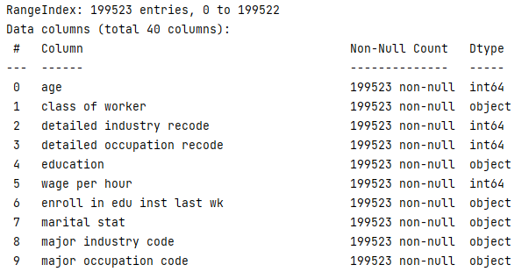
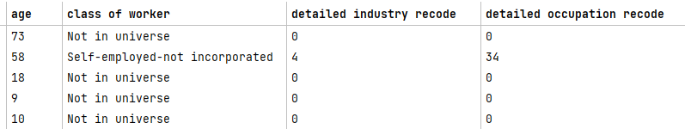
Data Cleaning
Get column names
Descriptive statistics
Handling placeholder values

Slide 8
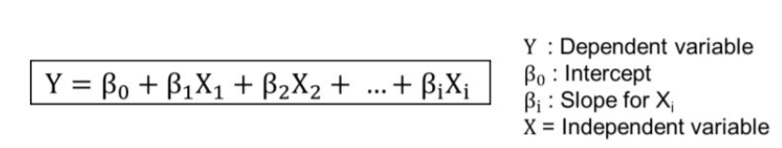
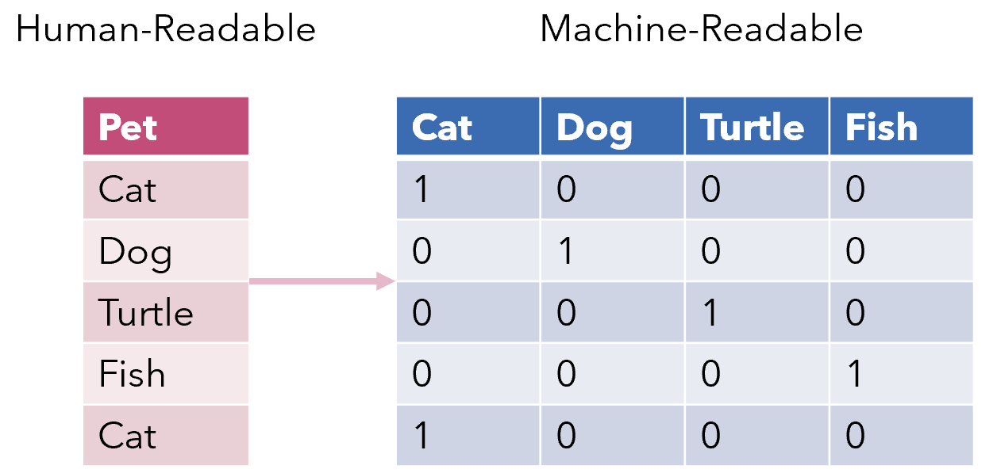
Feature Engineering and Encoding
Reduce excess dimensions
Encoding: the bridge from human to machine
Cardinality (unique values)

Slide 9
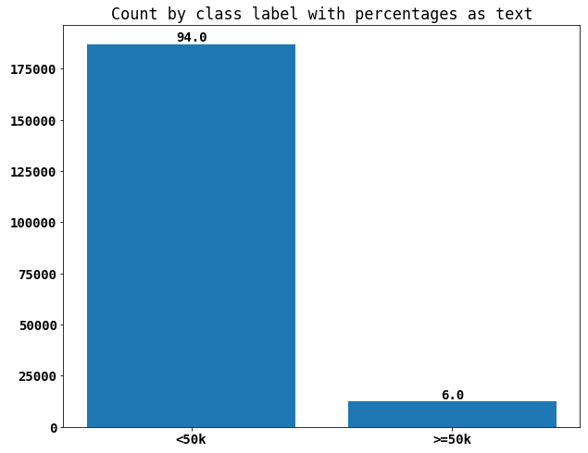
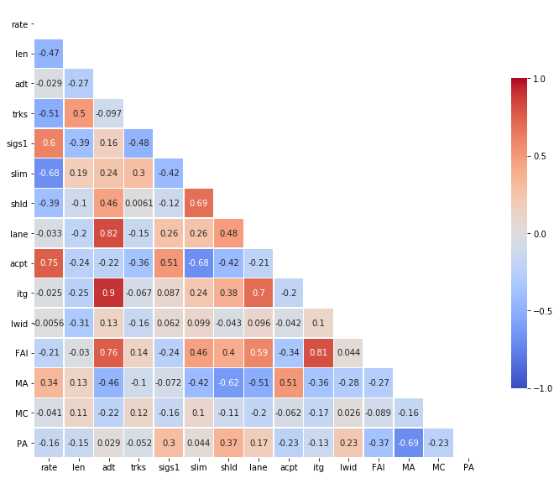
Exploratory Data Analysis
Feature distributions
Feature correlation
Multicollinearity

Slide 10
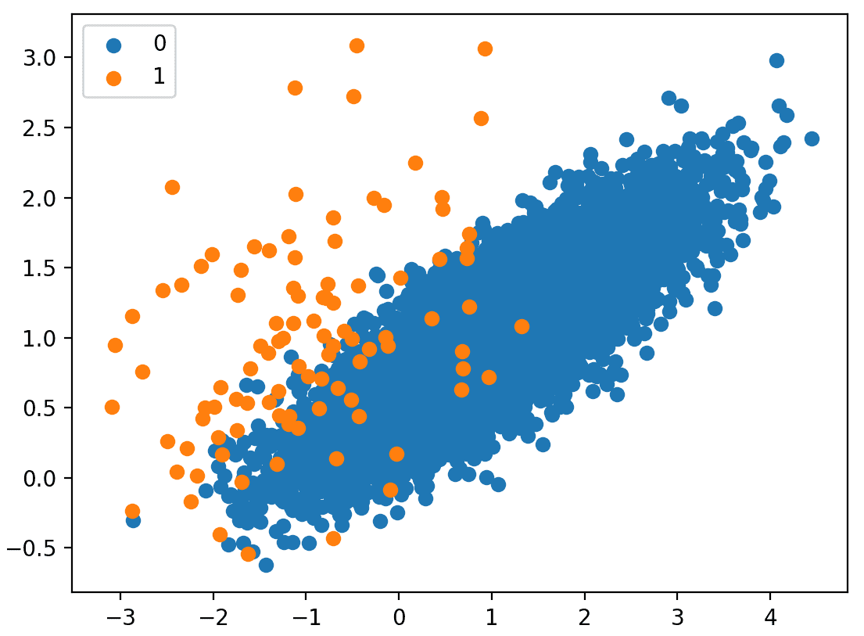
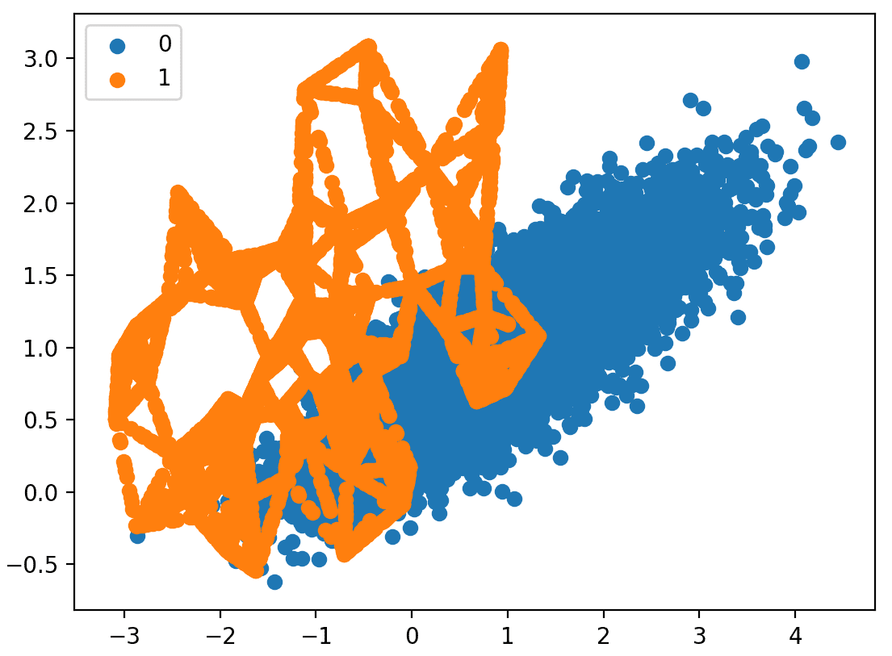
Class Imbalance and Resampling
Algorithms designed for balanced classes
Minority class usually more important
Under/Oversampling

Slide 11
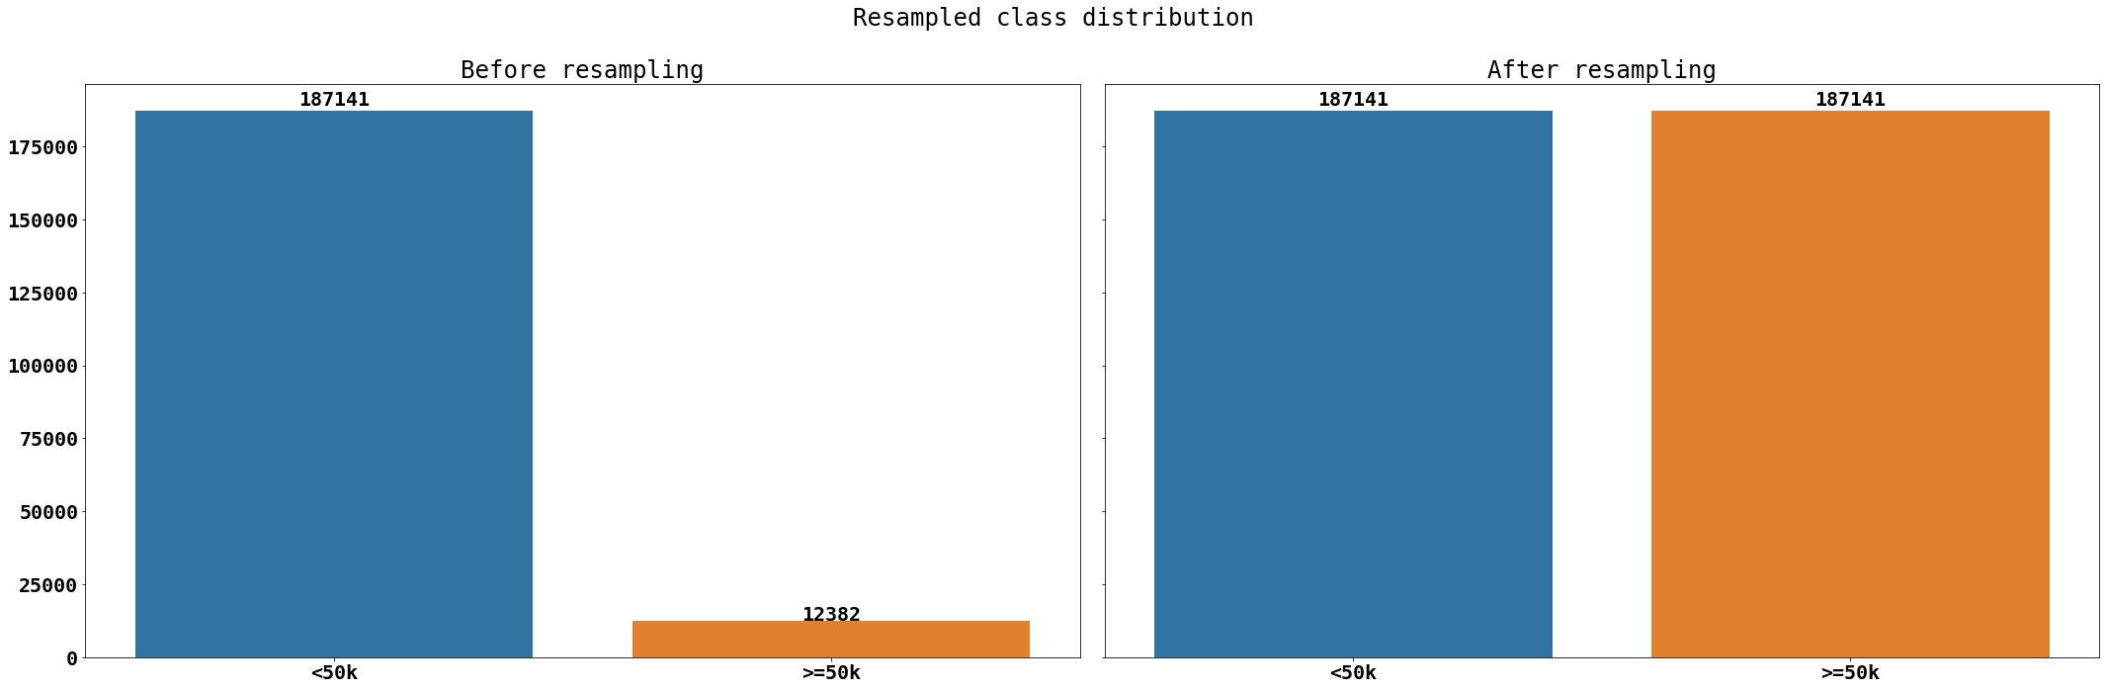
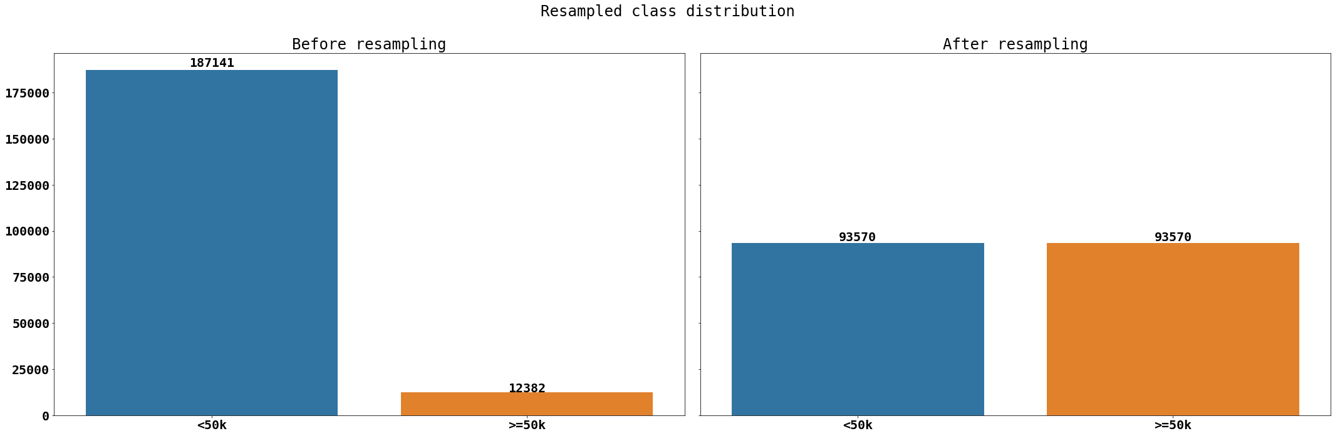
Class Imbalance and Resampling

Slide 12
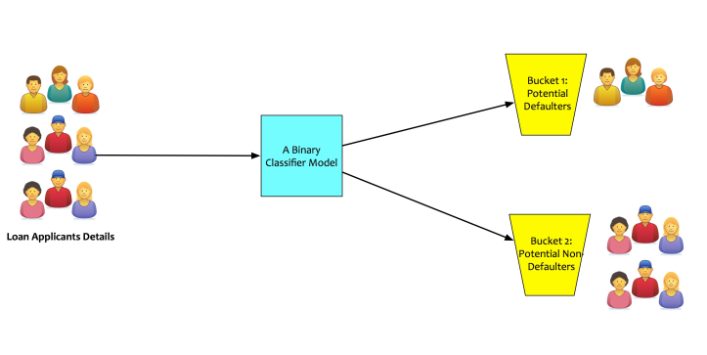
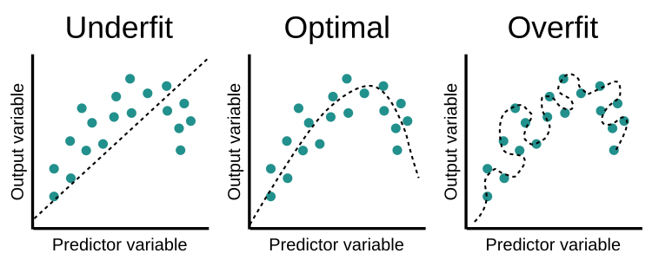
Training Models
≥50k
Problem statement
Training data for learning, test data for evaluating
Minimizing loss and over/underfitting
US Population
<50k

Slide 13
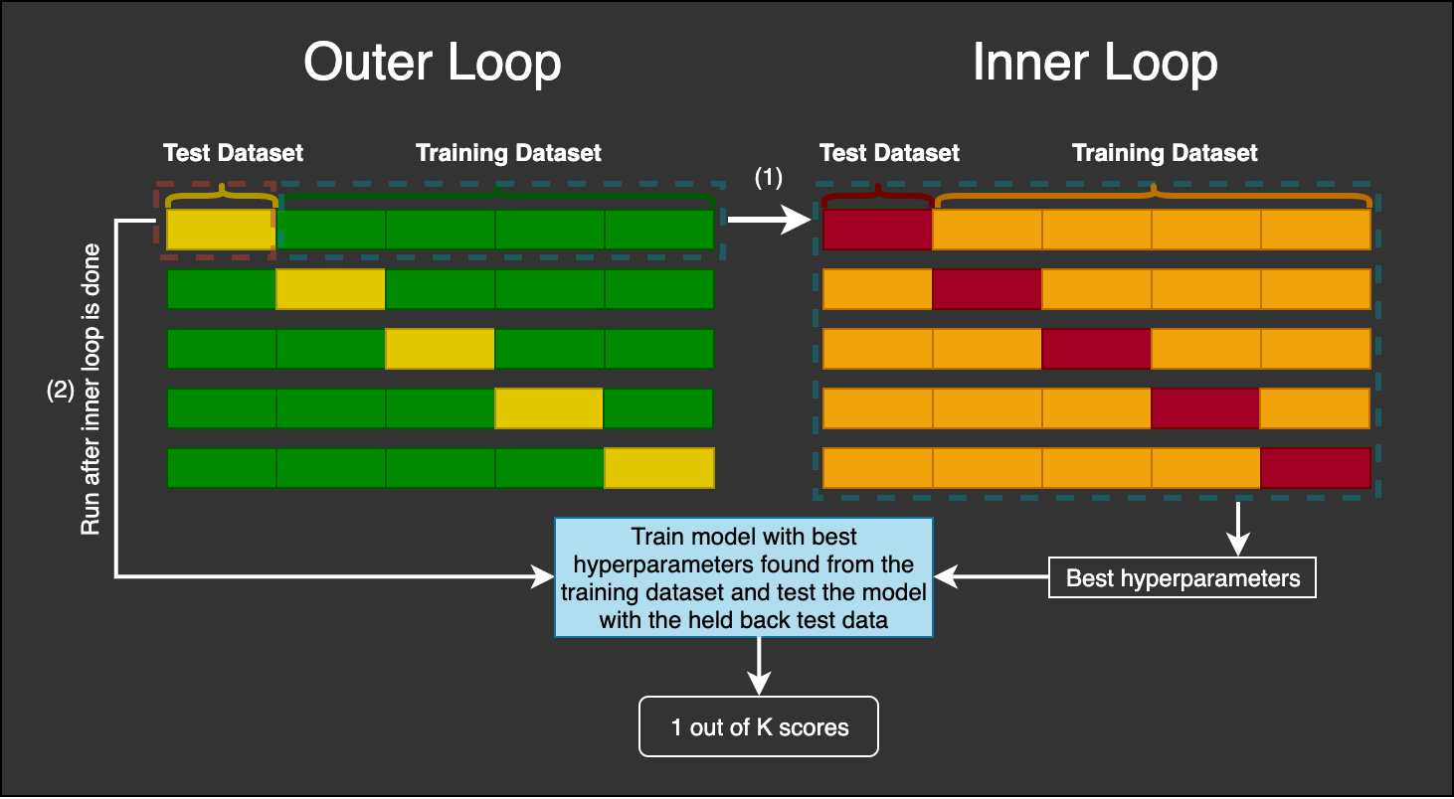
Cross Validation

Slide 14
Evaluating Algorithms

