Slide 1
Lymphoma Classifier
By Andy Block
September 22, 2021

Slide 2
Results
Achieved x accuracy via my trained model
Trained models of three different algorithm “types” of varying depth: ResNet, VGG, and DenseNet
Created a Streamlit web app to provide context

Slide 3
Motivation
Nearly ten years ago, I was treated for Hodgkin's Lymphoma and thankfully have been “no evidence of disease” since late 2013
Part of that experience is motivation for applying to Oscar
While my experience relying on the American insurance system was not relatively painful, it still was far from ideal and left much to be desired

Slide 4
Git Repo
Git repo: https://github.com/andy-j-block/lymphoma_classifier
Kaggle URL: https://www.kaggle.com/andrewmvd/malignant-lymphoma-classification
Authors: Nikita Orlov, Wayne Chen, David Eckley, Tomasz Macura, Lior Shamir, Elaine Jaffe, and Ilya Goldberg

Slide 5
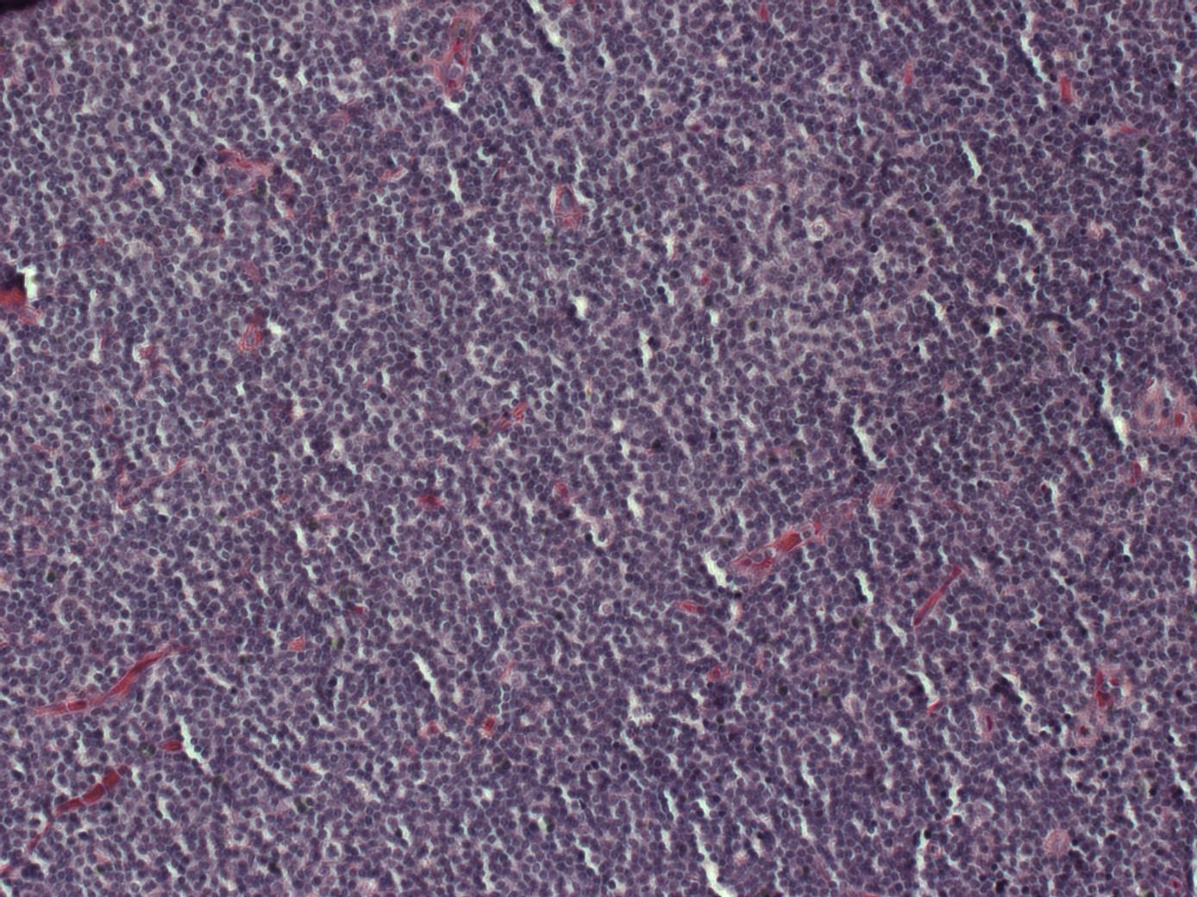
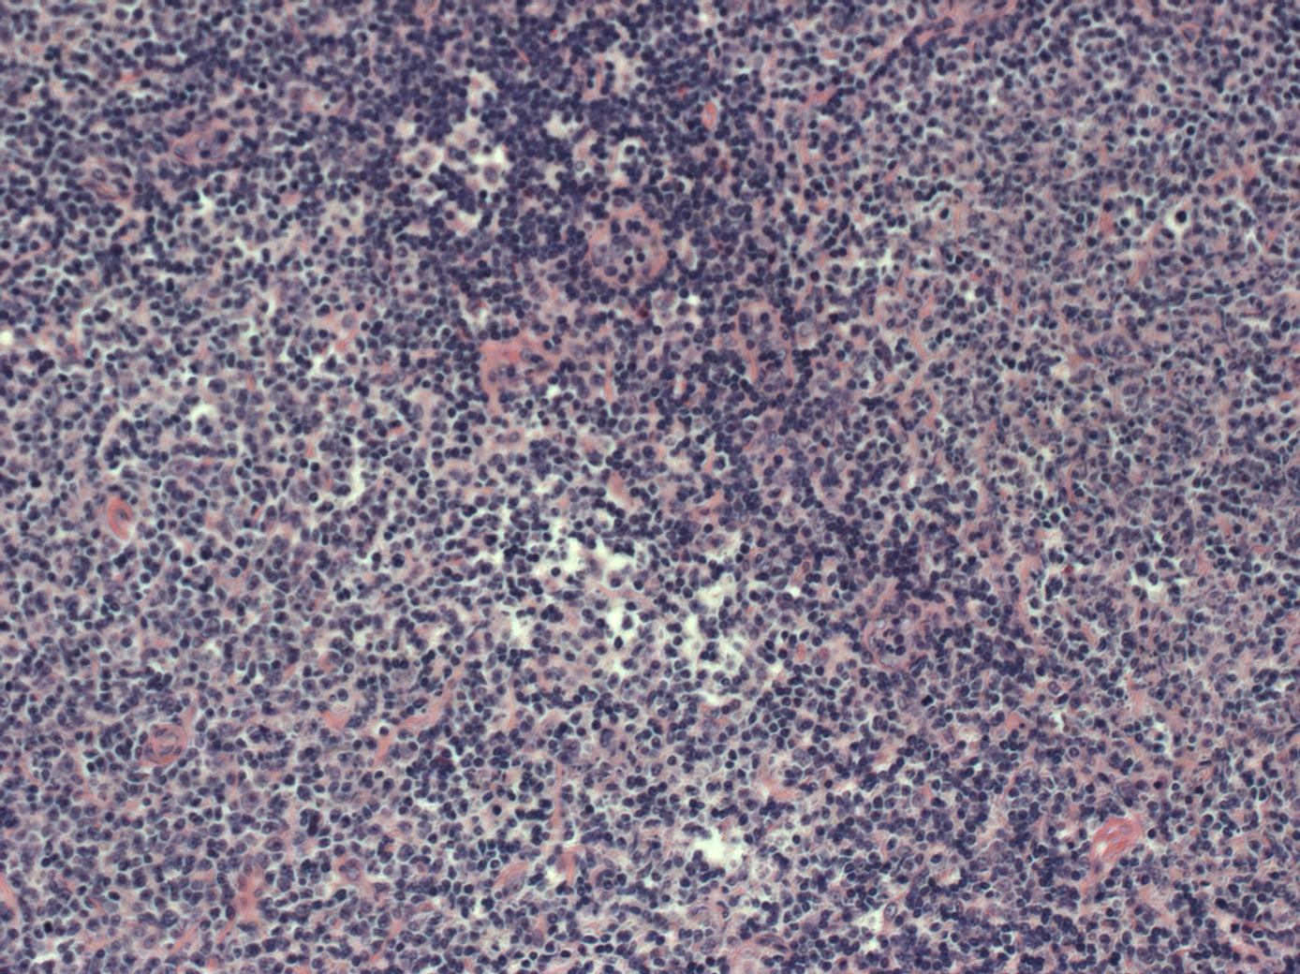
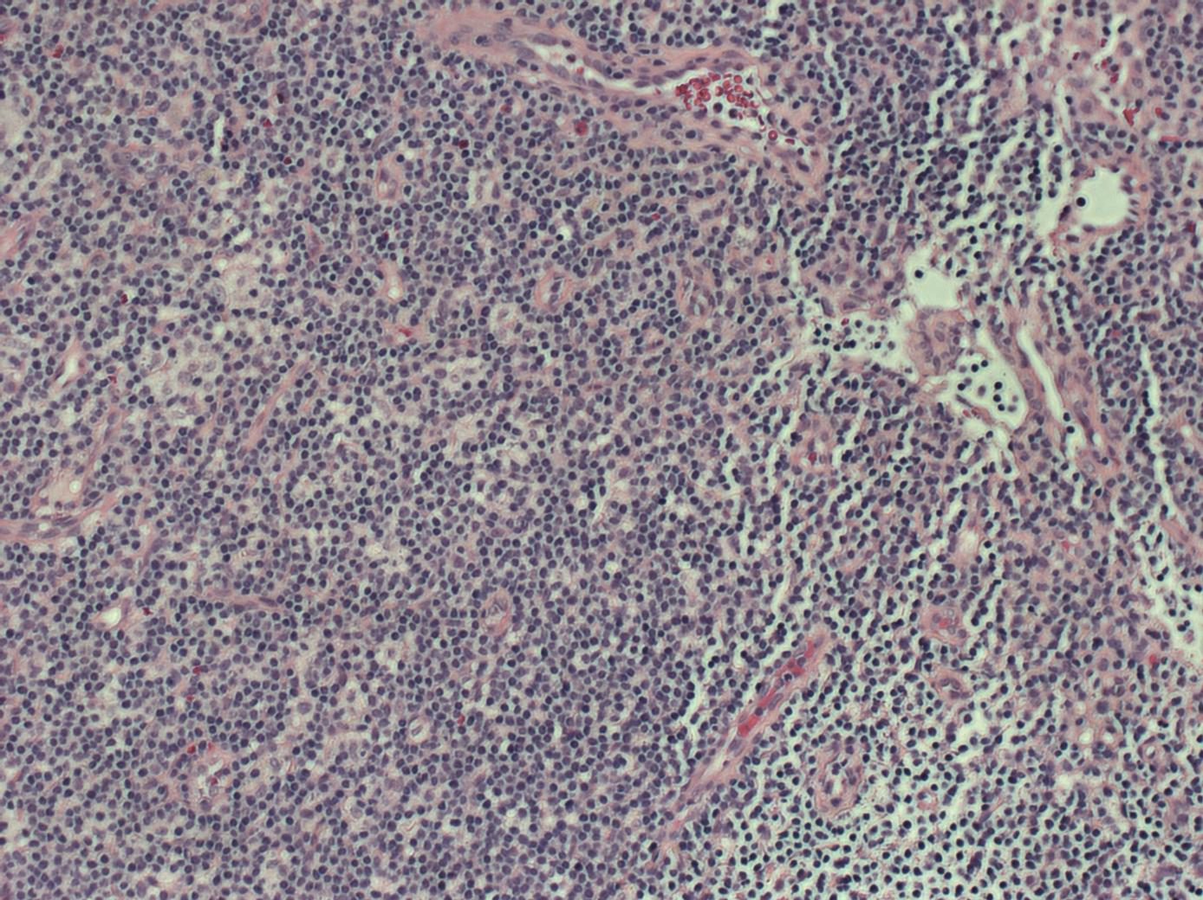
Sample Images
Chronic Lymphocytic Leukemia (CLL)
Follicular Lymphoma (FL)
Mantle Cell Lymphoma (MCL)

Slide 6
Exploratory Data Analysis

Slide 7
Image Data Augmentation
Since the overall dataset is pretty small (n=374), augmenting the dataset with was a high priority task
Pytorch and OpenCV has a substantial library of image augmentations, but after researching other available tools, Albumentations stuck out as the most comprehensive and
Created an array of potential image transformations, each with a probability variable p

Slide 8
Nested K-Fold
In order to expand the training set and

Slide 9
Hyperparameter Tuning with Optuna

Slide 10
Lessons Learned
Started this project as a functional programming project
Hit a wall in terms of complexity, the function inputs because miles long
Switched over to OOP

