Slide 1

City of Buenos Aires
Keeping the city beautiful with CRM
Buenos Aires government goes live with SAP CRM solution enabling the city to better respond to requests from citizens and keep the city beautiful.
Challenge
Across its nearly 2,000 square miles, the city of Buenos Aires has somewhere in the vicinity of 700,000 assets that are maintained by the local government, including 125,000 street lights; 54,000 sidewalks; 30,000 drains; 27,000 roads, and even upwards of 400,000 trees. The Ministry was not capable of managing efficiently the vast number of requests from their over 3 million citizens. The Ministry did not have the technology infrastructure required to do so and this led to deficiencies in the maintenance task planning, overlapping and duplication of work, inefficiencies in the monitoring and control functions, and long times of response.
Solution
The City has just gone live with a Deloitte-led CRM solution implementation that enhances their existing SAP platform (also a Deloitte project), enabling them to better manage the volumes of data and projects to keep this cosmopolitan city beautiful. For 10 months, beginning in December 2013, the Deloitte team worked through the complete project lifecycle, from preparation and blueprint, to realization, final preparation, the live and a support engagement.
Benefit
Just two months after the September 2014 go-live and already the 100 employees of the environment and Public Spaces Ministry are reaping the rewards of the new system.
The Environment and Public Spaces Ministry is now running a new IT completely integrated platform (SAP) for managing the citizens’ claims, which will not only provide information in real time, but also will ensure the integrity of the data contained. It will also allow its users to introduce, administrate and share information in a standardized way and to eliminate the back office tasks.

Slide 2
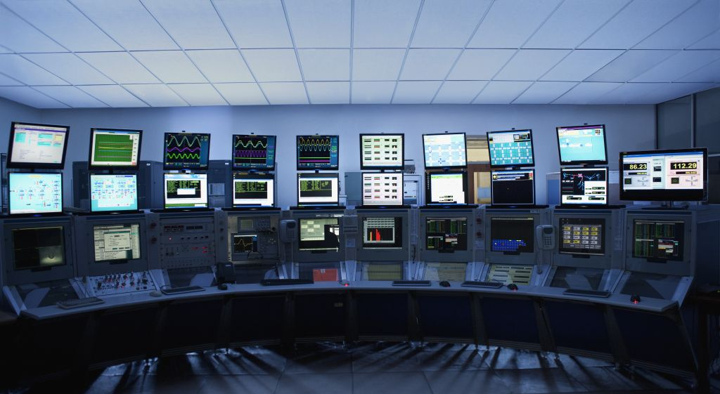
Smart City Cockpit
Real Time City Government
Deloitte, along with Siemens, implemented a Smart City Cockpit which enables better decision making by consolidating information from a wide range of administrative systems
Challenge
The information that is required to run the city effectively is dispersed in a number of administrative systems, with no integrated view. This resulted in decision making in silos, without considering the overall picture and all the processes that drive the city.
Solution
Deloitte supported the implementation of a Smart City Cockpit, working with Siemens. The Smart City Cockpit provides the central platform for the diverse demands of citizens and local authorities. Data from municipality and country are published together with publically available data, and provided on one integrated platform. Predictive Analytics are developed and controlled in a central platform.
Benefit
The Cockpit provides the city administration with a single integrated tool that supports better and faster decision making by consolidating information from a wide range of administrative systems. The Mayor will now be able to keep track of multiple processes that drive the city in real time.
Citizens can also use the centrally provided information for their own applications and share these with other citizens via the Cockpit platform.
Deloitte Contacts: Olaf Peter Schleichert (Berlin), Carsten Dolch (Dusseldorf)

Slide 3
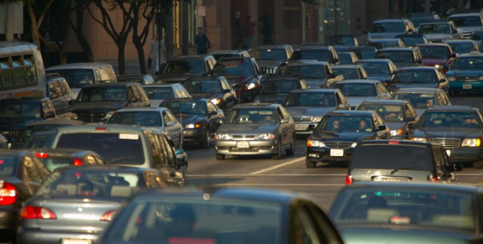
Transport for London
Still Waiting for Partner permission for external use
Real time traffic management
Using real time information and predictive analytics to better manage traffic.
Challenge
Over 26 million journeys begin on London’s roads each day. The challenge of keeping the traffic moving on London’s roads require real time actionable information available to traffic managers, enabling them to make timely interventions.
Solution
Deloitte worked with Transport for London to build a real-time traffic management service. The tool monitors traffic flows as vehicles enter central London. Data from sensors is fed into an analytics engine which processes over 10 million vehicle captures per day.
Deloitte designed and built the visual user interface and created a tool that gives traffic managers the information to make timely interventions to improve journey time reliability and alleviate congestion.
Benefit
The real time traffic management service now enables the city and the traffic managers to take more informed decisions on interventions required for ensuring smooth traffic movement.
Deloitte Contacts: Warwick Goodall (UK – London)

Slide 4
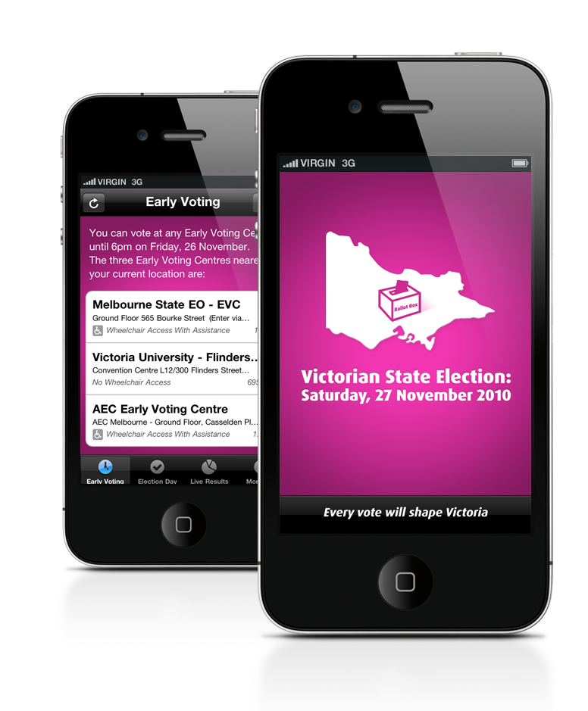
Vote Vic
24x7 app for citizen engagement
Deloitte designed and implemented an iPhone app to help Victoria Election Commission engage better with citizens, thereby ensuring a better voting process.
Challenge
Voting in the state of Victoria can be a challenge as the public need information on hand to find the closest places to vote both before, and on election day.
Would it be possible to create an iPhone app that would help Victorians, both in Victoria and abroad, to find the closest places to vote, both before, and on election day?
Solution
Deloitte worked closely with key members from Information Victoria and the Victorian Electoral Commission (VEC) to come up with an elegant and usable iPhone application to display VEC information about voting centres and election results.
Benefit
The application was download by 2,700 people on election day, 5,000 people in total, and featured in the top 50 most download apps for the week.
This enabled a smoother voting process for the Victorians on a key political day and engaged the public on a personal level using a digital platform.

Slide 5
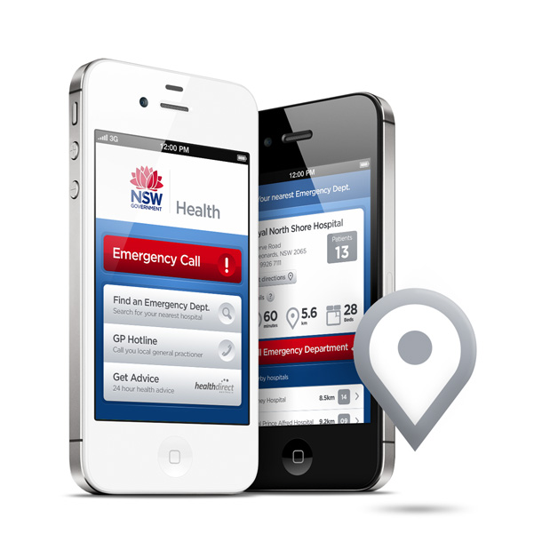
NSW Government
Emergency Department Wait Times – Mobile Website
Providing timely access to quality care and giving the public honest and accurate data.
Challenge
Given that emergencies don’t always happen within easy access of a computer, mobile access real-time emergency information is critical.
Would it be possible to create an iPhone app that would help Victorians, both in Victoria and abroad, to find the closest places to vote, both before, and on election day?
Solution
The Department of Health had already created a series of web services that collected information from emergency department management systems. Deloitte used this information to create a mobile site accessible by iPhone, Android and Blackberry devices.
The mobile site provides details such as the closest hospital location, a map overlaying the suggested route and estimated driving time, number of people waiting to be treated, how many beds are in each emergency department and an estimate of waiting times.
Benefit
With the mobile website, patients and carers can now make informed decisions about which hospital to go to, how to get there and what the likely waiting times will be.
It also provides the opportunity to spread the load across NSW emergency departments.

Slide 6
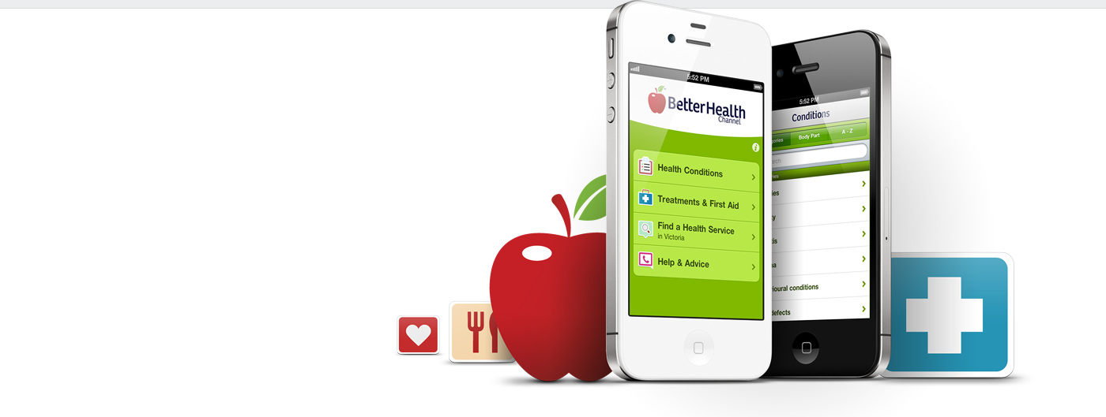
Better Health Channel
New mobile solution ensures health on the go
One of Australia’s leading health, medical and lifestyle websites, the Victorian Government’s the Better Health Channel (BHC), reaches over 1 million unique visits per month.
Challenge
With Australians now regularly using smartphones for content browsing and applications, the Victorian Government’s Department of Health wanted to broaden the delivery of the BHC message and service with a mobile application.
Solution
Designed to be intuitive for users, the app provides extensive BHC health and medical information, including health conditions, treatments, medical procedures and first aid.
A location-based search helps find health providers, and urgent medical contacts and advice are offered.
Benefit
The BHC mobile platform and content enables anywhere, anytime access to reliable health information and services for all Victorians.
The app supports health consumers to establish and maintain positive health behaviours, make informed decisions, and manage their own and their family’s health.

Slide 7
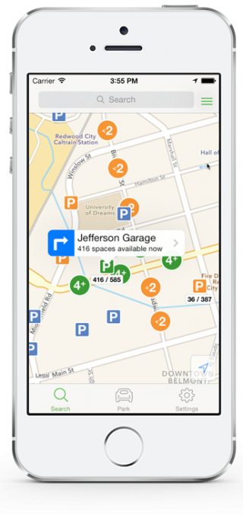
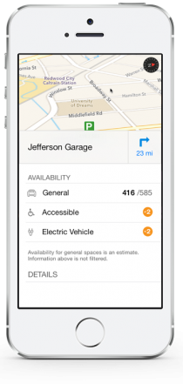
City of San Mateo
Mobile solution makes parking downtown easier
Providing commuters with an easy option for finding parking within the city
Challenge
The busy downtown of San Mateo presented a challenge for commuters when finding parking. This resulted in increased congestion and inefficient use of space within the city. The city of San Mateo pursued an innovative solution to the increasing traffic problem.
Solution
Designed to be accessible for users, Streetline’s Parker implementation provides real-time parking availability information, hands-free voice navigation and easy access to rates, hours and time limits.
Parker also enables users to keep a track of where they parked their car and store pictures of their car location to help them remember where their car is parked.
Benefit
San Mateo now has reduced traffic, emissions and driver frustration in the downtown area.
The parking solution helps attract more people to enjoy the downtown San Mateo experience.

Slide 8
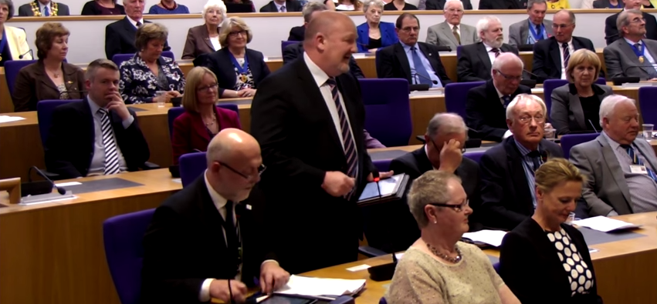
Monmouthshire Council
Livestreaming council meetings
Providing county residents and businesses a way to engage in the democratic process
Challenge
The closed room nature of council room meetings did not allow for the residents, organisations and businesses of the Monmouthshire council to have transparency in the decision making process.
Solution
The council uses YouTube to broadcast and livestream meetings live. The solution enables the meetings to be viewed by anyone, anywhere on any device.
Benefit
The Monmouthshire County Council has developed a reputations as a local authority which engages and brings the processes of local government decision making closer to the people.
Council happenings are now more accessible and transparent and provide accountability.

