Slide 1
Cassette – criticality analysis
Given HALEU, cassette is safe by design for criticality

Slide 2
Executive summary
Conclusions
Current cassette configuration is criticality safe (3x4x5)
Criticality is not credible under very conservative bounding assumptions for UO2F2, UF6

Slide 3
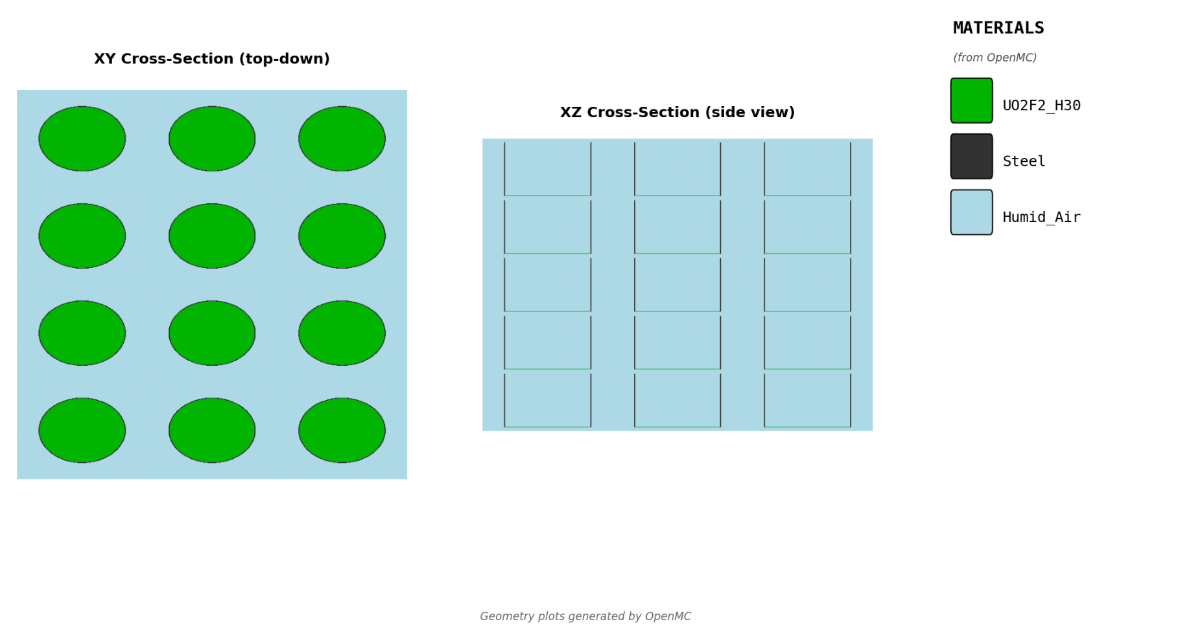
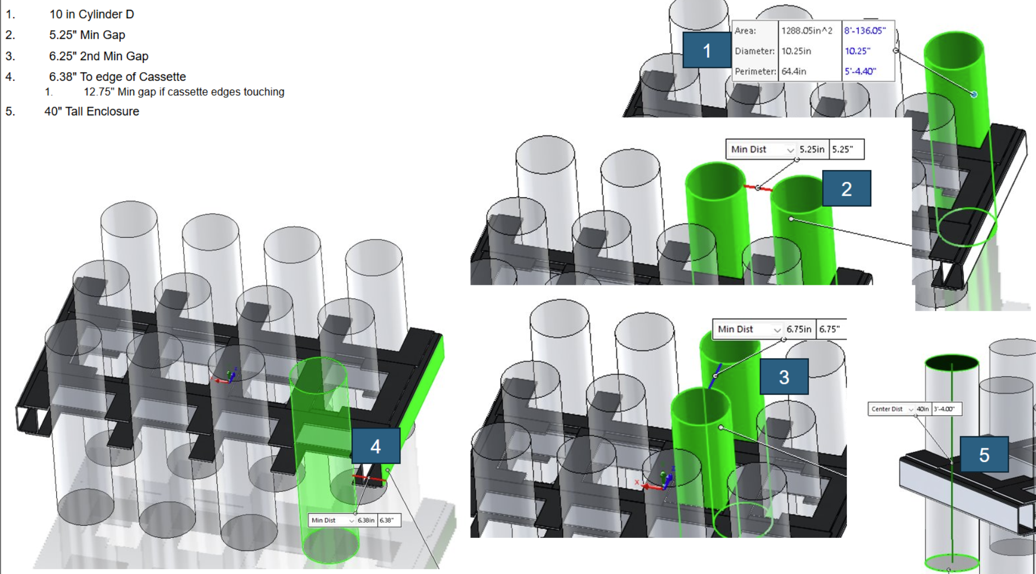
Model
Infinite Array Model (3×4×5 unit cell)
Cylinder dimensions:
10"(diameter) × 100 cm height
Wall material:
Steel, 1/8" thick
Horizontal gap:
5 inches (12.7 cm)
Vertical gap:
3 inches (7.62 cm)
Enrichment:
21% (bounding HALEU)
Boundary:
Reflective (infinite array)

Slide 4
Approach
Argument for criticality safety:
Critical threshold — Determine amount of fissile material that causes criticality
Max credible — Determine maximum credible material buildup in operating conditions
Safety margin — Show max credible is much less than material required for criticality
Use conservative assumptions all throughout

Slide 5
Conservative Assumptions
We use apply a number of conservative assumptions to make criticality argument obvious and defensible
Infinite array
Bounds any finite configuration and models an infinite-sized cascade
Peak moderation (H/U=25)
Maximum reactivity for wet UO2F2
21% enrichment
Maximum credible HALEU
100% humidity in air
Maximum water content when air ingresses
100% reaction and deposit
All UF6 + H20 converts to UO2F2 and is deposited in maker
0.01 torr continuous leak rate
All makers leak air in continuously at 0.01 torr/min

Slide 6
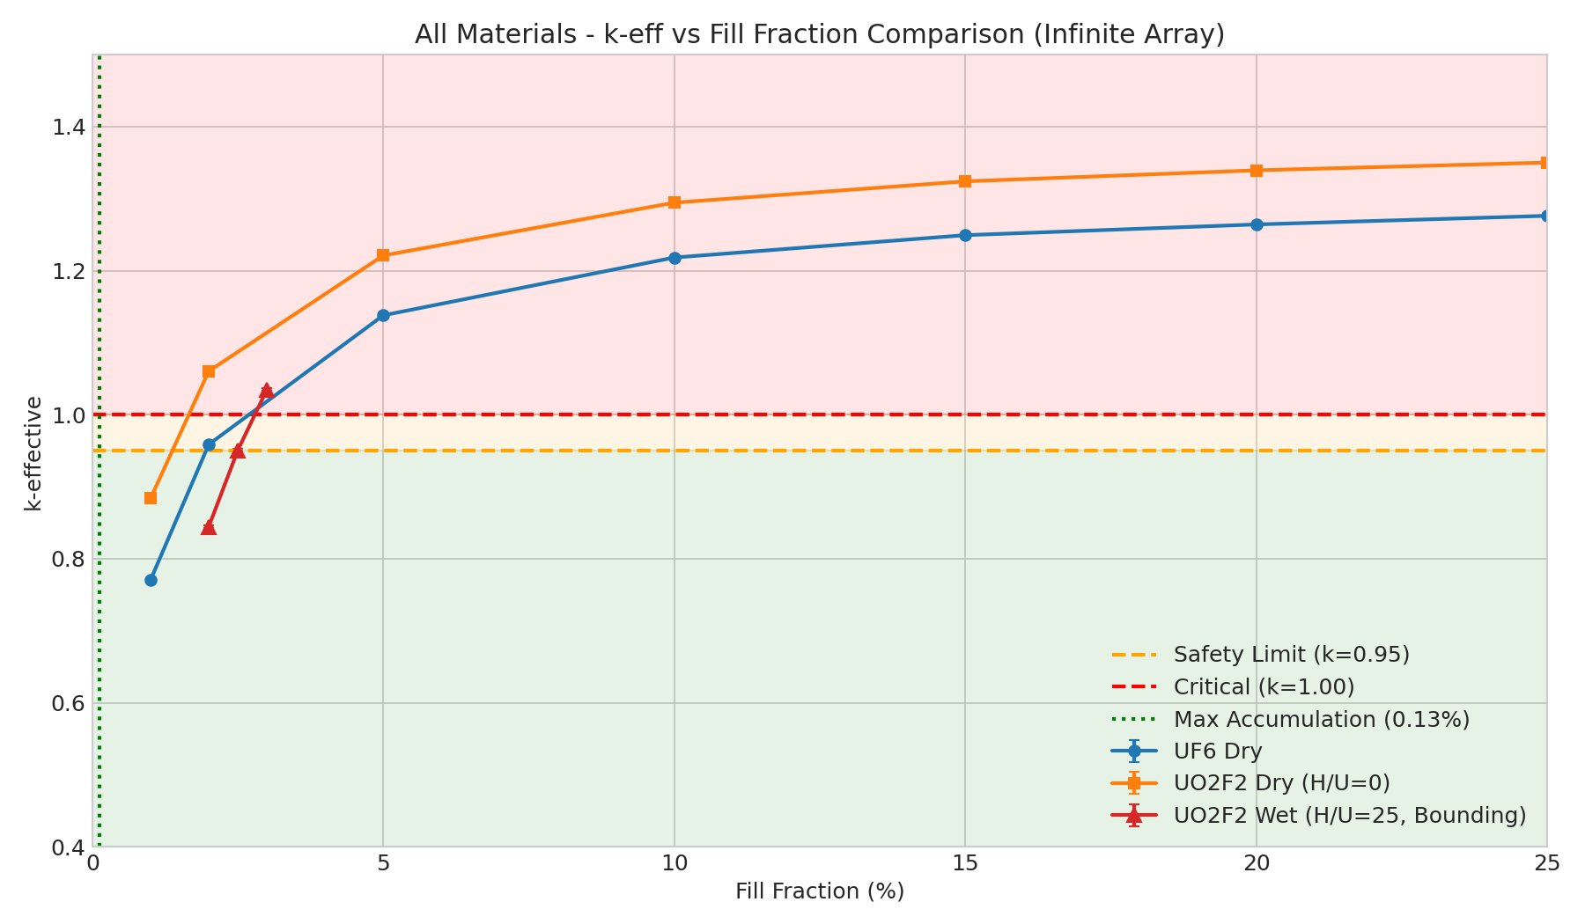
Results: k-eff as a function of fill fraction
Fill fraction refers to the % of fissile material in a maker (so 100% means the entire maker is filled with that fissile material).
We model an infinite cascade and plot fill % for 3 fissile materials (UF6, dry-UO2F2, wet-UO2F2) from 0% to 25%.
This graph shows the fill% needed to achieve criticality (keff > 1.0).

Slide 7
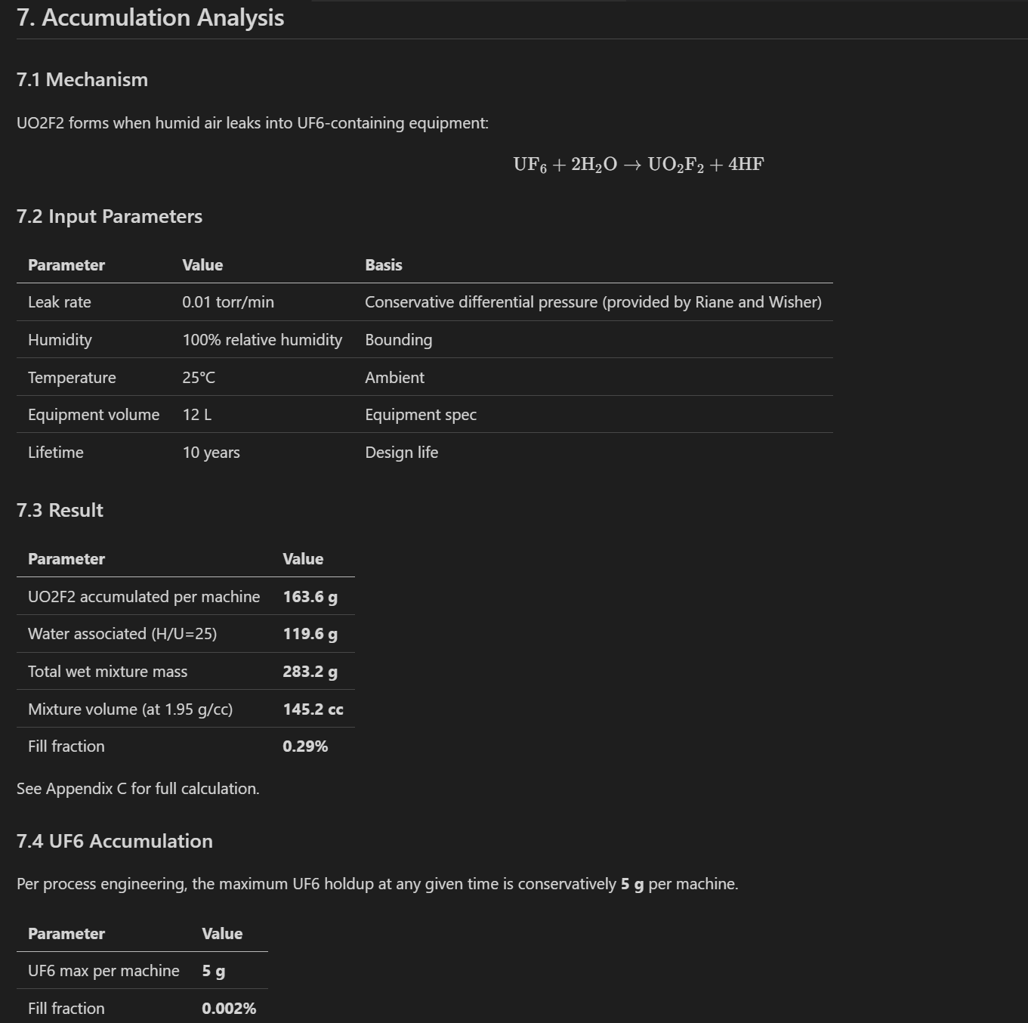
Results: bounding analysis for material accumulation
U02F2 :
Assume all water from air leakage reacts with UF6
Assume conservative 0.01 torr/min leak rate
Assume 100% of UO2F2 deposits in maker
For a lifetime of 10 years, the max amount of UO2F2 that is accumulated cannot achieve criticality
UF6
Assume 5g max of UF6 in a machine at a single time
To achieve criticality, you need to exceed 5kg of solid UF6, which is 1000x more than operating limit
We will likely have IROFS or administrative controls before this is credible.

Slide 8
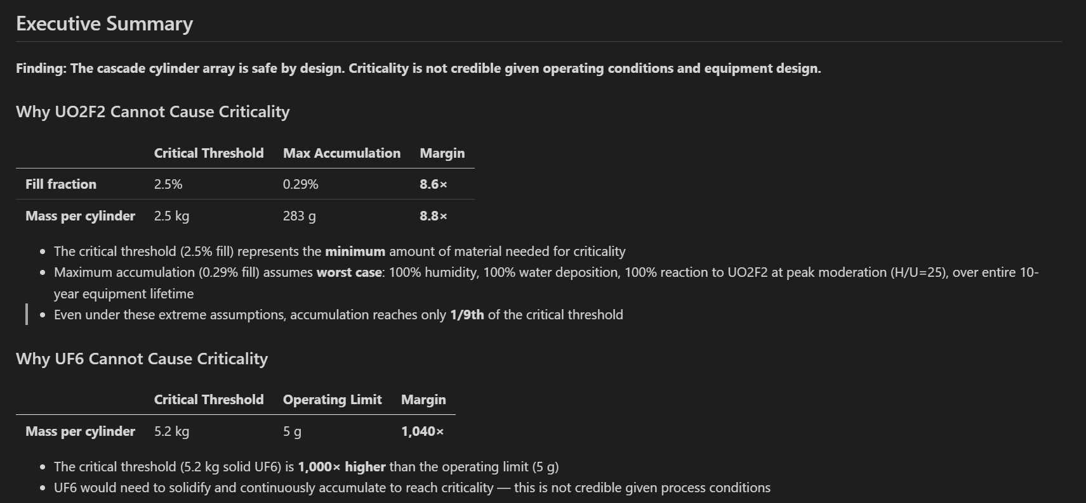
Result
The fissile material that can be credibly accumulated will not achieve criticality

Slide 9
Conclusions & Recommendations
Conclusions
Configuration is SAFE BY DESIGN
Criticality is not credible under bounding assumptions
Safety margins: 8× (UO2F2), 1,040× (UF6)
No reliance on administrative controls for criticality prevention
Recommendations
No additional criticality controls required
Get technical review by Amentum (validate assumptions)
Document safety basis in formal calculation file

Slide 10
Appendix

Slide 11
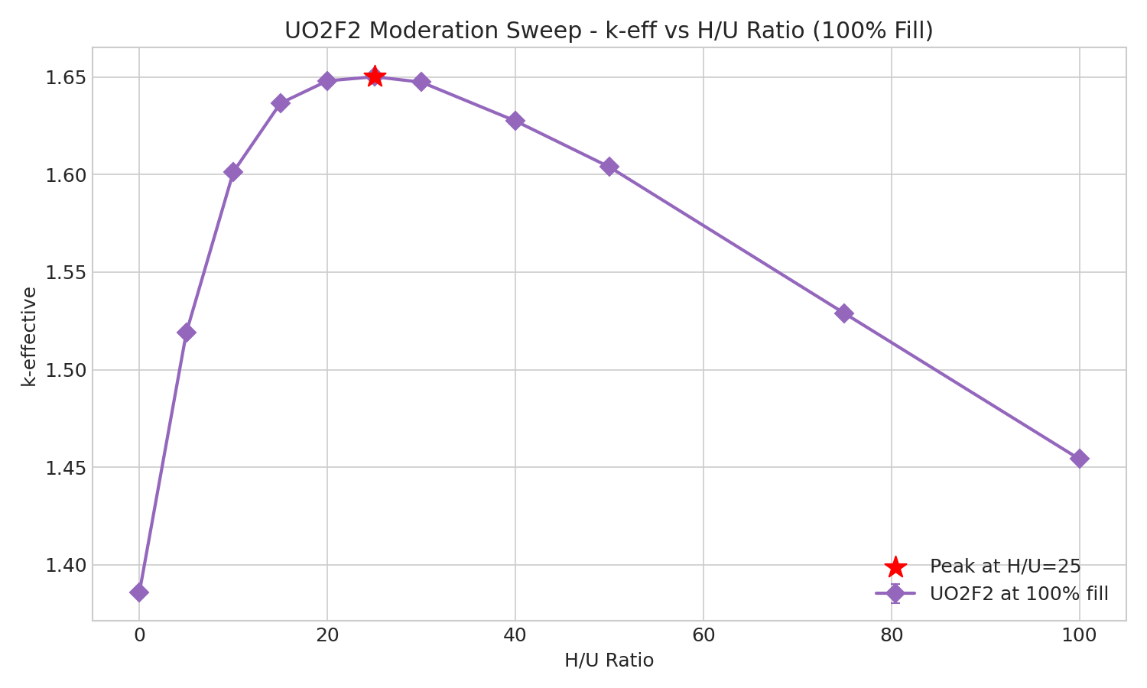
Peak Moderation Analysis
Why H/U = 25?
• Hydrolysis: UF6 + 2H2O → UO2F2 + 4HF
• Water provides moderation (H atoms)
• Peak reactivity at H/U = 25 (keff = 1.65)
• Used for bounding analysis

