Slide 1
CPI prediction web app
Yuanze Li

Slide 2
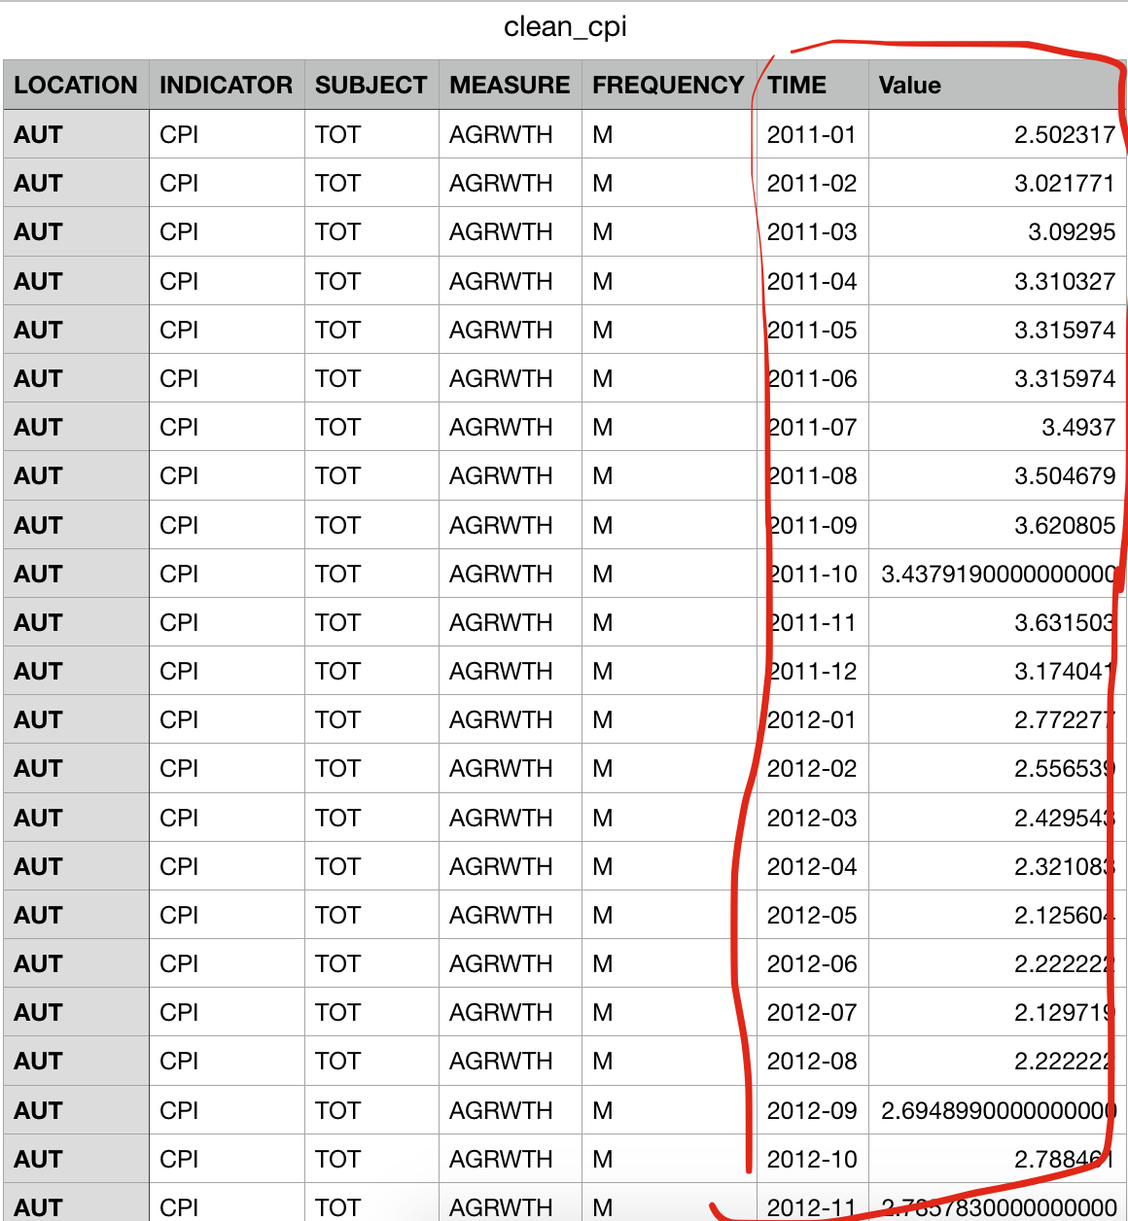
This is the dataset I use

Slide 3
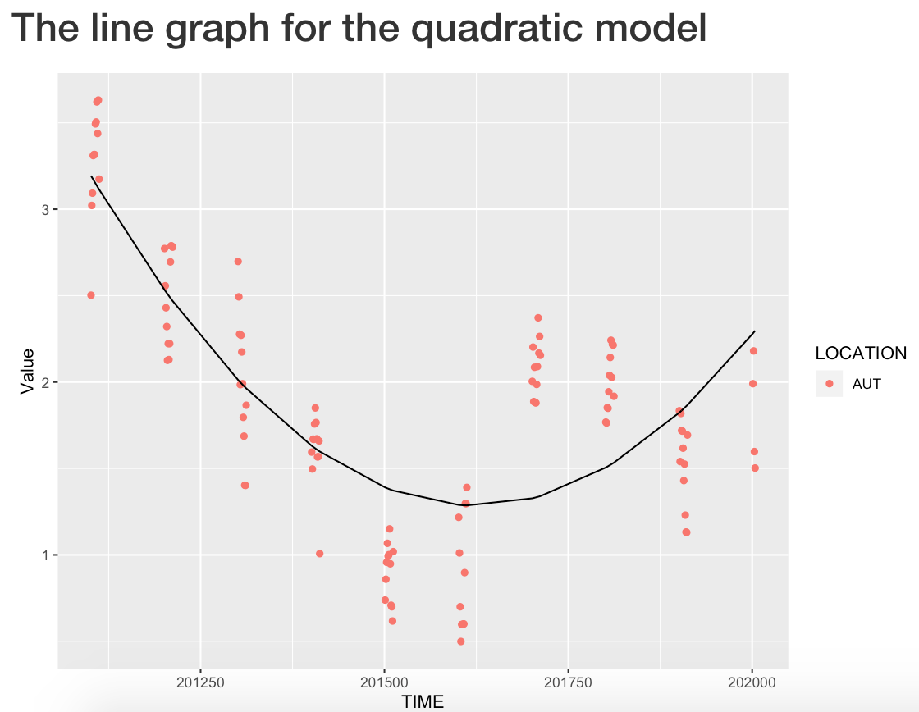
The model I use is quadratic model

Slide 4
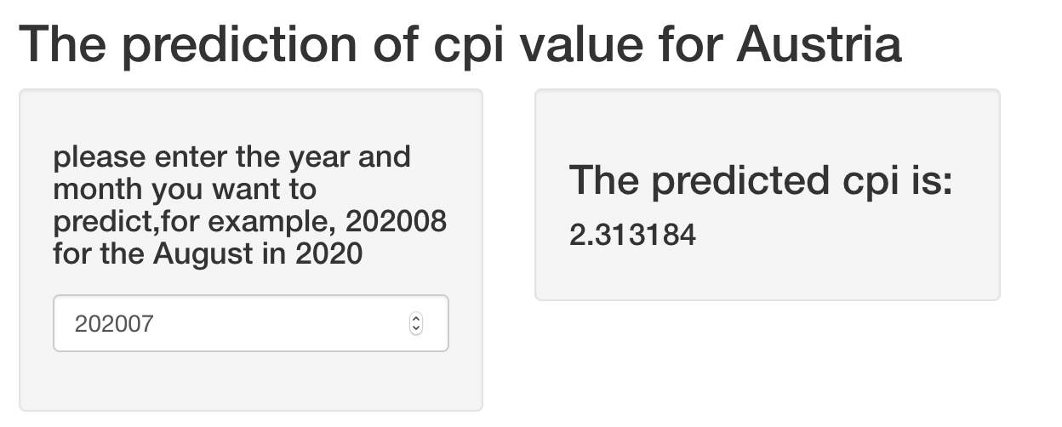
The prediction result is showed on the right

Slide 5
