Slide 1

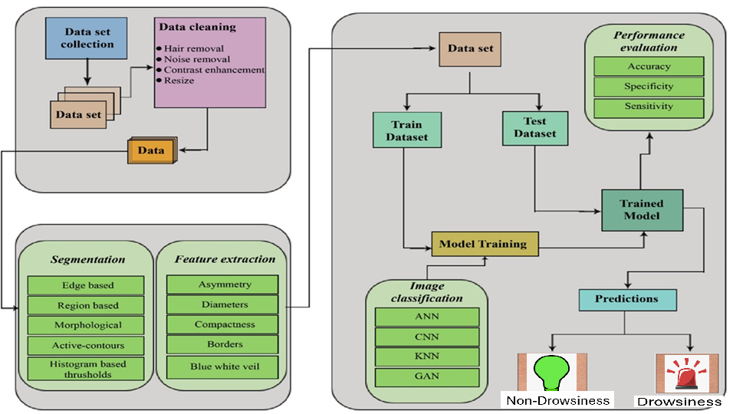
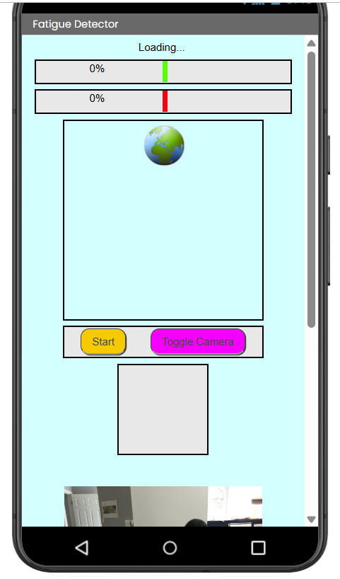
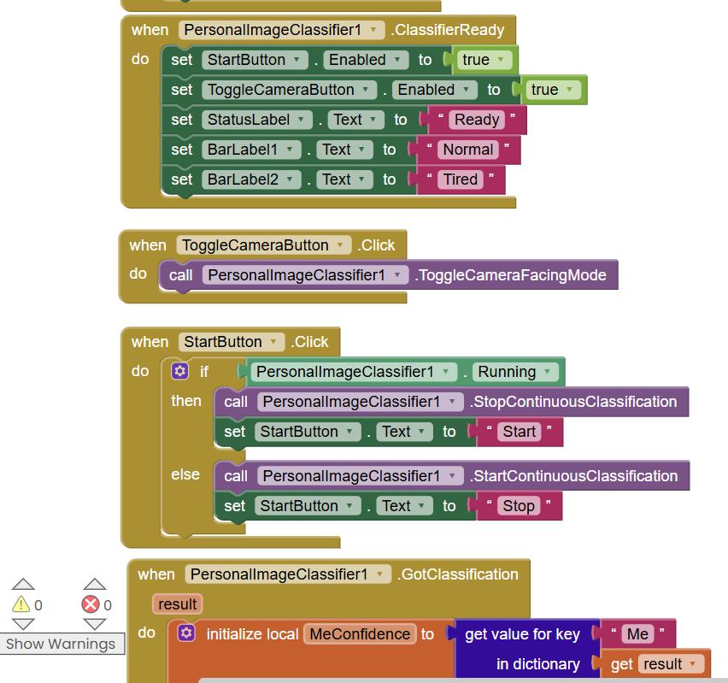
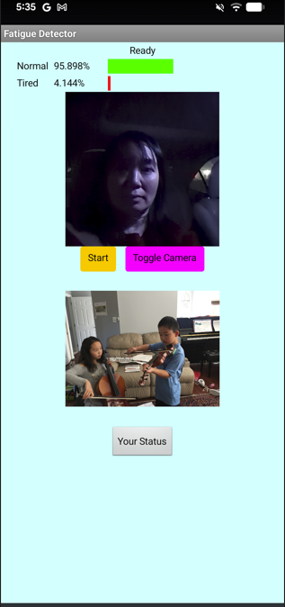
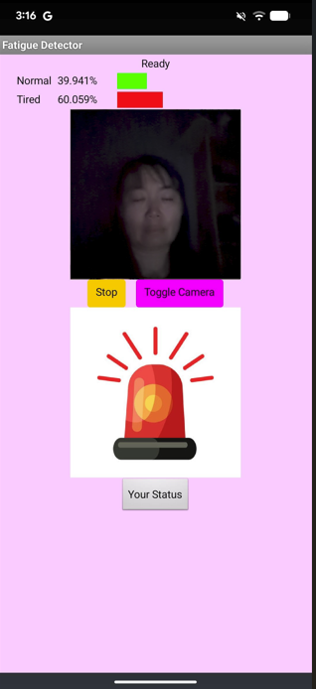
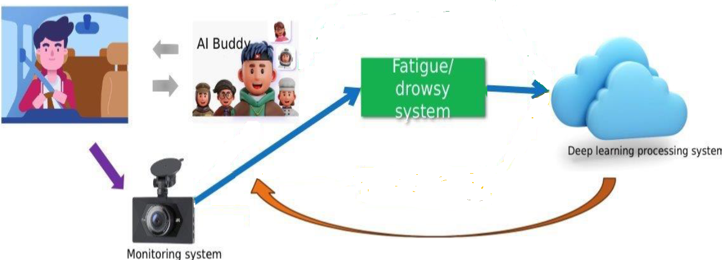
Eyesense: An AI-Powered Solution for Driver Safety
Andy Li
Langley High School
6520 Georgetown Pike, McLean, VA 22101
Abstract
Methods
A significant number of traffic accidents and fatalities are caused by driver fatigue, drowsiness, and aggressive driving. Despite advances in vehicle safety, there remains a pressing need for a comprehensive, real-time monitoring system that can effectively detect and respond to these states. This poster presents "Eyesense," a monitoring system equipped with an AI Buddy, designed to detect driver drowsiness and emotional state. The system utilizes a Convolutional Neural Network (CNN) model for visual analysis of the driver's face, achieving near-perfect accuracy (96%) in drowsiness detection and promising performance in emotion recognition from audio. The findings demonstrate the potential of deep learning models to provide real-time, individualized feedback, thereby enhancing driver safety.
Keywords: computer vision, image processing, mobile application development, driver drowsiness detection, convolutional neural network, intelligent transportation systems, real-time monitoring
The Basic Workflow
Experimental Results
Introduction
Mobilenet was trained to classify non-drowsiness and drowsiness images. MIT App inventor was used to develop the mobile App.
Traffic safety remains a critical global concern. In the United States alone, fatigue-related collisions are responsible for an estimated 50,000 injuries and 800 fatalities annually. Furthermore, aggressive driving is a factor in 56% of fatal crashes. These statistics underscore the urgent need for proactive systems that can mitigate human factors in accidents.
Research question: Can we develop a free and reliable AI-based app to detect driver’s drowsiness?
Current vehicle safety technologies often lack the capability to deliver real-time, personalized interventions for driver states like fatigue and aggression. The proliferation of sophisticated deep learning models and ubiquitous camera sensors in vehicles presents a unique opportunity to address this gap.
This poster introduces Eyesense, a fatigue and emotion monitoring system featuring an AI Buddy. The goal of this system is to leverage deep learning to perform frequent, individualized assessments of the driver's state through visual cues. By providing timely alerts and feedback, Eyesense aims to reduce the incidence of accidents caused by impaired driver states.
Future Work
Compare two different approaches:
Lightweight by design: maintaining a reasonable performance and is achieved by the introduction of depth-wise convolution layers which help reduce model size and complexity.
Large, pre-trained neural networks and compress them to reduce their size while minimizing loss in performance.
References
[1]El-Nabi,S.A.,El-Shafai,W.,El-Rabaie,ES.M.etal.Machinelearninganddeeplearningtechniquesfordriverfatigueanddrowsinessdetection:areview.MultipedToolsAppl83,9441–9477(2024).https://doi.org/10.1007/s11042-023-15054-0
[2]G.Ohetal.,“DRER:DeepLearning–BasedDriver’sRealEmotionRecognizer,”Sensors,vol.21,no.6,p.2166,Mar.2021,doi:https://doi.org/10.3390/s21062166.
[3]F.Liu,D.Chen,J.Zhou,andF.Xu,“AreviewofdriverfatiguedetectionanditsadvancesontheuseofRGB-Dcameraanddeeplearning,”EngineeringApplicationsofArtificialIntelligence,vol.116,p.105399,Nov.2022,doi:https://doi.org/10.1016/j.engappai.2022.105399.
[4]H.Jia,Z.XiaoandP.Ji,"FatigueDrivingDetectionBasedonDeepLearningandMulti-IndexFusion,"inIEEEAccess,vol.9,pp.147054-147062,2021,doi:10.1109/ACCESS.2021.3123388.
[5]RongrongFu,HongWang,WenboZhao,DynamicdriverfatiguedetectionusinghiddenMarkovmodelinrealdrivingcondition,ExpertSystemswithApplications,Volume63,2016,Pages397-411,ISSN0957-4174,https://doi.org/10.1016/j.eswa.2016.06.042.
[6] M. H. Alkinani, W. Z. Khan, and Q. Arshad, "Detecting Human Driver Inattentive and Aggressive Driving Behavior Using DeepLearning: Recent Advances, Requirements and Open Challenges," in IEEE Access, vol. 8, pp. 105008-105030, 2020, doi: 10.1109/ACCESS.2020.2999829.
[7] Kawaguchi, N.; Matsubara, S.; Takeda, K.; Itakura, F. CIAIR in-car speech corpus–influence of driving status–. IEICE Trans. Inf. Syst. 2005, 88, 578–582
[8] L. Mou, C. Zhou, P. Zhao, B. Nakisa, M. N. Rastgoo, R. Jain, and W. Gao, "Driver stress detection via multimodal fusion using attention-based CNN-LSTM," Expert Systems with Applications, vol. 173, p. 114693, 2021, doi: 10.1016/j.eswa.2021.114693.
The Theoretical Framework

