Slide 1
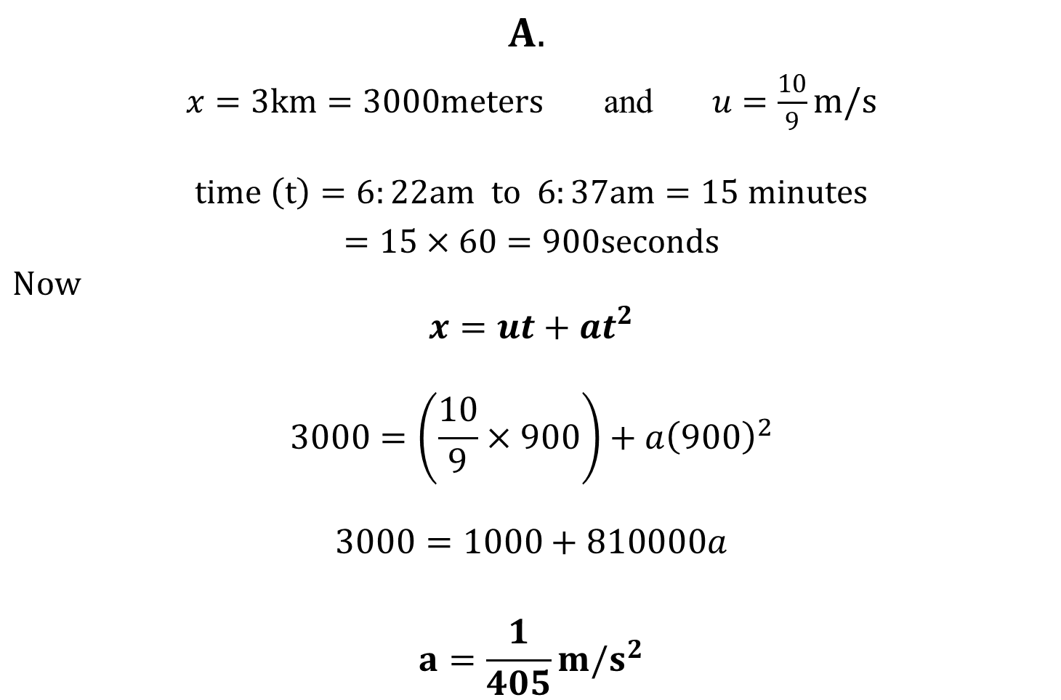
X – FACTOR
$$A.$$
$x=3km=3000meters$ and $u=\frac{10}{9}m/s$
$$time \left(t\right)=6:22am to 6:37am=15 minutes$$
$=15×60=900seconds$
$$Now$$
$$x=ut+at^{2}$$
$$3000=\left(\frac{10}{9}×900\right)+a{\left(900\right)}^{2}$$
$$3000=1000+810000a$$
$$a=\frac{1}{405}m/s^{2}$$

Slide 2
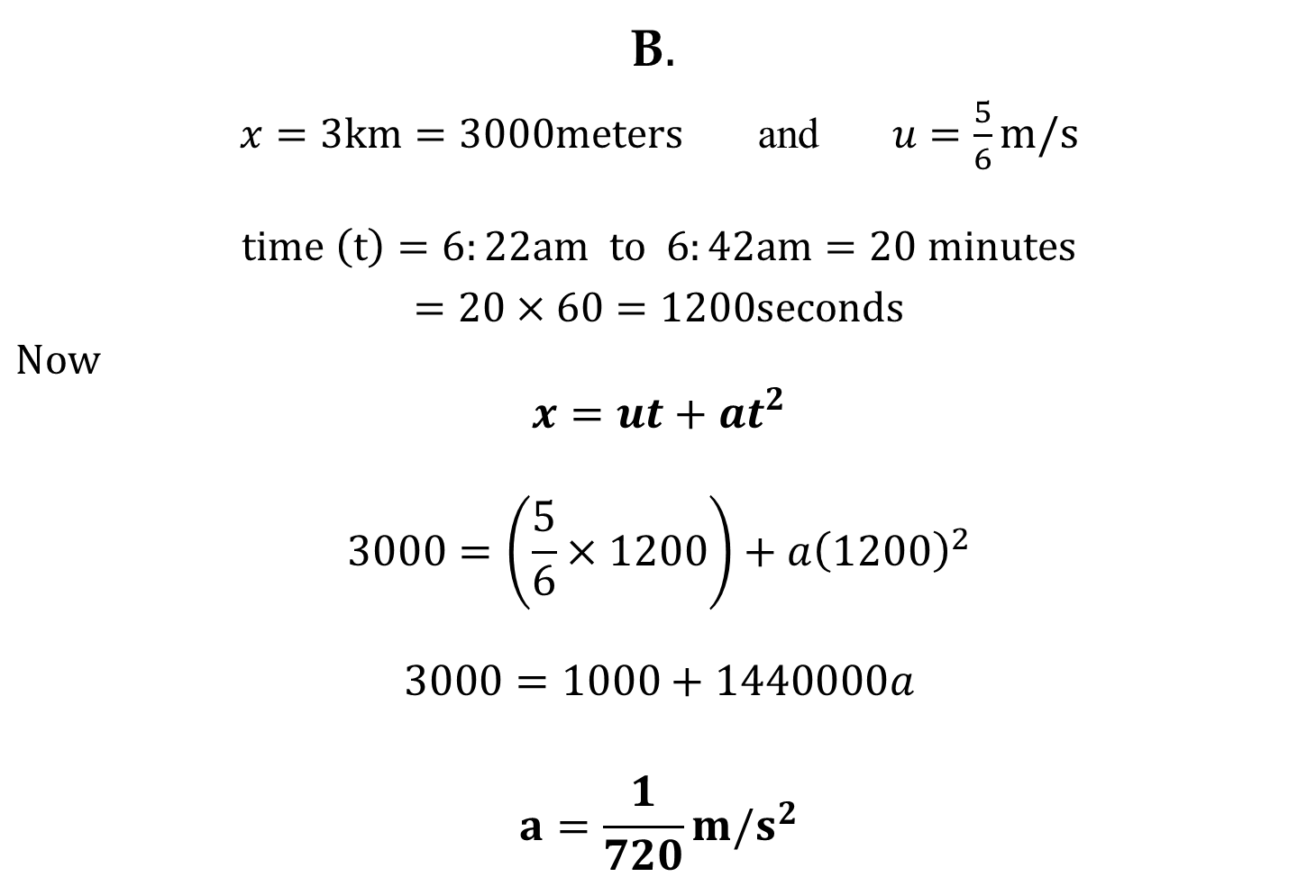
X – FACTOR
B$.$
$x=3km=3000meters$ and $u=\frac{5}{6}m/s$
$$time \left(t\right)=6:22am to 6:42am=20 minutes$$
$=20×60=1200seconds$
$$Now$$
$$x=ut+at^{2}$$
$$3000=\left(\frac{5}{6}×1200\right)+a{\left(1200\right)}^{2}$$
$$3000=1000+1440000a$$
$$a=\frac{1}{720}m/s^{2}$$

