Slide 1
Web-based Simulation Platform
Supervisor: Professor Wainer
Group Number: 50
By: Tyler Mak (101108389) and Andy Ngo (101132278)

Slide 2
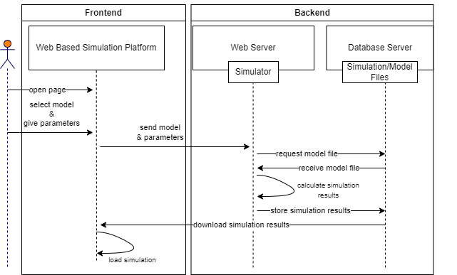
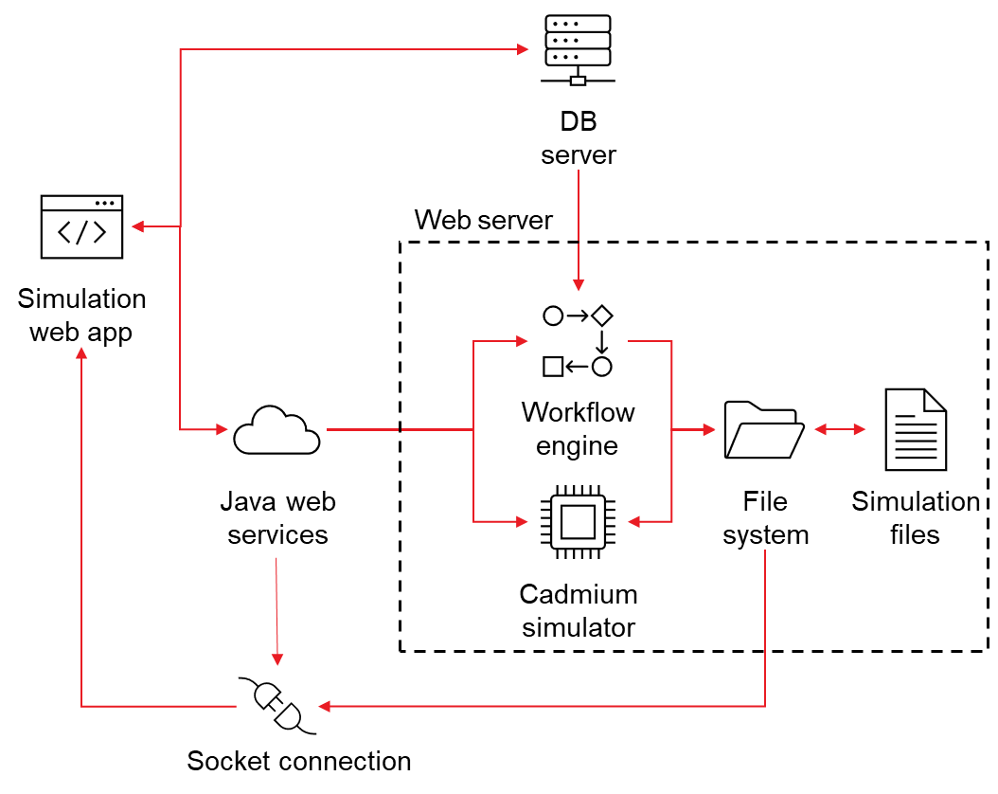
Architecture
Notes:
Here in this architecture diagram we have the main part of the system which is the web app, the database server, java web services, and socket connections all connect to it. The application uses Java in the backend of the system, the files are accessed through socket connections going through the file system.
On the right side we have the communication diagram of how the old system would process the simulation

Slide 3
Introduction
Motivation:
Not many web-based simulation platforms that are optimized
Goal:
Create a web-based simulation
Easier to access
Improve user experience
Make it more efficient
Contributions:
Implemented Websockets
Implemented webworkers
Implemented visualization
Notes:
This project was mainly focusing on working on a pre-existing project to improve on it since there aren’t that many optimized web-based simulations. Our goal to make it better is by making it easier to access, it’s a web-based simulation application and it takes away the need to download any files to run the application. By optimizing the system it will improve the overall user experience because it will become more efficient.
These improvements will be possible applying websockets and webworkers into the existing system where it will help process the data faster and more efficiently to be outputted visually

Slide 4
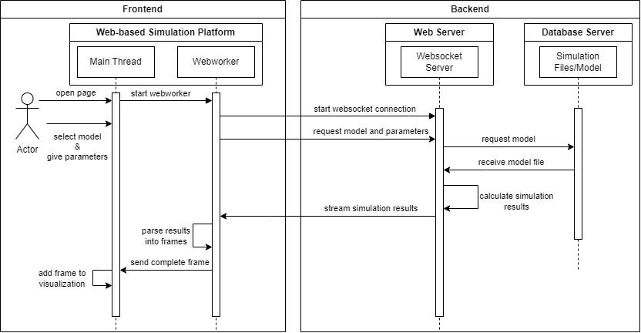
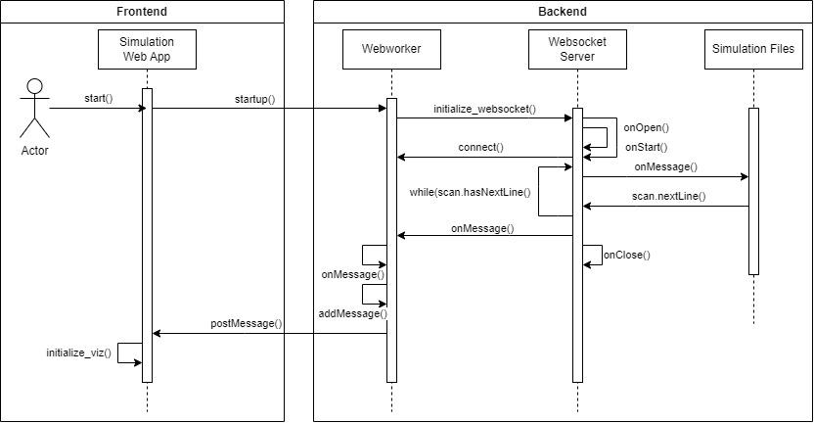
Communication Diagram
Notes:
Going over the current communication diagram:
User accesses page
Begins webworker
Will start the websocket connection and request model and parameters
The websocket server will ask the database server for the file/model and it will send it back
Websocket server will continue to calculate results until the whole file has been read and will stream the results
Worker will

Slide 5
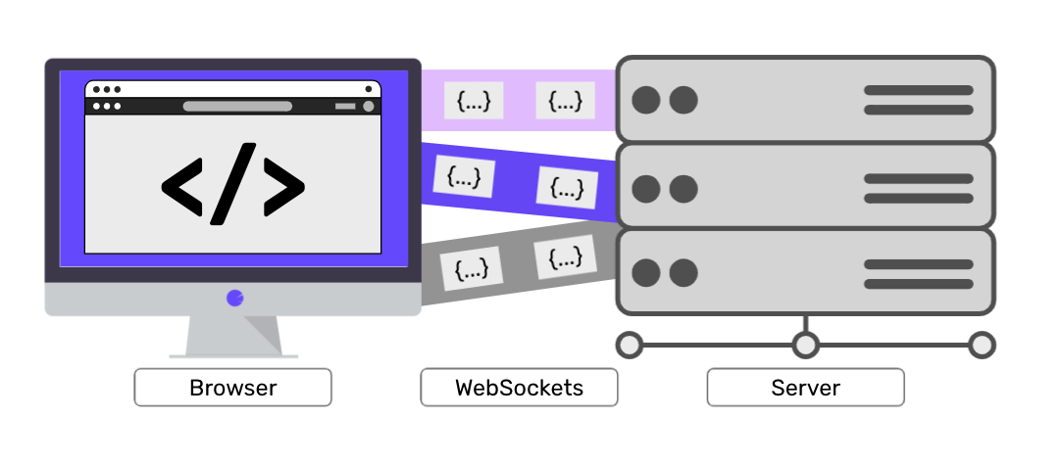
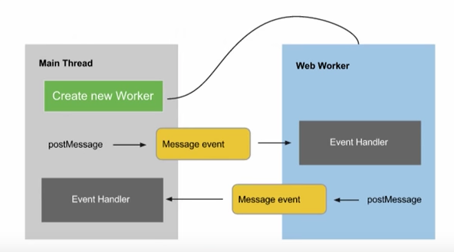
Technology used
Websocket:
Allows the client and server to communicate simultaneously
Webworker:
Background thread
Notes:
REST architecture was being used before, which was a one way communication. With websocket it allows the browser and server to communicate at the same time.
Webworker will be used because it will be used as a background thread to read through the model file and send each time frame to be visualized

Slide 6
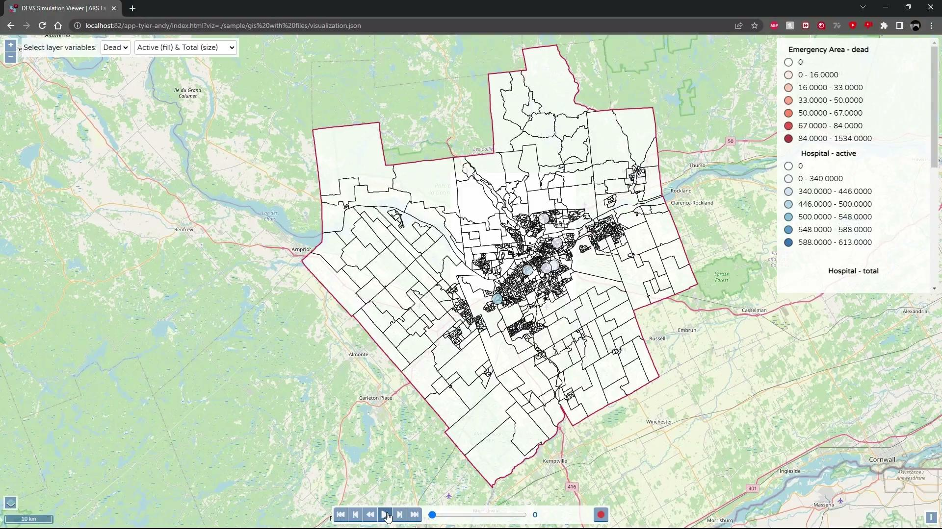
Demonstration
Notes:
This simulation example is a map of Ottawa simulating number of emergency cases and occupied hospitals.
The darker the shade of red indicates more reports of death cases
The blue circles indicate the hospitals and the bigger the circles are indicate a certain amount people

Slide 7
Issues and Challenges
Many different implementation methods of Websockets
Testing each implementation
SockJS and STOMP compatibility with Webworkers
Physically alter the library file
Changed to native websockets later
Websocket streaming data out of order
Required adjustments in the Websocket configuration
Processing simulation result data correctly
Testing for proper object creation
Testing for validity of data received

Slide 8
Conclusion
Have a better understanding of how websockets optimize the front and backend communication
Understand how webworkers allow work to be divided to separate threads
Results send faster using websocket and webworkers
Webworker will process through the simulation results to visualize onto a map

