Slide 1


Flight Delays By Time of Day and Day of the Week
ST 599 – Big Data Project 2
Sarah Guermond
Andy Olstad
Jasmine Pahukula
Tim Skalland

Slide 2
Question of Interest
What time of the day and day of the week is best for avoiding flight delays?
-Bureau of Transportation Statistics (BTS)
-on-time performance data

Slide 3
Assumptions
Redefined the population to only include the last 3 years (2011-2013)
Arrival delay
Made negative times zero

Slide 4
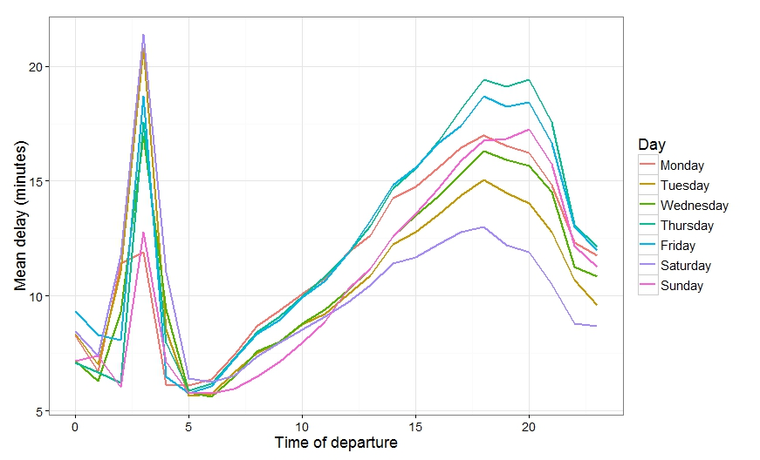
Population-based Findings
-Wednesday 5:00 pm ~23%
- Thursday 8:00 pm ~ 51%
Saturday 3:00 am ~21.5 min
Wednesday
6:00 am ~5.5 min
Notes:
Animations!

Slide 5
Sampling Method
Method 1: Simple Random Sample
Small subsamples for late evenings/early mornings
Omitted some hours entirely
Method 2: Stratify by day of week and hour of day
24 hrs * 7 days = 168 stratum
About 2000 flights each
Notes:
We considered several sampling designs and decided to stratify by day of week and hour of day. Our initial simple random sample gave small subsamples for late evening/early morning flights, and omitted some hours entirely on some days. By stratifying, we ensured we could estimate a value for all 168 (24 hours * 7 days) times. We sampled roughly 2000 flights in each stratum, or the whole population if that was smaller.

Slide 6
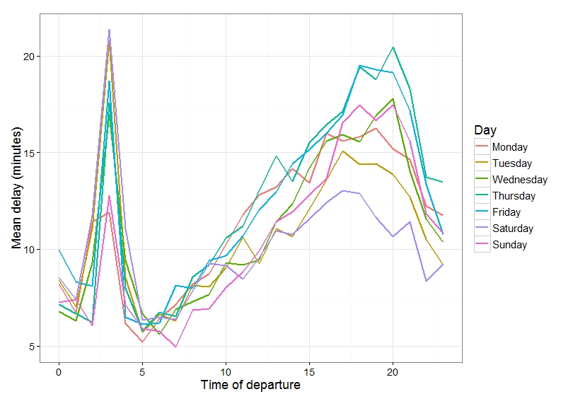
Sample-based Findings
Saturday 3:00 am ~21.5 min
Sunday
7:00 am ~4.9 min
-Wednesday 5:00 am ~22%
- Thursday 8:00 pm ~ 53%
Notes:
Saturday morning at 3:00 am still highest delay and Thursday at 8:00 pm still largest proportion. But now we have Sunday at 7:00 am with the shortest delay and Wednesday at 5:00 am with the lowest proportion.
The sample data was able to show statistically significant differences between days for nearly all the daytime hours (p-values were inconclusive between 1 and 6 am) using ANOVA tests. The margin of error for each of the 168 confidence intervals, without any multiple comparisons correction, ranged from 1 to 10 minutes (2 minute average ME).

Slide 7
Fivethirtyeight?

Slide 8
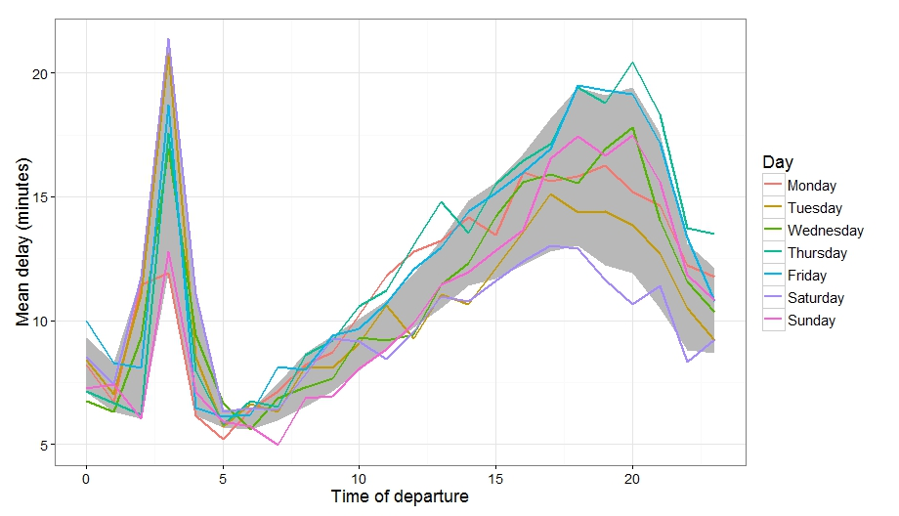
Comparison
Notes:
Our sample data was consistent with the population data. Similar trend. The grey band represents the minimum and maximum average delay for each time of day from our population.

Slide 9
Obstacles and Solutions
Defining the population
Deciding which delay was worse
(arrival or departure)
Specific times, not indexed
Size of data

Slide 10
Thank You! Questions?

